Slide 1
Global change ecology
Henriques Kaelin, Efe Egemen, Skokanová Simona

Slide 2
Index
What is a mass extinction
1st Paper & conclusion
2nd Paper & conclusion
Comparing both papers & our conclusion

Slide 3
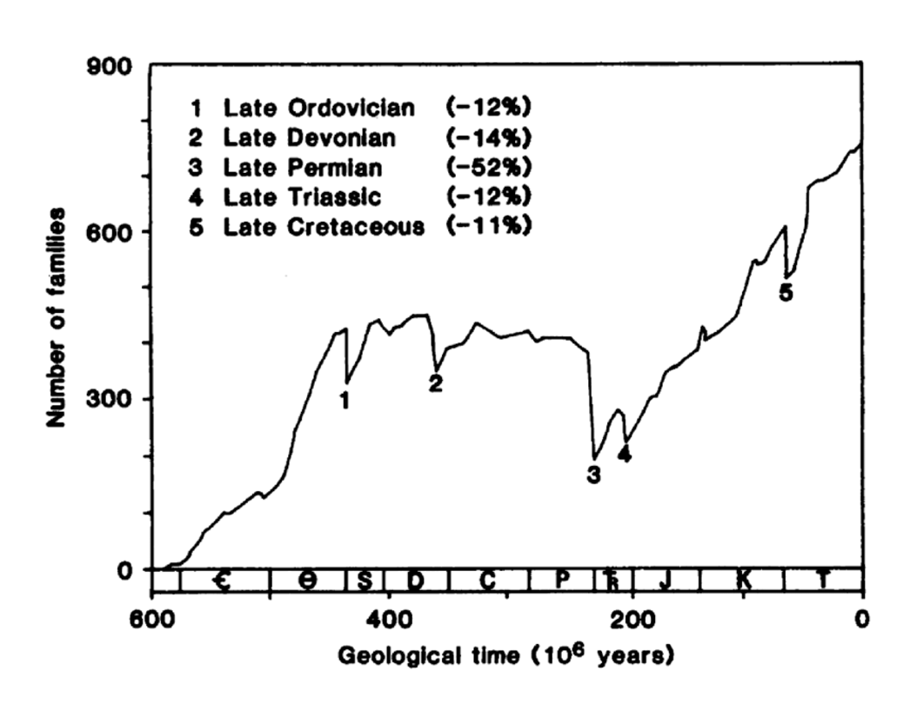
Mass Extinciton
Notes:
A mass extinction is defined as a relatively rapid, widespread event that leads to a sharp decrease in the number of species on Earth.
It’s characterized by the loss of 75% or more of all species within a geologically short period of time.
It’s usually caused by sudden, catastrophic global events resulting from major environmental upheaval
Mass extinctions are extremely rare events in Earth's history. There have been only five major mass extinction events over the past 540 million years, which are often cited as the “Big Five.”
These events fundamentally reset the course of evolution.

Slide 4


Mass Extinction vs. Background Extinction
Feature | Mass Extinction | Background Extinction
Rate | Extremely high | Low
Magnitude | Widespread | Localized
Duration | Geologically short | Continuous over geological timescales
Cause | Catastrophic global events | Normal ecological, evolutionary pressures
Frequency | Very rare | Ongoing

Slide 5

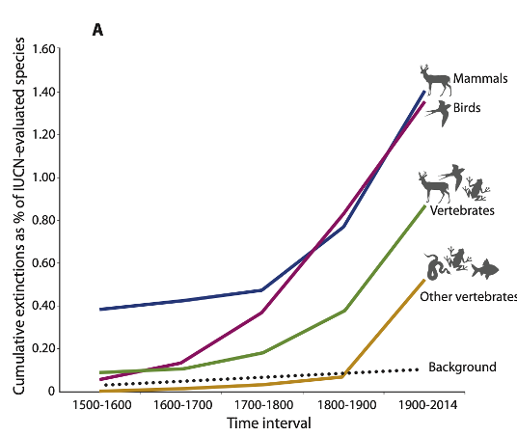
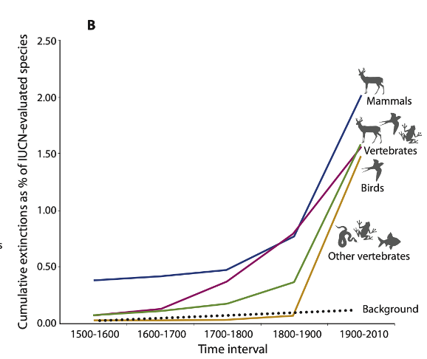
Accelerated Species Losses and the Sixth Mass Extinction
Main Goal
Methodology
Conservative Background Rate
Key Findings
Quantification
Conclusion
Notes:
Main Goal: To conservatively assess whether current extinction rates justify the claim that Earth's biota is entering a sixth “mass extinction”
Methodology: Compared modern vertebrate extinction rates to a high, conservative background rate
Conservative Background Rate: 2 E/MSY (2 extinctions per 10.000 species per 100 years) this is double the previous highest estimate.
Key Findings: Modern extinction rates for vertebrates are up to 100 times higher than the background rate.
Quantification: The number of species that went extinct in the last century would have taken between 800 and 10.000 years to disappear under the background rate.
Conclusion: An exceptionally rapid loss of biodiversity is underway, indicating that a sixth mass extinction is already occurring

Slide 6
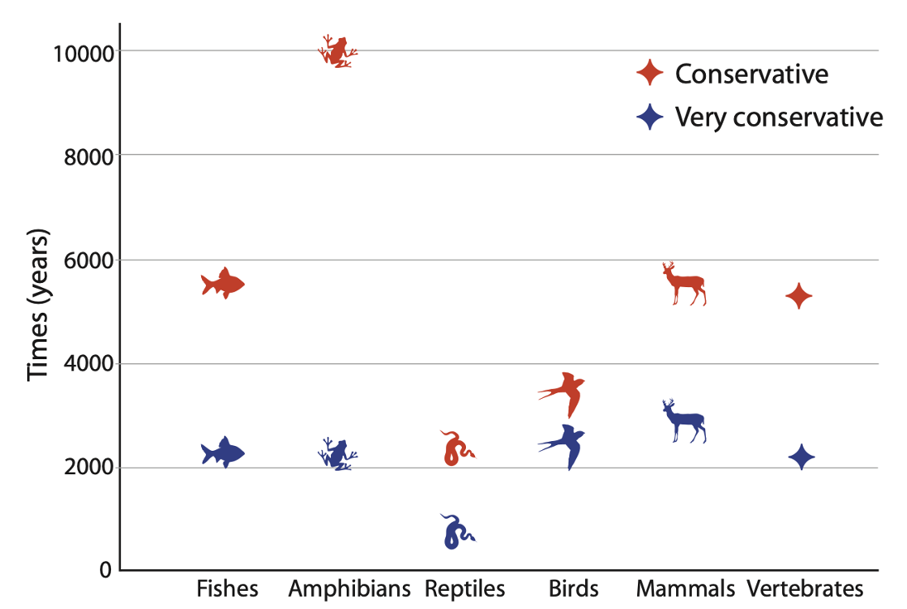
Extinction Data
Total Documented Vertebrate Extinctions
Total Vertebrate Extinctions
Consequence
Severity
Urgency
Opportunity
Notes:
Total Documented Vertebrate Extinctions: 338 species.
Total Vertebrate Extinctions: 617 species.
Most extinctions have occurred in the last 114 years (since 1900).
Consequence: Loss of biodiversity threatens crucial ecosystem services and human well being.
Severity: The analysis likely underestimates the crisis because it does not account for the widespread extirpation of populations or non-vertebrate species.
Urgency: Avoiding a true sixth mass extinction requires rapid, greatly intensified conservation efforts to alleviate pressures like habitat loss, overexploitation, and climate change.
Opportunity: Time to act is rapidly closing.

Slide 7
Questioning the sixth mass extinction
Main goal
Quantitative Criterion
Current status
Future projections
Timeframe
Notes:
Main goal: While Earth faces a severe biodiversity crisis, the scientific evidence to strictly categorize it as a mass extinction event is questionable
Quantitative Criterion: The primary threshold defined by proponents for a “mass extinction” is the loss of 75% of global species diversity
Current status: Over the last 500 years, less than 0.1% of Earth’s known species have actually gone extinct
Future projections: Analyses considering multiple major threats project a future species loss of ~12-40%, which is catastrophic but quantitatively far below the 75% threshold
Timeframe: Reaching the 75% threshold would likely take thousands to millions of years, weakening the case for using “mass extinction” to justify immediate conservation action

Slide 8
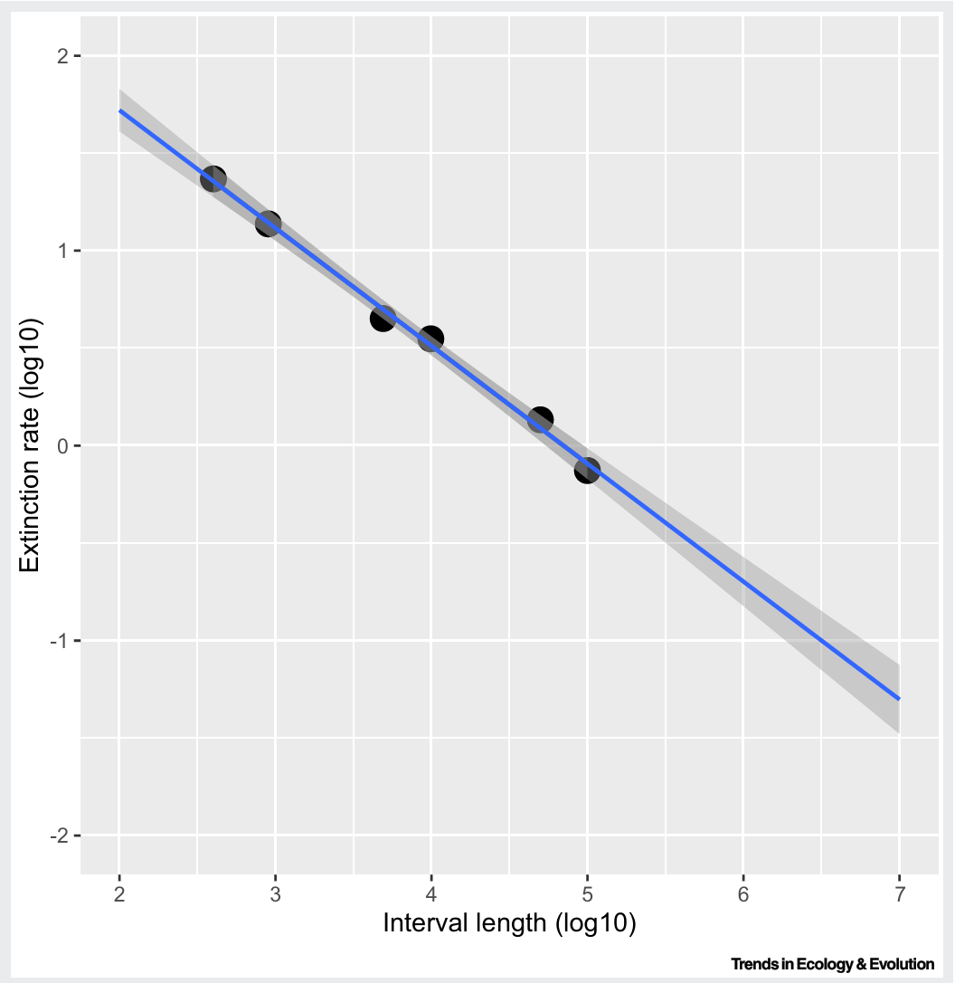
Methodological Issues in extinction rate comparisons
Timescale bias
Historical Context
Island Generalization
Taxonomic Bias
Assumption Errors
Recent mammalian extinction rates estimated at different timescales
Wiens & Saban (2025)
Notes:
Timescale bias - Studies often compare short-term rates (hundreds of years) to long-term fossil rates (millions of years), which artificially inflates the difference without proper correction
Historical Context - High extinction rates alone are insufficient evidence; The fossil record shows many spikes in extinction rates that were not mass extinction events
Island Generalization - Approximately 75% of recent extinction occurred on islands, but studies problematically project these rates onto mainland species which face different primary threats
Taxonomic Bias - Supporting studies focus on land vertebrates (~2.4% of animal diversity) while generally ignoring insects, which make up half of all described species
Assumption Errors - Projections often assume non-threatened species (currently >50% of assessed groups) will disappear as quickly as threatened species without a specified cause

Slide 9
Comparison (conclusions)
Ceballos et al.
Elevated extinction rates and widespread population decline > "we are entering a 6th mass extinction"
Wiens
Extinction rates elevated in places + groups > Formal mass extinction classification not reached globally.
This means that "we have not entered a 6th mass extinction".
Notes:
Comparison of conclusions (simplified)
Ceballos et al.
Took into account the elevated extinction rates and the widespread population decline
Wiens.
Only took into account the extinction rates in specific groups (not the widespread overall population decline)
This decreases the studies validity and reliability as it is not taking important information into account.

Slide 10
Comparison (methodology)
Ceballos et al.
More broad empirical approach.
Considering (extinctions + population collapse across taxa and regions)
> Mass extinction already in effect.
Wiens
Conceptual + methodological approach
Considering (if available evidence meets with the definitions thresholds)
> problem identified but extinction criteria not met (75%).
Notes:
Important:
Both research papers address modern biodiversity loss and emphasize on its importance and possible negative effects!
Definitions;
Empirical: non-theory, real world data
Methodology: system of principles and methods used, the strategy. In this case the extinction criteria. (ideas, theories and models)
In conclusion both papers state that there is a decline in biodiversity. While Ceballos et al. uses empirical data from a very large sample to prove its point Wiens focuses less on the quality and sample size of the data {doesn’t take into account the decline of widespread populations} rather focusing on if the results of their study are concordant with the extinction criteria.

Slide 11
Comparison (strenghts)
Ceballos et al.
Use of real-world data showing many factors that prove their point for ex. Population loss, ecological impact (shrinking habitats, shrinking ecosystems)
Wiens.
Use of methodological precision , meaning authors focused on whether the methods used to make this claim are logical and reliable.
Notes:
Ceballos et al.
Use of real-world data showing many factors that prove theirpoint for ex. Population loss, ecological impact (shrinkinghabitats, shrinking ecosystems)
This means that their findings increase the studies reliability and validity as well as its application to real world scenarios as many factors were taken into account .
This makes tge paper powerful for things like: influencing policies, encouraging action and altering the publics opinion (numbers don’t lie!)
Wiens.
Use of methodological precision , meaning authors focused on whether the methods used to make this claim are logical and reliable.
The use of such precision and focus on definition make this paper powerful when it comes to making scientific claims more solid and trusted (no grey are in science!)

Slide 12
Comparison (weaknesses)
Ceballos et al.
May overreach in claiming this
Incomplete data (no insects or deep-sea life)
Some areas of the world more studied than others
Wiens.
Focuses strictly on documented species extinction
Underplay the severity of the situation and its effects
Notes:
Ceballos et al.
May overreach in claiming this – decreases the studies reliability (how reliable are the findings if the conclusion is not statistically significant)
Incomplete data (no insects or deep-sea life) - slight decrease in application to real world
Some areas of the world more studied than others - slight decrease in application to real world
Wiens.
Focuses strictly on documented species extinction – massive decrease in application to real world
Underplay the severity of the situation and its effects – can cause problems with how the puplic perception (people may use this as a way of downplaying the effects pf the problem at hand)

Slide 13
Implication and our opinion
! The findings of both papers are by no means contradictory, both agree on the severity of the loss of biodiversity and its implications
Where they disagree is on the label of a "6th mass extinction)

