Slide 1
FundAmentals of Ecology
introductions
course overview
expectations
Martin Bulla bullam@fzp.czu.cz
Peter Mikula mikulap@fzp.czu.cz
Notes:
The aim of the lectures is not frontal teaching, but something that helps you.
Ask questions!!!

Slide 2


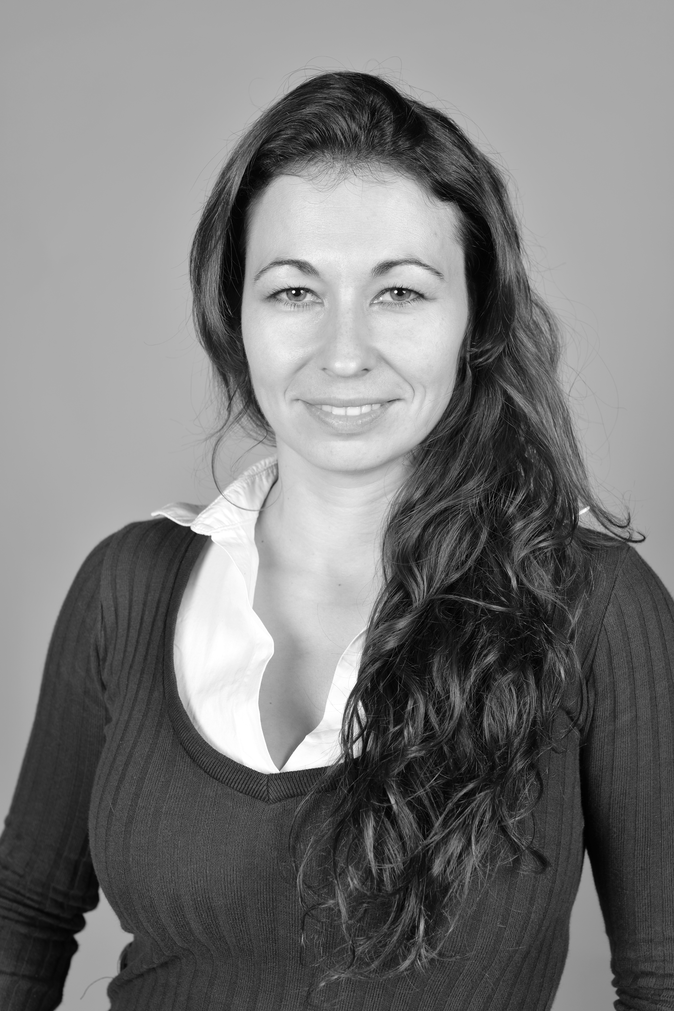
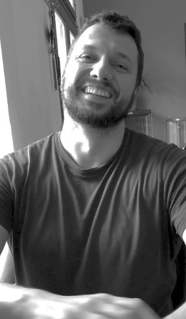
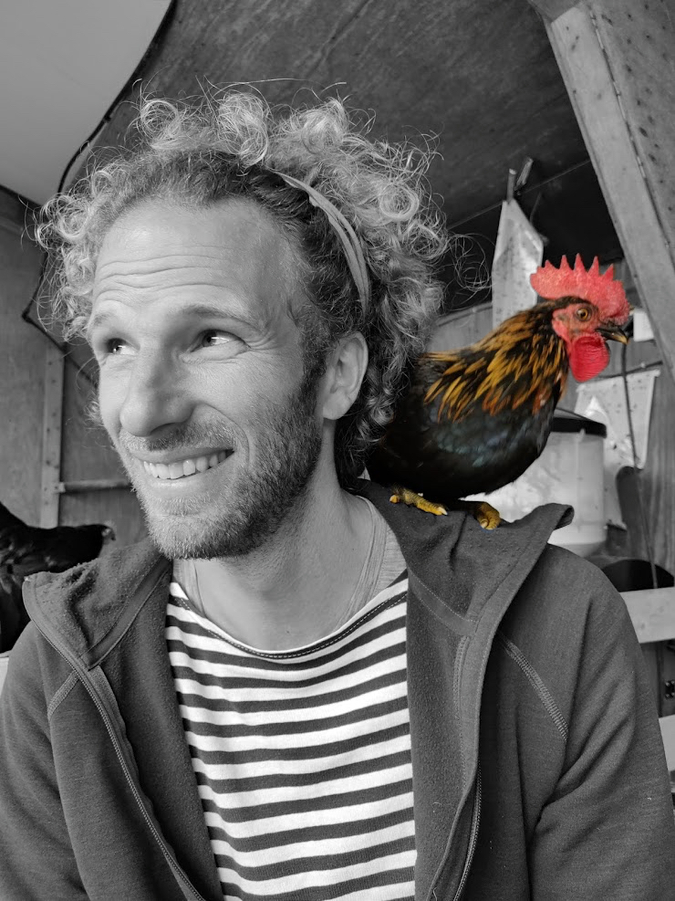
bullab
bullab.fzp.czu.cz
macroecology & evolution,
open science,
birds
, reproduction
, song
fear
reproducibility
biorhythms
science on science
What is our job?
Notes:
- a newly founded research group exploring global patterns and evolution of traits along with local adaptations
using mainly birds as our model species to understand reproduction and mating systems, song and fear;
all tied together by a common threads: biorhythms and reproducibility
- we are promoters of open science
- we do science on science

Slide 3
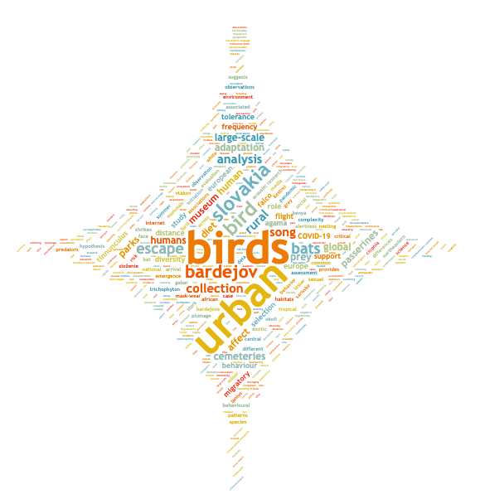
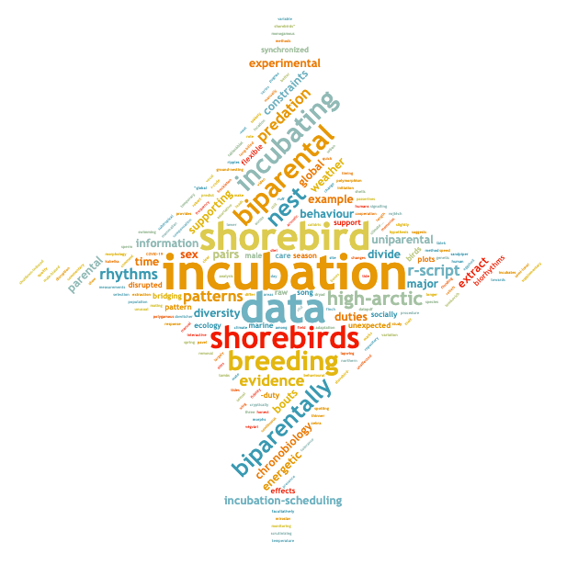
bullab
bullab.fzp.czu.cz
macroecology & evolution,
open science,
birds
, reproduction
, song
fear
reproducibility
biorhythms
science on science
https://scholargoggler.com

Slide 4







bullab
bullab.fzp.czu.cz
macroecology & evolution,
open science,
birds
, reproduction
, song
fear
reproducibility
biorhythms
science on science
Notes:
International team

Slide 5
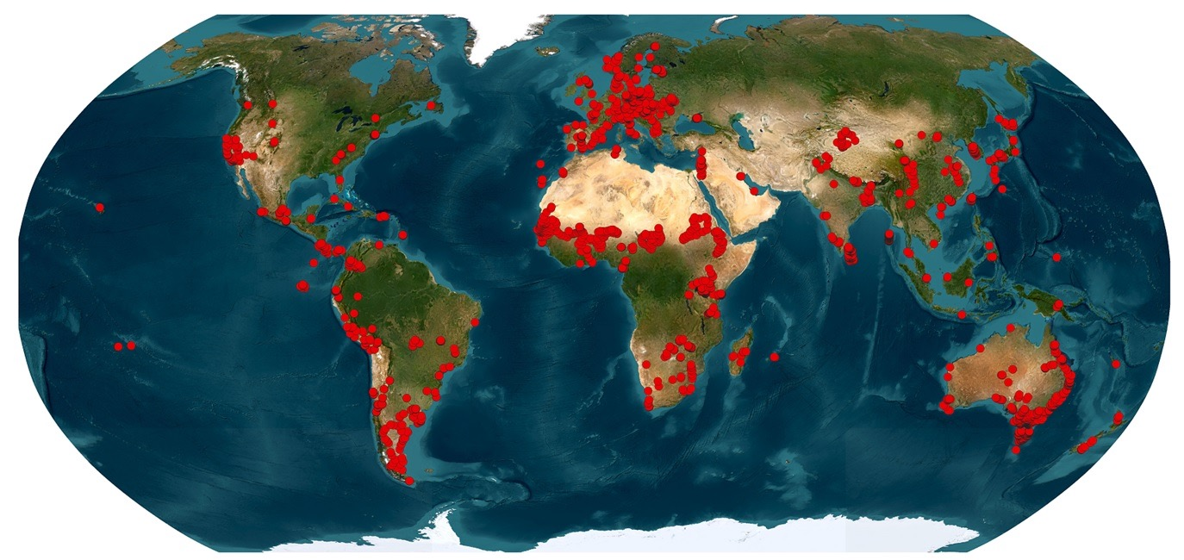
bullab
bullab.fzp.czu.cz
macroecology & evolution,
open science,
birds
, reproduction
, song
fear
reproducibility
biorhythms
Notes:
collaborate with institutions and people across the globe
questions?

Slide 6

your turn
Notes:
Who are you?
Anyone not proficient in English?
One word wish for the course?

Slide 7
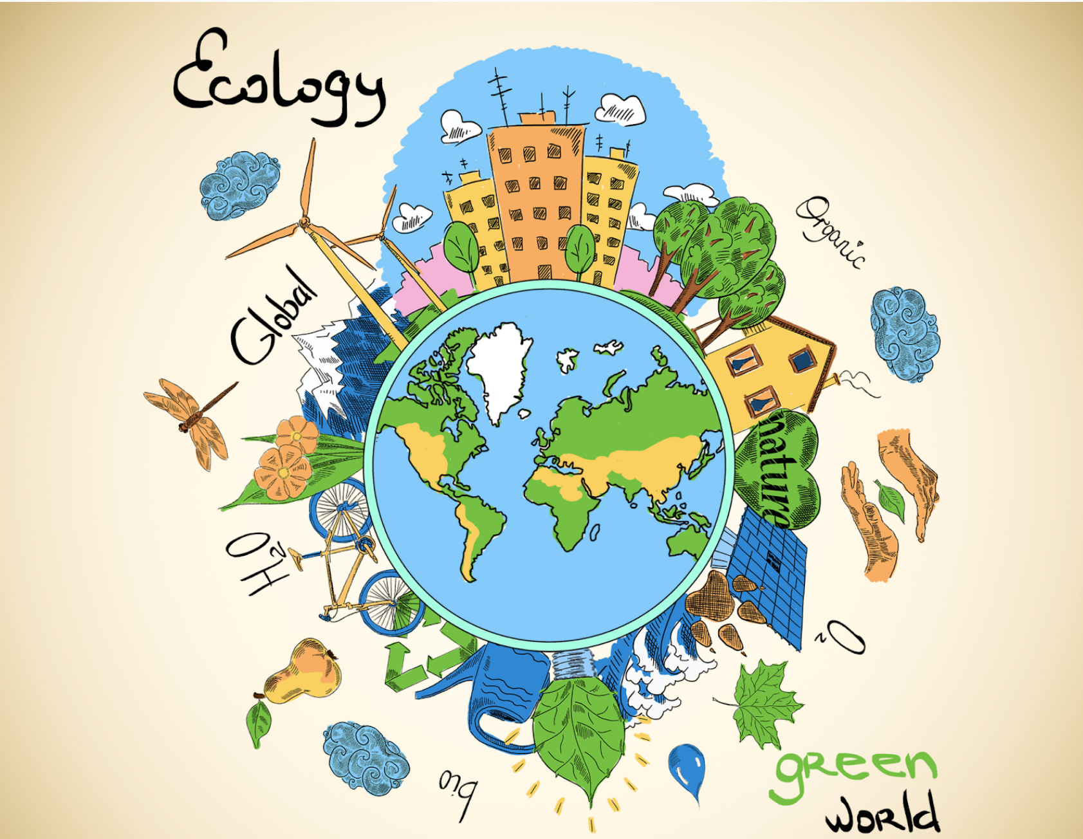
©Shelby Wells
Notes:
The aim of the course is to provide you with
a fundamental understanding of the science of ecology, its scope, methods, and
relevance to both basic and applied research.
Gain
insights into
ecological theory,
empirical approaches,
how ecology helps in addressing pressing global environmental challenges.
ability to work independently within a team (using individual strength to the team’s advantage)
experience in
synthetising literature
scientific communication
time management
critical thinking

Slide 8

©https://eej.ac.nz/
Notes:
Hands on learning
Work in team & Presentations = back bones of the course
Read and synthesize primary literature
Learn about basic ecological concepts
Practice scientific thinking and clear communication
Connect classic ideas with modern developments
Create re-usable study material for peers

Slide 9


Course format
30.09. 14:00 - 18:00 (D119) Course intro
(D218) Intro to ecology
01.10. 14:45 - 17:00 (D222) Scientific work
02.10. 9:00 - 16:00 (ZOO) Excursion
09.10. 8:30 - 17:00 (VN306) Supervised preparation
20.10. 8:00 - 13:45 (D222) Symposium (presentations)
21.10. 14:00 - 18:30 ?D424? Symposium (presentations)
BE ON TIME!!!
Course syllabus
https://tinyurl.com/FunEcol
Course material
https://github.com/MartinBulla/Ecology_Fund_Gen
Notes:
Syllabus https://is.czu.cz/auth/katalog/syllabus.pl?predmet=291370
Course notes https://github.com/MartinBulla/Ecology_Fund_Gen
Late arrivals = course failed

Slide 10
Presentations logistics
20 min talk + 25 min discussion
On key aspects of ecology
  Topic
  Papers - traditional and current
10 teams of ~5 people
  randomly selected
  all members contribute equally & present
  ~workload
    1 day – reading the papers and literature search
    1 day – preparing the presentation
    1 day – hands on seminar finalising the presentation
    1 day – training the presentation
    1 day – presentation and engagement in the discussion
    (yours and presentations of others)

Slide 11
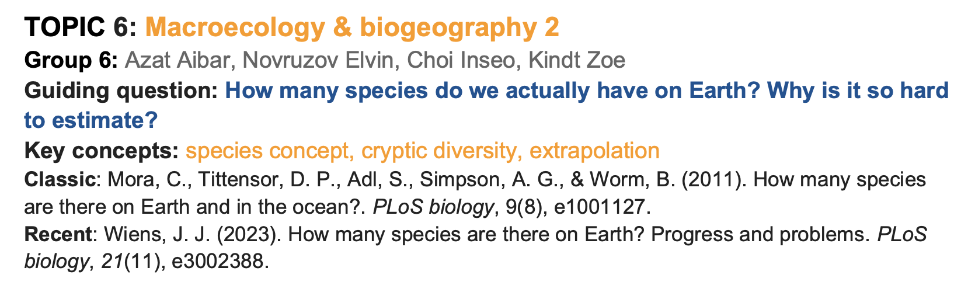
Notes:
Think of a presentation you really enjoyed. What made it work?
And what makes a presentation difficult or unpleasant to follow?

Slide 12
What makes you want to listen to a presentation for 20 minutes?
What makes you switch off?
Notes:
Think of a presentation you really enjoyed. What made it work?
And what makes a presentation difficult or unpleasant to follow?

Slide 13
Presentations format
General
Tell a coherent story with a clear red line, not a sequence of summaries.
Question → Ideas → Evidence → Answer
  Question: What are we trying to understand, and why does it matter?
  Ideas: Introduce key concepts when they are needed to understand the story.
  Evidence: Use the two provided papers and your additional research as evidence within the story.
  Answer / Bring evidence together: what have we learnt, what remains uncertain, and why it matters.
Explain clearly
  the content of each slide & graphic
  how the classic & recent views compare
Engage critically with the methods, evidence, uncertainty & limitations
Acknowledge sources of information & visuals on each slide (AI)
On the final slide, state who did what: photo, name & contribution
Slides
Engaging
  Keep text to minimum.
  Use high visual-signal content: photos, diagrams, graphs, etc.
  Dynamic content is welcome.
  Balance number of slides, detail, time needed for explanation
  Free speaking rather than reading from the slides
Study material for peers
  Put detailed descriptions into slide notes
Notes:
The aim is to synthesize the topic, not to summarize two studies separately.
Do not structure the presentation as ‘Paper 1, then Paper 2’.
- Instead, start from the ecological question or problem and build the presentation around that.
- Introduce concepts only when they help move the story forward. Bring in results from both papers where they provide relevant evidence.
- By the end, the audience should understand the main ecological idea, what evidence supports it, where the evidence is limited or conflicting, and what the broader significance is.
In other words:
Start with the ecological question or problem: why does it matter?
Introduce the key concepts when they are needed to understand the story.
Use the two key papers as evidence, not as two separate paper summaries.
Bring the evidence together: what have we learned, what remains uncertain, and why does it matter?
Question → ideas → evidence → answer
Attempt to understand without AI first
Engaging slides – rule of thumb: do the slides the way you learn the most when you see a presentation.
Study material – great if slides are dynamic (but either keep non-dynamic version or keep in mind that peers will study from the slides; text hidden behind boxes, pics non-suitable)
Various approaches
one has clear signal content per slide and then many slides are possible
other has dynamic (perhaps denser) slides, but then fewer slides are needed
AI – needs to be acknowledged/citation AI generated = fail

Slide 14
Presentations evaluation
Conceptual understanding and clarity
  Ability to synthesize primary literature
  Connection of ideas (e.g. classical with modern developments)
Correctness: arguments grounded in evidence
Academic integrity / AI
TEAM-work
Individual penalisation
  Yellow card = - 10 points (very poor presentation/involvement)
  Red card = fail (no or minimal cooperation and participation in preparing presentation)
Engagement: ability to capture audience’s attention
Visual quality
Structure: logical and easy to follow
Timing (20min): those continuing over 20 min - stopped and loosing 10 points
Ability to discuss & defend your views
Reusability as study material for pears
Notes:
Presentation – a backbone of the course
Read and synthesize primary literature
Learn about basic ecological concepts
Practice scientific thinking and clear communication
Connect classic ideas with modern developments
Create re-usable study material for peers

Slide 15
Course requirements
To be admitted to the exam, you need to:
– fully attend one-day excursion
– fully attend one-day hands-on seminar
– fully attend symposia and receive a score >50%
        presentation
        active participation and contribution to the discussion, e.g.:
            asking questions & providing feedback
            no question = -10 points
  – arrive BEFORE the scheduled start of compulsory activity
    late commers fail
    early leavers fail
    reasons for absences - evaluated individually; contact mikulap@fzp.czu.cz
      as early as possible, ideally few days before the affected course activity
      along with relevant documentation where required.
      ad hoc excuses and excuses after the start of an activity are not considered.
Final grade composition
  symposia (60%)
  exam (40%) – multiple choice test evaluating knowledge of key ecological principles
Passing the course requires:
  symposia >50%
  exam grade ≥ 70%
  overall course score ≥ 70%
Notes:
Active participation in excursion, hands-on, and the symposium is required for the admission to the exam.

Slide 16
No Emails about the content of this presentation, please!
Questions please!

Slide 17
Topics & Readings
Assignment to groups
1. Eco-evolutionary dynamics & life histories
Sifakakis Stylianos, Serikbay Assiya, Bjorklof Juulia, Varga Luca Anna, Flaskova Katerina
2. Population ecology essentials
Alvarado Diaz Cristhiam, Sengul Ali Eren, Dashab Laaura, Koci Aron, Otubushin Marco Olukayode, Ferencova Zoe
3. Species interactions & coexistence
Vaghadia Saket Dilip, De Mar Youssef Ralf, Singh Angleen, Mejsnarova Veronika, Kerkhoff Sigrid
4. Food webs & network ecology
Olari Eugenia, Goretti Francesca, Gonon Yoan Alexis, Katende Ukasha Ndugwa Kinene, Rattu Siddhant Santosh, Drahokoupil Denis
5. Macroecology & biogeography 1
Polackova Natalie, Naik Vinayak Kumar, Musel Simon, Mehlhose Hagen Maik, Garner Alexandra, Novruzov Novruz
6. Macroecology & biogeography 2
Plivova Klara, Folgado Toscano Santos Ines de Oliveira, Tsvetkov Stanislav Atanasov, Tassel Elise Marie Claire, Duarte Daniela de Mělo
7. Global change ecology
Domingos Lourenco Marreiros Loureiro Joao Maria, Kandl Matyas, Casian Romana, Thapa Kripa, Kyaw Phone Thant
8. Drivers of biodiversity crisis
Owlanj Hesam, Dimitrievski Matej, Muchowska Zofia, Alvarez Peralta Diana Raphaela, Keenen Katelyn
9. Biodiversity
DiNicola Julie, Havlik Zdenek, Daniiarov Zhantai, Sturaite Goda, Gantulga Munkhtulga
10. Applied ecology: New tools & data streams
Revazishvili Anano, Kyaw Htet Aung, Ponya Valeria, Hazuchova Zoja, Saran Abhishek

Slide 18
Eco-evolutionary dynamics & life histories
Does the fast-slow continuum adequately capture life history variation across taxa, or do we need multiple axes of life-history strategy?
Classic:
  Stearns, S. C. (1977). The evolution of life history traits: a critique of the theory and a review of the data. Annual Review of Ecology and Systematics, 145–171.
Recent:
  Stott, I. et al. (2024). Life histories are not just fast or slow. Trends in Ecology & Evolution, 39(9), 830–840.

Slide 19
Population ecology essentials
Allee effects: ecological curiosity or fundamental driver of population dynamics?
Classic:
  Stephens, P. A., Sutherland, W. J., & Freckleton, R. P. (1999). What is the Allee effect? Oikos, 185–190.
Recent:
  Muir, E. J., Lajeunesse, M. J., & Kramer, A. M. (2024). The magnitude of Allee effects varies across mechanisms. Oikos, 2024(7), e10386.

Slide 20
Species interactions & coexistence
Top-down control or bottom-up release: Is there evidence for predation’s grip on prey numbers?
Classic:
  Krebs, C. J. et al. (1995). Impact of food and predation on the snowshoe hare cycle. Science, 269, 1112–1115.
Recent:
  Oli, M.K. et al. (2025). Demographic mechanisms of snowshoe hare population cycles in Yukon, Canada. Journal of Animal Ecology, 1–18.

Slide 21
Food webs & network ecology
From keystone to rewiring: does food-web complexity build local biodiversity?
Classic:
  Paine, R. T. (1966). Food web complexity and species diversity. The American Naturalist, 100(910), 65–75.
Recent:
  Bartley, T. J. et al. (2019). Food web rewiring in a changing world. Nature Ecology & Evolution, 3, 345–354.

Slide 22
Macroecology & biogeography 1
Latitudinal gradients in biodiversity (and its dimensions) - how and why?
Classic:
  Willig, M. R., Kaufman, D. M., & Stevens, R. D. (2003). Latitudinal gradients of biodiversity. AREES, 34, 273–309.
Recent:
  Brodie, J. F., & Mannion, P. D. (2023). The hierarchy of factors predicting the LDG. TREE, 38(1), 15–23.

Slide 23
Macroecology and biogeography 2
How many species do we actually have on Earth? Why is it so hard to estimate?
Classic:
  Mora, C. et al. (2011). How many species are there on Earth and in the ocean? PLoS Biology, 9(8), e1001127.
Recent:
  Wiens, J. J. (2023). How many species are there on Earth? Progress and problems. PLoS Biology, 21(11), e3002388.

Slide 24
Global change ecology
Are we facing a sixth mass extinction?
Classic:
  Ceballos, G. et al. (2015). Entering the sixth mass extinction. Science Advances, 1(5), e1400253.
Recent:
  Wiens, J. J., & Saban, K. E. (2025). Questioning the sixth mass extinction. TREE, 40(4), 375–384.

Slide 25
Drivers of biodiversity crisis
What are the main drivers of the current biodiversity crisis?
Classic:
  Bar-On, Y. M., Phillips, R., & Milo, R. (2018). The biomass distribution on Earth. PNAS, 115(25), 6506–6511.
Recent:
  Jaureguiberry, P. et al. (2022). Direct drivers of global biodiversity loss. Science Advances, 8(45), eabm9982.

Slide 26
Biodiversity ↔ ecosystem functioning/services
From services to contributions: valuing nature in a human world
Classic:
  Costanza, R. et al. (1997). The value of the world's ecosystem services and natural capital. Nature, 387, 253–260.
Recent:
  Díaz, S. et al. (2018). Assessing nature's contributions to people. Science, 359(6373), 270–272.

Slide 27
Applied ecology: New tools & data streams
From new dawn to new standard: citizen science in ecology
Classic:
  Silvertown, J. (2009). A new dawn for citizen science. TREE, 24(9), 467–471.
Recent:
  Fraisl, D. et al. (2022). Citizen science in environmental & ecological sciences. Nature Reviews Methods Primers, 2, 64.

Slide 28
FundAmentals of Ecology
General ecology
introductions
course overview
expectations
Martin Bulla bullam@fzp.czu.cz
Peter Mikula mikulap@fzp.czu.cz
Česká zemědělská univerzita v Praze • CZU Prague

