Slide 1

FUNDAMENTALS OF ECOLOGY
miscellaneous
scientific talk
lecture 3
Peter Mikula
Martin Bulla
Course material
https://github.com/MartinBulla/Ecology_Fund_Gen

Slide 2

Course format
30.09. 14:00 - 18:00 (D119) Course intro
(D218) Intro to ecology
01.10. 14:45 - 17:00 (D222) Scientific work
02.10. 9:00 - 16:00 (ZOO) Excursion (mandatory)
09.10. 8:30 - 17:00 (VN306) Supervised preparation (mandatory)
20.10. 8:00 - 13:45 (D222) Symposium (presentations) (mandatory)
21.10. 14:00 - 18:30 ?D424? Symposium (presentations) (mandatory)
Course syllabus
https://tinyurl.com/FunEcol
Course material
https://github.com/MartinBulla/Ecology_Fund_Gen
Notes:
Syllabus https://is.czu.cz/auth/katalog/syllabus.pl?predmet=291370
Course notes https://github.com/MartinBulla/Ecology_Fund_Gen
Late arrivals = course failed

Slide 3
Topics & Readings
Eco-evolutionary dynamics & life histories
Population ecology essentials
Species interactions & coexistence
Food webs & network ecology
Macroecology & biogeography 1
Macroecology & biogeography 2
Global change ecology
Drivers of biodiversity crisis
Biodiversity (ecosystem functioning/services)
Applied ecology: New tools & data streams
Macroecology & biogeography 3
Classic vs. modern papers

Slide 4
TOPIC 11: Macroecology & biogeography 3
Guiding question: Island biodiversity and its dimensions
Key concepts: Island rule, dwarfism, gigantism, meta-analyses.
Classic:. Meiri, S., Cooper, N., & Purvis, A. (2008). The island rule: made to be broken?. Proceedings of the Royal Society B: Biological Sciences, 275(1631), 141-148.
Recent: Benítez-López, A., Santini, L., Gallego-Zamorano, J., Milá, B., Walkden, P., Huijbregts, M. A., & Tobias, J. A. (2021). The island rule explains consistent patterns of body size evolution in terrestrial vertebrates. Nature Ecology & Evolution, 5(6), 768-786.

Slide 5
Island rule
Peter Mikula
Martin Bulla

Slide 6
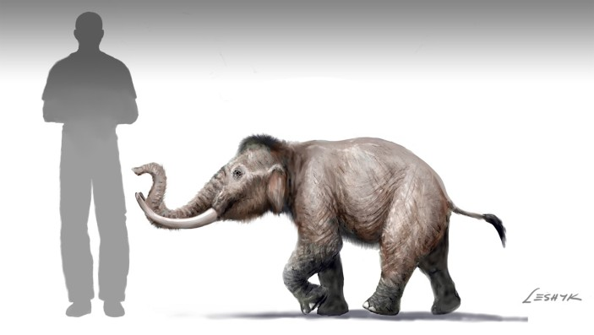
Perkins, Nature (2012)
Notes:
What is the “island rule“?
Example of island dwarfism - „Mini“ mammoth Mammuthus creticus from Crete, other examples are mammoths from Channel islands (US) or Wrangel Island (Russia)

Slide 7
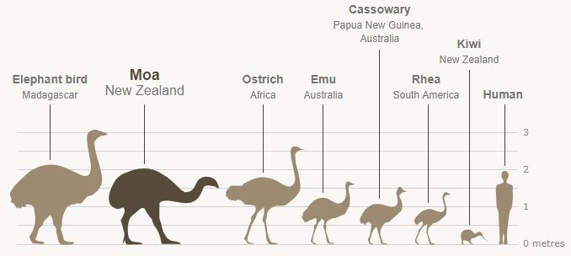
https://jp.pinterest.com/pin/ratite-birds--849421179738330234/
Notes:
Guess which species are living on islands?

Slide 8
Island species
Mainland species
https://jp.pinterest.com/pin/ratite-birds--849421179738330234/
Notes:
Examples of island gigantism – elephants bird and moa are island species

Slide 9
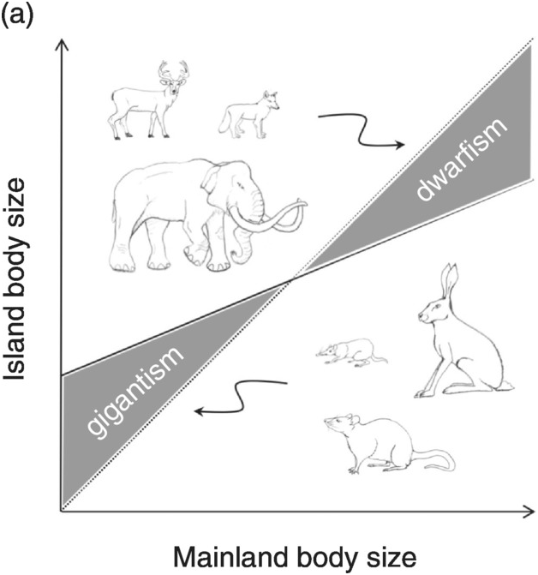
What is the Island rule in principle?
Burns, K. C. (2019). Cambridge University Press
Notes:
A biogeographical hypothesis that states that small-bodied animals tend to evolve larger body sizes on islands (gigantism), while large-bodied animals tend to evolve smaller body sizes (dwarfism).
In other words. body size of large animal species tend to decrease on islands (dwarfism), whereas body size of small animal species tend to increase on islands (gigantism)

Slide 10
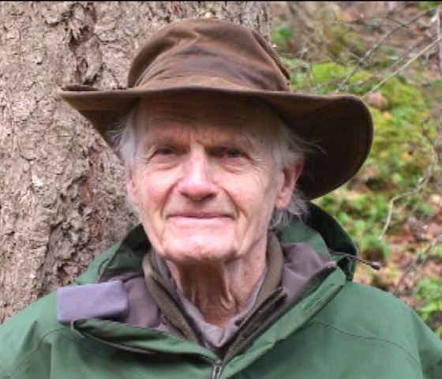
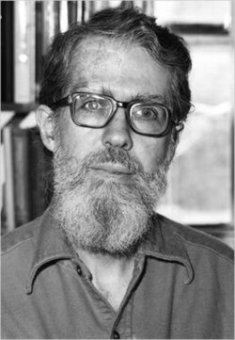
Island (Foster‘s) rule
Bristol Foster
Leigh Van Valen
https://ecoreserves.bc.ca/2012/03/17/a-conversation-with-bristol-foster/
https://wikipedia.org/
Notes:
Formulated by Leigh Van Valen (evolutionary biologist; right picture) in 1973 based on study of Bristol Foster (mammalogist; left picture)

Slide 11
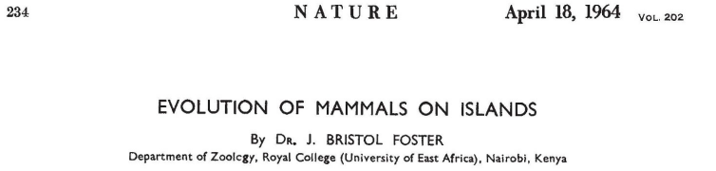
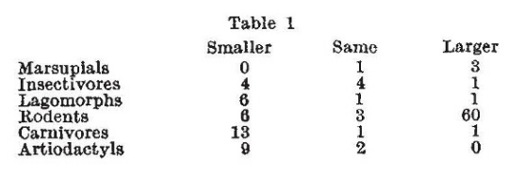
Notes:
Foster
noticed that animals often change their body size compare to their presumed mainland ancestors
compared 116 island mammal species with mainland relatives and found consistent gigantism and dwarfism
„I made a survey of 116 insular races or species of 6 orders mostly living on the islands of Western North America and Europe. The results are shown in the Table, which indicates whether the insular form is smaller, the same size, or larger than the presumed adjacent mainland ancestor“
attributed this to relaxed predation enlarging small species and limited island resources shrinking large ones

Slide 12
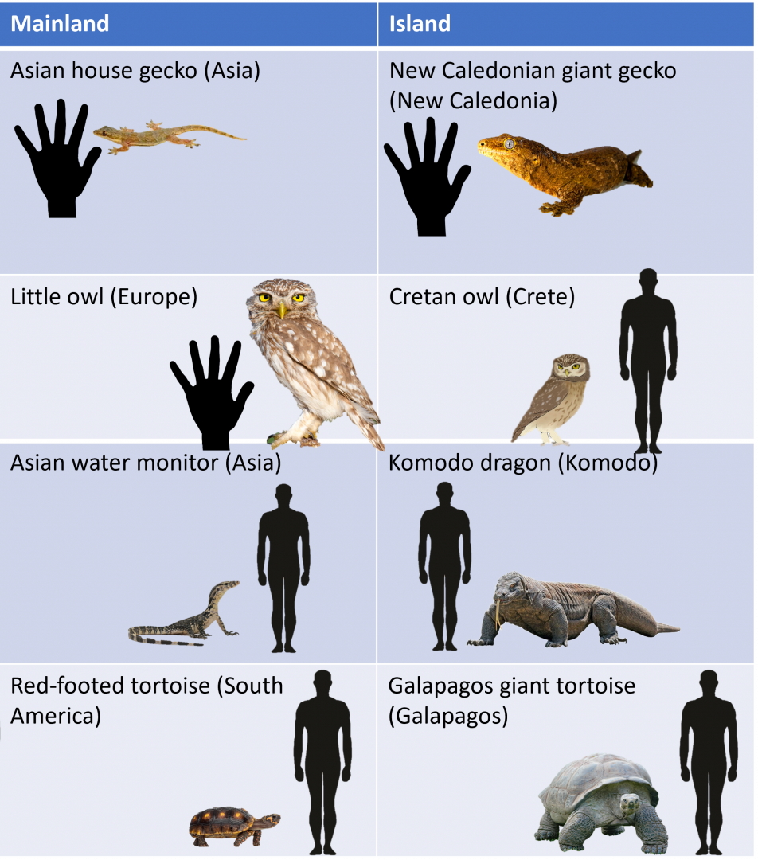
Gigantism
https://www.zoochat.com/community/media/examples-of-island-gigantism.546759/
Notes:
Island faunas are characterized by gigantism in small animals and dwarfism in large animals

Slide 13
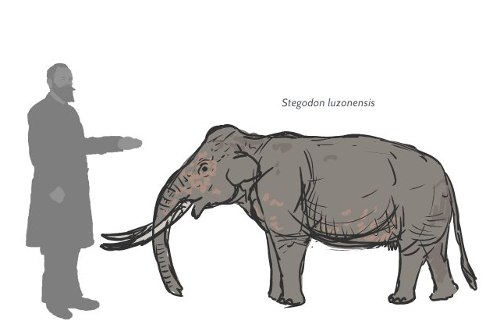
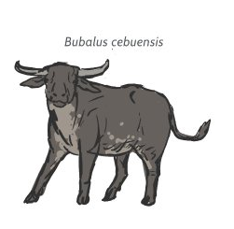
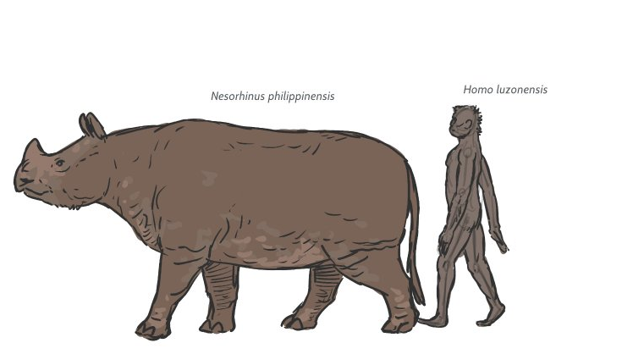
Dwarfism
https://www.reddit.com/r/Dinosaurs/comments/1gtpnz3/should_skull_islands_fauna_be_affected_by_insular/
Notes:
Dwarfism of mammals on Phillippines

Slide 14
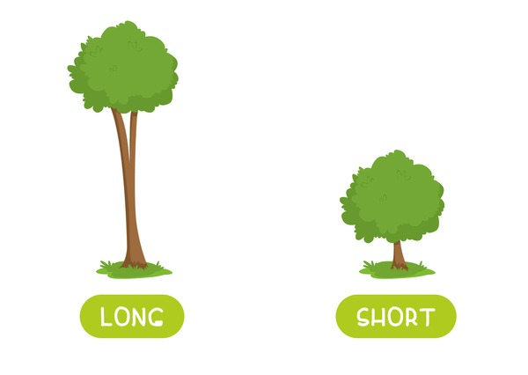
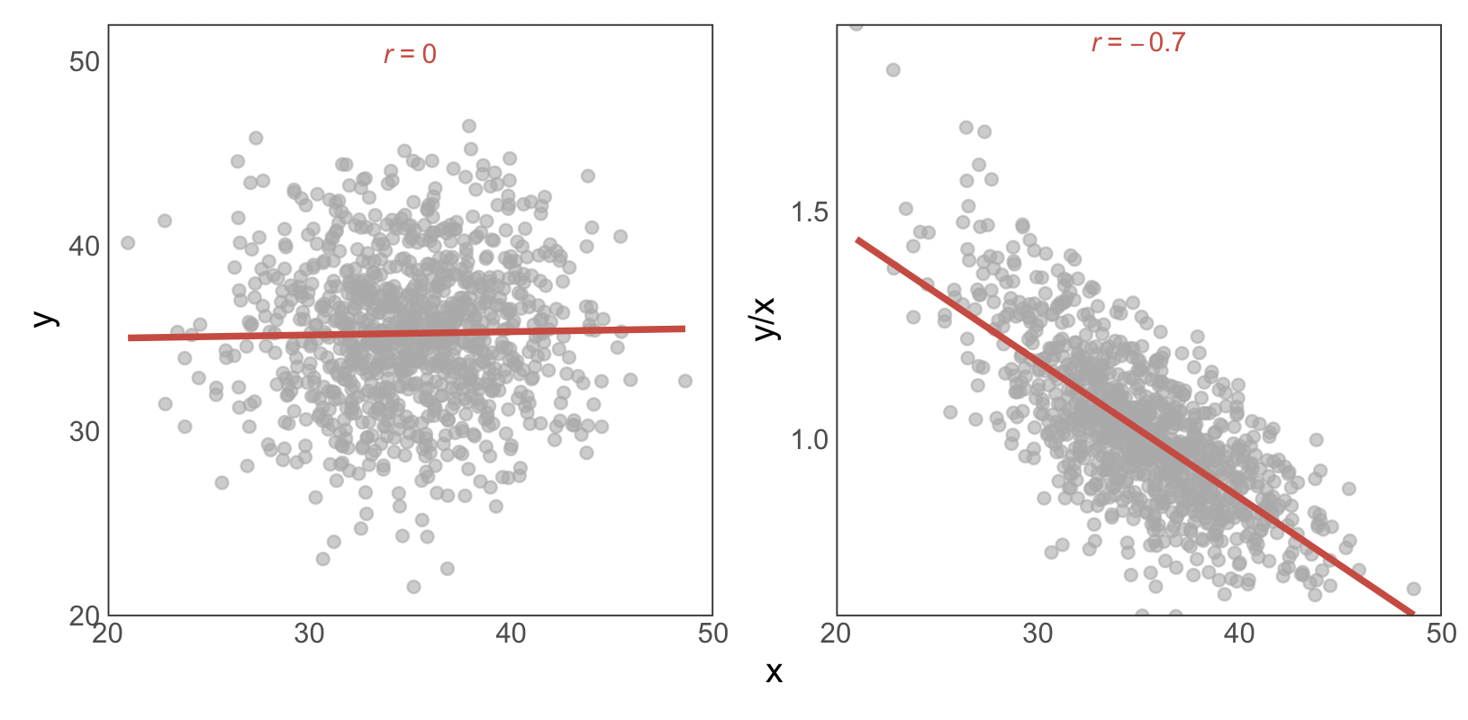
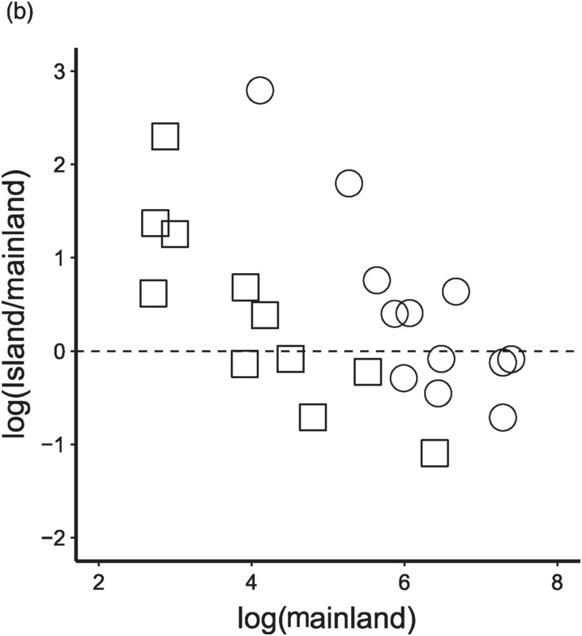
How about plants?
Burns, K. C. (2019). Cambridge University Press
Bulla & Forstmeier (2025), ecoevoRxiv
Notes:
Island rule has been claimed (even in a book) to apply also for plants!
Note that the y-axis here shows the ratio of island to mainland plant size, which makes the pattern look reversed compared to the previous slides (where raw island size was on the y-axis, not the ratio). The relationship is essentially the same: a high ratio means plants are larger on islands than on the mainland.
But it might be a statistical artifact – see our simulated data on the right.

Slide 15
Why?
Burns, K. C. (2019). Cambridge University Press
Notes:
Explanations:
Reduced predation (predator release): fewer/absent predators relax selection for vigilance, favouring larger size and slower life histories in small taxa.
Relaxed interspecific competition: simplified communities broaden niches; body size shifts to fill missing guilds.
Resource (energy) limitation: chronic, low/stable productivity selects for smaller bodies in large, high-energy taxa (dwarfism) and caps extremes.
Burns, K. C. (2019). Cambridge University Press

Slide 16
IS IT REALLY THAT SIMPLE?
EMPIRICAL EVIDENCE

Slide 17
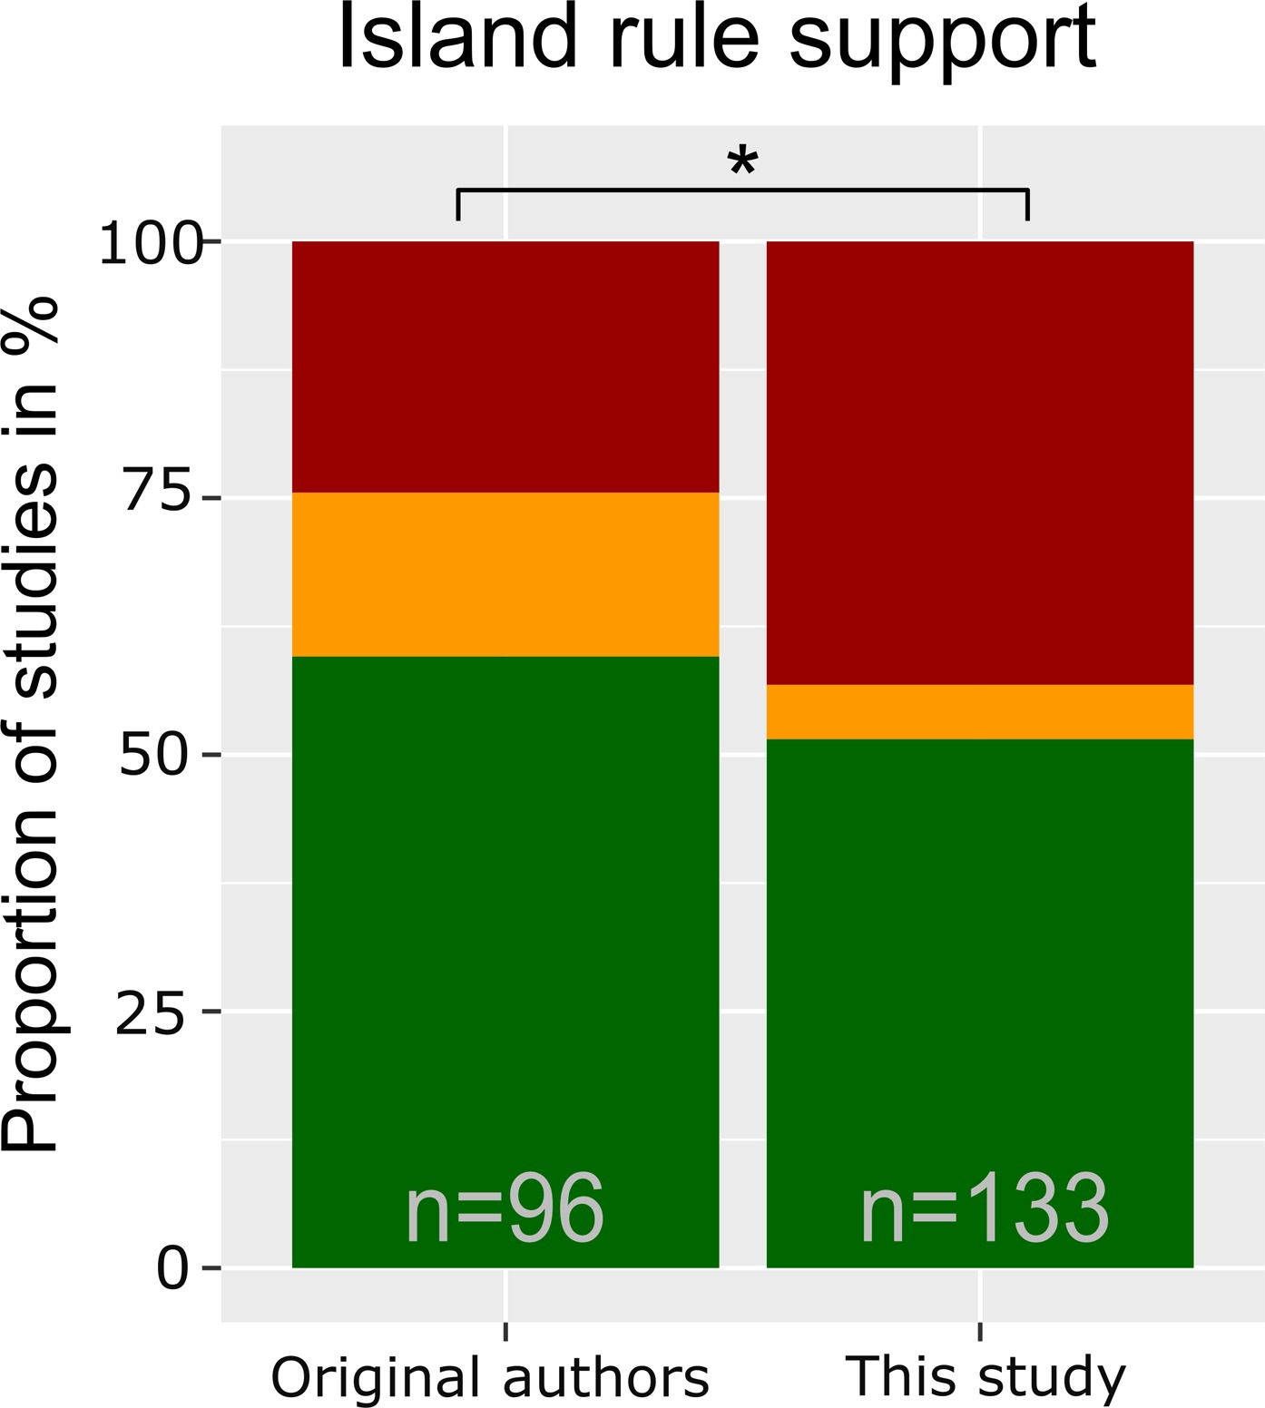
Island rule support
Lokatis & Jeschke 2018, J Biogeogr 45:289–303
Notes:
Proportions of studies supporting (in green), questioning (in red) or being undecided about (in yellow) the island rule.
Original authors: interpretations of the results of their study
Lokatis & Jeschke: re-evaluated results from original authors according to the criteria defined in the main text and additional studies included where authors did not necessarily draw conclusions about the island rule themselves but that reported data to test the island rule; thus, the sample size is larger here.
Note that the re-evaluated evidence is equivocal.

Slide 18
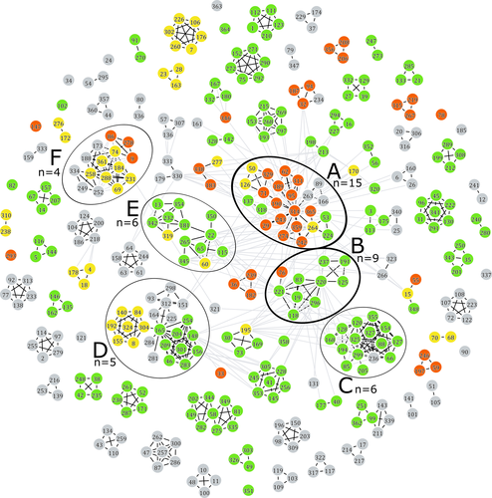
Author groups disagree on island rule support
Lokatis & Jeschke 2018, J Biogeogr 45:289–303
Notes:
Authorship network of researchers that have published articles on the island rule. Colours indicate that an author's studies are, according to the original author interpretation, largely supporting (in green), questioning (in red), or undecided (in yellow) about the island rule, taking the median across studies; grey (not assignable) was mainly due to authors not interpreting their results in light of the island rule. Each author was assigned to an anonymous ID number shown in the figure. Black lines connect authors that have co-authored a scientific publication. Grey lines indicate that one or both connected researchers have mentioned the other in the acknowledgement section of one of their articles. Black circles indicate the author groups that encompass at least four articles; n is the exact number of publications by each author group. Group A and B were selected for in-depth analysis (group A: 24 authors, 15 articles; group B: 10 authors, 9 articles)

Slide 19
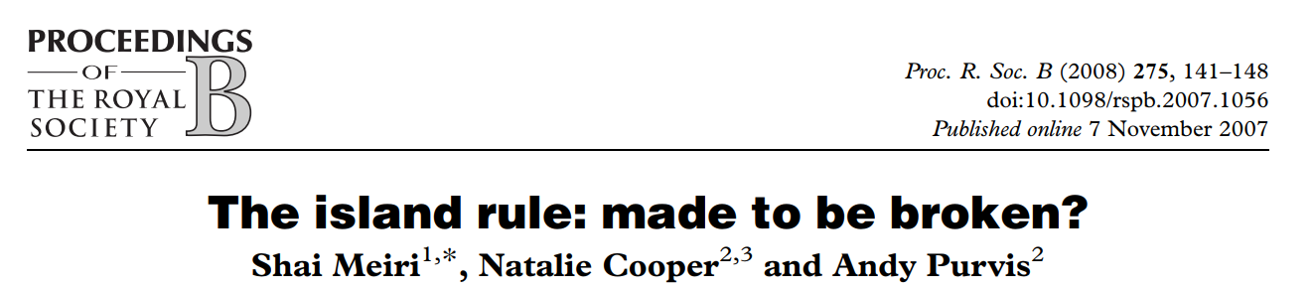
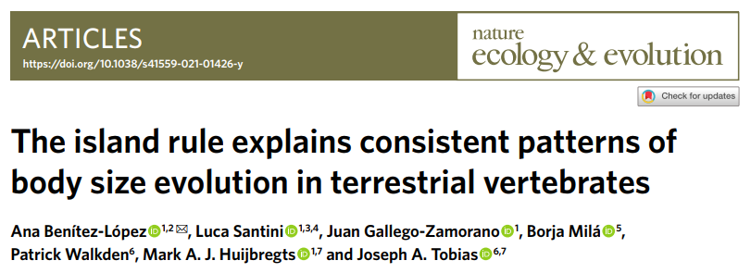
Island rule: two perspectives
vs

Slide 20
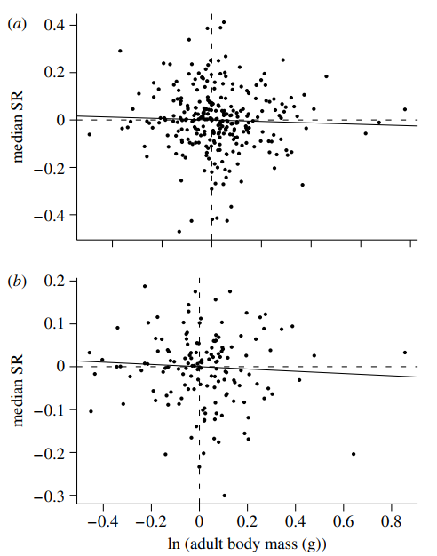
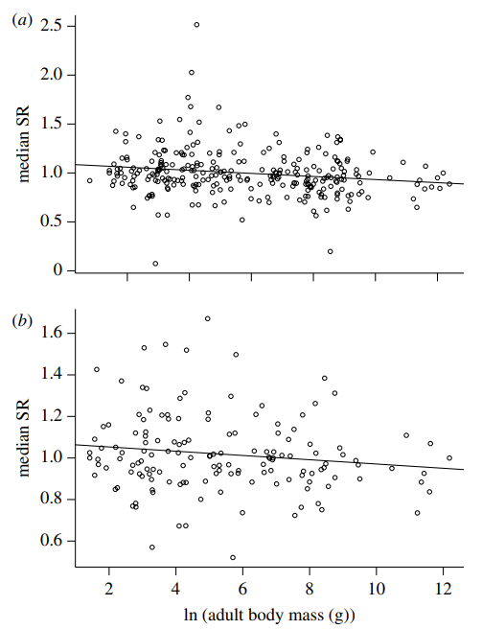
Phylogenetic model Non-phylogenetic model
All species
Well-sampled
species
Notes:
No general island‑rule signal once phylogeny is controlled (slopes ≈ 0)
Non‑phylogenetic slopes weakly negative but tiny (R² ≈ 0.02–0.05)
Clade‑specific patterns: murids → gigantism; artiodactyls & some carnivores/heteromyids → dwarfism
Island area, isolation, trophic level, carnivore richness: generally non‑significant

Slide 21
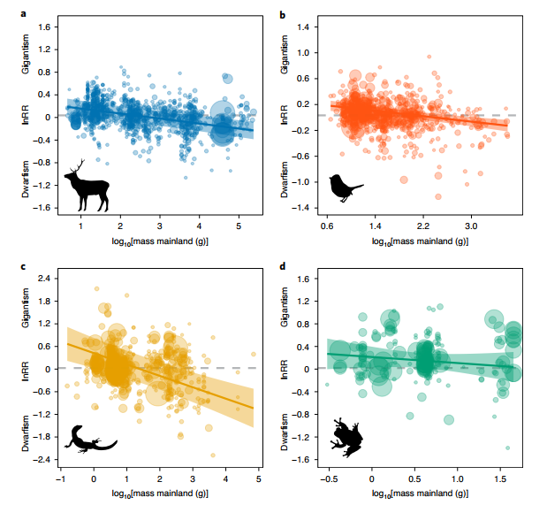
Notes:
Island rule supported for mammals, birds and reptiles
Amphibians: weak/non‑significant slope; general tendency to gigantism

Slide 22
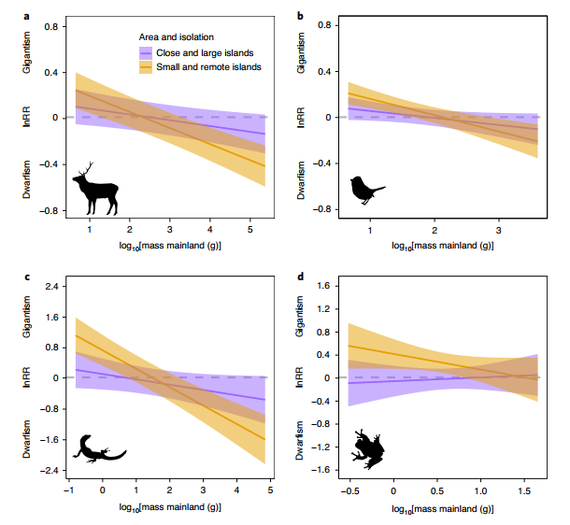
Notes:
Effects stronger on small and remote islands (especially mammals, reptiles)
Climate matters: larger bodies on cooler islands (endotherms); seasonality & productivity shape ectotherms

Slide 23
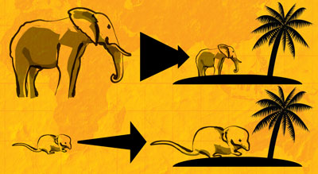
SYNTHESIS
Island rule generally holds Context-dependant
Lineage-dependant signal Methods matter
Notes:
The ‘island rule’ broadly holds across vertebrates when data are pooled and modelled hierarchically
Strength and direction are context‑dependent (island size/isolation, climate, productivity) and taxon‑dependent
Within mammals alone and under stricter pairing/phylogenetic control, signals may weaken to clade‑specific patterns
Methodology critically shapes conclusions

Slide 24

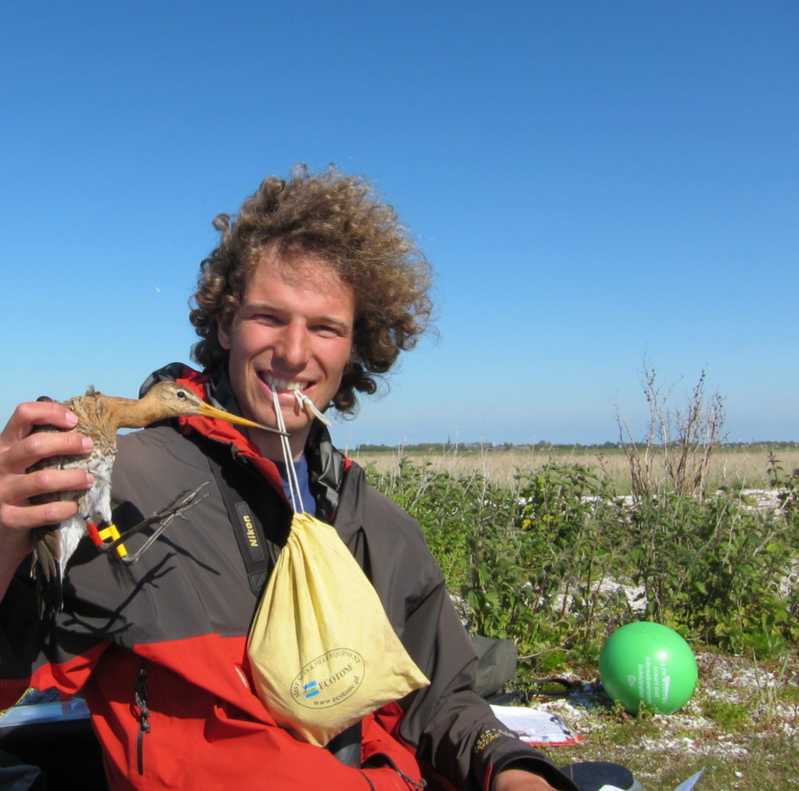
Contributions
Peter Mikula
Conceptualisation
Prepared presentation & notes
Checked sources
Extracted info
Martin Bulla
Conceptualisation
Checked slides
Improved graphics

Slide 25
QUESTIONS?

Slide 26

Differences
methods
Mammals only
1184 island–mainland comparisons
Species‑level median size ratios (unlogged)
Explicit phylogenetic tests (independent contrasts on mammal supertree)
Moderators: mainland body mass, island area & isolation, trophic level, carnivore richness
Repeated analyses with ‘well‑sampled’ species (≥6 individuals per island and mainland)
Mammals, birds, reptiles, amphbians
2,479 island–mainland comparisons
Within and cross-species population mean size ratio (logged)
Multi‑level meta‑regression with random effects: species, source, observation, phylogeny
Moderators: mainland body mass, island area & isolation, trophic level, productivity, temperature & seasonality
Bias checks: ratio regressions, small‑sample correction, imputation, publication bias

Slide 27
Differences
limitations
Mammals only
Do not control for unequal sampling error/precision across species
High residual heterogeneity → unmeasured factors likely
Calculating ratios for diverse size indices
Global, cross-taxa
Bias checks: ratio regressions, small‑sample correction, imputation, publication bias
Solid proportion of variance explained
Converting diverse size indices to mass via allometry
None use raw data
Extinct fauna excluded → historical signals may be masked
Notes:
Converting diverse size indices to mass via allometry → error propagation possible
Meiri – preferred indexes for body mass, but calculated ratios also for other size indices – this may introduce serious error if island rule creates different allometry for different size metrics

Slide 28
HOW TO FIND RELEVANT OVERVIEW AND SOURCES ON A TOPIC
THE PROCESS

Slide 29

it!
Notes:
Google it first

Slide 30
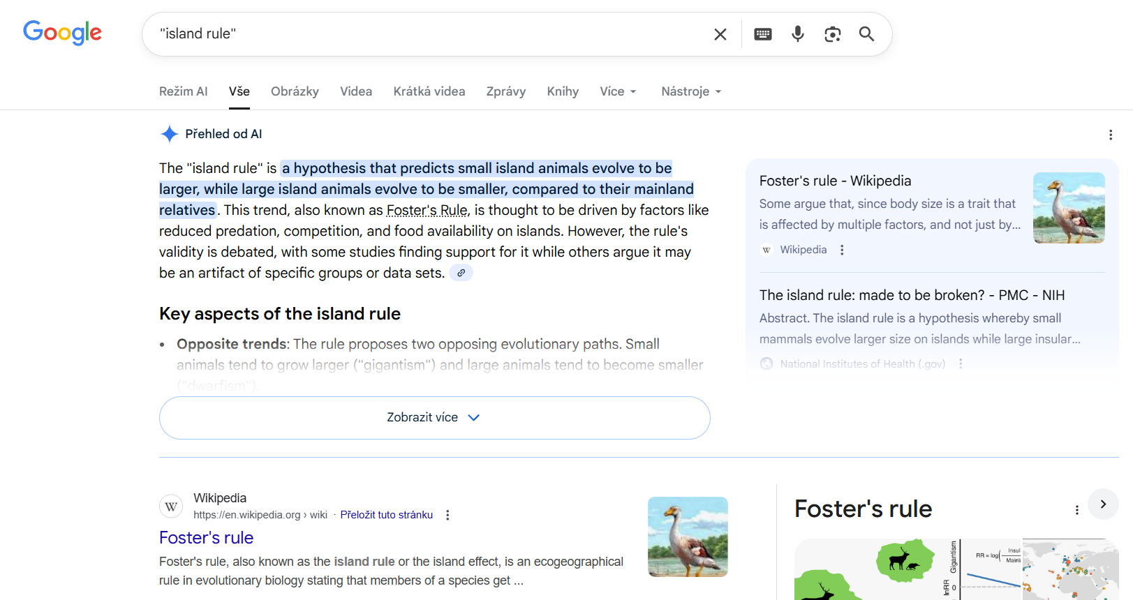
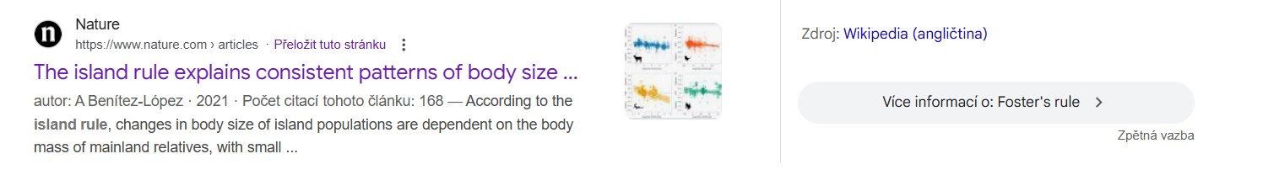
Notes:
Notice that Google now shows AI first, it was Wikipedia until recently; start with Wiki
Put your searching term in ““ if you wanna find exact match and word combination
Try to google different terms
You may search for online university courses (e.g. https://evolution.berkeley.edu/search/?q=%22island+rule%22),

Slide 31
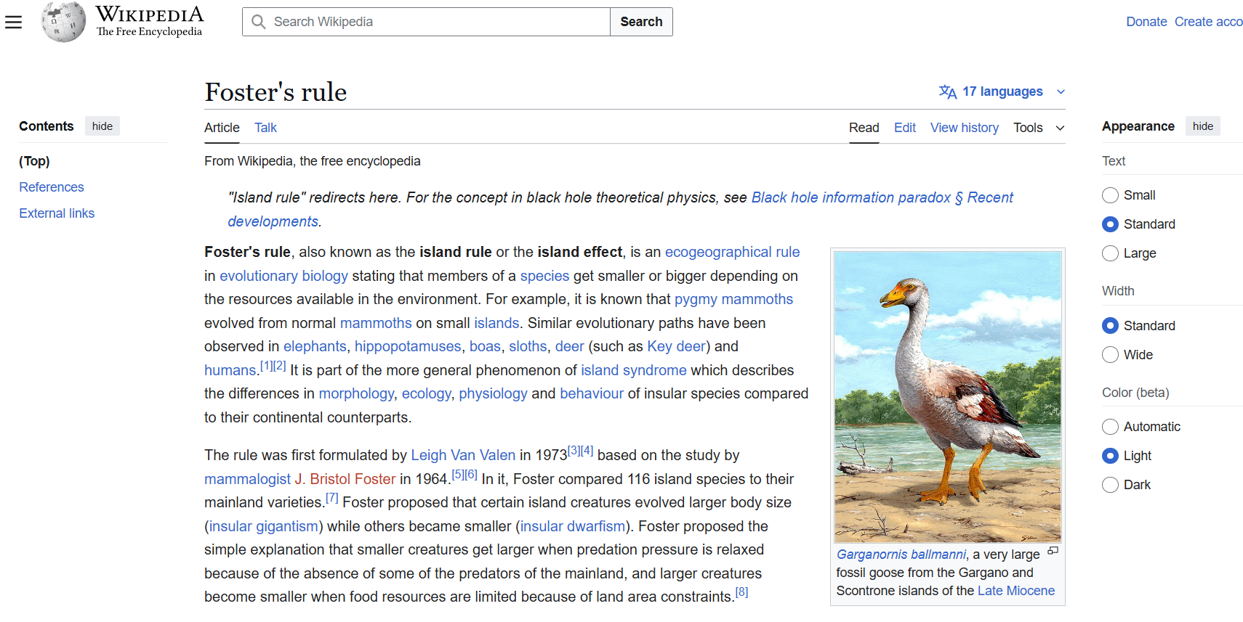
Notes:
Be aware of different topic coverage among languages

Slide 32
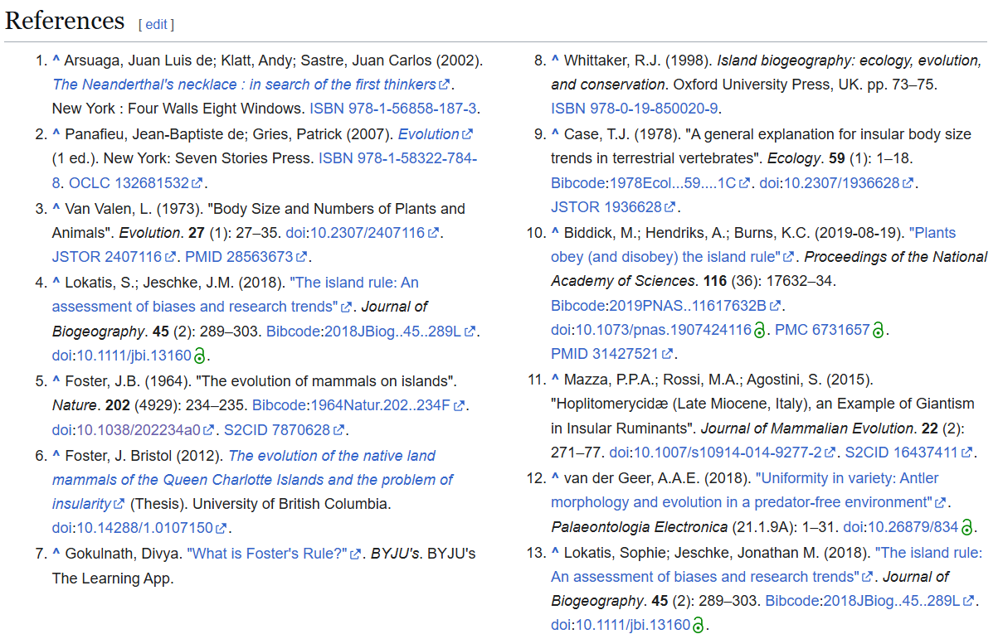
Notes:
Wiki offers references, thats great, you may directly click on them

Slide 33
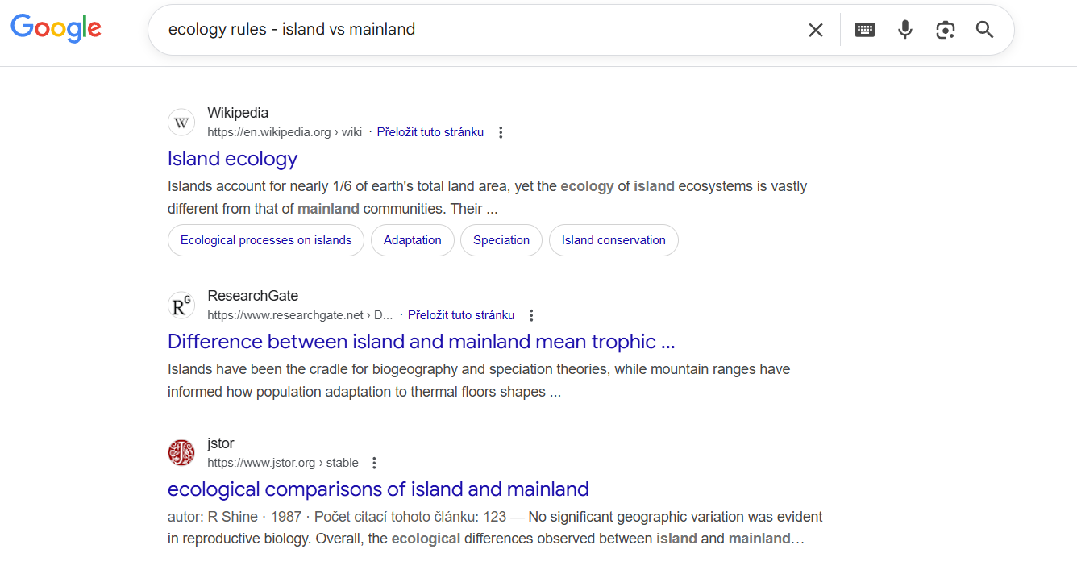
Notes:
We may ask also differently, e.g. more generally – lets try ecology rules - island vs mainland
It sets up your target topic to the wider conceptual frame

Slide 34
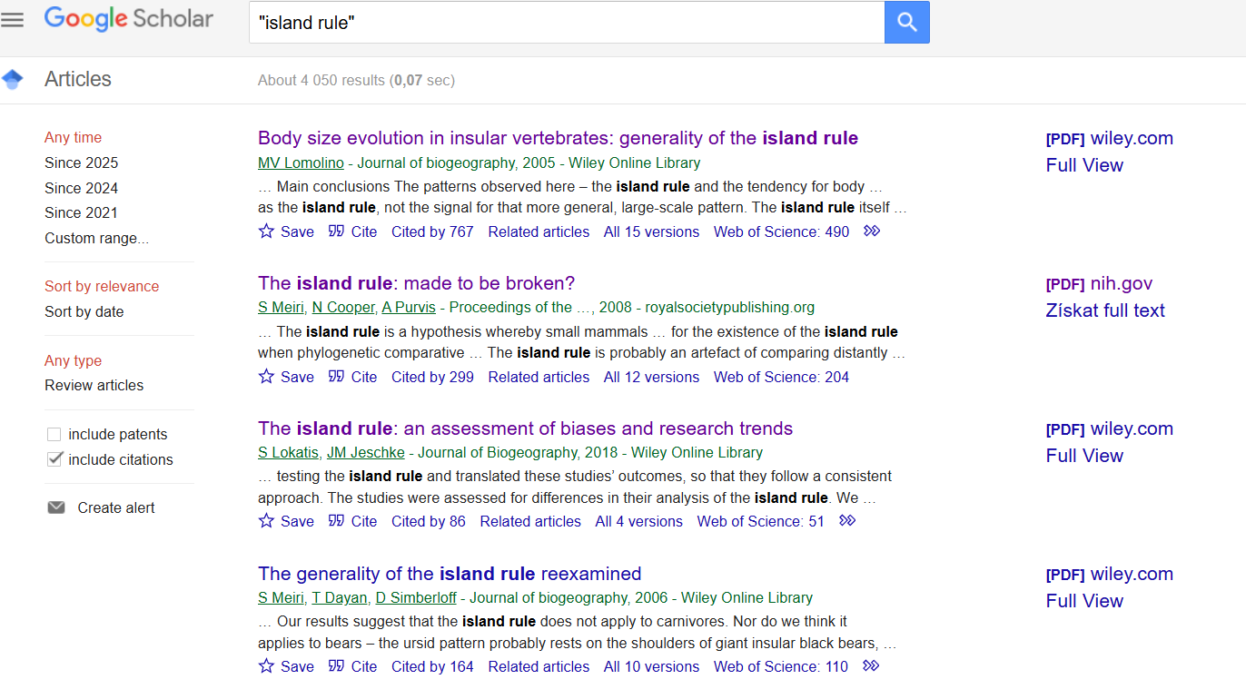
Notes:
Google Scholar

Slide 35

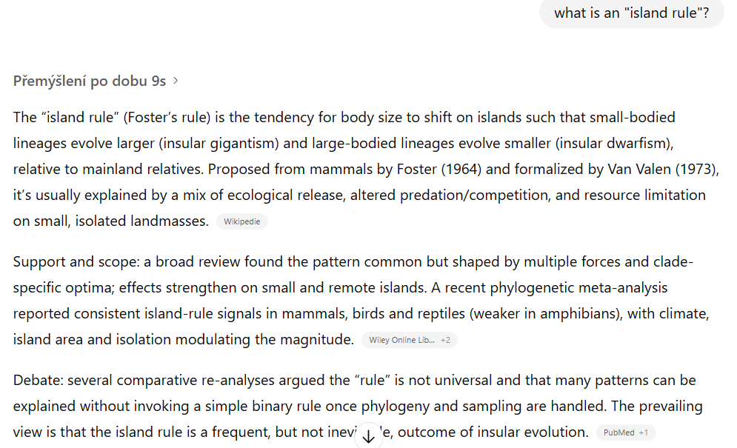
Notes:
First try to google it and gather information on your own
Only then chatgpt is decreasing your ability to critically review information and hampering your learning process

Slide 36
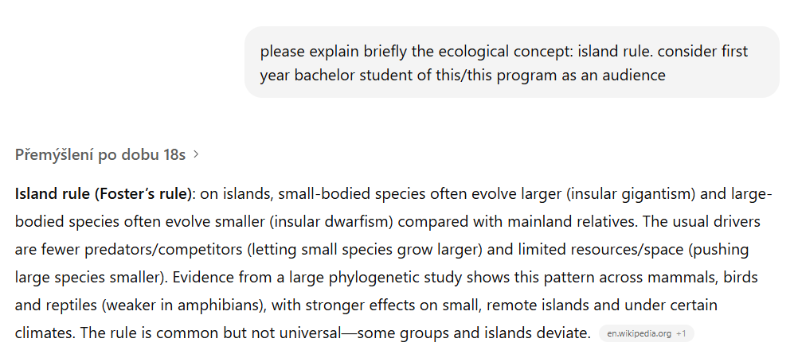
Notes:
You may play a bit with searching query, or develop predefined assistent specififally for this purpose.
Read and pondered upon the two example papers for your topic without AI first.

Slide 37



Slide 38
Lets check one example paper

Slide 39
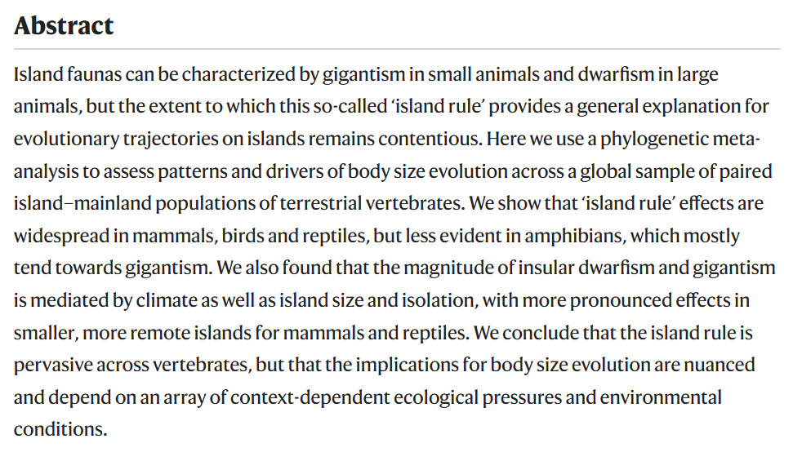
What is an important info in the Abstract?

Slide 40
What is known
Data & Statistics
Main results
Interpretations
Notes:
For the analysis of the main text, see pdf on github where the sections discussing the similar parts as in the Abstract are highlighted. Can you see how we used the paper information to generate our lecture?

Slide 41
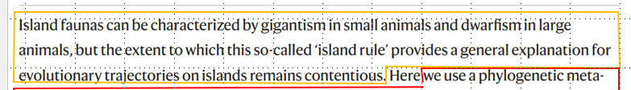
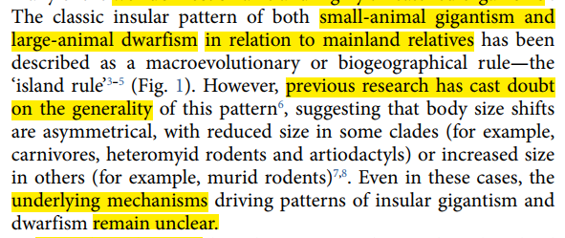
Abstract details are in the main text!
First sentence of abstract
=
Introduction in the main text

Slide 42
What is known = Introduction
Data & Statistics = Methods
Main results = Results
Interpretations = Discussion
Notes:
For the analysis of the main text, see pdf on github where the sections discussing the similar parts as in the Abstract are highlighted. Can you see how we used the paper information to generate our lecture?

Slide 43





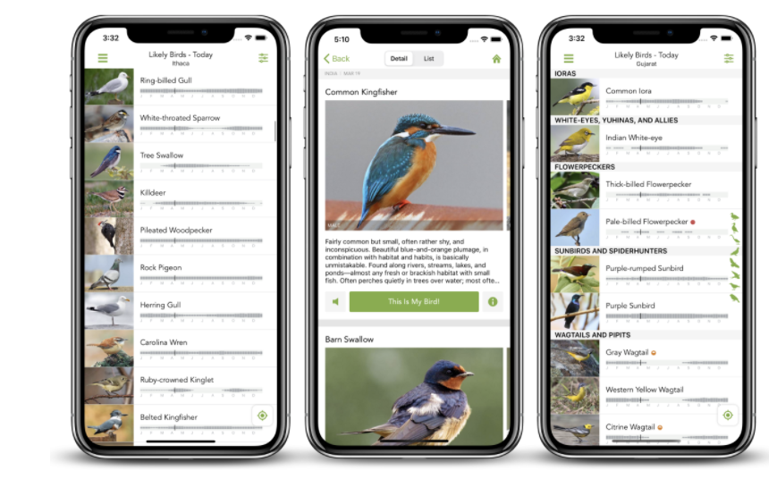
BEFORE EXCURSION
MERLIN
Download app to your phone
Notes:
Bird identifications from sounds and photos

Slide 44


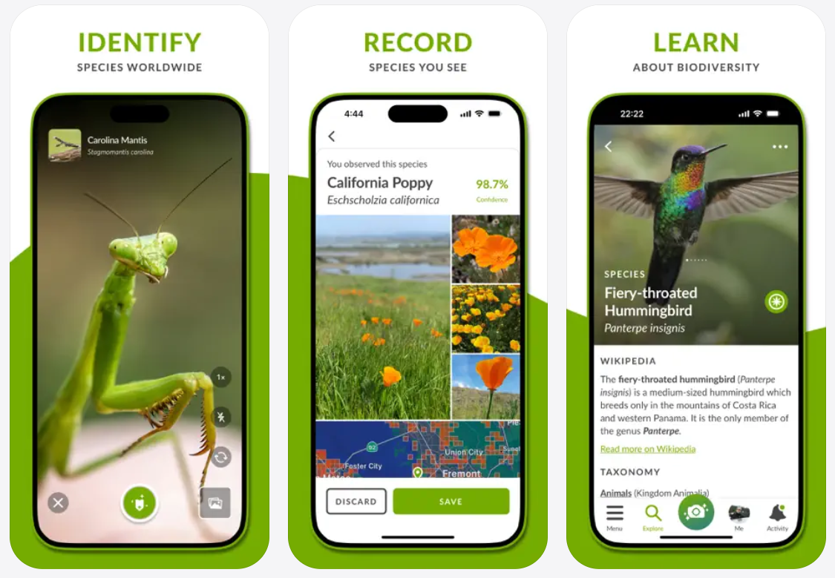
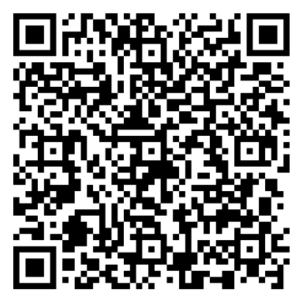
iNaturalist
Download app to your phone
Notes:
Living organisms identifications from photos

Slide 45
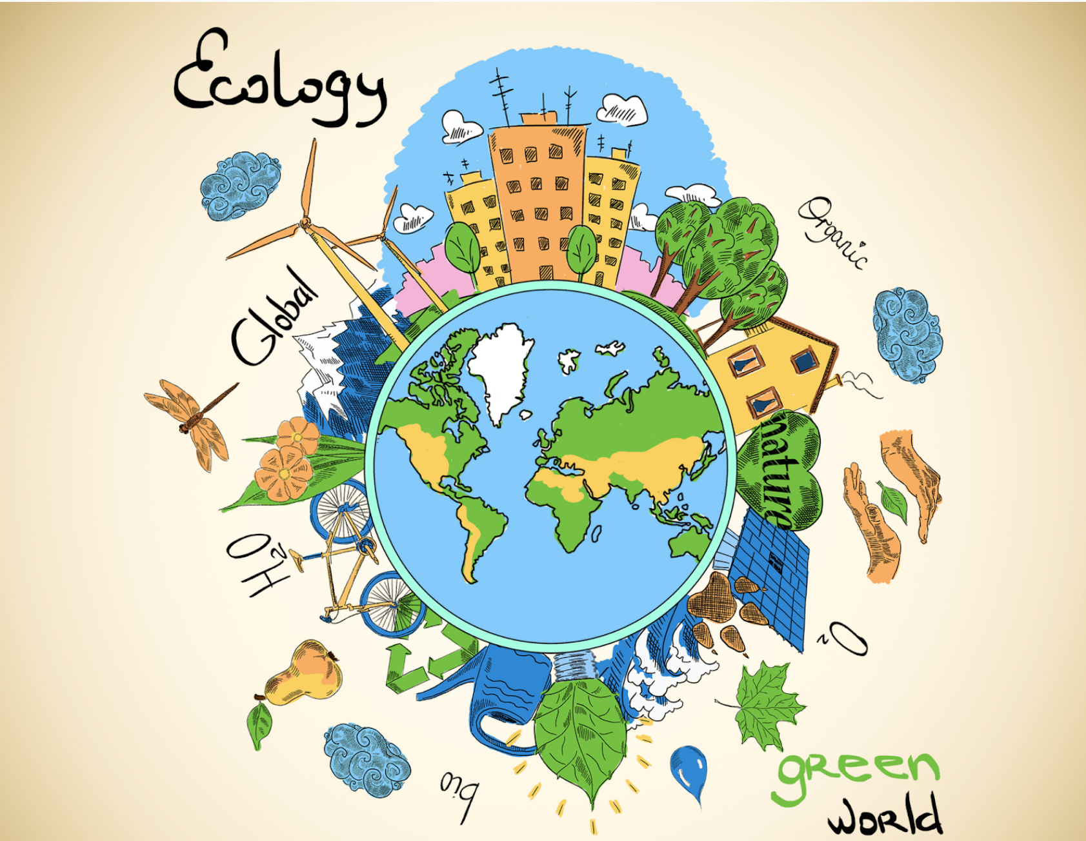
Thank you for your attention
© Shelby Wells
Happy
to take questions

