Slide 1
FUNDAMENTALS OF ECOLOGY GENERAL ECOLOGY
HANDS ON
Peter Mikula
Martin Bulla
Czech University of Life Sciences Prague

Slide 2

Course format
21.10. 10:30 - 12:00 (Z118) Course intro
04.11. 10:30 - 12:00 (Z118) Intro to ecology
18.11. 10:30 - 12:00 (Z118) Intro to hands on
21.11. 8:00 - 17:00 Excursion
28.11. 8:30 - 17:00 (VN306) Home-work on the topics
05.12. 8:30 - 17:00 (VN306) Symposium (presentations)
Course material
https://github.com/MartinBulla/Ecology_Fund_Gen

Slide 3
OUTLINE
SAMPLE PRESENTATION
HANDS ON
INFO ABOUT EXCURSION/HOMEWORK

Slide 4
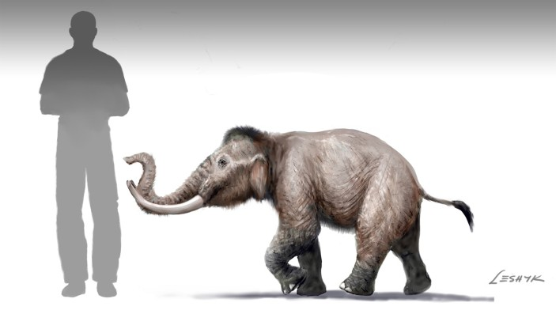
Perkins, Nature (2012)
Notes:
What is the “island rule“?
Example of island dwarfism - „Mini“ mammoth Mammuthus creticus from Crete, other examples are mammoths from Channel islands (US) or Wrangel Island (Russia)

Slide 5
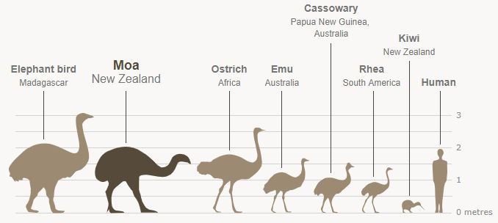
https://jp.pinterest.com/pin/ratite-birds--849421179738330234/
Notes:
Examples of island gigantism – elephants bird and moa are island species

Slide 6
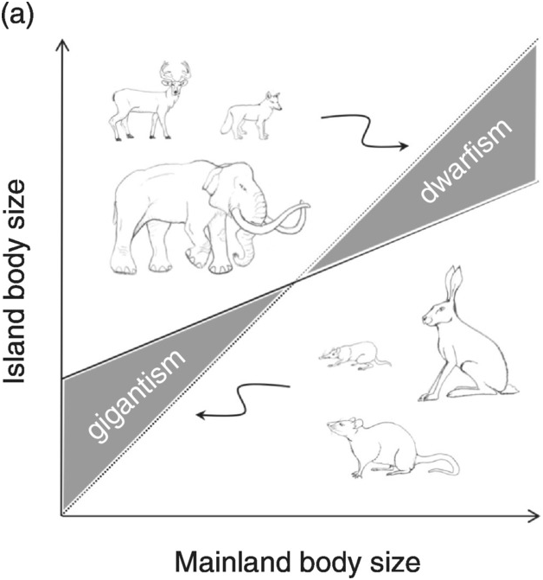
Island rule
Burns, K. C. (2019). Cambridge University Press
Notes:
A biogeographical hypothesis that states that small-bodied animals tend to evolve larger body sizes on islands (gigantism), while large-bodied animals tend to evolve smaller body sizes (dwarfism).
In other words. body size of large animal species tend to decrease on islands (dwarfism), whereas body size of small animal species tend to increase on islands (gigantism)

Slide 7
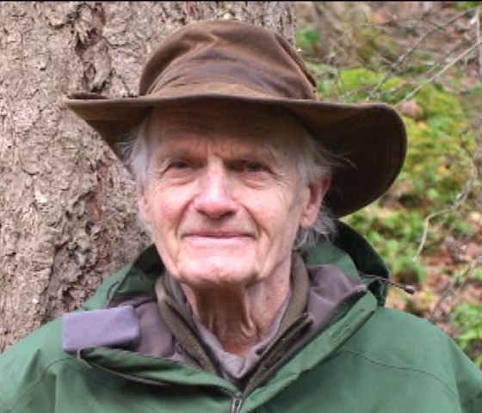
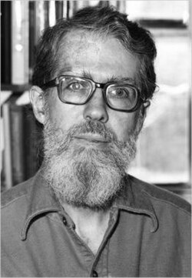
Island (Foster‘s) rule
Bristol Foster
Leigh Van Valen
https://ecoreserves.bc.ca/2012/03/17/a-conversation-with-bristol-foster/
https://wikipedia.org/
Notes:
Formulated by Leigh Van Valen (evolutionary biologist; right down picture) in 1973 based on study of Bristol Foster (mammalogist; upper left picture)

Slide 8
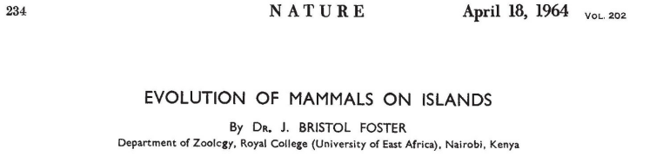
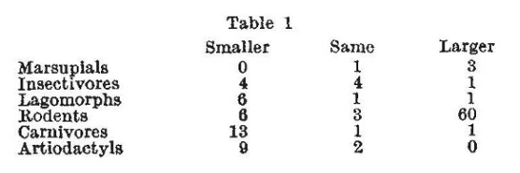
Notes:
Foster
noticed that animals often change their body size compare to their presumed mainland ancestors
compared 116 island mammal species with mainland relatives and found consistent gigantism and dwarfism
„I made a survey of 116 insular races or species of 6 orders mostly living on the islands of Western North America and Europe. The results are shown in the Table, which indicates whether the insular form is smaller, the same size, or larger than the presumed adjacent mainland ancestor“
attributed this to relaxed predation enlarging small species and limited island resources shrinking large ones

Slide 9
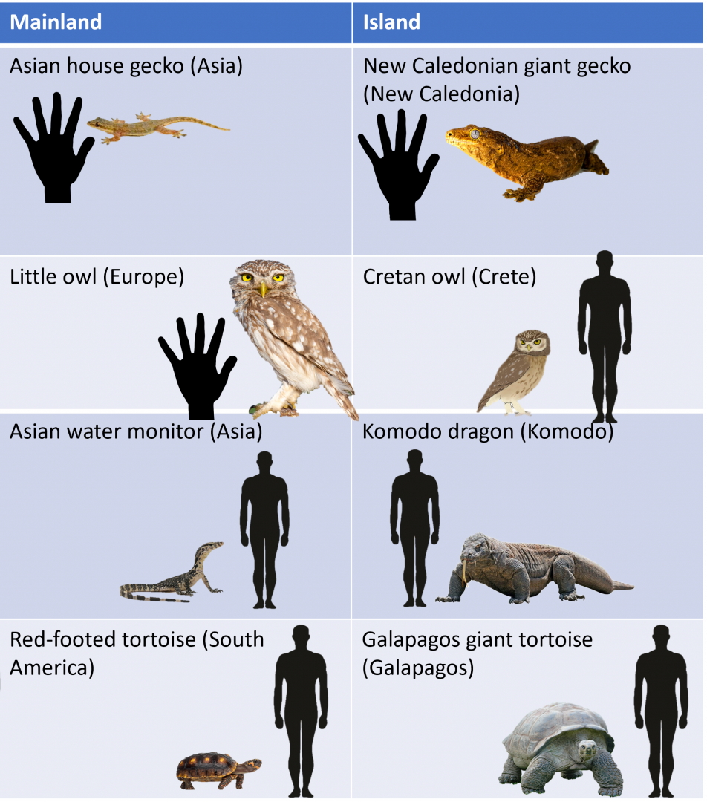
Gigantism
https://www.zoochat.com/community/media/examples-of-island-gigantism.546759/
Notes:
Island faunas are characterized by gigantism in small animals and dwarfism in large animals

Slide 10
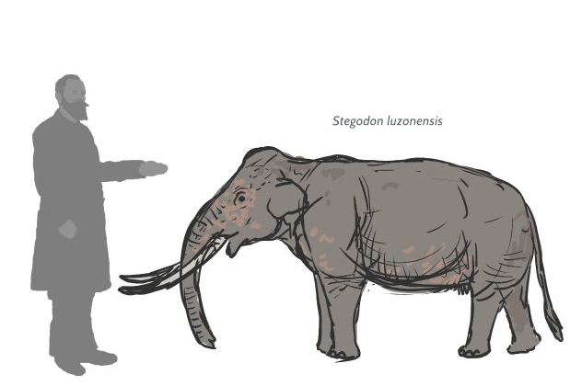
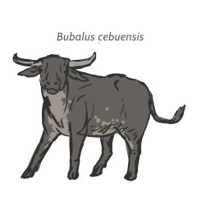
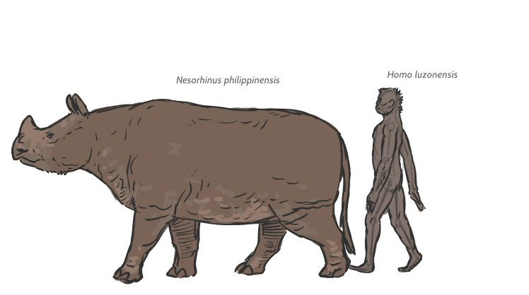
Dwarfism
https://www.reddit.com/r/Dinosaurs/comments/1gtpnz3/should_skull_islands_fauna_be_affected_by_insular/
Notes:
Dwarfism on Phillippines

Slide 11
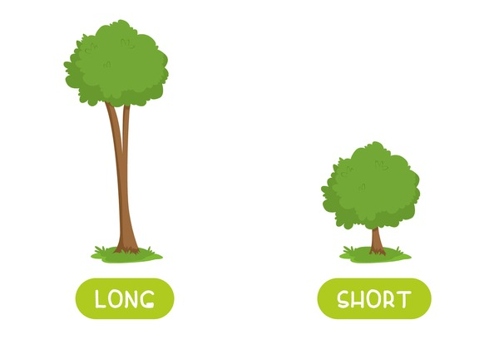
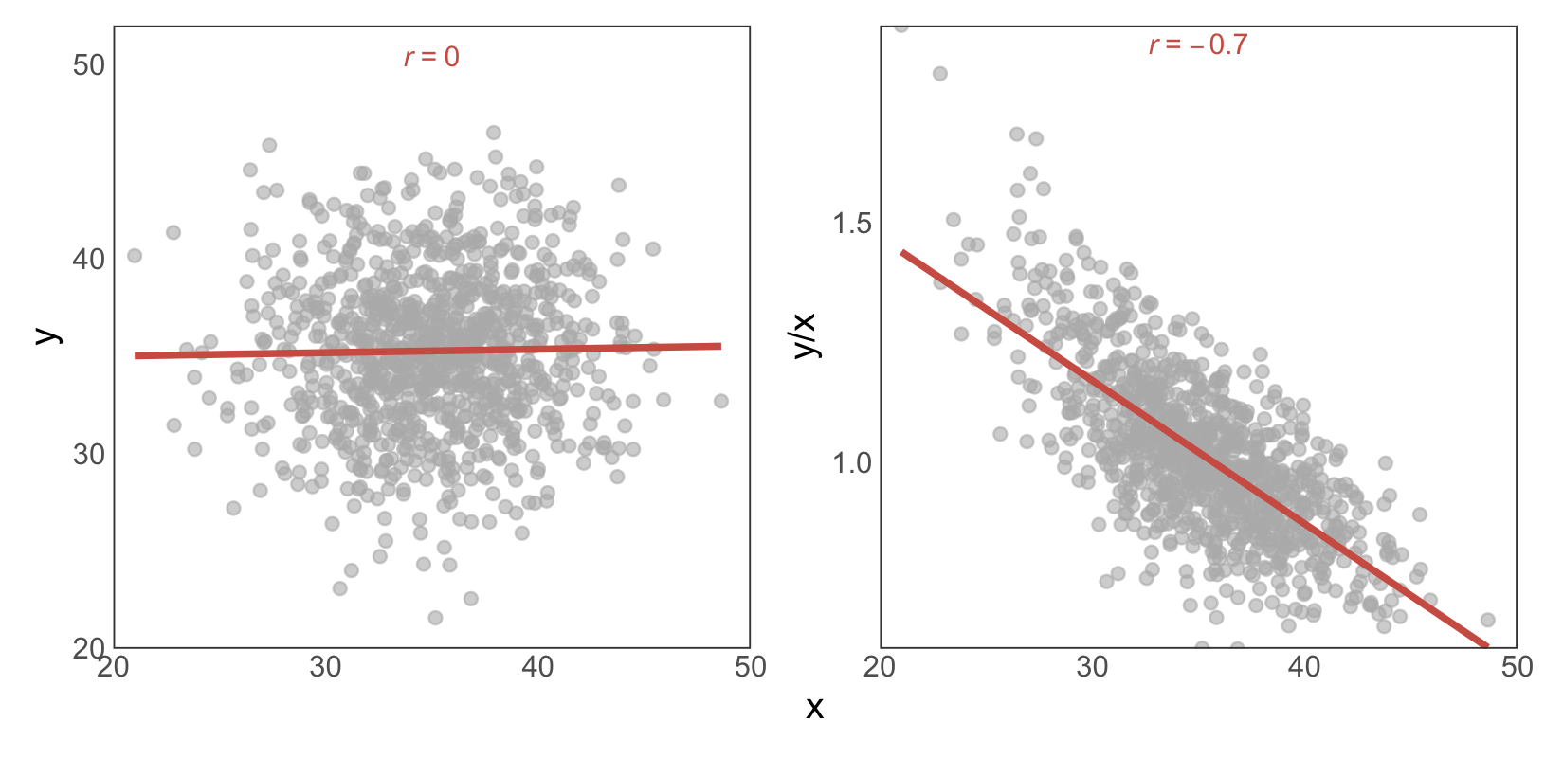
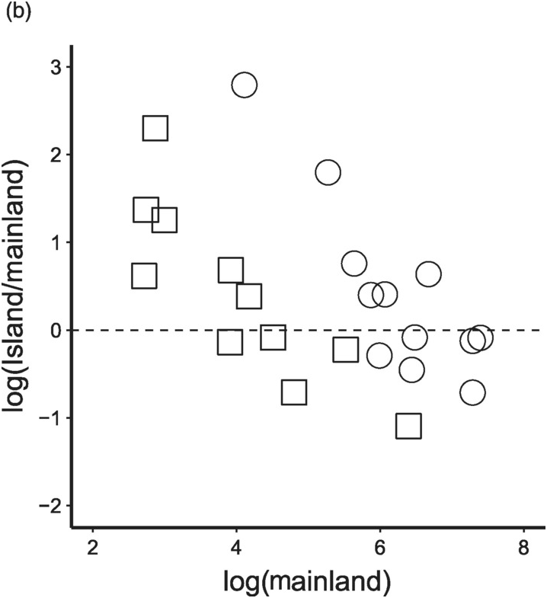
How about plants?
Burns, K. C. (2019). Cambridge University Press
Notes:
Island rule has been claimed (even in a book) to apply also for plants!
Note that the y-axis here shows the ratio of island to mainland plant size, which makes the pattern look reversed compared to the previous slides (where raw island size was on the y-axis, not the ratio). The relationship is essentially the same: a high ratio means plants are larger on islands than on the mainland.
But that is a statistical artifact – see our simulated data.

Slide 12
Why?
Burns, K. C. (2019). Cambridge University Press
Notes:
Explanations:
Reduced predation (predator release): fewer/absent predators relax selection for vigilance, favouring larger size and slower life histories in small taxa.
Relaxed interspecific competition: simplified communities broaden niches; body size shifts to fill missing guilds.
Resource (energy) limitation: chronic, low/stable productivity selects for smaller bodies in large, high-energy taxa (dwarfism) and caps extremes.
Burns, K. C. (2019). Cambridge University Press

Slide 13
IS IT REALLY THAT SIMPLE?
EMPIRICAL EVIDENCE

Slide 14
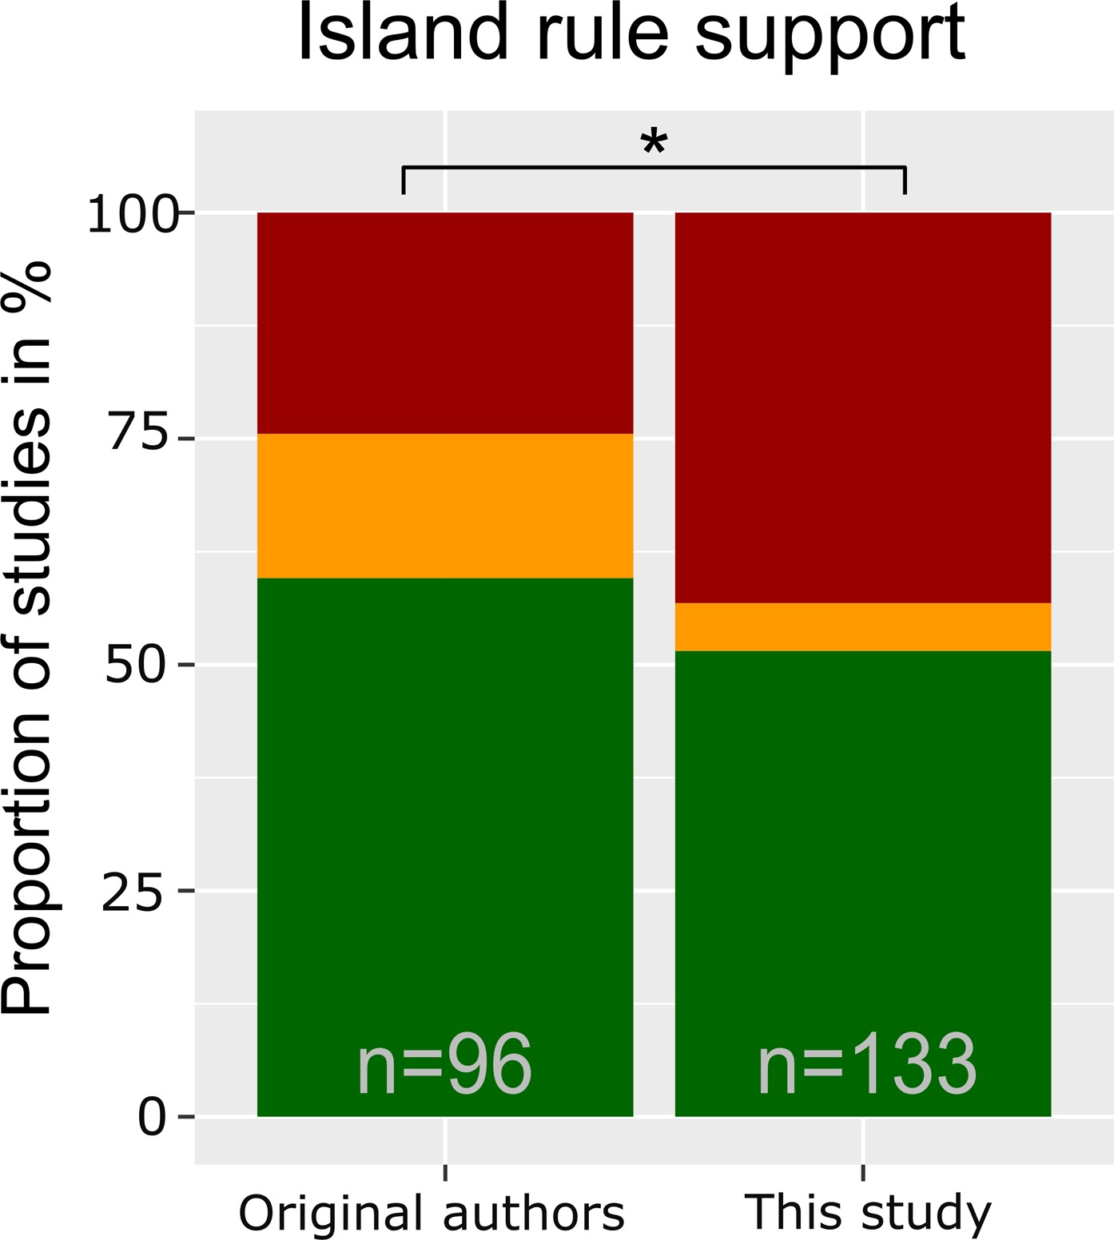
Island rule support
Lokatis & Jeschke 2018, J Biogeogr 45:289–303
Notes:
Proportions of studies supporting (in green), questioning (in red) or being undecided about (in yellow) the island rule.
Original authors: interpretations of the results of their study
Lokatis & Jeschke: re-evaluated results from original authors according to the criteria defined in the main text and additional studies included where authors did not necessarily draw conclusions about the island rule themselves but that reported data to test the island rule; thus, the sample size is larger here.
Note that the re-evaluated evidence is equivocal.

Slide 15
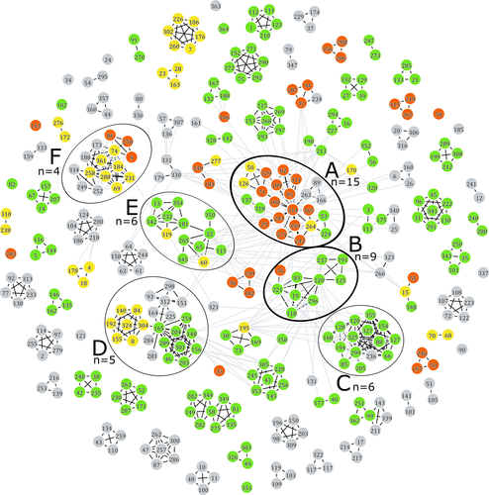
Author groups disagree on island rule support
Lokatis & Jeschke 2018, J Biogeogr 45:289–303
Notes:
Authorship network of researchers that have published articles on the island rule. Colours indicate that an author's studies are, according to the original author interpretation, largely supporting (in green), questioning (in red), or undecided (in yellow) about the island rule, taking the median across studies; grey (not assignable) was mainly due to authors not interpreting their results in light of the island rule. Each author was assigned to an anonymous ID number shown in the figure. Black lines connect authors that have co-authored a scientific publication. Grey lines indicate that one or both connected researchers have mentioned the other in the acknowledgement section of one of their articles. Black circles indicate the author groups that encompass at least four articles; n is the exact number of publications by each author group. Group A and B were selected for in-depth analysis (group A: 24 authors, 15 articles; group B: 10 authors, 9 articles)

Slide 16
WHO READ THE PAPERS?

Slide 17
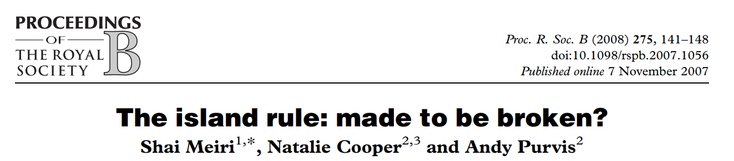
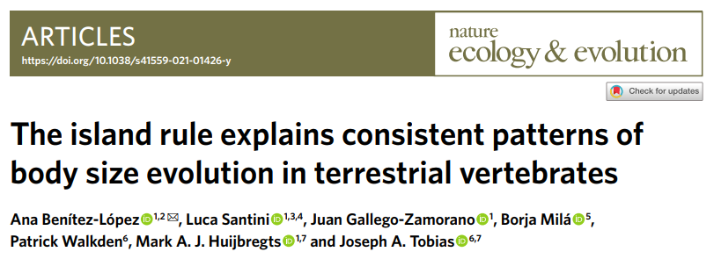
The island rule: example of two perspectives
vs

Slide 18

Differences
methods
Mammals only
1184 island–mainland comparisons
Species‑level median size ratios (unlogged)
Explicit phylogenetic tests (independent contrasts on mammal supertree)
Moderators: mainland body mass, island area & isolation, trophic level, carnivore richness
Repeated analyses with ‘well‑sampled’ species (≥6 individuals per island and mainland)
Mammals, birds, reptiles, amphbians
2,479 island–mainland comparisons
Within and cross-species population mean size ratio (logged)
Multi‑level meta‑regression with random effects: species, source, observation, phylogeny
Moderators: mainland body mass, island area & isolation, trophic level, productivity, temperature & seasonality
Bias checks: ratio regressions, small‑sample correction, imputation, publication bias

Slide 19
Differences
limitations
Mammals only
Do not control for unequal sampling error/precision across species
High residual heterogeneity → unmeasured factors likely
Calculating ratios for diverse size indices
Global, cross-taxa
Bias checks: ratio regressions, small‑sample correction, imputation, publication bias
Solid proportion of variance explained
Converting diverse size indices to mass via allometry
None use raw data
Extinct fauna excluded → historical signals may be masked
Notes:
Converting diverse size indices to mass via allometry → error propagation possible
Meiri – preferred indexes for body mass, but calculated ratios also for other size indices – this may introduce serious error if island rule creates different allometry for different size metrics

Slide 20
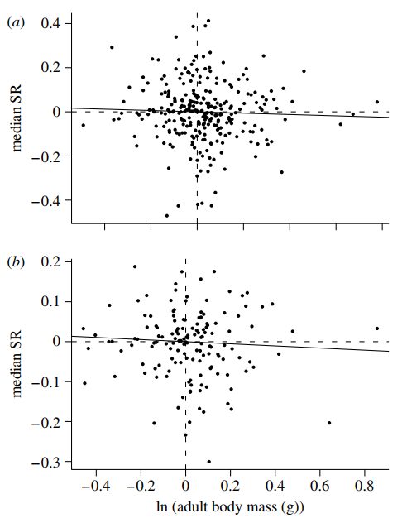
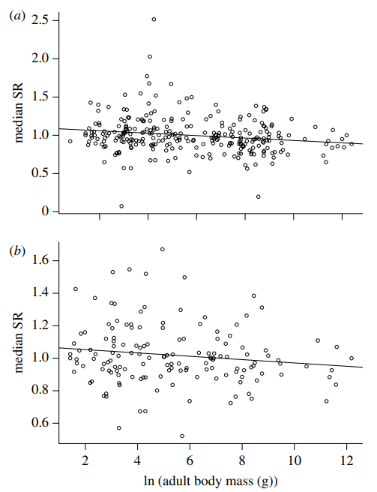
R e s u l t s
Phylogenetic model Non-phylogenetic model
All species
Well sampled species
Notes:
No general island‑rule signal once phylogeny is controlled (slopes ≈ 0)
Non‑phylogenetic slopes weakly negative but tiny (R² ≈ 0.02–0.05)
Clade‑specific patterns: murids → gigantism; artiodactyls & some carnivores/heteromyids → dwarfism
Island area, isolation, trophic level, carnivore richness: generally non‑significant

Slide 21
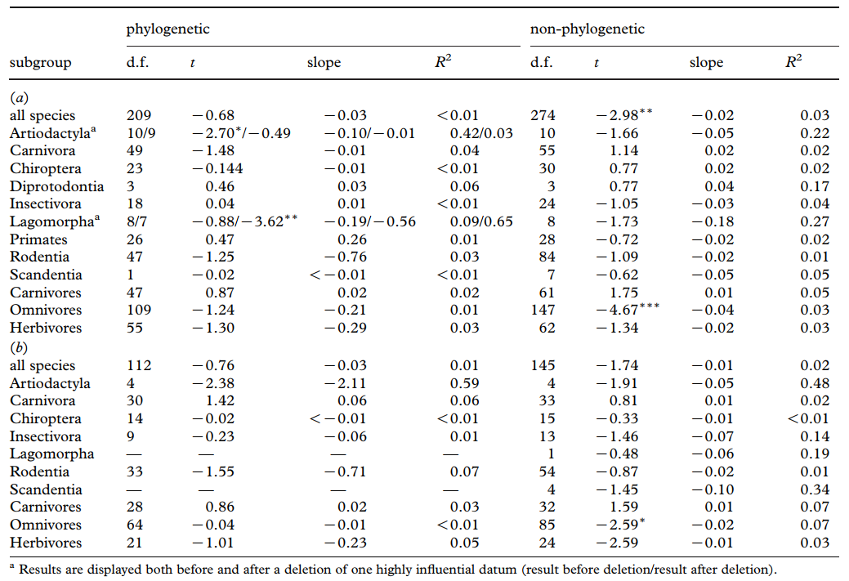
Notes:
No general island‑rule signal once phylogeny is controlled (slopes ≈ 0)
Non‑phylogenetic slopes weakly negative but tiny (R² ≈ 0.02–0.05)
Clade‑specific patterns: murids → gigantism; artiodactyls & some carnivores/heteromyids → dwarfism
Island area, isolation, trophic level, carnivore richness: generally non‑significant

Slide 22
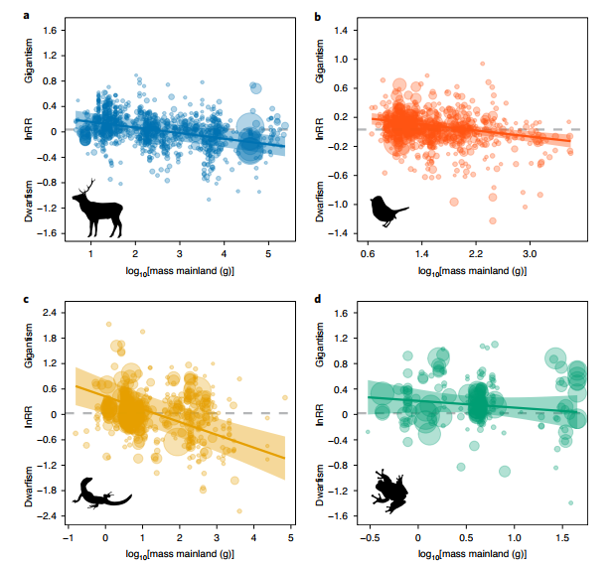
Notes:
Island rule supported for mammals, birds and reptiles
Amphibians: weak/non‑significant slope; general tendency to gigantism

Slide 23
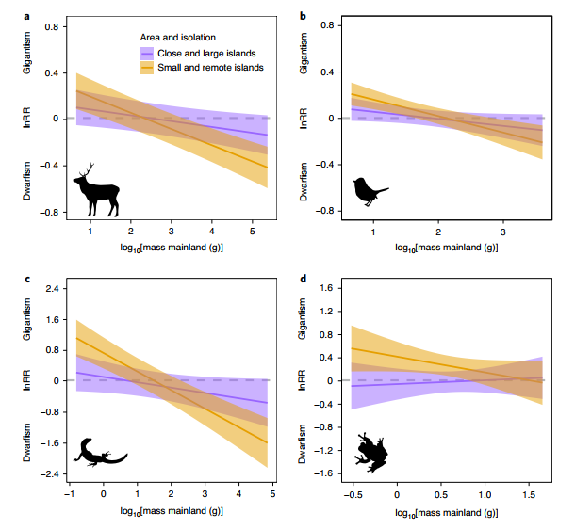
Notes:
Effects stronger on small and remote islands (especially mammals, reptiles)
Climate matters: larger bodies on cooler islands (endotherms); seasonality & productivity shape ectotherms

Slide 24
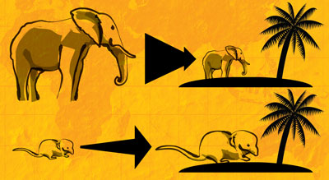
SYNTHESIS
Island rule generally holds Context-dependant
Lineage-dependant signal Methods matter
Notes:
The ‘island rule’ broadly holds across vertebrates when data are pooled and modelled hierarchically
Strength and direction are context‑dependent (island size/isolation, climate, productivity) and taxon‑dependent
Within mammals alone and under stricter pairing/phylogenetic control, signals may weaken to clade‑specific patterns
Methodology critically shapes conclusions

Slide 25
QUESTIONS?

Slide 26
TOPIC 11: Macroecology & biogeography 3
Guiding question: Island biodiversity (and its dimensions) - how and why?
Key concepts: Island rule, dwarfism, gigantism, meta-analyses.
Classic:. Meiri, S., Cooper, N., & Purvis, A. (2008). The island rule: made to be broken?. Proceedings of the Royal Society B: Biological Sciences, 275(1631), 141-148.
Recent: Benítez-López, A., Santini, L., Gallego-Zamorano, J., Milá, B., Walkden, P., Huijbregts, M. A., & Tobias, J. A. (2021). The island rule explains consistent patterns of body size evolution in terrestrial vertebrates. Nature Ecology & Evolution, 5(6), 768-786.

Slide 27
Topics & Readings
Eco-evolutionary dynamics & life histories
Population ecology essentials
Species interactions & coexistence
Food webs & network ecology
Macroecology & biogeography 1
Macroecology & biogeography 2
Global change ecology
Drivers of biodiversity crisis
Biodiversity (ecosystem functioning/services)
Applied ecology: New tools & data streams
Macroecology & biogeography 3
Classic vs. modern papers

Slide 28
OUTLINE
SAMPLE PRESENTATION
HANDS ON
INFO ABOUT EXCURSION/HOMEWORK

Slide 29
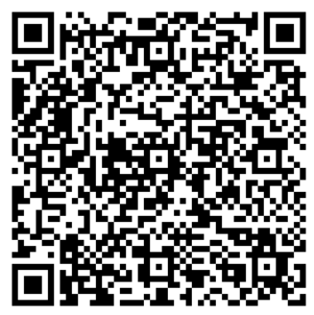
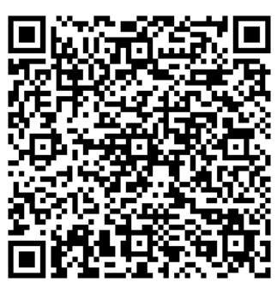
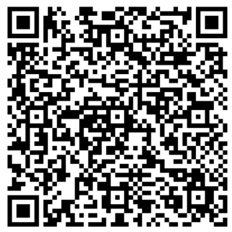
Attendance
Fundamentals of Ecology
(ZEX101E)
Fundamentals of Ecology
(ZEX111E)
General Ecology
(ZEX12E)

Slide 30
HOW TO FIND RELEVANT OVERVIEW AND SOURCES ON A TOPIC
THE PROCESS

Slide 31

it!
Notes:
Google it first

Slide 32
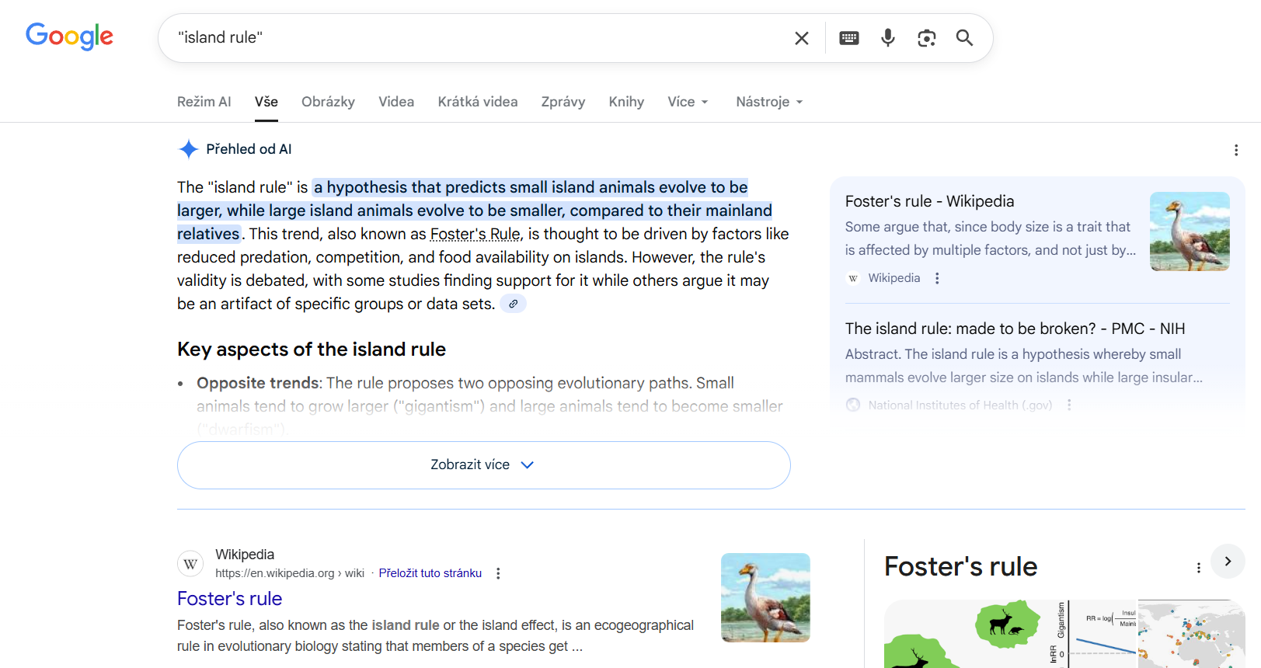
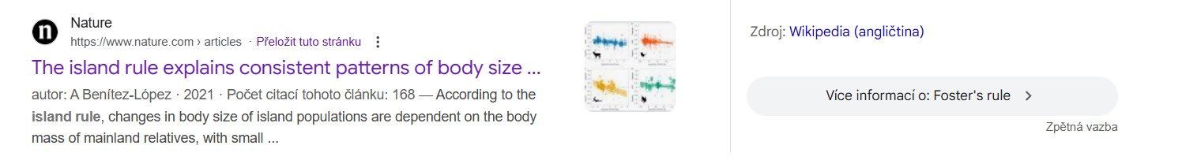
Notes:
Notice that Google now shows AI first, it was Wikipedia until recently; start with Wiki
Put your searching term in ““ if you wanna find exact match and word combination
Try to google different terms
You may search for online university courses (e.g. https://evolution.berkeley.edu/search/?q=%22island+rule%22),

Slide 33
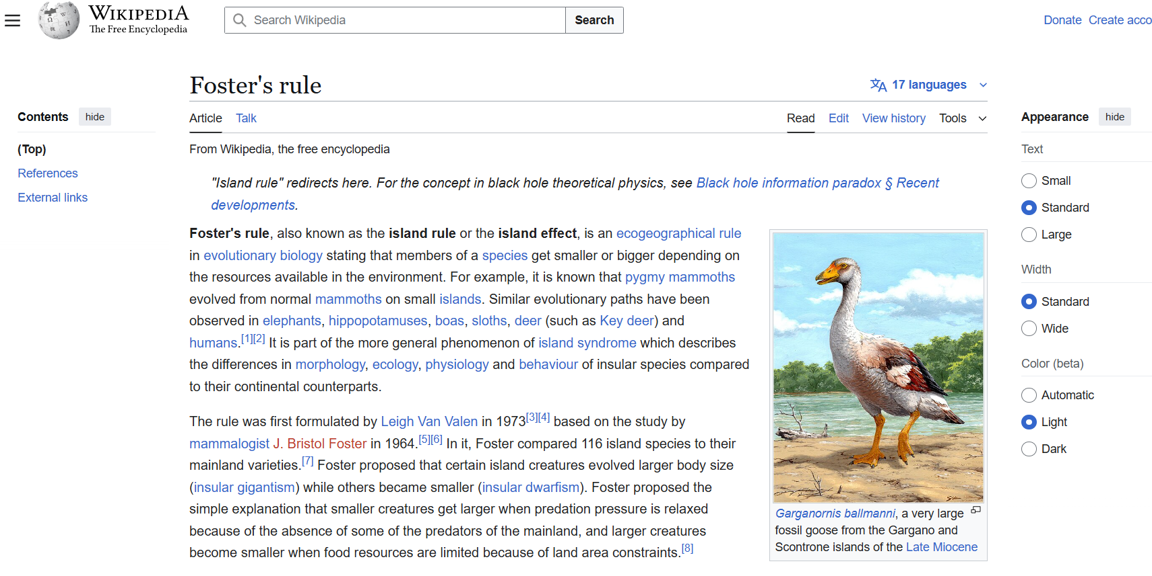
Notes:
Be aware of different topic coverage among languages

Slide 34
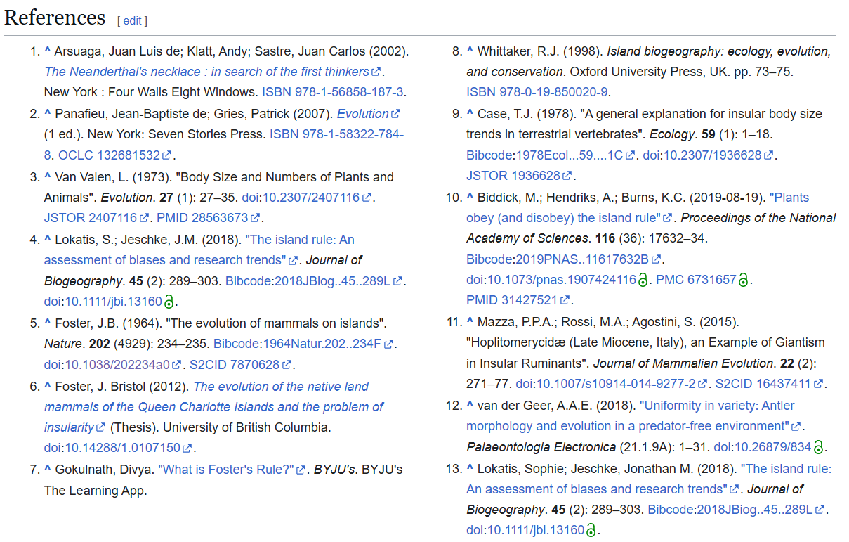
Notes:
Wiki offers references, thats great, you may directly click on them

Slide 35
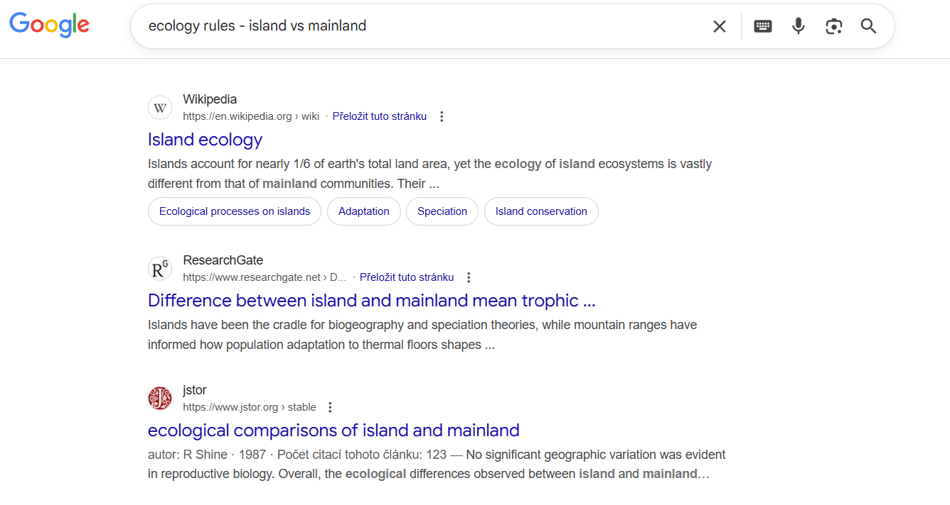
Notes:
We may ask also differently, e.g. more generally – lets try ecology rules - island vs mainland
It sets up your target topic to the wider conceptual frame

Slide 36
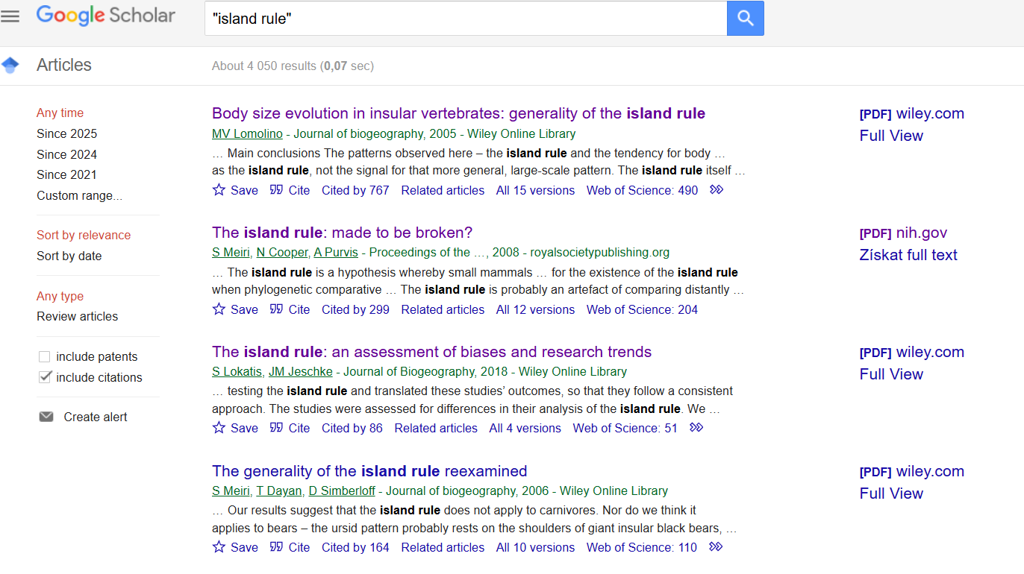
Notes:
Google Scholar

Slide 37

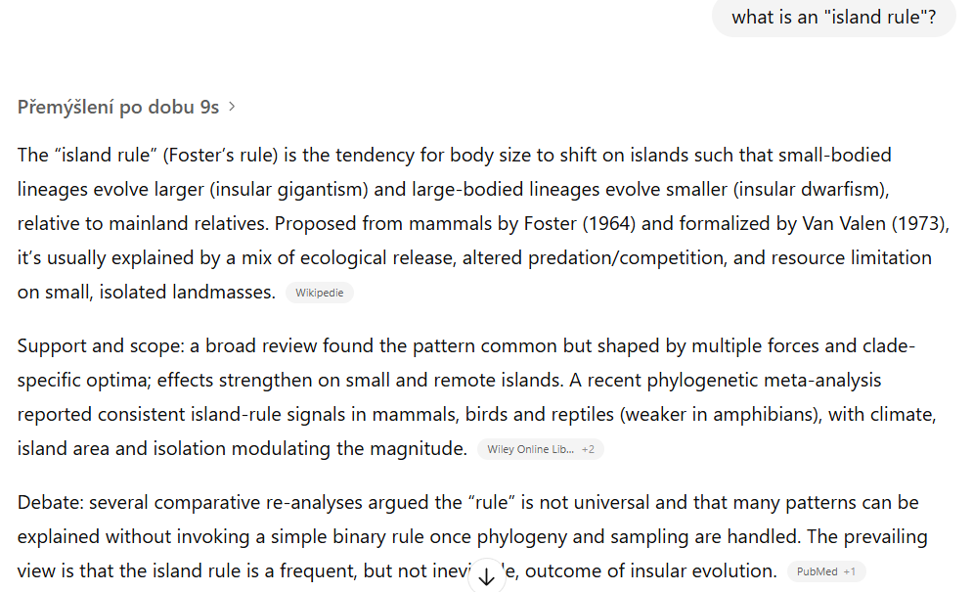
Notes:
First try to google it and gather information on your own
Only then chatgpt is decreasing your ability to critically review information and hampering your learning process

Slide 38
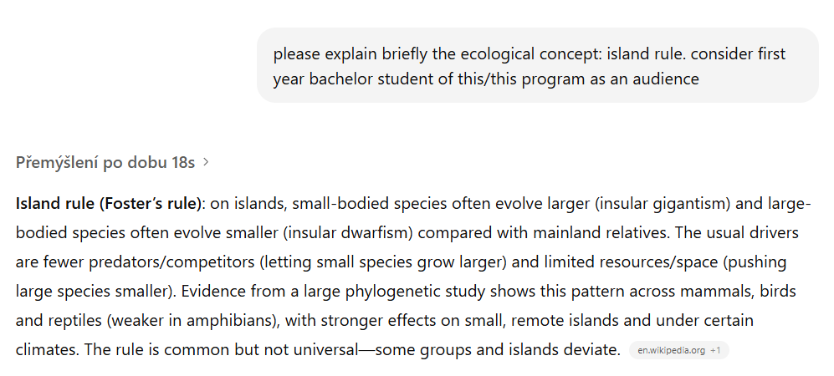
Notes:
You may play a bit with searching query, or develop predefined assistent specififally for this purpose.
Read and pondered upon the two example papers for your topic without AI first.

Slide 39
Lets check one example paper

Slide 40
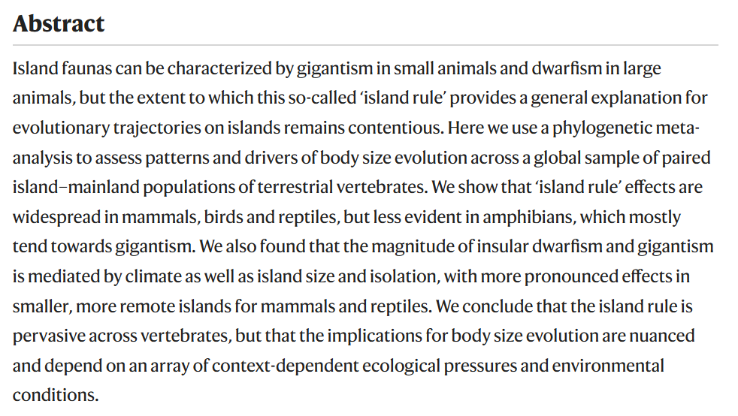
What is an important info in the Abstract?

Slide 41
What is known
Data & Statistics
Main results
Interpretations
Notes:
For the analysis of the main text, see pdf on github where the sections discussing the similar parts as in the Abstract are highlighted. Can you see how we used the paper information to generate our lecture?

Slide 42
OUTLINE
SAMPLE PRESENTATION
HANDS ON
INFO ABOUT EXCURSION 2025-11-21
HOMEWORK 2025-11-28

Slide 43





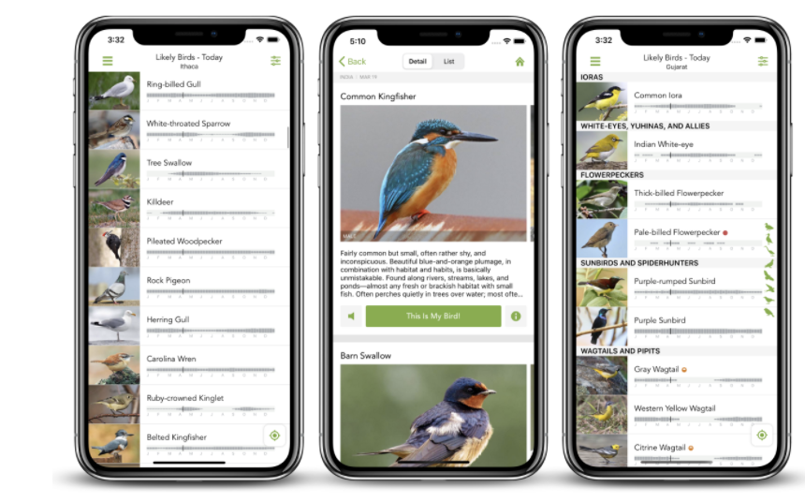
BEFORE EXCURSION
MERLIN
Download app to your phone
Notes:
Bird identifications from sounds and photos

Slide 44




BEFORE EXCURSION
EPICOLLECT
Download app to your phone
Locate project:
https://five.epicollect.net/project/escapecollector-teaching
Notes:
App for escape distance data collection
Project escapecollector-teaching

Slide 45
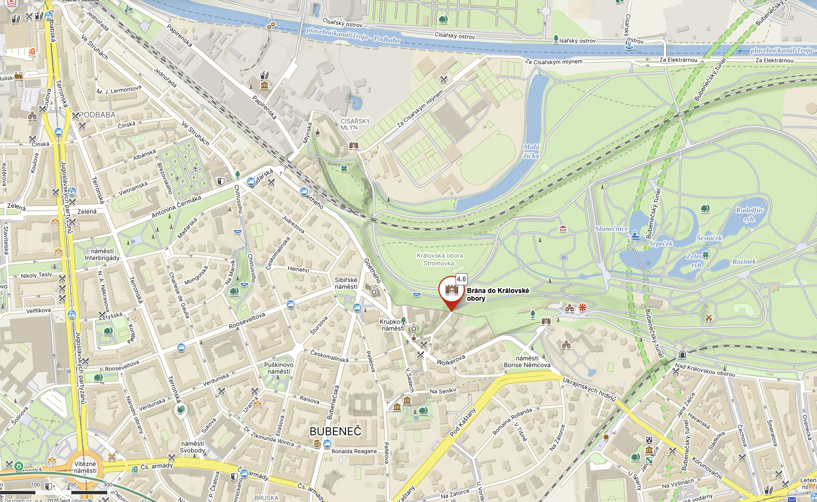
EXCURSION
Starting point: Stromovka
Meeting point: https://mapy.com/s/kalokepuma
Time: 08:00 Date: 2025-11-21

Slide 46
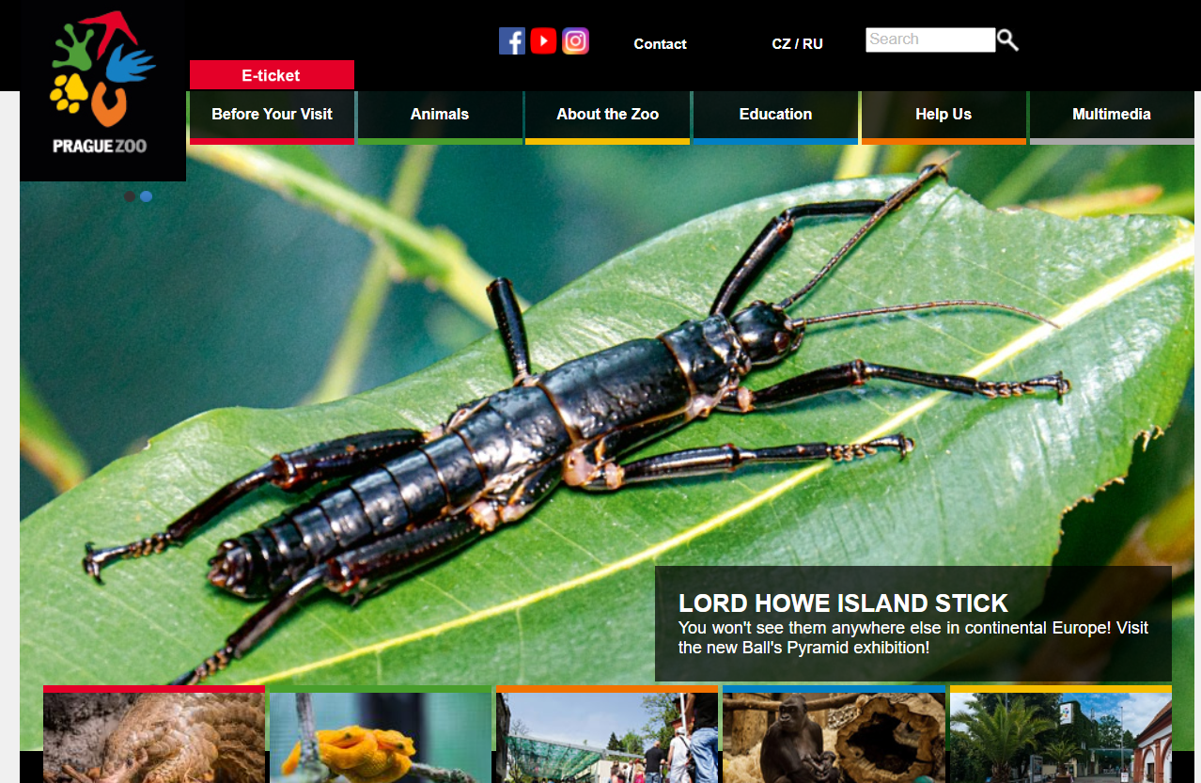
ZOO
Buy online tickets in advance
Click on https://www.zoopraha.cz/en

Slide 47
2. Click on E-ticket

Slide 48
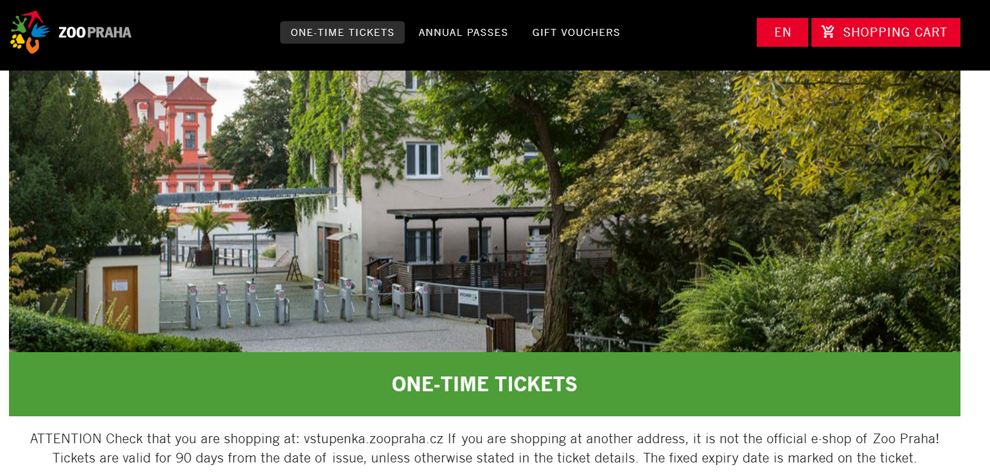
3. Select „ONE-TIME TICKETS“

Slide 49
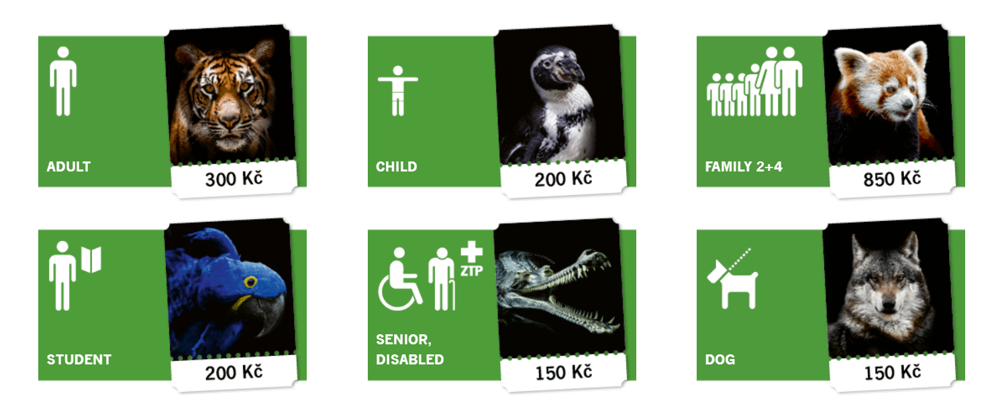
4. Scroll down and select “STUDENT“
If you have a valid student card and can take it with you!
Select „ADULT“ otherwise.

Slide 50
LAST NOTES
Warm clothing, it will be cold
Bring some food and water
Eventually, you may buy something in ZOO

Slide 51
Course format
21.10. 10:30 - 12:00 (Z118) Course intro
04.11. 10:30 - 12:00 (Z118) Intro to ecology
18.11. 10:30 - 12:00 (Z118) Intro to hands on
21.11. 8:00 - 17:00 Excursion
28.11. 8:30 - 17:00 (VN306) Home-work on the topics
05.12. 8:30 - 17:00 (VN306) Symposium (presentations)
Course material
https://github.com/MartinBulla/Ecology_Fund_Gen

Slide 52
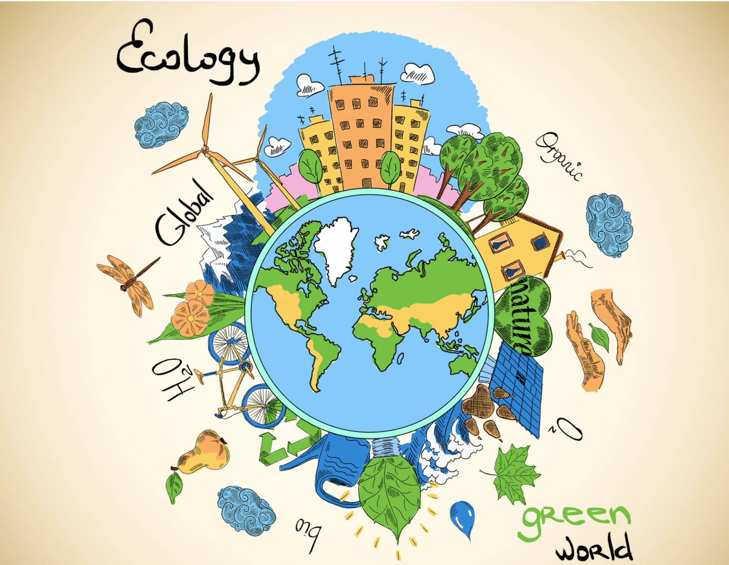
Thank you for your attention
© Shelby Wells
Happy
to take questions

