Slide 1
How did you find the symposium experience?
What have you taken from the presenting exercise?
Whose presenting is stuck in your mind?
Tips and tricks for engaging presentation
        hook
        digest the info into essentials
        use slides to guid you through what you want to say
        show what you know
        switch often among members
        innovative approaches
        looking into the audience
        help each other
        tuned/practiced (non-reliance on notes/tech, etc.)
        coherent slide design (helpful if a single person overseas the process)
        Try that all works in advance

Slide 2
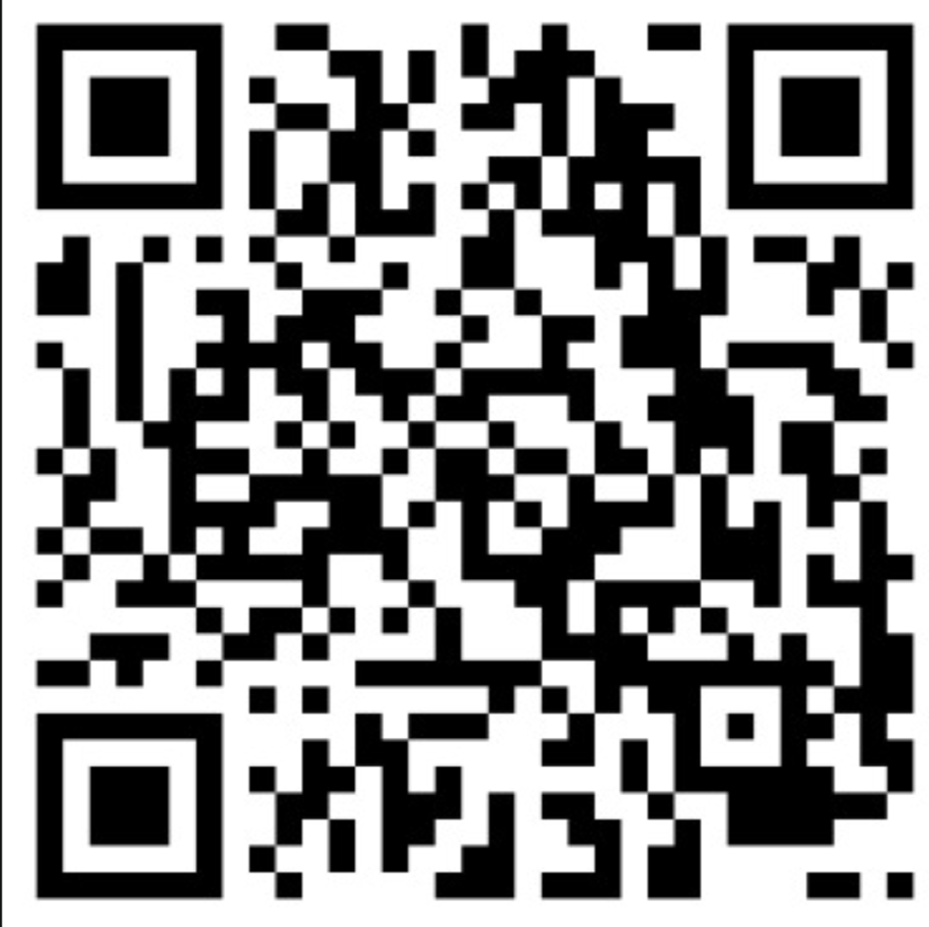
YOUR FEEDBACK ON THE COURSE

Slide 3
Exam
Format
~20 multiple-choice questions (one or more correct answers)
10min
Study material
Lectures
Glossary (will be shared tomorrow)
Symposium materials
Notes:
Presentation – a back bone of the course
Read and synthesize primary literature
Learn about basic ecological concepts
Practice scientific thinking and clear communication
Connect classic ideas with modern developments
Create re-usable study material for peers

Slide 4
Picture time

