Slide 1
FUNDAMENTALS OF ECOLOGY
GENERAL ECOLOGY
EXCURSION
Peter Mikula
Martin Bulla
Czech University of Life Sciences Prague

Slide 2
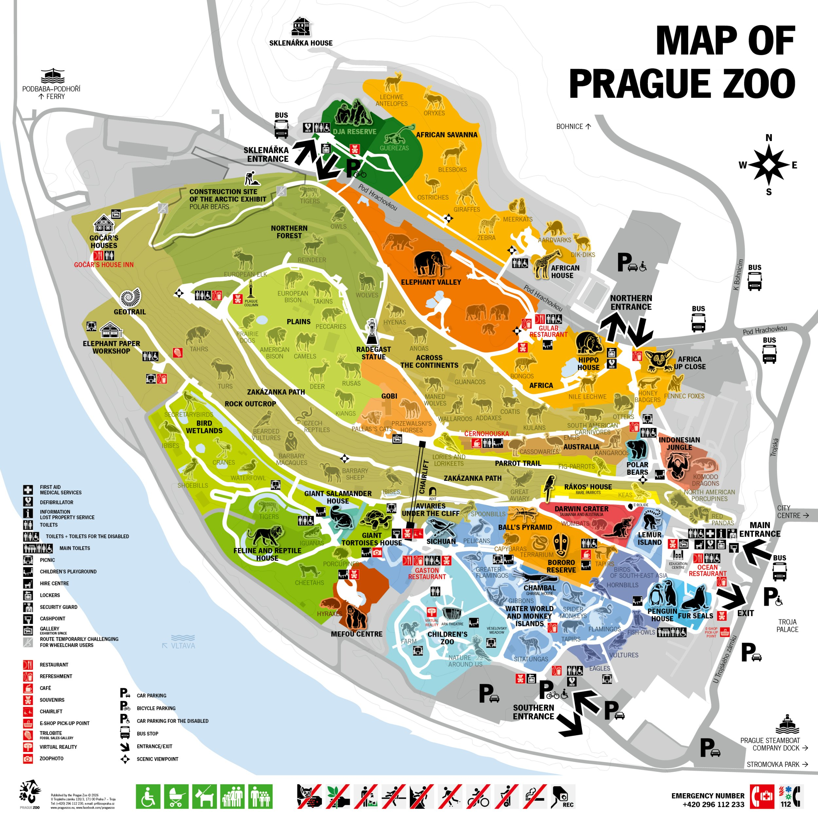

Slide 3
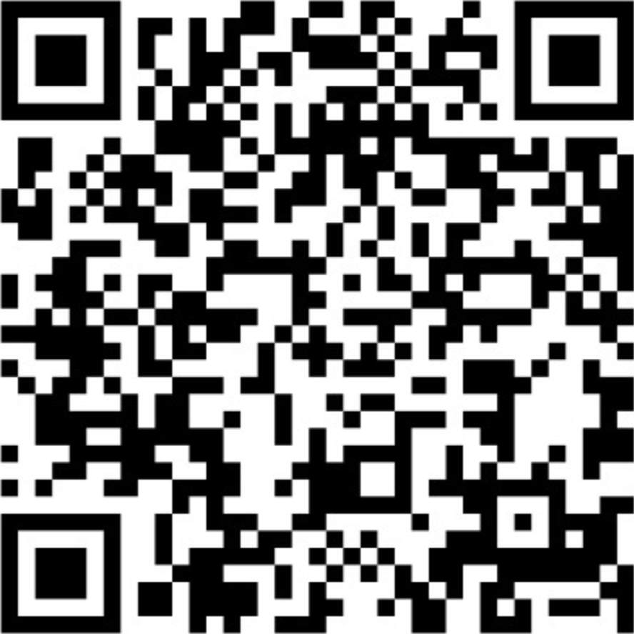
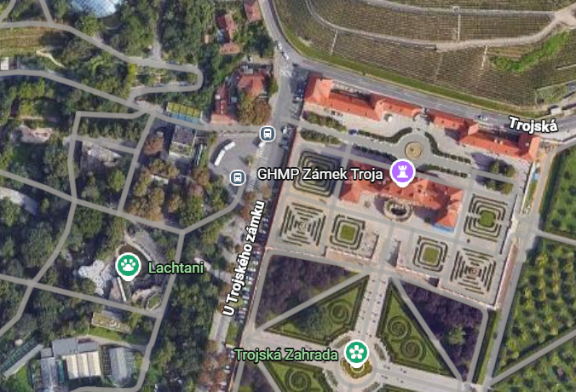
EXCURSION
Starting point: Zoo Praha – Troja (bus stop)
Meeting point: https://maps.app.goo.gl/N8GuNJP2XwiFAQAh8
Time: 09:00 Date: 2 October 2026

Slide 4
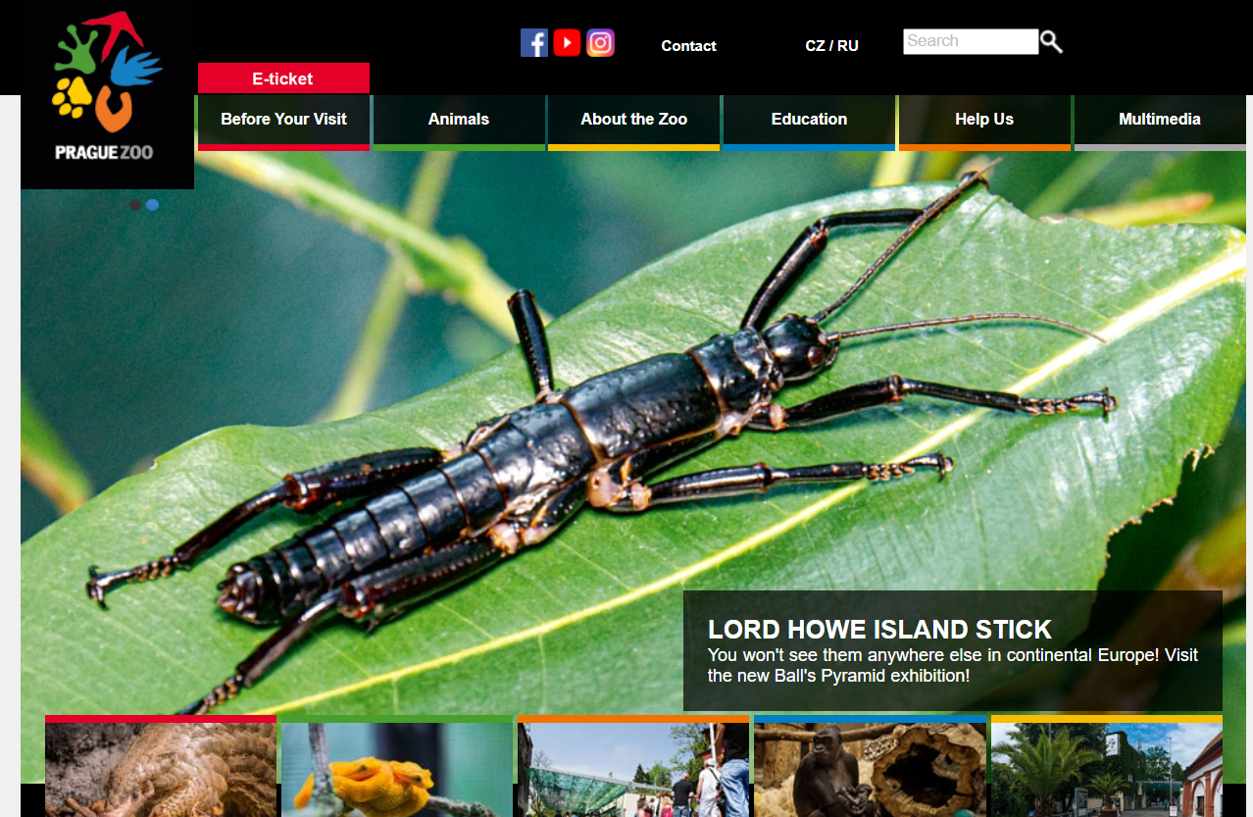
ZOO
Buy online tickets in advance
Click on https://www.zoopraha.cz/en

Slide 5
2. Click on E-ticket

Slide 6
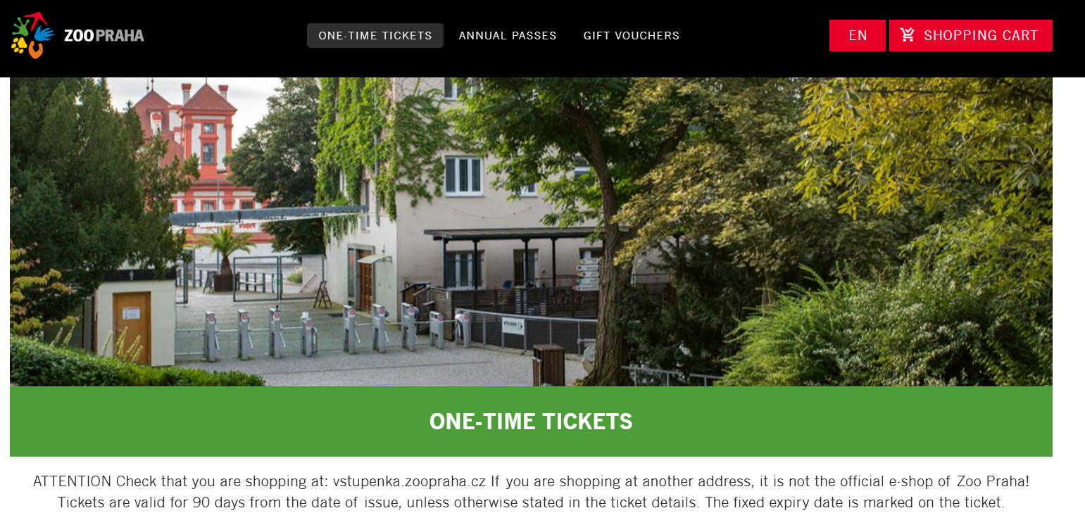
3. Select „ONE-TIME TICKETS“

Slide 7
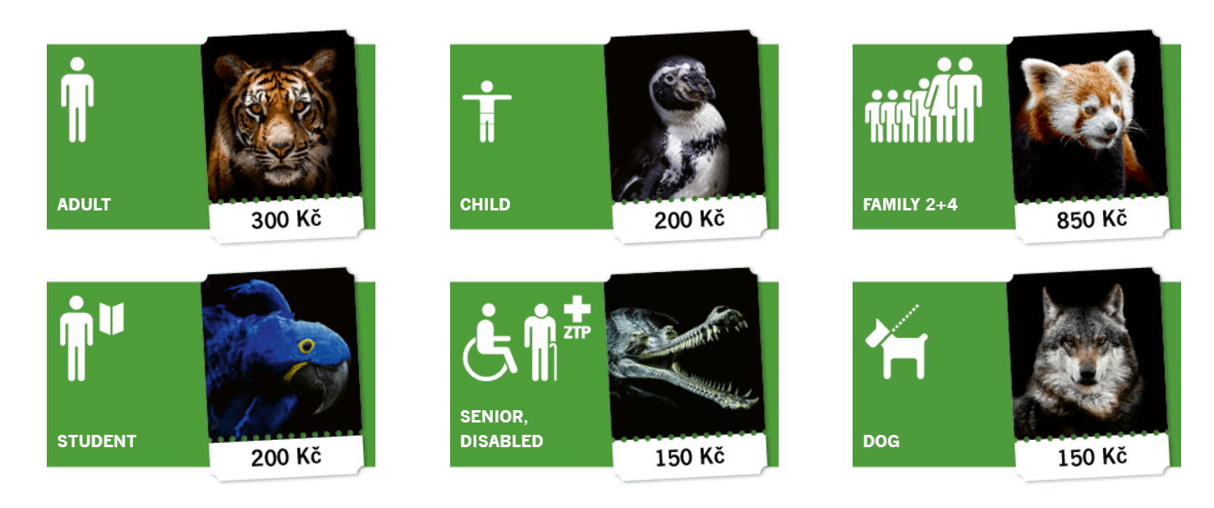
4. Scroll down and select “STUDENT“
Only if you have a valid student card (should také it with you)!
Select „ADULT“ otherwise.

Slide 8
LAST NOTES
Take warm cloth; it might be cold in the afternoon
Bring some food and water
Eventually, you may buy something in ZOO

Slide 9

Thank you for your attention
© Shelby Wells
Happy
to take questions

