Slide 1
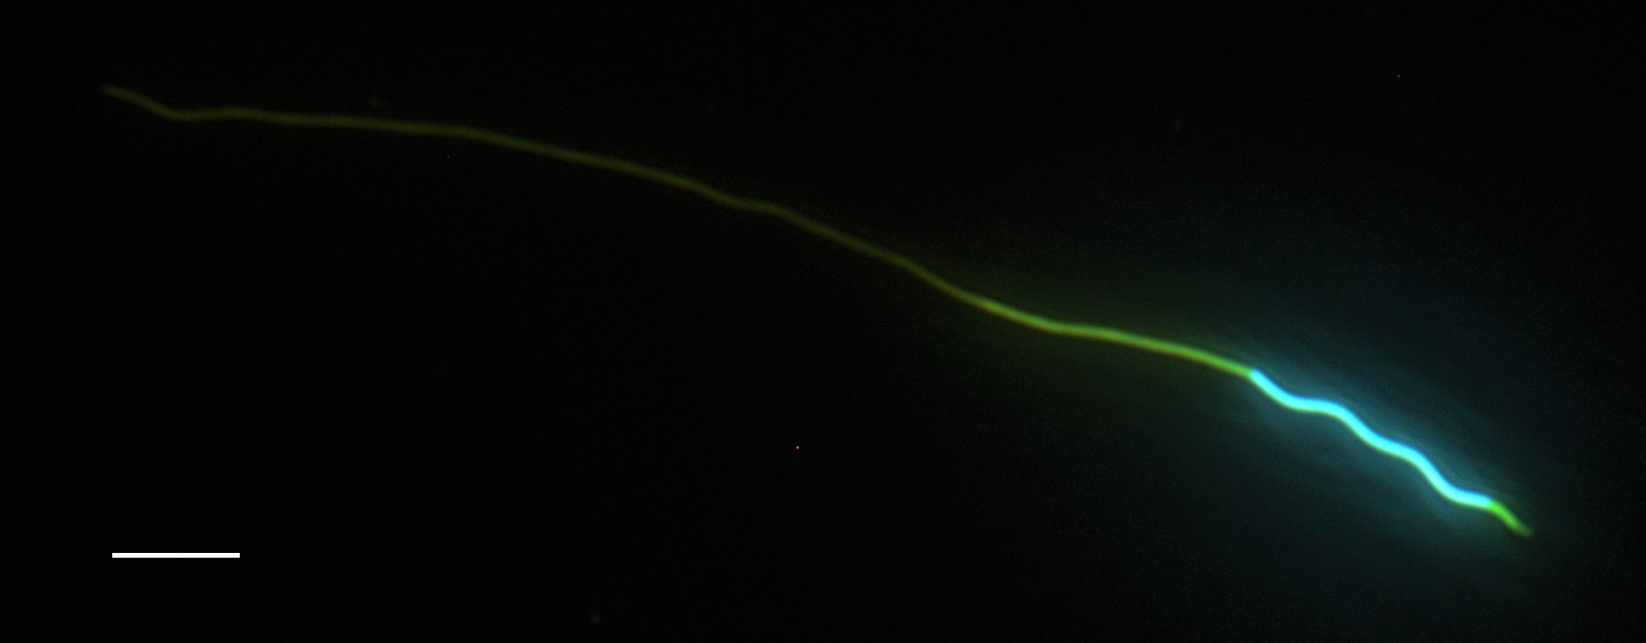
Tail
Nucleus
Midpiece
Acrosome
10 µm

