Slide 1
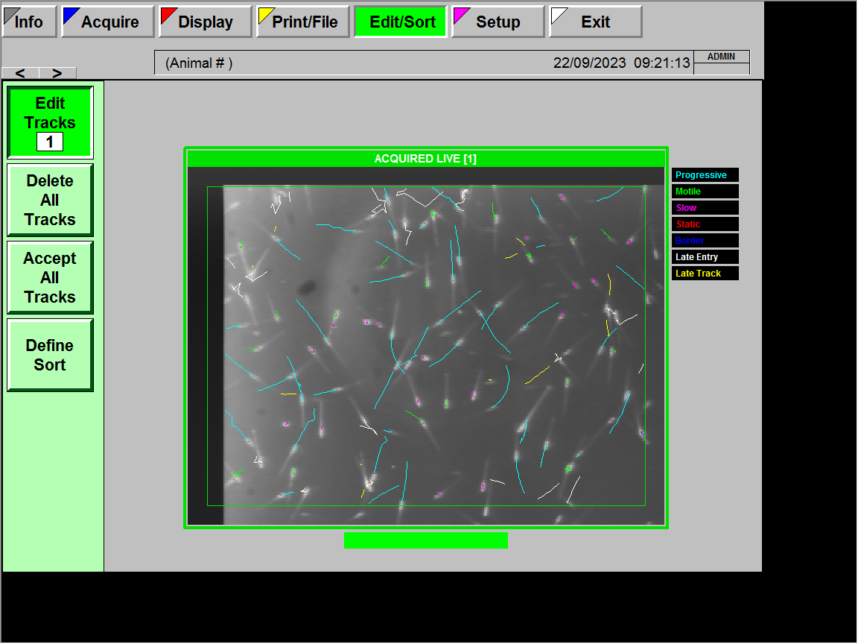
Zebra finch K_19180

Slide 2
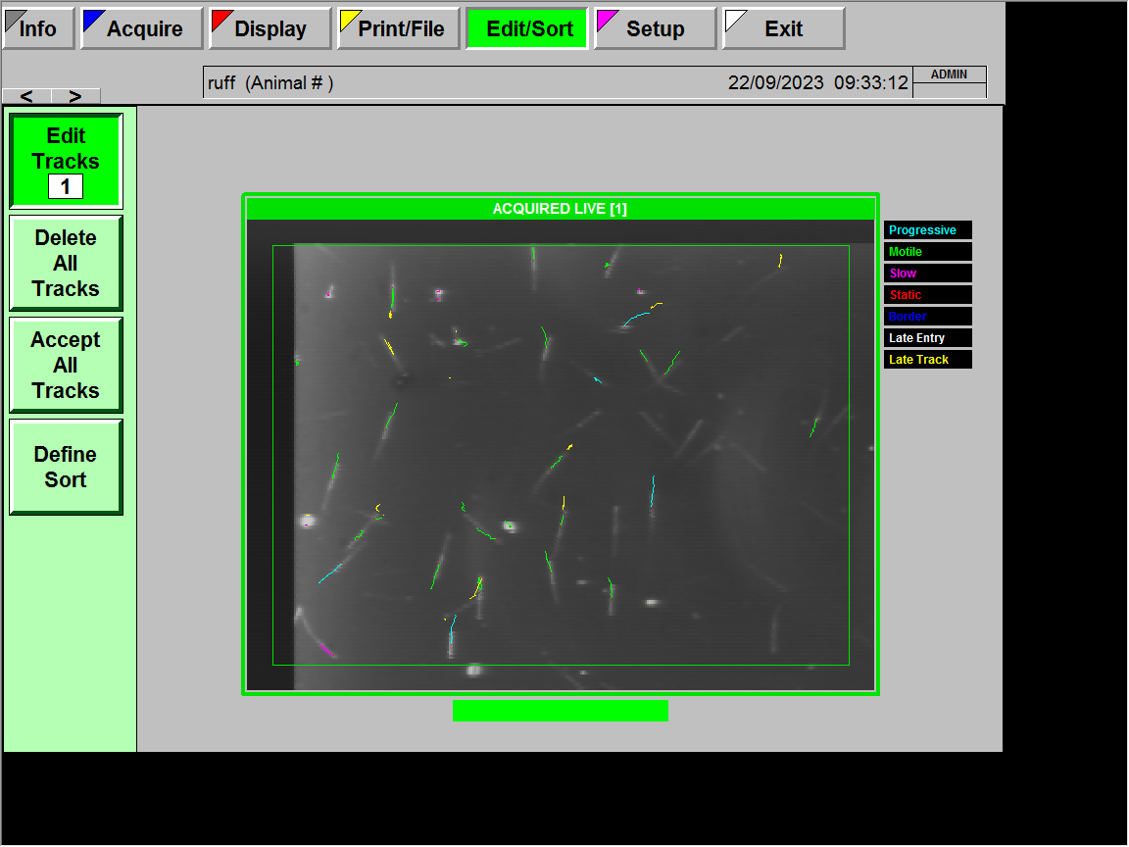
Ruff_May_1368

