Slide 1
EMBODIED INTERACTION AND REMOTE INTIMACY
Holding Together
An embracing interface
with room for human connection
Research and design proposal for an HCI application portfolio
Martin Cao / 3 November 2026
01
Notes:
This project investigates controllable comfort and partner-mediated intimacy. The work completed is research synthesis, concept design and an offline interaction demonstrator. User research, hardware testing and real calling remain future work.

Slide 2
PERSONAL MOTIVATION
Why I began
Since January, I have moved from one
demanding period into the next.
Even with friends, I sometimes felt lonely.
What I wanted was the quiet feeling of being held.
My experience starts the inquiry. Participant research will test whether it is shared.
02
Notes:
First-person account based only on the designer’s stated experience. This is motivation, not a participant result or diagnosis.

Slide 3
RESEARCH QUESTION
What should an embrace offer?
Physical comfort
A particular person
Permission to need
Pressure, softness and a place to pause may matter in different ways.
A partner’s voice can give a remote gesture context and meaning.
Ask how self-reliance norms affect requesting support, without assuming all men agree.
Loneliness, exhaustion and expectations of masculinity remain distinct questions.
03
Notes:
The project distinguishes perceived relationship insufficiency from occupational exhaustion and from conformity to particular masculine norms. The literature does not establish a universal male emotional need.
Hawkley, L. C., & Cacioppo, J. T. (2010). Loneliness matters: A theoretical and empirical review of consequences and mechanisms. Annals of Behavioral Medicine, 40(2), 218–227. https://doi.org/10.1007/s12160-010-9210-8
Access: PubMed record and accessible review excerpts
Maslach, C., & Leiter, M. P. (2016). Understanding the burnout experience: Recent research and its implications for psychiatry. World Psychiatry, 15(2), 103–111. https://doi.org/10.1002/wps.20311
Access: Abstract, publisher excerpts and bibliographic record
Wong, Y. J., Ho, M.-H. R., Wang, S.-Y., & Miller, I. S. K. (2017). Meta-analyses of the relationship between conformity to masculine norms and mental health-related outcomes. Journal of Counseling Psychology, 64(1), 80–93. https://doi.org/10.1037/cou0000176
Access: Abstract, APA manuscript excerpts and bibliographic record

Slide 4
PUBLISHED RESEARCH
Touch evidence sets a limit on the claim
95% confidence intervals
Objects or robots
0.34 [0.19, 0.49]
Human touch
0.58 [0.43, 0.73]
Packheiser et al., 2024. Subgroup estimates across studies, not a direct comparison of this product.
04
Notes:
Values from the published abstract and synthesis. Bars show pooled means; intervals are printed alongside rather than drawn as unsupported error-bar geometry. Small-study bias, limited blinding and near-intervention outcomes constrain transfer. No product efficacy estimate is implied.
Packheiser, J., Hartmann, H., Fredriksen, K., Gazzola, V., Keysers, C., & Michon, F. (2024). A systematic review and multivariate meta-analysis of the physical and mental health benefits of touch interventions. Nature Human Behaviour, 8(6), 1088–1107. https://doi.org/10.1038/s41562-024-01841-8
Access: Full-text methods, limitations and results excerpts; quantitative subgroup values checked in PubMed abstract

Slide 5
AI COMPANIONSHIP EVIDENCE
Immediate relief and lasting change
Study | Observation | Limit for this project
De Freitas et al., 2026 | Momentary relief, including repeated relief during one week | No demonstrated effect of this physical device
Li et al., 2026 | Two-week loneliness decline in the human-peer condition | First-year students and a specific chatbot
Fang et al., 2025 | Higher voluntary use correlated with worse psychosocial outcomes | Preprint; usage time was not randomized
These studies answer different questions. Engagement time will not be the project’s success measure.
05
Notes:
Keep effects, measures and time horizons separate. Fang et al. cannot show that voluntarily longer use caused harm. The partner-call proposal supports an existing human relationship and needs its own evaluation.
De Freitas, J., Oğuz-Uğuralp, Z., Uğuralp, A. K., & Puntoni, S. (2026). AI companions reduce loneliness. Journal of Consumer Research, 52(6), 1126–1148. https://doi.org/10.1093/jcr/ucaf040
Access: Publisher issue metadata plus author-hosted accepted article; online first 2025, issue year 2026
Li, R.-N., Folk, D., Singh, A., Ungar, L., & Dunn, E. (2026). Is a random human peer better than a highly supportive chatbot in reducing loneliness over time? Journal of Experimental Social Psychology, 125, Article 104911. https://doi.org/10.1016/j.jesp.2026.104911
Access: Publisher indexed abstract and result excerpt; full publisher page blocked
Fang, C. M., Liu, A. R., Danry, V., Lee, E., Chan, S. W. T., Pataranutaporn, P., Maes, P., Phang, J., Lampe, M., Ahmad, L., & Agarwal, S. (2025). How AI and human behaviors shape psychosocial effects of chatbot use: A longitudinal randomized controlled study [Preprint]. arXiv. https://doi.org/10.48550/arXiv.2503.17473
Access: Preprint abstract; no peer-reviewed status inferred

Slide 6
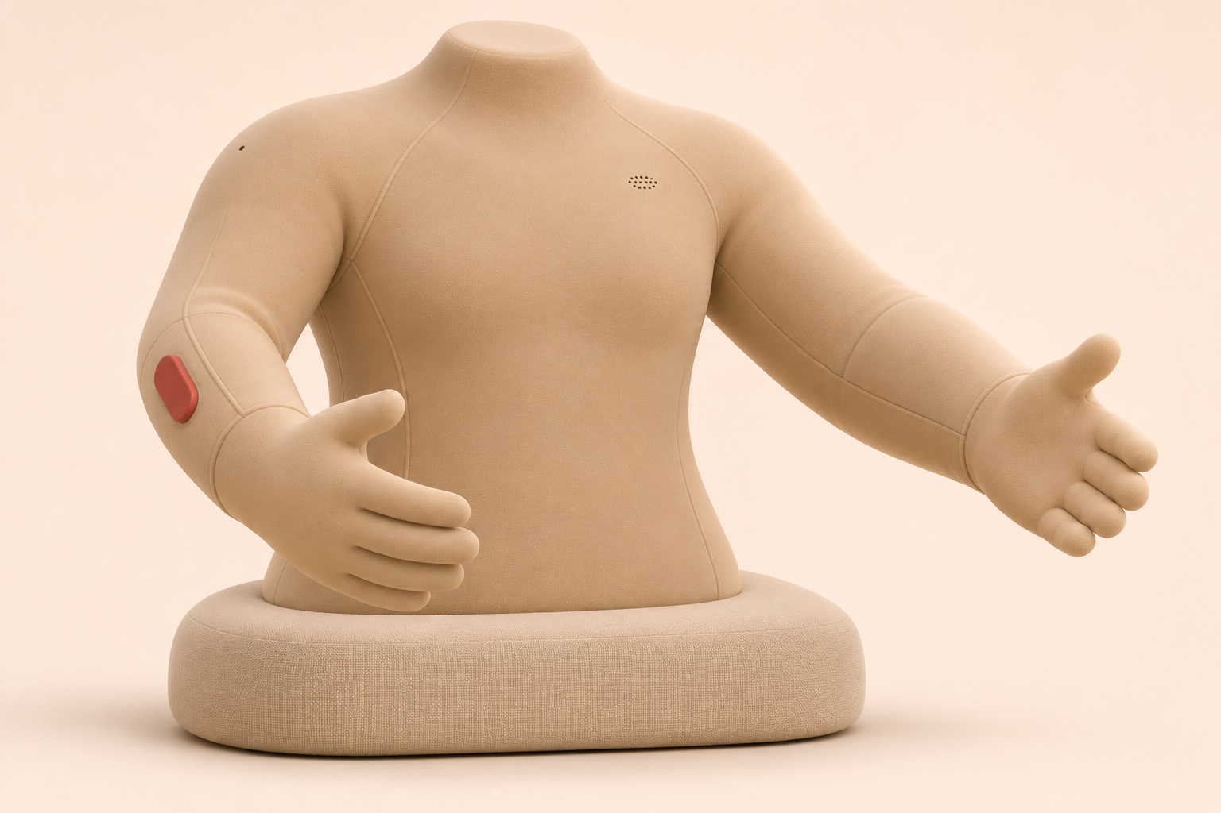
APPEARANCE PROPOSAL
The HT 0.2 form
A torso, two arms
and soft hands
A closed, padded neck stump
A replaceable contact sleeve
An accessible forearm stop
A supported removable base
AI concept render. The resting shape, materials and mechanisms still need physical tests.
06
Notes:
HT0.2 revises the earlier concept by adding a closed padded neck stump and proposed chest speaker and shoulder microphone. The figure describes design intent, not measured dimensions or safety. Source asset: visuals/HT02_Product.png, generated for this project.

Slide 7
INITIAL DESIGN TARGETS IN MILLIMETRES
A consistent dimensional model
420
Neck 60
Torso depth 230 mm
Assembled height 700 mm
560 torso + 60 neck + 80 base
Torso
560 high
420 wide
Upper arm
280
Forearm
260
Hand
160
560
700 mm shoulder to fingertip when unflexed
Base 560 × 400 × 80
Envelope schematic, not CAD. Reach, fit and support height must be tested with adjustable mockups.
07
Notes:
All values are unvalidated design targets shared with HT02_Design_Targets.json. The arm length equals 280+260+160=700 mm and does not establish the reachable workspace. The diagram is editable. The torso schematic uses an approximate uniform scale; arm chain is independently scaled for legibility.

Slide 8
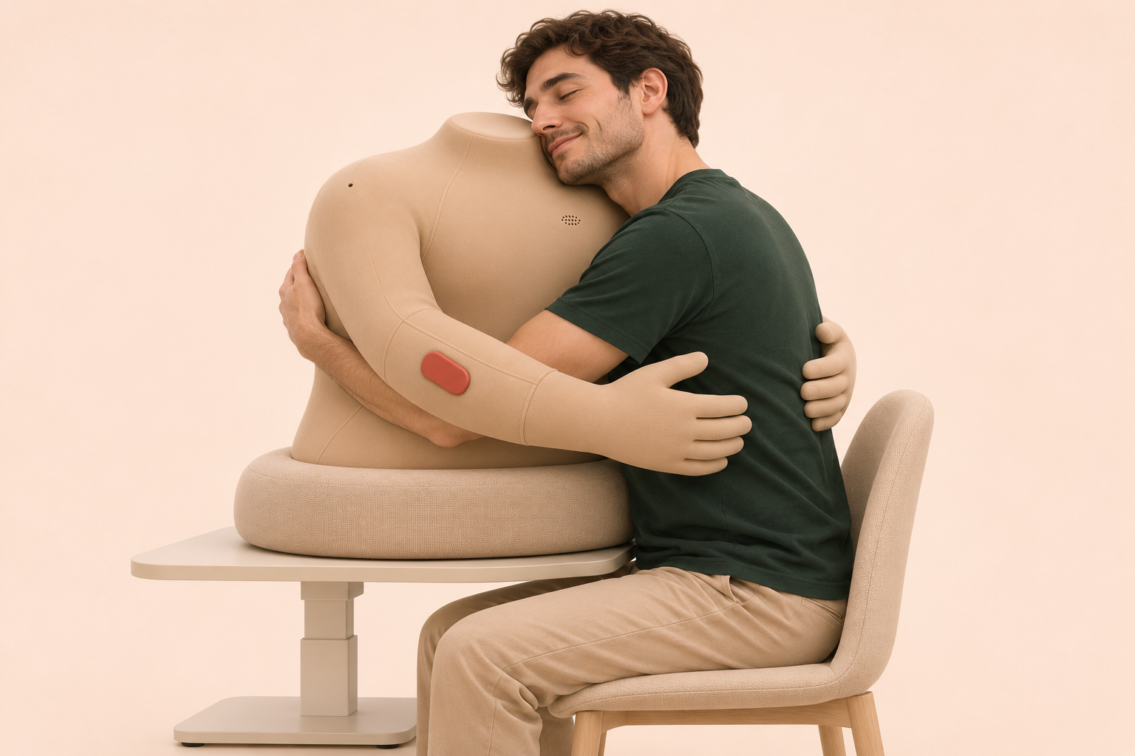
PROPOSED USE POSTURE
The cheek rests at the neck–shoulder junction
The user remains
self-supporting.
Nose and mouth stay clear.
No contact at the throat.
Arms remain below the neck.
The support height adjusts.
Illustrated posture for body-probe testing. No person has tested this prototype.
08
Notes:
Use image is AI-generated and uses the same device and adult identity as the rear-view scenario. The cheek-rest posture is a hypothesis. Comfort, posture, clearance and ease of leaving must be observed with a passive mockup. It is not a load-bearing head support claim.

Slide 9
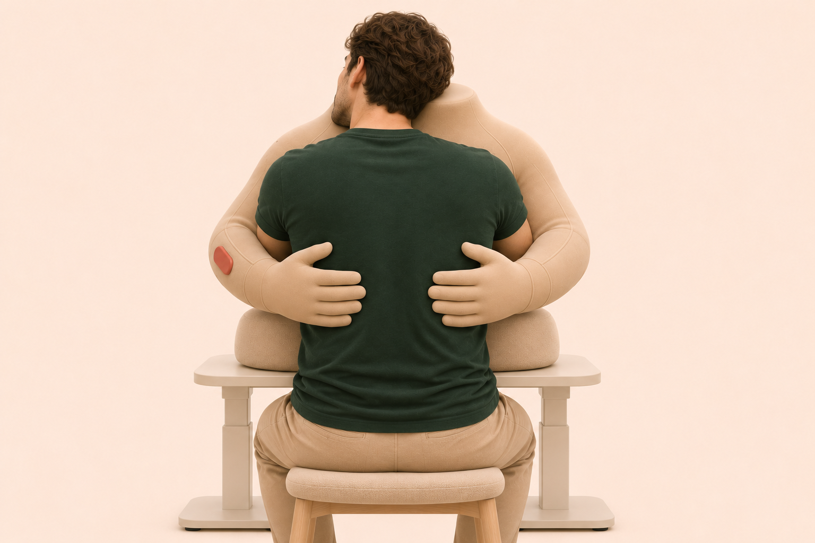
ILLUSTRATIVE CONTACT ENVELOPE
Where the hands could move
Planned patch
120 × 180 mm
each side
Pat
≤30 mm travel
Spine strip
100 mm wide
excluded
Stroke
≤60 mm travel
Overlay is editable and not to scale. Contact zones and travel limits are unvalidated hypotheses.
09
Notes:
The conceptual patches sit below shoulder level and on either side of the spine. They are not anatomically validated safe zones. Hand travel is displacement, not a force or safety specification. The powered workspace and required forces, speeds and clearances remain undefined. All values match the dossier. The two images share the same user and product.

Slide 10
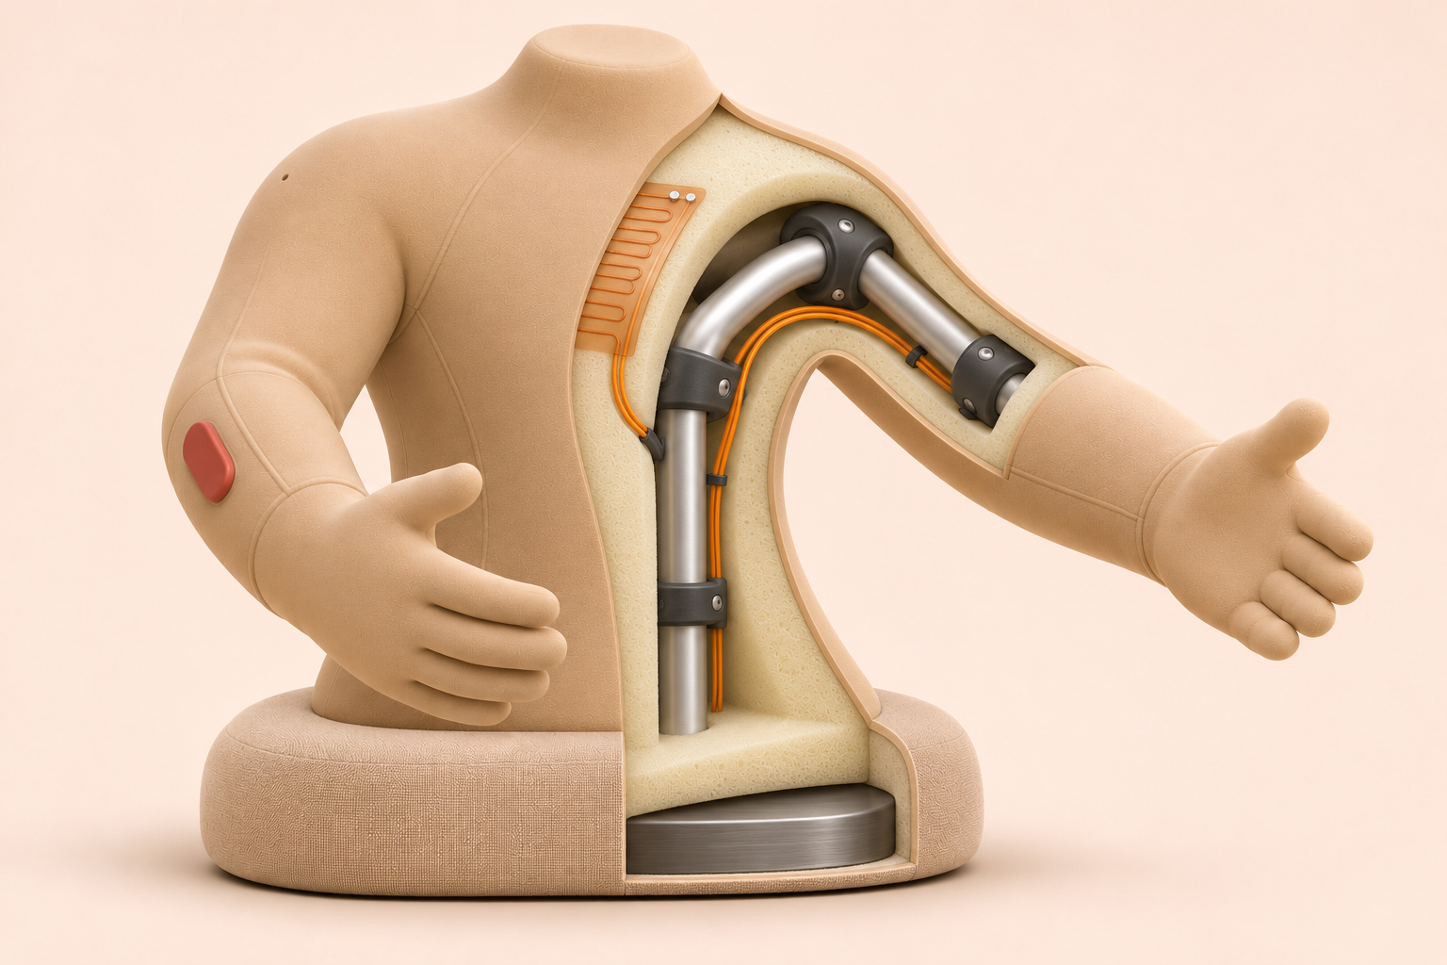
CONCEPTUAL CUTAWAY
A proposed material section
4 Frame and joints
6061-T6 aluminum and PA12
1 Contact sleeve
Polyether TPU, 0.5–1.0 mm
2 Local heat layer
Heater and surface sensors
3 Compliant filling
PU foam, 30–50 mm
Illustrative layer order and component placement. Thicknesses, joints and load paths are not validated.
10
Notes:
AI cutaway is not CAD. Heater sits under the surface over a local torso region, away from the neck/face rest. Image exaggerates layers for legibility. Hands and neck remain passive foam. A steel ballast is proposed inside the removable base. Actual stackup, wiring, fatigue, hard-point shielding and thermal gradients require fixtures.
Dąbrowska, A. K., Rotaru, G.-M., Derler, S., Spano, F., Camenzind, M., Annaheim, S., Stämpfli, R., Schmid, M., & Rossi, R. M. (2016). Materials used to simulate physical properties of human skin. Skin Research and Technology, 22(1), 3–14. https://doi.org/10.1111/srt.12235
Access: Full-text sections and PubMed metadata
Rus, D., & Tolley, M. T. (2015). Design, fabrication and control of soft robots. Nature, 521, 467–475. https://doi.org/10.1038/nature14543
Access: Publisher indexed metadata and summary; full page inaccessible

Slide 11
MATERIAL SELECTION
Why these materials remain candidates
Candidate | Why investigate it | Reason to reject it
TPU over PU foam | Non-silicone surface with a replaceable sleeve | Unpleasant friction, odor, seam feel or cleaning failure
Textile over the same foam | A washable comparison with fewer realism cues | Poor pressure distribution or unwanted associations
Aluminum with PA12 guards | A serviceable internal structure | Hard-point exposure, mass or pinch paths
Exact formulations, additives and adhesives require review. A material family is not a contact-safety approval.
11
Notes:
TPU chemistry and properties vary. BASF describes grade-dependent properties and hydrolysis resistance; manufacturer information is not independent evidence for this assembly’s skin safety. Sample selection and testing must precede a supplier commitment.
Dąbrowska, A. K., Rotaru, G.-M., Derler, S., Spano, F., Camenzind, M., Annaheim, S., Stämpfli, R., Schmid, M., & Rossi, R. M. (2016). Materials used to simulate physical properties of human skin. Skin Research and Technology, 22(1), 3–14. https://doi.org/10.1111/srt.12235
Access: Full-text sections and PubMed metadata
BASF. (n.d.). Elastollan thermoplastic polyurethane. https://plastics-rubber.basf.com/global/en/performance_polymers/products/elastollan
Access: Manufacturer product information, accessed 3 November 2026; not independent contact-safety evidence
Rus, D., & Tolley, M. T. (2015). Design, fabrication and control of soft robots. Nature, 521, 467–475. https://doi.org/10.1038/nature14543
Access: Publisher indexed metadata and summary; full page inaccessible

Slide 12
ENGINEERING ALLOCATION, NOT A MEASURED WEIGHT
A 6.0 kg mass budget
4.5 kg
Body budget
1.5 kg
Removable base
Includes 0.7 kg contingency. The device stays supported during use; handling and tip resistance need tests.
12
Notes:
All values are design allocations. Sum is 1.0+1.0+0.9+0.4+0.5+1.5+0.7=6.0 kg, including base. Body allocation excludes base and equals 4.5 kg. No part has been weighed. The native chart includes editable data and a literal workbook snapshot.

Slide 13
THERMAL HYPOTHESIS FOR BENCH TESTING
A surface warmth target
33 °C
Heat selected chest and forearm regions only.
Keep the neck and cheek-rest area unheated in the first heated prototype.
Set cutoff values and exposure limits after thermal risk assessment.
Proposed default surface target
32–35 °C
Proposed adjustment range
Design targets are not a safe-use clearance. Large-area contact and blocked surfaces require separate assessment.
13
Notes:
Do not present 32–35 °C as a limit set by ISO or the affective-touch studies. Passive prototypes come first. ISO 13732-1 public scope excludes certain large-area contacts and does not define comfort limits. Independent cutoff values are deliberately unresolved pending testing.
Ackerley, R., Backlund Wasling, H., Liljencrantz, J., Olausson, H., Johnson, R. D., & Wessberg, J. (2014). Human C-tactile afferents are tuned to the temperature of a skin-stroking caress. The Journal of Neuroscience, 34(8), 2879–2883. https://doi.org/10.1523/JNEUROSCI.2847-13.2014
Access: Abstract and bibliographic record
International Organization for Standardization. (2006). Ergonomics of the thermal environment—Methods for the assessment of human responses to contact with surfaces—Part 1: Hot surfaces (ISO Standard No. 13732-1:2006). https://www.iso.org/standard/43558.html
Access: Public scope only; full normative text not assessed
International Organization for Standardization. (2014). Robots and robotic devices—Safety requirements for personal care robots (ISO Standard No. 13482:2014). https://www.iso.org/standard/53820.html
Access: Public scope only; full normative text not assessed

Slide 14
A USER-LED ENCOUNTER
Solo mode
Choose quiet
or selected words
Preview contact
and set limits
Start when ready
Holding comes first. Patting or stroking needs a separate choice.
Stop ends contact. A new encounter requires a fresh start.
14
Notes:
Initial prototype uses passive contact and optional selectable words. Generative speech is a later comparison, not the default. Physical release must remain possible without voice, application or network.

Slide 15
PARTNER MODE
A live call while both partners embrace
Request and
accept a call
Speak together
with touch off
Separately accept
a touch session
Mute the microphone
Stop touch
Hang up
These controls act independently. AI speech stays silent during a live call.
15
Notes:
Proposed live partner-to-partner calling. No call auto-answers on hugging. The source of touch remains explicit. Microphone on outer shoulder and speaker on upper chest are proposed placements. A paired phone/laptop call can test the scenario before embedded acoustics. Recording, transcription and auto-translation are not included.
WebRTC. (n.d.). Getting started with peer connections. https://webrtc.org/getting-started/peer-connections
Access: Official implementation guide, accessed 3 November 2026
Valin, J.-M., & Bran, C. (2016). WebRTC audio codec and processing requirements (RFC 7874). Internet Engineering Task Force. https://doi.org/10.17487/RFC7874
Access: Official RFC, codec and acoustic echo cancellation requirements

Slide 16
CONTROL ARCHITECTURE
A call does not authorize an arm movement
Voice call
Speech between partners
Separate microphone mute
and call permission
Touch events
Session and local permission
Local controller
Bounded physical actions
No live audio enters the AI layer. No remote raw-force or heater commands.
16
Notes:
Independent channels are a design requirement. The calling layer does not set mechanical limits. A disconnect or hang-up clears touch permission, while stop-touch can leave the call running. WebRTC requires separate signaling and network traversal; media protection alone does not secure caller identity.
WebRTC. (n.d.). Getting started with peer connections. https://webrtc.org/getting-started/peer-connections
Access: Official implementation guide, accessed 3 November 2026
Rescorla, E. (2021). WebRTC security architecture (RFC 8827). Internet Engineering Task Force. https://doi.org/10.17487/RFC8827
Access: Official RFC, communications security and permission sections

Slide 17
VOICE ENGINEERING
Audio quality and privacy need their own tests
Issue | Proposed response | Evidence still needed
Echo and rubbing noise | Test port placement, echo control and mute | Audio during real contact and movement
Delay | Aim below 200 ms one-way | Measurements across realistic network conditions
Intimate conversation | No recording or transcription; no AI audio routing | Authenticated calls, inspected data flow and deletion rules
Unexpected ending | Close microphone and clear touch permission | Drop, reconnect and hang-up scenario tests
The latency is a design target. The portfolio does not claim a working secure call implementation.
17
Notes:
RFC 7874 supports investigating codec and acoustic echo cancellation requirements. RFC 8827 specifies protected media and permission requirements. The current project has not implemented or verified the call stack. Use paired existing calling tools for the first passive scenario study.
Valin, J.-M., & Bran, C. (2016). WebRTC audio codec and processing requirements (RFC 7874). Internet Engineering Task Force. https://doi.org/10.17487/RFC7874
Access: Official RFC, codec and acoustic echo cancellation requirements
Rescorla, E. (2021). WebRTC security architecture (RFC 8827). Internet Engineering Task Force. https://doi.org/10.17487/RFC8827
Access: Official RFC, communications security and permission sections

Slide 18
PROPOSED FORMATIVE RESEARCH
The first study challenges the form
12–16 adult interviews
Use adjustable torso and arm probes, TPU and textile samples,
and an optional neck–shoulder resting test.
Include varied genders and touch preferences, with 6–8 men
who bring different experiences of emotional self-reliance.
Recruitment targets, not completed research. Ethics review and withdrawal choices precede contact.
18
Notes:
Interview questions investigate comfort-seeking, a particular person’s role, fit, unwanted contact and independent control of voice and touch. Formative sample sizes support learning, not prevalence estimates. Include people who dislike the concept and do not require trauma disclosure.

Slide 19
PROPOSED EVALUATION
What the comparisons can tell me
Comparison | Question | Design decision
TPU versus textile | Which surface feels welcome? | Surface assembly and cleaning plan
With or without neck rest | Does the resting point improve the posture? | Rest shape and support height
Voice call versus call plus passive hug | What does the body form add to a familiar call? | Value of the partner scenario
Hold versus one reviewed gesture | Does movement add enough value? | Whether to invest in actuation
Record hesitation, non-use and discomfort alongside preference. No effectiveness results exist yet.
19
Notes:
A formative adult study can identify control and handling issues after safety review. Within-couple comparisons should preserve the voice call and vary the tactile component. A later loneliness measure needs the original time frame and a justified study design.
Hughes, M. E., Waite, L. J., Hawkley, L. C., & Cacioppo, J. T. (2004). A short scale for measuring loneliness in large surveys: Results from two population-based studies. Research on Aging, 26(6), 655–672. https://doi.org/10.1177/0164027504268574
Access: Paper abstract and bibliographic front matter

Slide 20
BUILD PLAN
The prototype sequence follows the uncertainties
Stage | Prototype | Advance when
Form | Passive adjustable body and sleeves | Fit, head position and exit are acceptable
Shared voice | Paired passive bodies and an existing call tool | The tactile form adds value beyond voice alone
One action | Guarded fixture and release mechanism | Qualified review clears supervised contact
Warmth and networking | Thermal samples, then authenticated channels | Fault, privacy and permission tests pass
Heating and autonomous AI enter only when a research question justifies them.
20
Notes:
The roadmap is conditional rather than a promise to build a safe robot on a fixed schedule. Force, speed, heating exposure and fault response remain unresolved engineering requirements.

Slide 21
PROJECT STATUS
What I can show in an application now
Developed
Demonstrated
Next evidence
A critical review, coherent form, construction hypotheses and control model.
An offline walkthrough of separate call and touch permissions.
Participant accounts, measured mockups and documented revisions.
Concept renders show intent. They are not prototype photographs or participant outcomes.
21
Notes:
No interviews, hardware validation or real calling have been completed. The applicant can claim research and design work, but not user impact. A good next case-study artifact is a reasoned revision grounded in observed evidence rather than more finished-looking renderings.

Slide 22
NAMING DIRECTION
Holding Together
Waiting Together suggests shared time.
Holding Together suggests shared physical presence.
The name stays provisional. Its meanings of support, restraint
and “keeping oneself together” should be tested.
22
Notes:
Working name, not a cleared trademark. Held Together and An Embrace Apart remain alternatives. Only the prior project names were provided, so the thematic relation to IP Alive remains provisional.

Slide 23
SOURCES AND ACCESS NOTES
References 1 of 5
Hawkley, L. C., & Cacioppo, J. T. (2010). Loneliness matters: A theoretical and empirical review of consequences and mechanisms. Annals of Behavioral Medicine, 40(2), 218–227. https://doi.org/10.1007/s12160-010-9210-8
Maslach, C., & Leiter, M. P. (2016). Understanding the burnout experience: Recent research and its implications for psychiatry. World Psychiatry, 15(2), 103–111. https://doi.org/10.1002/wps.20311
Wong, Y. J., Ho, M.-H. R., Wang, S.-Y., & Miller, I. S. K. (2017). Meta-analyses of the relationship between conformity to masculine norms and mental health-related outcomes. Journal of Counseling Psychology, 64(1), 80–93. https://doi.org/10.1037/cou0000176
Cohen, S., Janicki-Deverts, D., Turner, R. B., & Doyle, W. J. (2015). Does hugging provide stress-buffering social support? A study of susceptibility to upper respiratory infection and illness. Psychological Science, 26(2), 135–147. https://doi.org/10.1177/0956797614559284
Hughes, M. E., Waite, L. J., Hawkley, L. C., & Cacioppo, J. T. (2004). A short scale for measuring loneliness in large surveys: Results from two population-based studies. Research on Aging, 26(6), 655–672. https://doi.org/10.1177/0164027504268574
23
Notes:
Complete APA 7 references and source access depth appear in the revised literature review. Manufacturer information is identified as such. Fang et al. is a preprint. Standards are context, not a compliance claim.
Hawkley, L. C., & Cacioppo, J. T. (2010). Loneliness matters: A theoretical and empirical review of consequences and mechanisms. Annals of Behavioral Medicine, 40(2), 218–227. https://doi.org/10.1007/s12160-010-9210-8
Access: PubMed record and accessible review excerpts
Maslach, C., & Leiter, M. P. (2016). Understanding the burnout experience: Recent research and its implications for psychiatry. World Psychiatry, 15(2), 103–111. https://doi.org/10.1002/wps.20311
Access: Abstract, publisher excerpts and bibliographic record
Wong, Y. J., Ho, M.-H. R., Wang, S.-Y., & Miller, I. S. K. (2017). Meta-analyses of the relationship between conformity to masculine norms and mental health-related outcomes. Journal of Counseling Psychology, 64(1), 80–93. https://doi.org/10.1037/cou0000176
Access: Abstract, APA manuscript excerpts and bibliographic record
Cohen, S., Janicki-Deverts, D., Turner, R. B., & Doyle, W. J. (2015). Does hugging provide stress-buffering social support? A study of susceptibility to upper respiratory infection and illness. Psychological Science, 26(2), 135–147. https://doi.org/10.1177/0956797614559284
Access: Author manuscript and PubMed record
Hughes, M. E., Waite, L. J., Hawkley, L. C., & Cacioppo, J. T. (2004). A short scale for measuring loneliness in large surveys: Results from two population-based studies. Research on Aging, 26(6), 655–672. https://doi.org/10.1177/0164027504268574
Access: Paper abstract and bibliographic front matter

Slide 24
SOURCES AND ACCESS NOTES
References 2 of 5
Packheiser, J., Hartmann, H., Fredriksen, K., Gazzola, V., Keysers, C., & Michon, F. (2024). A systematic review and multivariate meta-analysis of the physical and mental health benefits of touch interventions. Nature Human Behaviour, 8(6), 1088–1107. https://doi.org/10.1038/s41562-024-01841-8
Löken, L. S., Wessberg, J., Morrison, I., McGlone, F., & Olausson, H. (2009). Coding of pleasant touch by unmyelinated afferents in humans. Nature Neuroscience, 12(5), 547–548. https://doi.org/10.1038/nn.2312
Ackerley, R., Backlund Wasling, H., Liljencrantz, J., Olausson, H., Johnson, R. D., & Wessberg, J. (2014). Human C-tactile afferents are tuned to the temperature of a skin-stroking caress. The Journal of Neuroscience, 34(8), 2879–2883. https://doi.org/10.1523/JNEUROSCI.2847-13.2014
Block, A. E., Christen, S., Gassert, R., Hilliges, O., & Kuchenbecker, K. J. (2021). The six hug commandments: Design and evaluation of a human-sized hugging robot with visual and haptic perception. In Proceedings of the 2021 ACM/IEEE International Conference on Human-Robot Interaction (pp. 380–388). Association for Computing Machinery. https://doi.org/10.1145/3434073.3444656
24
Notes:
Complete APA 7 references and source access depth appear in the revised literature review. Manufacturer information is identified as such. Fang et al. is a preprint. Standards are context, not a compliance claim.
Packheiser, J., Hartmann, H., Fredriksen, K., Gazzola, V., Keysers, C., & Michon, F. (2024). A systematic review and multivariate meta-analysis of the physical and mental health benefits of touch interventions. Nature Human Behaviour, 8(6), 1088–1107. https://doi.org/10.1038/s41562-024-01841-8
Access: Full-text methods, limitations and results excerpts; quantitative subgroup values checked in PubMed abstract
Löken, L. S., Wessberg, J., Morrison, I., McGlone, F., & Olausson, H. (2009). Coding of pleasant touch by unmyelinated afferents in humans. Nature Neuroscience, 12(5), 547–548. https://doi.org/10.1038/nn.2312
Access: Abstract and bibliographic record
Ackerley, R., Backlund Wasling, H., Liljencrantz, J., Olausson, H., Johnson, R. D., & Wessberg, J. (2014). Human C-tactile afferents are tuned to the temperature of a skin-stroking caress. The Journal of Neuroscience, 34(8), 2879–2883. https://doi.org/10.1523/JNEUROSCI.2847-13.2014
Access: Abstract and bibliographic record
Block, A. E., Christen, S., Gassert, R., Hilliges, O., & Kuchenbecker, K. J. (2021). The six hug commandments: Design and evaluation of a human-sized hugging robot with visual and haptic perception. In Proceedings of the 2021 ACM/IEEE International Conference on Human-Robot Interaction (pp. 380–388). Association for Computing Machinery. https://doi.org/10.1145/3434073.3444656
Access: Author manuscript, arXiv abstract and MPI publication metadata

Slide 25
SOURCES AND ACCESS NOTES
References 3 of 5
Block, A. E., Seifi, H., Hilliges, O., Gassert, R., & Kuchenbecker, K. J. (2023). In the arms of a robot: Designing autonomous hugging robots with intra-hug gestures. ACM Transactions on Human-Robot Interaction, 12(2), Article 18. https://doi.org/10.1145/3526110
Mueller, F., Vetere, F., Gibbs, M. R., Kjeldskov, J., Pedell, S., & Howard, S. (2005). Hug over a distance. In CHI ’05 Extended Abstracts on Human Factors in Computing Systems (pp. 1673–1676). Association for Computing Machinery. https://doi.org/10.1145/1056808.1056994
van Erp, J. B. F., & Toet, A. (2015). Social touch in human–computer interaction. Frontiers in Digital Humanities, 2, Article 2. https://doi.org/10.3389/fdigh.2015.00002
Huisman, G. (2017). Social touch technology: A survey of haptic technology for social touch. IEEE Transactions on Haptics, 10(3), 391–408. https://doi.org/10.1109/TOH.2017.2650221
Rus, D., & Tolley, M. T. (2015). Design, fabrication and control of soft robots. Nature, 521, 467–475. https://doi.org/10.1038/nature14543
25
Notes:
Complete APA 7 references and source access depth appear in the revised literature review. Manufacturer information is identified as such. Fang et al. is a preprint. Standards are context, not a compliance claim.
Block, A. E., Seifi, H., Hilliges, O., Gassert, R., & Kuchenbecker, K. J. (2023). In the arms of a robot: Designing autonomous hugging robots with intra-hug gestures. ACM Transactions on Human-Robot Interaction, 12(2), Article 18. https://doi.org/10.1145/3526110
Access: Author manuscript and bibliographic front matter
Mueller, F., Vetere, F., Gibbs, M. R., Kjeldskov, J., Pedell, S., & Howard, S. (2005). Hug over a distance. In CHI ’05 Extended Abstracts on Human Factors in Computing Systems (pp. 1673–1676). Association for Computing Machinery. https://doi.org/10.1145/1056808.1056994
Access: Author institution abstract and publication metadata
van Erp, J. B. F., & Toet, A. (2015). Social touch in human–computer interaction. Frontiers in Digital Humanities, 2, Article 2. https://doi.org/10.3389/fdigh.2015.00002
Access: Full-text review excerpts
Huisman, G. (2017). Social touch technology: A survey of haptic technology for social touch. IEEE Transactions on Haptics, 10(3), 391–408. https://doi.org/10.1109/TOH.2017.2650221
Access: Author institution metadata and PubMed abstract
Rus, D., & Tolley, M. T. (2015). Design, fabrication and control of soft robots. Nature, 521, 467–475. https://doi.org/10.1038/nature14543
Access: Publisher indexed metadata and summary; full page inaccessible

Slide 26
SOURCES AND ACCESS NOTES
References 4 of 5
De Freitas, J., Oğuz-Uğuralp, Z., Uğuralp, A. K., & Puntoni, S. (2026). AI companions reduce loneliness. Journal of Consumer Research, 52(6), 1126–1148. https://doi.org/10.1093/jcr/ucaf040
Li, R.-N., Folk, D., Singh, A., Ungar, L., & Dunn, E. (2026). Is a random human peer better than a highly supportive chatbot in reducing loneliness over time? Journal of Experimental Social Psychology, 125, Article 104911. https://doi.org/10.1016/j.jesp.2026.104911
Fang, C. M., Liu, A. R., Danry, V., Lee, E., Chan, S. W. T., Pataranutaporn, P., Maes, P., Phang, J., Lampe, M., Ahmad, L., & Agarwal, S. (2025). How AI and human behaviors shape psychosocial effects of chatbot use: A longitudinal randomized controlled study [Preprint]. arXiv. https://doi.org/10.48550/arXiv.2503.17473
Dąbrowska, A. K., Rotaru, G.-M., Derler, S., Spano, F., Camenzind, M., Annaheim, S., Stämpfli, R., Schmid, M., & Rossi, R. M. (2016). Materials used to simulate physical properties of human skin. Skin Research and Technology, 22(1), 3–14. https://doi.org/10.1111/srt.12235
BASF. (n.d.). Elastollan thermoplastic polyurethane. https://plastics-rubber.basf.com/global/en/performance_polymers/products/elastollan
26
Notes:
Complete APA 7 references and source access depth appear in the revised literature review. Manufacturer information is identified as such. Fang et al. is a preprint. Standards are context, not a compliance claim.
De Freitas, J., Oğuz-Uğuralp, Z., Uğuralp, A. K., & Puntoni, S. (2026). AI companions reduce loneliness. Journal of Consumer Research, 52(6), 1126–1148. https://doi.org/10.1093/jcr/ucaf040
Access: Publisher issue metadata plus author-hosted accepted article; online first 2025, issue year 2026
Li, R.-N., Folk, D., Singh, A., Ungar, L., & Dunn, E. (2026). Is a random human peer better than a highly supportive chatbot in reducing loneliness over time? Journal of Experimental Social Psychology, 125, Article 104911. https://doi.org/10.1016/j.jesp.2026.104911
Access: Publisher indexed abstract and result excerpt; full publisher page blocked
Fang, C. M., Liu, A. R., Danry, V., Lee, E., Chan, S. W. T., Pataranutaporn, P., Maes, P., Phang, J., Lampe, M., Ahmad, L., & Agarwal, S. (2025). How AI and human behaviors shape psychosocial effects of chatbot use: A longitudinal randomized controlled study [Preprint]. arXiv. https://doi.org/10.48550/arXiv.2503.17473
Access: Preprint abstract; no peer-reviewed status inferred
Dąbrowska, A. K., Rotaru, G.-M., Derler, S., Spano, F., Camenzind, M., Annaheim, S., Stämpfli, R., Schmid, M., & Rossi, R. M. (2016). Materials used to simulate physical properties of human skin. Skin Research and Technology, 22(1), 3–14. https://doi.org/10.1111/srt.12235
Access: Full-text sections and PubMed metadata
BASF. (n.d.). Elastollan thermoplastic polyurethane. https://plastics-rubber.basf.com/global/en/performance_polymers/products/elastollan
Access: Manufacturer product information, accessed 3 November 2026; not independent contact-safety evidence

Slide 27
SOURCES AND ACCESS NOTES
References 5 of 5
International Organization for Standardization. (2006). Ergonomics of the thermal environment—Methods for the assessment of human responses to contact with surfaces—Part 1: Hot surfaces (ISO Standard No. 13732-1:2006). https://www.iso.org/standard/43558.html
International Organization for Standardization. (2014). Robots and robotic devices—Safety requirements for personal care robots (ISO Standard No. 13482:2014). https://www.iso.org/standard/53820.html
Tabassi, E. (2023). Artificial intelligence risk management framework (AI RMF 1.0) (NIST AI 100-1). National Institute of Standards and Technology. https://doi.org/10.6028/NIST.AI.100-1
Valin, J.-M., & Bran, C. (2016). WebRTC audio codec and processing requirements (RFC 7874). Internet Engineering Task Force. https://doi.org/10.17487/RFC7874
Rescorla, E. (2021). WebRTC security architecture (RFC 8827). Internet Engineering Task Force. https://doi.org/10.17487/RFC8827
WebRTC. (n.d.). Getting started with peer connections. https://webrtc.org/getting-started/peer-connections
27
Notes:
Complete APA 7 references and source access depth appear in the revised literature review. Manufacturer information is identified as such. Fang et al. is a preprint. Standards are context, not a compliance claim.
International Organization for Standardization. (2006). Ergonomics of the thermal environment—Methods for the assessment of human responses to contact with surfaces—Part 1: Hot surfaces (ISO Standard No. 13732-1:2006). https://www.iso.org/standard/43558.html
Access: Public scope only; full normative text not assessed
International Organization for Standardization. (2014). Robots and robotic devices—Safety requirements for personal care robots (ISO Standard No. 13482:2014). https://www.iso.org/standard/53820.html
Access: Public scope only; full normative text not assessed
Tabassi, E. (2023). Artificial intelligence risk management framework (AI RMF 1.0) (NIST AI 100-1). National Institute of Standards and Technology. https://doi.org/10.6028/NIST.AI.100-1
Access: Official framework overview and publication metadata
Valin, J.-M., & Bran, C. (2016). WebRTC audio codec and processing requirements (RFC 7874). Internet Engineering Task Force. https://doi.org/10.17487/RFC7874
Access: Official RFC, codec and acoustic echo cancellation requirements
Rescorla, E. (2021). WebRTC security architecture (RFC 8827). Internet Engineering Task Force. https://doi.org/10.17487/RFC8827
Access: Official RFC, communications security and permission sections
WebRTC. (n.d.). Getting started with peer connections. https://webrtc.org/getting-started/peer-connections
Access: Official implementation guide, accessed 3 November 2026

