Slide 1
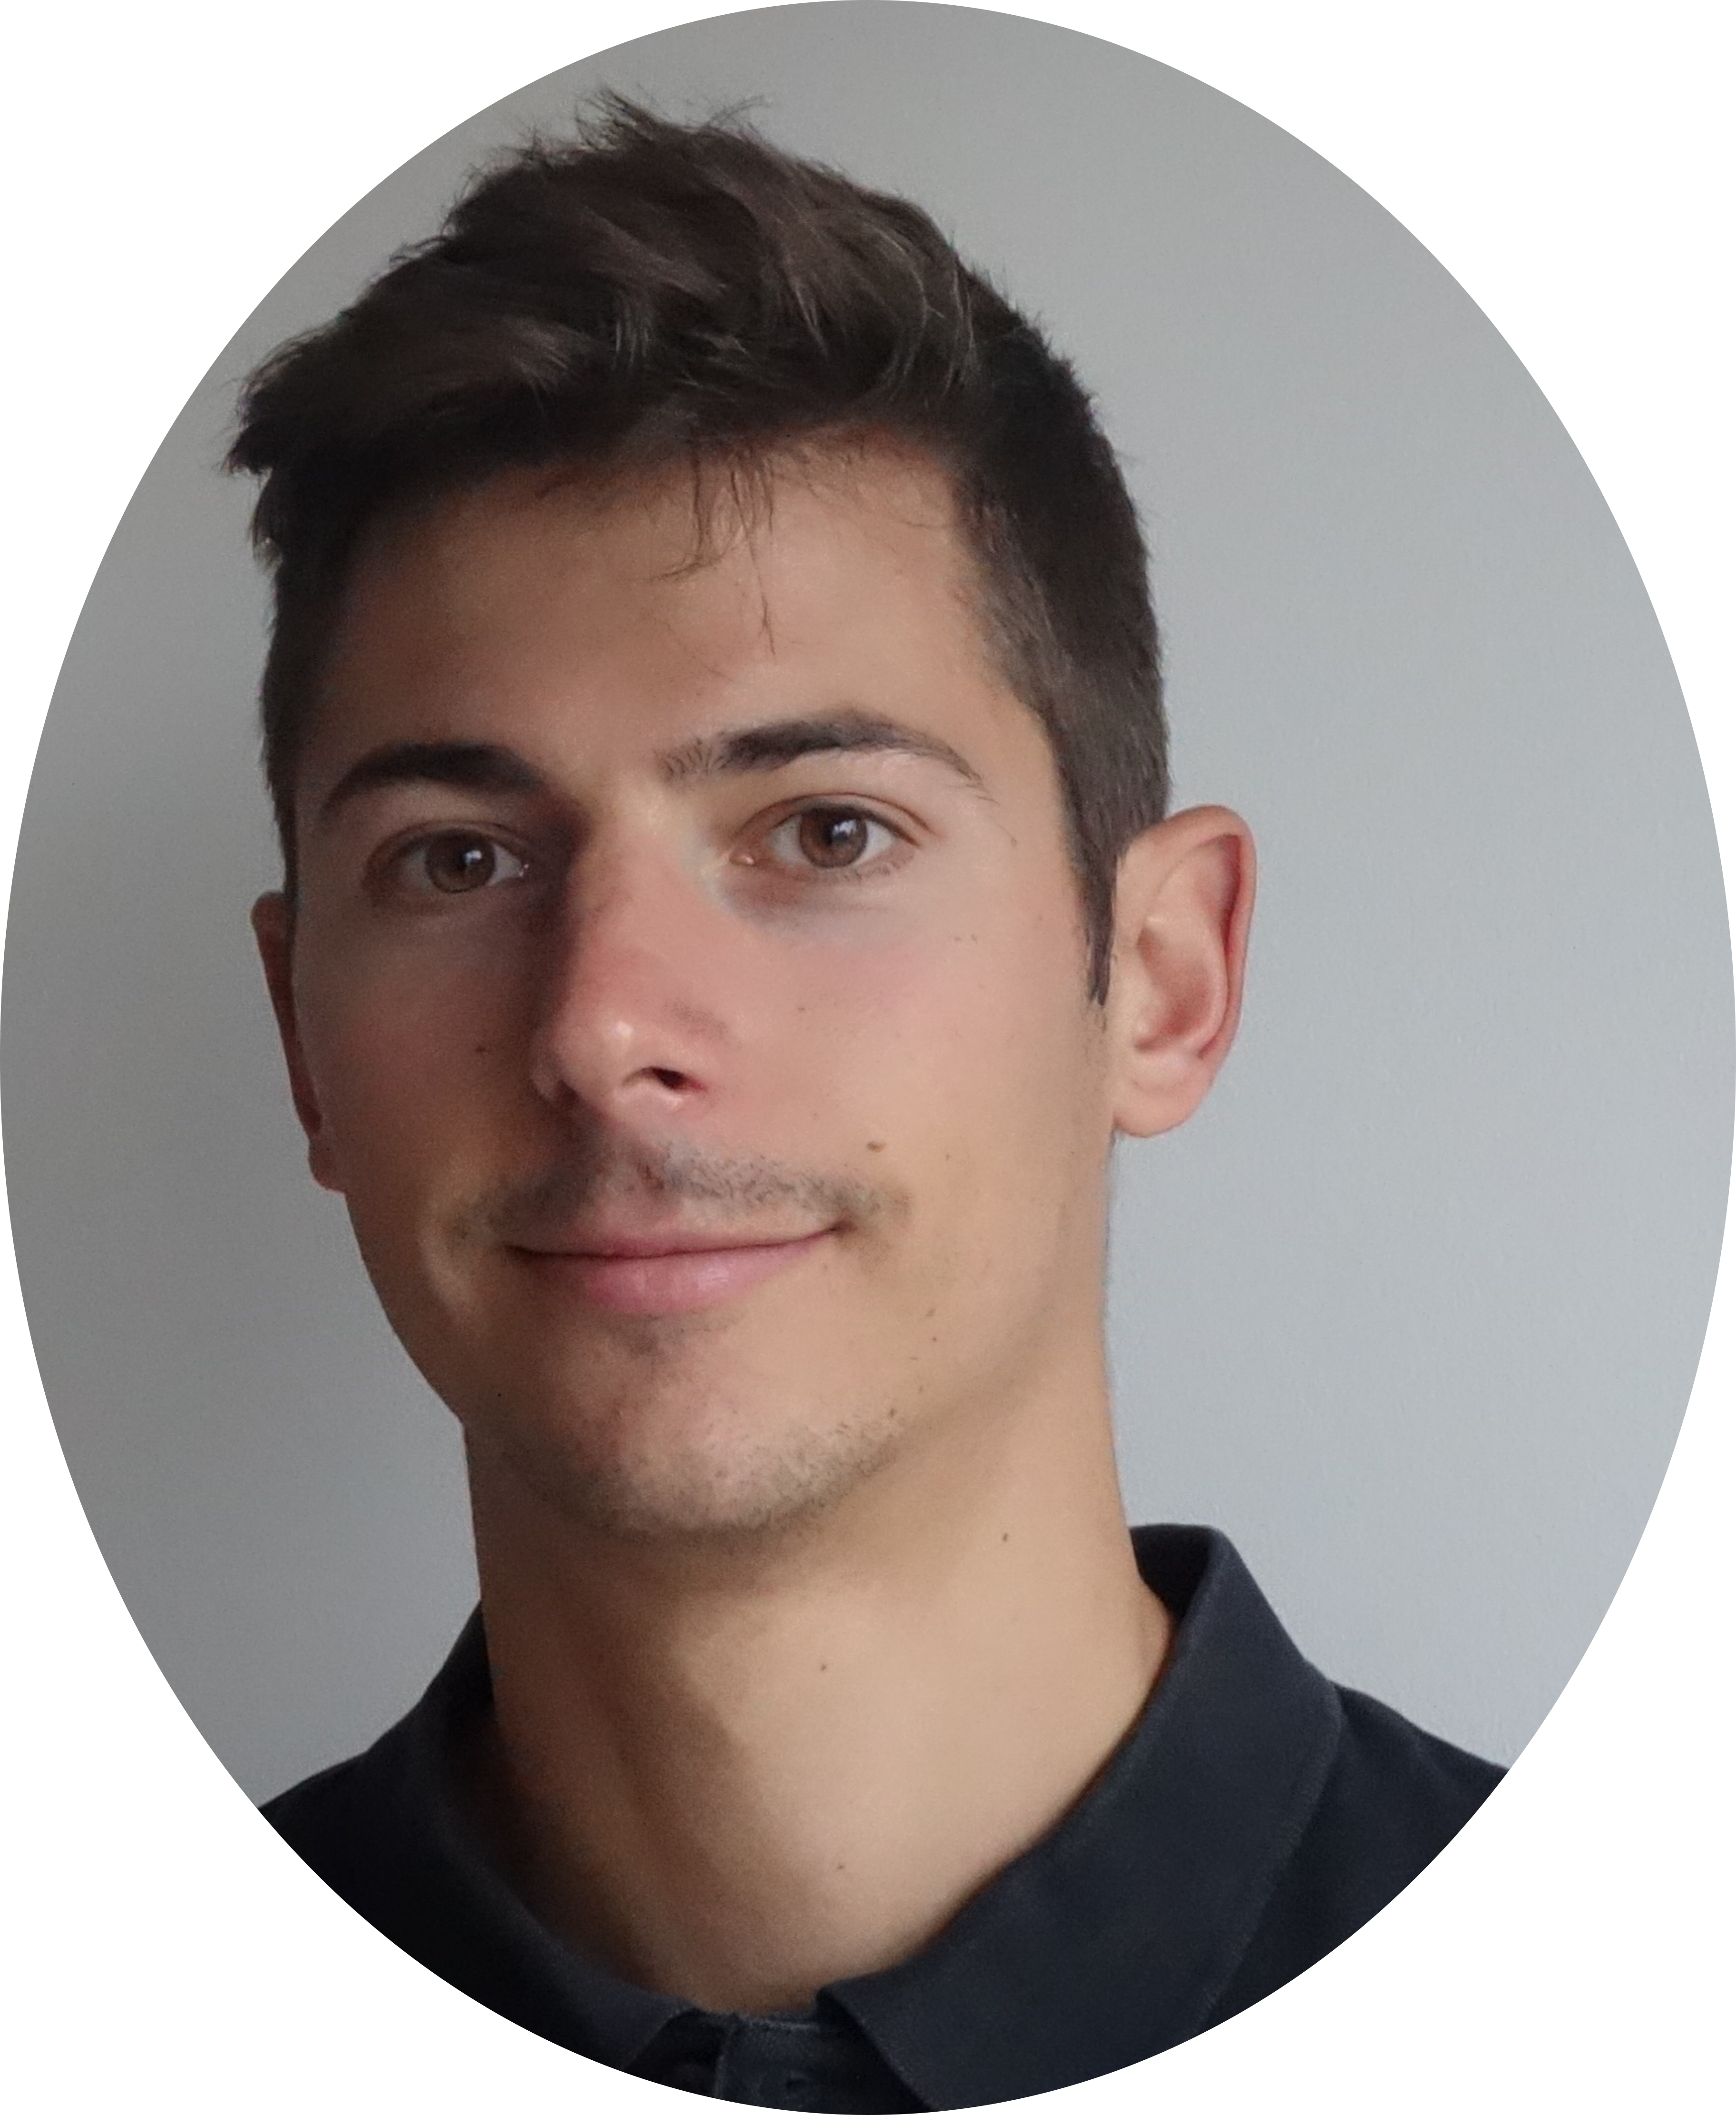





Martin DAVID
Postdoctoral scholar (UPPA)
French qualification for the position of Assoc. Prof.
Laboratory of Mathematics and their Application – UMR CNRS 5142
Université de Pau & des Pays de l’Adour (UPPA)
Driving license
Phone: +33688528106
Email: martin.david@inria.fr
ABOUT ME
Graduated with a doctorate in engineering sciences, passionate by scientific research and teaching, I wish to make a career as a university lecturer and researcher. I consider myself as a social and respectful person that always gives its best for the group benefit.
0000-0001-5213-8712
LANGUAGES
English: B2 (TOEIC 850)
Spanish: school level
COMPUTER KNOWLEDGE
Programming : MATLAB (7/10) Fortran (8/10), Visual Basic (8/10), Gnuplot (9/10)
CFD
- Code_Saturne (9/10)
- ANSYS Fluent (7/10)
- TrioCFD (9/10)
- Comsol (6/10)
- Fire Dynamics Simulator (5/10)
Visualization
- Paraview (9/10)
- VisIt (8/10)
- Tecplot360 (5/10)
Others
- WindPRO (8/10)
- OpenWind (7/10)
Meshing
- GMSH (8/10)
Date
Training - Education
2018-2021
PhD thesis at the PROMES – CNRS laboratory - Perpignan
Simulation and modeling of flows in gas-pressurized solar receivers
Ph.D. defense: 11/26/2021 - jury: DOR C.Castelain, Pr S.Vincent, EDOR G.Flamant, DOR J.Magnaudet, and Pr A.Bastide
2015-2018
Engineering school ‘Ecole Nationale Supérieure en Génie des Technologies Industrielles’ (ENSGTI) - Pau
Specialization in industrial energy
Fluid mechanics
Renewable energies
Computational fluid dynamics
Numerous team projects
2013-2015
Preparatory classes to engineering school - Pau
2012-2013
Undergraduate studies to prepare for competitive entry exams to engineering schools at lycée Paul Cézanne - Aix en Provence
2012
Scientific high school diploma with honours - Aix en Provence

Slide 2





Date
Ph.D. thesis
10/2018 – 09/2021
Ph.D. defense:
11/26/2021
Ph.D. thesis - PROMES CNRS superv. by A.Toutant and F.Bataille - Perpignan
Simulation and modeling of flows in gas-pressurized solar receivers
Research areas: computational fluid dynamics, turbulence, heat transfers, CSP
Expert in Thermal Large Eddy Simulations and Direct Numerical Simulations
High Performance Computing (HPC)
Multi-scale approach
TrioCFD – use and programming, VisIt
Professional experiences
10/2022 - 10/2023
Postdoctoral student - INRIA – supervised by Rémi Manceau - Pau
Development of an adaptative hybrid RANS/LES methodology
CFD, self-adaptive meshing based on physical criteria, HTLES model
Code_Saturne, GMSH
09/2021 - 09/2022
Temporary research and teaching assistant - PROMES CNRS - Perpignan
Development and improvement of subgrid-scale models of T-LES
CFD, turbulence, heat transfers, mixed models, CSP
TrioCFD, VisIt
04/2018 - 09/2018
Industrial internship (M2) - EOLINK supervised by M.Guyot - Brest
Optimization of windturbine placement in an offshore windfarm
Code development, wake model, optimisation algorithm
Matlab, WindPRO, OpenWind
06/2017 - 09/2017
Research internship (M1) - PIMENT superv. by A.Bastide - La Réunion island
Modeling smoke extraction in buildings
CFD, mixed convection, natural ventilation, smoke extraction
Fire Dynamics Simulator, Tecplot360
Research activities
Publications in scientific journals
  International: 6
  National: 2
Conferences
  International: 5
  National: 3
Obtaining computational hours on supercomputers (total: 26 million of hours)
3 calls for national projects (DARI)
1 call for european project (PRACE)
1 review for an international journal
1 review for an international conference
3 reviews for a national conference
Teachings
400 hours (lectures, tutorials, practical works, and projects)
  University of Perpignan Via Domitia & Sup EnR engineering school (300 h) - Perpignan
  University of Pau & Pays de l’Adour & ENSGTI engineering school (100h) - Pau
60 hours of private lessons to secondary school pupils - videoconference - Hellomentor plateform
Volunter homework support at the Hameau social centre - Pau
Awards
Valedictorian throughout my three years in engineering school, ENSGTI
2 times selected for Biot-Fourier award of the Société Française de Thermique (2020-21)
Ranked 4th of the Assoc. Prof. competition of the PROMES laboratory in 2022

Slide 3
Publications
Papers published in international journals:
  M. David, A. Toutant, et F. Bataille, "Thermal Large-Eddy Simulations methods to model highly anisothermal and turbulent flows", Physics of Fluids, vol 35, p. 035106, Mar. 2023.
  M. David, A. Toutant, et F. Bataille, "Study of asymmetrically heated flows passing through gas- pressurized solar receivers using Direct Numerical Simulations", International Journal of Heat and Mass Transfer, vol. 201, p. 123577, Feb. 2023.
  M. David, A. Toutant, and F. Bataille, “Impact of asymmetrical heating on the uncertainty propagation of flow parameters on wall heat transfers in solar receivers,” Applied Thermal Engineering, vol. 199, p. 117547, Nov. 2021.
  M. David, A. Toutant, and F. Bataille, “Direct simulations and subgrid modeling of turbulent channel flows asymmetrically heated from both walls,” Physics of Fluids, vol. 33, no. 8, p. 085111, Aug. 2021.
  M. David, A. Toutant, and F. Bataille, “Investigation of thermal large-eddy simulation approaches in a highly turbulent channel flow submitted to strong asymmetric heating,” Physics of Fluids, vol. 33, no. 4, p. 045104, Apr. 2021.
  M. David, A. Toutant, and F. Bataille, “Numerical development of heat transfer correlation in asymmetrically heated turbulent channel flow ,” International Journal of Heat and Mass Transfer, vol. 164, p. 120599, Jan. 2021.
Papers published in national journal:
  M. David, A. Toutant, and F. Bataille, “Analyse de sensibilité des flux de chaleur pariétaux en canal asymétriquement chauffé au moyen d’une corrélation permettant d’estimer les transferts de chaleur,” Entropie, vol. 2, no. 2, Nov. 2021.
  M. David, A. Toutant, and F. Bataille, “Evaluation de modèles de simulation des grandes échelles en canal plan turbulent chauffé asymétriquement : de la comparaison des grandeurs intégrales à l’analyse des corrélations,” Entropie, vol. 1, no. 4, Nov. 2020.
International conferences:
  M. David, M. Mehta, and R. Manceau, “Towards self-adaptivity in hybrid RANS/LES based on physical criteria” presented at the 10th international symposium on Turbulence, Heat and Mass Transfer, Rome, Italy, Sep. 2023
  A.Toutant, M. David, Y. Zatout, F. Bataille, L. Mathelin, O. Semeraro, “Thermal large eddy simulations for high temperature solar receivers” presented at the 17th International Heat Transfer Conference, Cape Town, South Africa, Aug. 2023
  M. David, A. Toutant, and F. Bataille, "Study of anisothermal channel flow physics with direct numerical simulations" presented at the Franco-Polish Mechanics Seminars, Perpignan, France, Oct 2021.
  M. David, A. Toutant, and F. Bataille, “Assessment and comparison of Large Eddy Simulations in asymmetrically heated and highly turbulent channel flows” presented at the International ERCOFTAC Symposium on Engineering Turbulence Modelling and Measurements, Rhodes, Greece, Sep. 2021.
  M. David, A. Toutant, and F. Bataille, “Sensitivity analysis of heat transfers in an asymmetrically heated turbulent channel flow” presented at the International Conference on Computational Heat Mass and Momentum Transfer, Paris, France, May 2021.
National conferences:
  M. David, A. Toutant, and F. Bataille, “Tests et améliorations de modèles mixtes de Simulation des Grandes Échelles d’un écoulement à fort nombre de Reynolds en canal asymétriquement chauffé,” presented at the SFT, Valencienne, France, Jun. 2022.
  M. David, A. Toutant, and F. Bataille, “Développement et analyse d’une corrélation pour estimer les transferts de chaleur en situation de fort chauffage asymétrique d’un écoulement en canal.,” presented at the SFT, Belfort, France, Jun. 2021.
  M. David, A. Toutant, and F. Bataille, “Tests a posteriori de modèles de sous-mailles dans un écoulement en canal plan à haut nombre de Reynolds et soumis à un fort flux de chaleur,” presented at the SFT, Belfort, France, Jun. 2020.
Conferences
Book chapters
Annual activity report of GENCI 2021
Public participations
  M. David and R. Manceau, “Demonstrator of self-adaptive hybrid RANS/LES based on physical criteria: application to the backward-facing step case,” IHCantabria, invited Prof. J. Lopez Lara, Nov. 2023.

