Slide 1
Energy Sector
Martin J. Brucker
SoSe 2024 | 17.06.2024

Slide 2
Agenda
Introduction
Data Sources and Data Types
IT-Architecture and Big Data Technologies
Data Visualisation and Business Value
Real World Examples
Conclusion

Slide 3

Energy Sector
Largely Distributed Systems
Widely spaced power-grid
Increasing importance with renewable Energy
Integration of distributed energy resources
-> Data Driven Decision-making
Notes:
Largely Distributed Systems: The energy sector relies on a vast and interconnected network of power grids and substations.
Widely spaced powerPower transmission between widely spaced power-grid stations can lead to considerable travel times.
Increasing Importance with Renewable Energy: As renewable energy sources proliferate, the grid becomes more decentralized, necessitating sophisticated management.
Integration of Distributed Energy Resources: Private households are increasingly contributing to the energy grid, making the system more complex and distributed.
Data-Driven Decision-Making: Leveraging Big Data for informed decision-making is crucial to managing these complex, distributed energy systems efficiently.

Slide 4
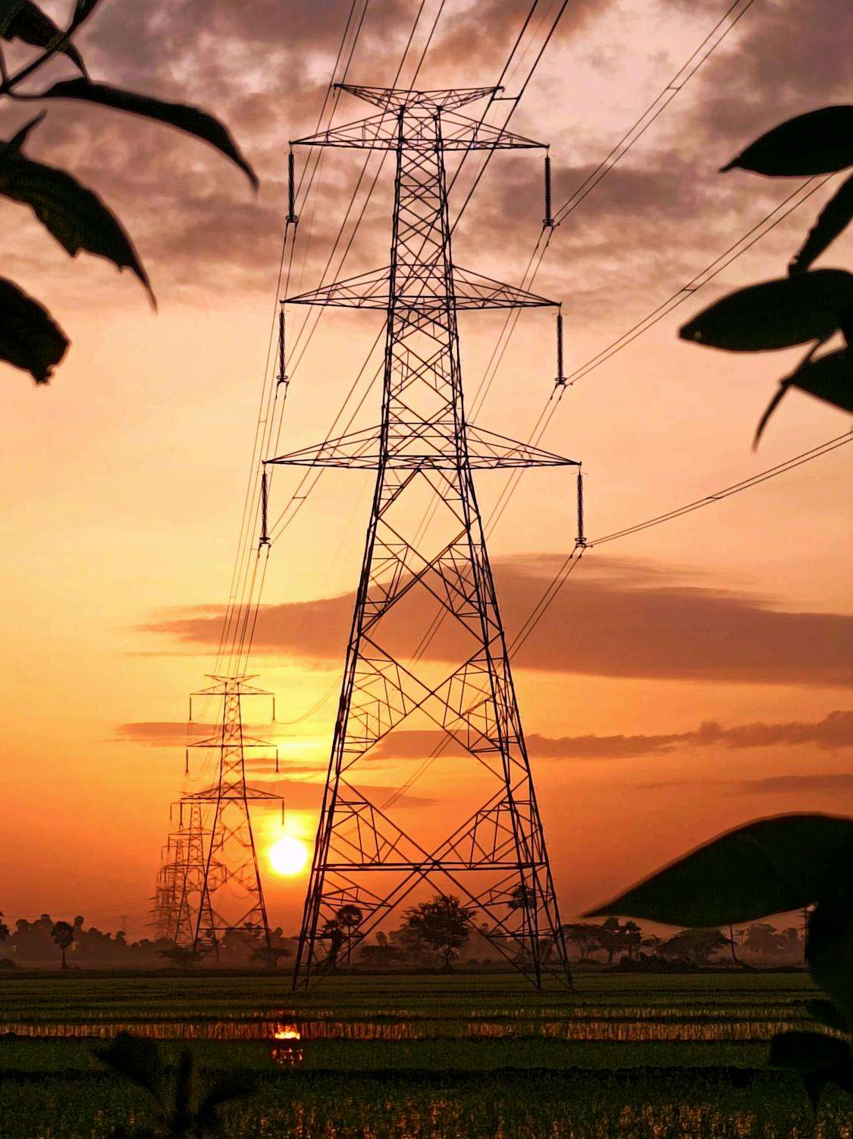
Data Sources
Sensory data from equipment
Historical maitencance records
Weather data
Market demand and supply
Data Types
Time-series data
Structured and unstructured data
Real-time streaming data

Slide 5






IT Architecture and Big Data Technologies
Data Ingestion
Data Storage
Data Processing
Data Analytics
Visualisation

Slide 6

Data Analytics and business value
Analytics Used:
Predictive analytics to foresee equipment failures
Machine learning algorithms for anomaly detection
Business Value:
Reduced downtime and maintenance costs
Increased efficiency and lifespan of equipment
Enhanced safety and reliability of power supply

Slide 7
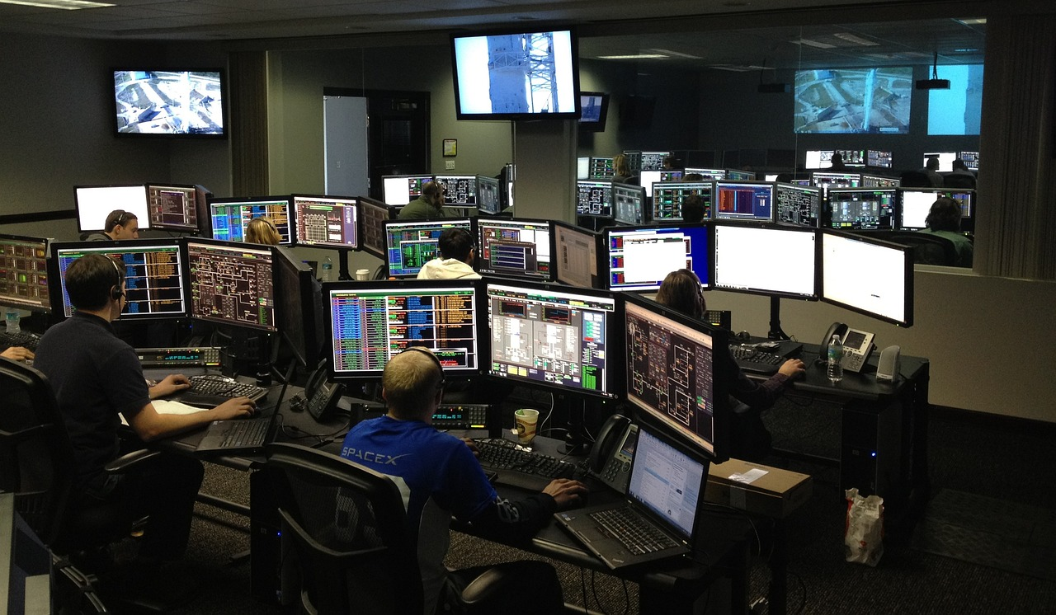
Data Visualization and Dashboards
Visualization Tools:
Tableau
Power BI
Custom dashboards using D3.js
User Groups:
Operations managers
Maintenance teams
Executive leadership
Key Metrics Displayed:
Equipment health scores
Predicted maintenance schedules
Real-time operational status

Slide 8

Real-World Examples
Example 1: A utility company using predictive maintenance to reduce turbine failures.
Example 2: A renewable energy provider optimizing the performance of solar panels through real-time data analytics.

Slide 9

Conclusion
Enhanced Efficiency
Informed Decision-Making
Sustainability
Great job opportunitys for us Data Scientist ☺!

Slide 10
Thanks :)!
Martin Johannes Brucker
+49 1590 5842081
martin.brucker@student.fh-kiel.de

