Slide 1
Variant calling using local reference-helped assemblies
Martin Dráb

Slide 2
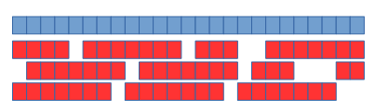
The Task
Problem
We are unable of reading the whole DNA at once
The usual approach is to chop it into a set of short sequences (reds) that we are able to read
The short sequences are then assembled into the original one
The reference sequence may help with this process
Read length: 150 bp, genome length (3 Gbp, 40 Mbp for the tested region)
Input
A set of reads (short strings) extracted from the target DNA and covering the regions of interest
The reads usually contain sequencing errors
Multiple reads may cover the smae part of the sequence
A reference sequence
Output
A set of differences (SNPs, indels) from the reference, so-called variants

Slide 3
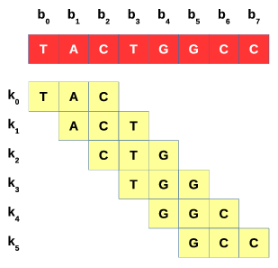
Major Approaches
De Bruijn graphs (DBG)
Decompose each read into k-mers
Build a de Bruijn graph
(k-mers = nodes, edges = k-mer order)
Optimize its structure
Extract the sequence
HaploCall (used in GATK)
Overlap-layout-consensus (OLC)
Compute overlaps between reads
Build an overlap graph (nodes = reads, edges = overlaps)
Optimize its structure
Extract the seuqnce(s)
Fermi

Slide 4
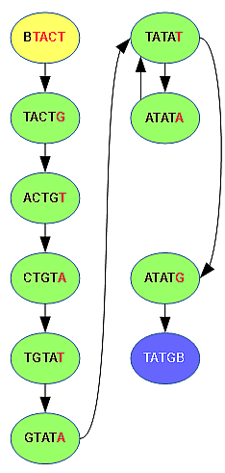
Our Algorithm
TATCGTATATATG
Divide into regions
Uniformly
Same size (2000 bases)
Processed independently and in parallel
Transform the reference into a DBG,
Add reads assigned into the region
Optimize graph structure
Detect variants
Filter them

Slide 5
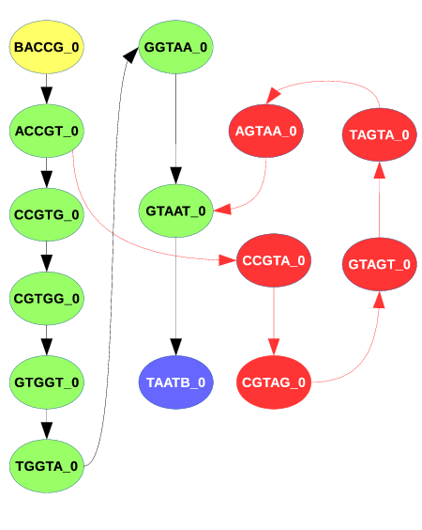
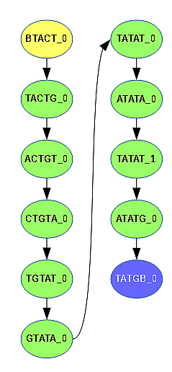
Problems with the k-mer size
111
TATCGTATATATG
ACCGTGGTAAT
ACCGTAGTAAT

Slide 6
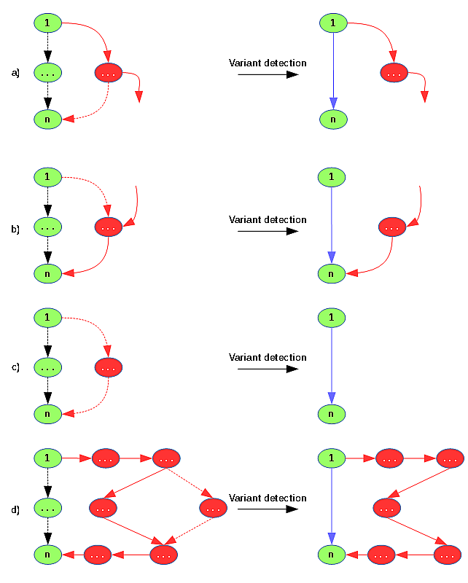
Variant Detection

Slide 7
Results
 | Fermikit | Fermikit (regions) | mpileup | Our algorithm
True positives (SNP) | 45,241 (89.3%) | 47,630 (94%) | 49,201 (97.1%) | 48,172 (95%)
False Negatives (SNP) | 5,432 (10.7%) | 3,043 (6%) | 1,472 (2.9%) | 2,501 (5%)
False Positives (FP) | 385 (0.76%) | 1,441 (2.84%) | 2,090 (4.12%) | 816 (1.61%)
True Positives (INDEL) | 7,853 (71.6%) | 9,602 (87.55%) | 8,707 (79.39%) | 9,476 (86.4%)
False Negatives (INDEL) | 3,114 (28.4%) | 1,365 (13.45%) | 2,260 (20.61%) | 1,491 (13.6%)
False Positives (INDEL) | 250 (2.28%) | 835 (7.61%) | 1,412 (12.95%) | 1,255 (11.4%)

Slide 8
Different Parameters
K = 21 | 2 | 3 | 4 | 5 | 6 | 7 | 8
SNP TP | 48464 | 48427 | 48172 | 47774 | 47156 | 46409 | 45342
SNP FN | 2209 | 2246 | 2501 | 2899 | 3517 | 4264 | 5331
SNP FP | 1364 | 1117 | 816 | 650 | 513 | 403 | 351
INDEL TP | 10004 | 9851 | 9476 | 9265 | 8906 | 8474 | 7948
INDEL FN | 963 | 1116 | 1491 | 1702 | 2061 | 2493 | 3019
INDEL FP | 2581 | 1982 | 1255 | 905 | 684 | 532 | 431
K = 31 | 2 | 3 | 4 | 5 | 6 | 7 | 8
SNP TP | 48353 | 48182 | 47733 | 47123 | 46250 | 45108 | 43555
SNP FN | 2320 | 2491 | 2940 | 3550 | 4423 | 5565 | 7118
SNP FP | 1252 | 1011 | 735 | 585 | 456 | 360 | 308
INDEL TP | 9873 | 9659 | 9302 | 8903 | 8428 | 7923 | 7314
INDEL FN | 1094 | 1308 | 1665 | 2064 | 2539 | 3044 | 3653
INDEL FP | 1884 | 1341 | 891 | 623 | 470 | 363 | 292

Slide 9
Genotypic Results
 | Fermi.kit | Fermi (regions) | mpileup | Our algorithm
SNP TP | 44085 | 47735 | 48203 | 47024
SNP FN | 6588 | 2938 | 2470 | 3649
SNP FP | 1484 | 3408 | 3167 | 1808
INDEL TP | 6375 | 8092 | 6864 | 7566
INDEL FN | 4592 | 2875 | 4103 | 3401
INDEL FP | 1343 | 2339 | 4462 | 3415

