Slide 1
Hiding Things on Windows Platforms
Martin Dráb
martin.drab@email.cz

Slide 2
Agenda
Areas of interest
  Windows registry
  Network communication
  File systems
Attacker's point of view
No extra knowledge required

Slide 3
Windows Registry

Slide 4
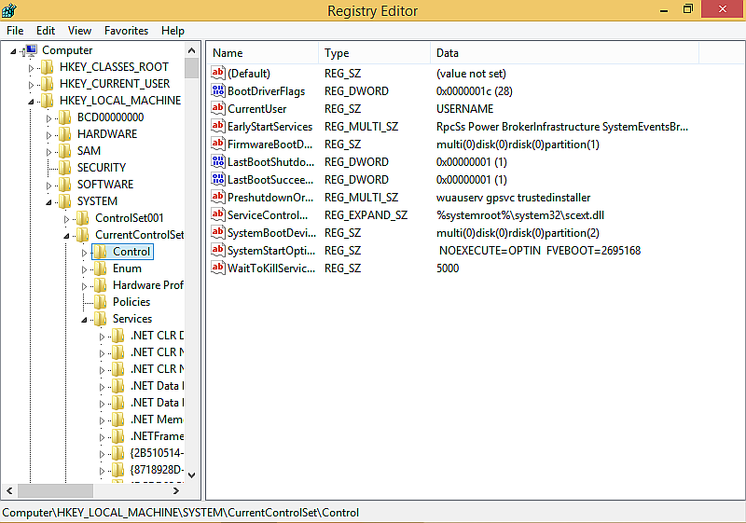
Windows Registry – basic info
Configuration storage similar to file systems
  keys = directories
  values = files
Typed, small sized data
Stored on disk, lives in RAM

Slide 5
Filtering Registry Operations
Driver-supplied callbacks (CmRegisterCallback(Ex))
    Invoked before and after a registry operation in context of the thread taht irequested it
    Multiple callback registrations allowed (layered model)
Modes of operation
  Monitor (gather information about each operation)
  Block (the requestor receives an error)
  Modify (operation parameters and/or results can be changed)
  Emulate (the whole operation is performed by the filter driver)

Slide 6
RegHider
Hides registry keys
  QueryKey and EnumerateSubkeys operation modified in order not to report given registry keys
Reports nonexistent registry values
  Operations on these values are emulated
  Each value may be visible either systém-wide, or only to certain processes

Slide 7
Detection
Special registry operations
Offline analysis
  Offline Registry Library
  Parsing registry files directly (e.g. chntpw)
Online analysis
  Registry tree is stored in memory (usually)
  It can be read directly (without using any system routines)

Slide 8
Network Communication

Slide 9
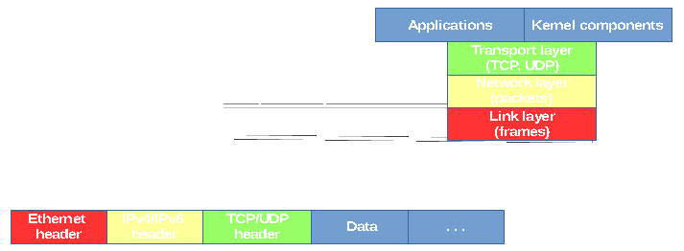
Network Basics

Slide 10
Winsock Kernel
A socket-like interface for the kernel world
  Usual socket calls (socket(), bind(), connect(), listen())
  Used in the same way as in usermode
  An easy way how a driver can comminucate over network
Implementation details
  Asynchronous
  Nonpaged memory

Slide 11
Raw Ethernet Frames
Kernel dirvers are able to send raw ethernet frames over network, thus bypassing any packet filters placed above
Difficulty: easy (PoC at least)
  Just get the ndisprot sample from the WDK package
  Delete few lines of code and it will work
  Fill in the IP header correctly

Slide 12
File Systems

Slide 13
Driver and Device Objects
Driver object
  Gathers all necessary information about certain device driver, such as addresses of routines servicing various types of requests
Device object
  Receives requests from applications and other drivers
  A driver owning the device is responsible for handling incomming requests

Slide 14
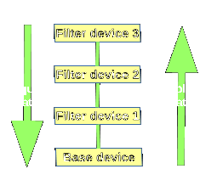
Device Stacks
  When a driver needs to see requests comming to a particular device (of another driver), it can attach its own device object above that device and form a device stack
  Requests usually sent to the top device
  Unknown requests passed down
  All drivers in the stack should keep their manners

Slide 15
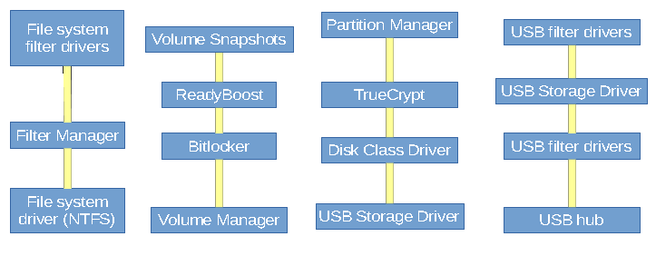
Where to Attach?

Slide 16
Implications
  Problems of a lower attacher
    Hardware dependencies
    Software encryption
    No context information
    Direct (S)ATA/SCSI commands
    Writting a basic FS parser is quite easy
  Tips & Tricks
    Build your own file system
    Take advantage of symbolic links (such as drive letters)

Slide 17
Conclusion

Slide 18
References
  Demo projects (may be updated in the future)
    https://github.com/MartinDrab/Hackerfest2015
  Registry
    https://msdn.microsoft.com/en-us/library/windows/hardware/ff545879(v=vs.85).aspx
    http://dfrws.org/2008/proceedings/p26-dolan-gavitt.pdf
    http://amnesia.gtisc.gatech.edu/~moyix/suzibandit.ltd.uk/MSc/Registry%20Structure%20-%20Appendices%20V4.pdf
  FAT & NTFS data structures (mirrors)
    http://www.jadro-windows.cz/download/ntfsdoc-0.5.zip
    http://www.jadro-windows.cz/download/fat.zip

Slide 19
www.hackerfest.cz
www.gopas.cz

