Slide 1
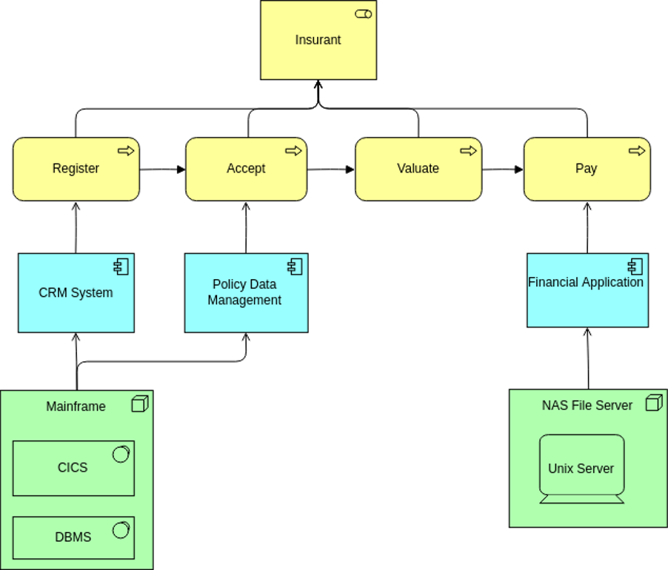


ArchiMate Cookbook
Author: Eero Hosiaisluoma Instructor: Zhao Xiaoqi

Slide 2
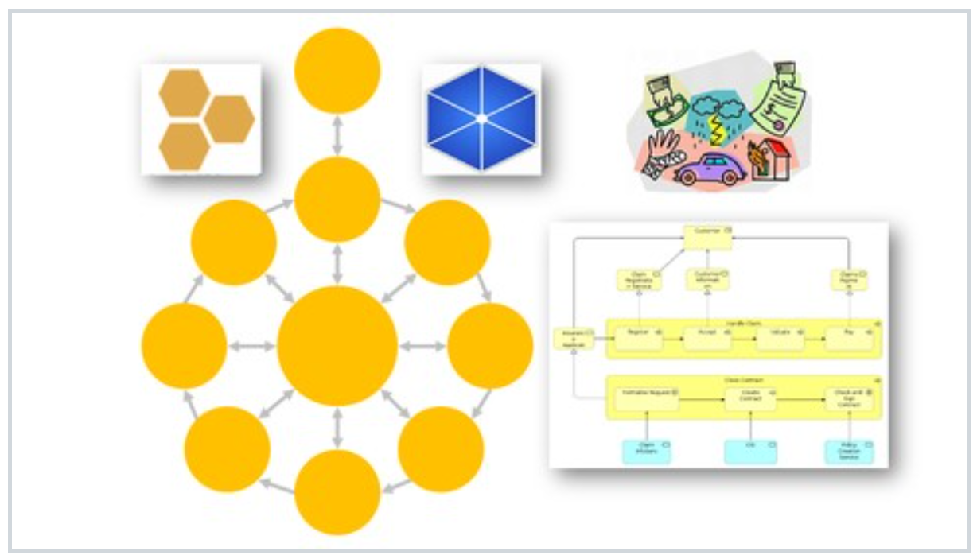
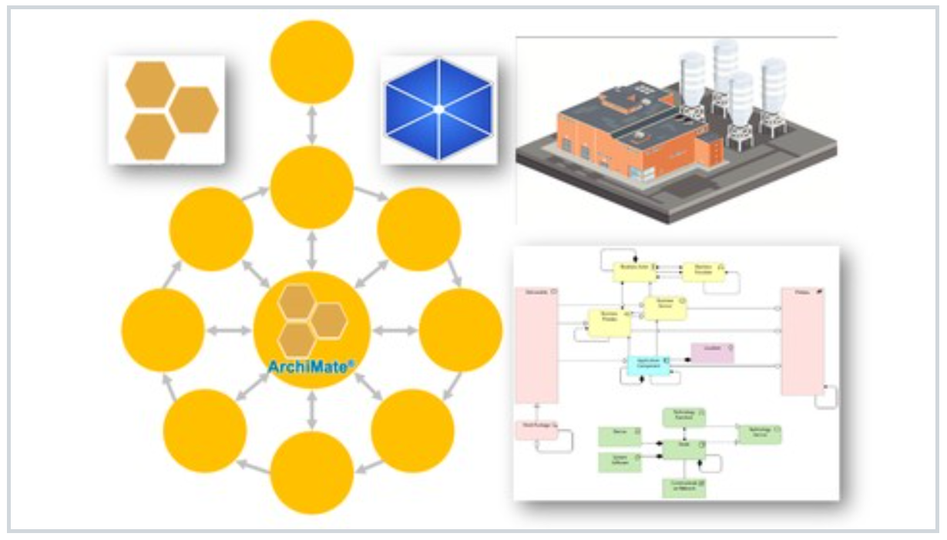

ArchiSurance
ArchiMetal
NEW

