Slide 1
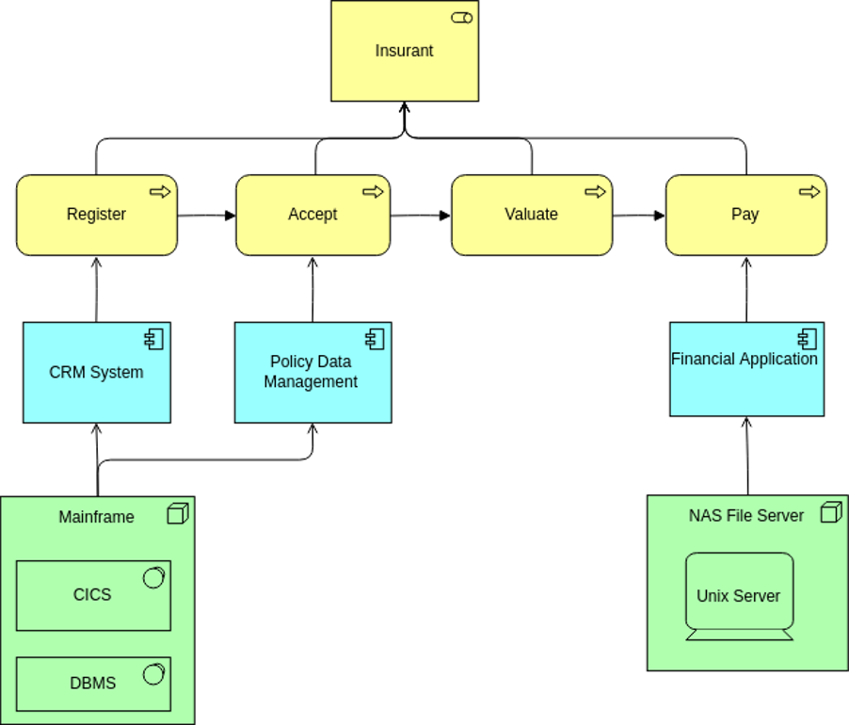

ArchiMate Cookbook
Author: Eero Hosiaisluoma Instructor: Zhao Xiaoqi

Slide 2
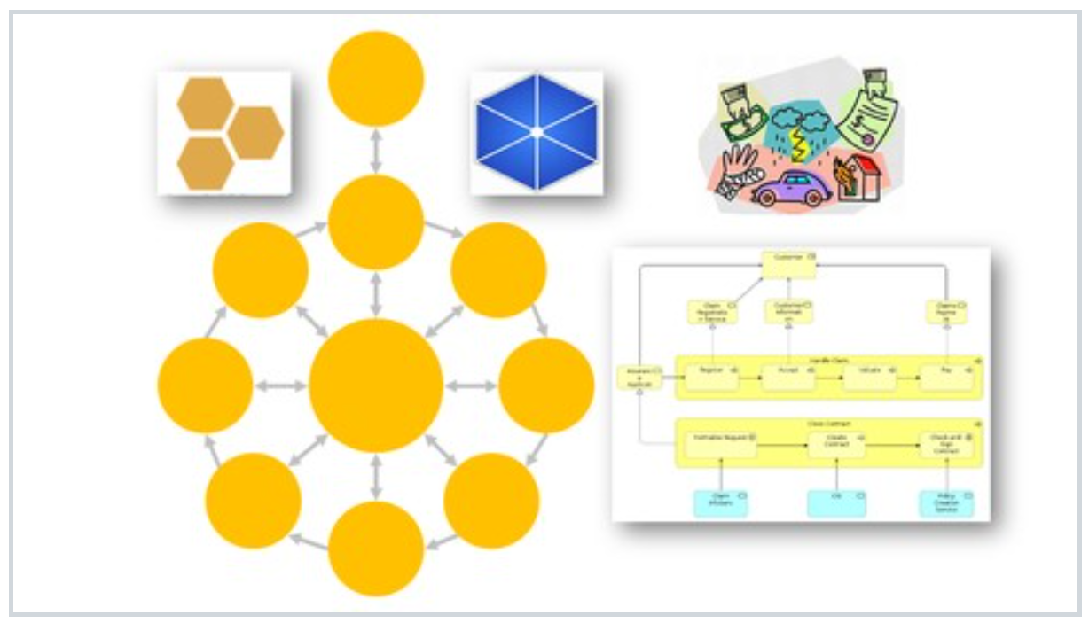
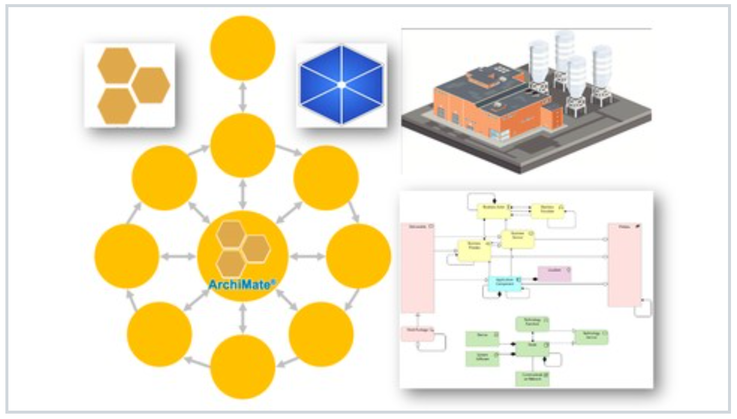

ArchiSurance
ArchiMetal

