Slide 1
ILAS Exercise 2
Group 20
Martin Schmitz
Paul Bryan Alexander Hinzen

Slide 2
Used Technologies
class Node(object):
def __init__(self, used_atts = [], examples = None, leaf = False, label = None):
self.used_atts = used_atts
self.examples = examples
self.left = None
self.right = None
self.split_attr = None
self.split_value = None
self.label = label
self.leaf = leaf
def becomes_leaf(self,c):
self.leaf = True
self.label = c
Python
Simple Tree structure
Pandas DataFrame
Used Libraries:
NumPy
Pandas
PyDot
Pickle

Slide 3
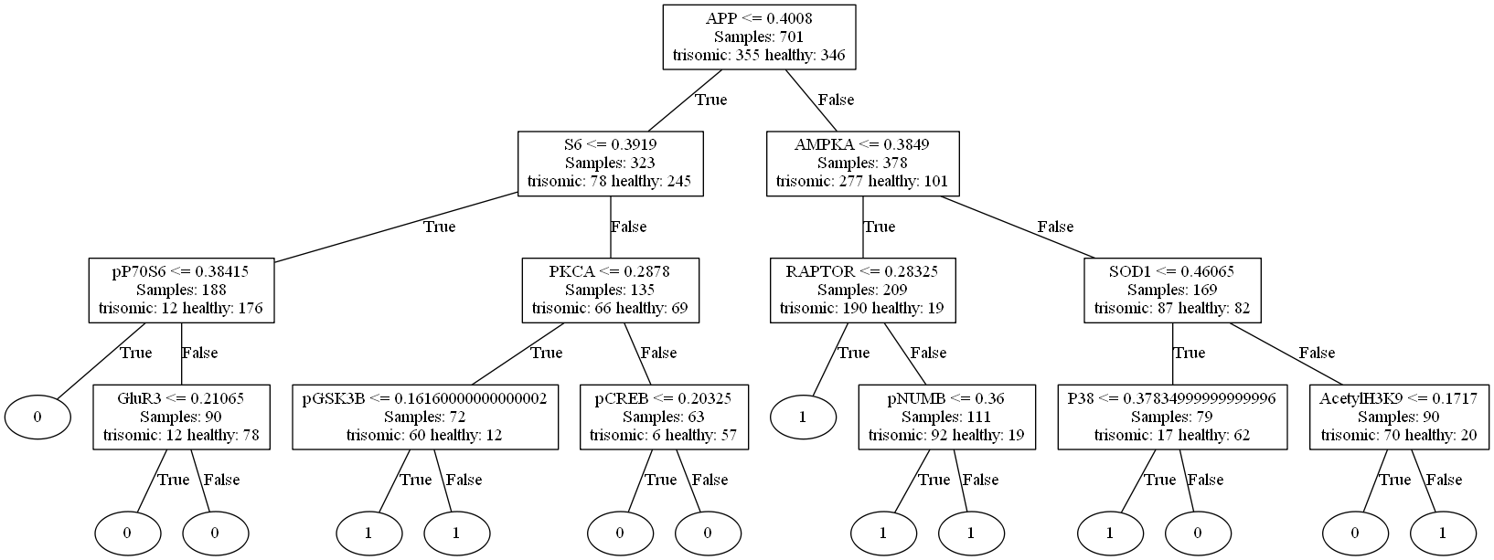
Used Technologies
Accuracy: 0.853 (Depth 3) Accuracy: 0.922 (Depth 7)

Slide 4
Google Scholar Search
APP: 23100
S6: 3600
AMPKA: 839
PKCA: 3530
RAPTOR: 255
SOD1: 2160
pP70S6: 161
GluR3: 72
pGSK3B: 19
pCREB: 76
pNUMB: 1270
P38: 3620
AcetylH3K9: 7

Slide 5
Group dependent Task
Effect of label noise:
1. “Flip” each class label of the training data with a probability of
(a) 0.1, and
(b) 0.25, respectively.
2. Construct a decision tree using the training data with “noisy” labels.
3. Measure the accuracy of the decision tree on the test data. (Please note that you should not flip the labels of the test data!)
Notes:
(With “flipping”, we mean that the label indicating trisomy, is replaced by the label indicating a healthy mouse, and vica versa.) This way, you generate a “noisy” version of the labels of the training data.

Slide 6
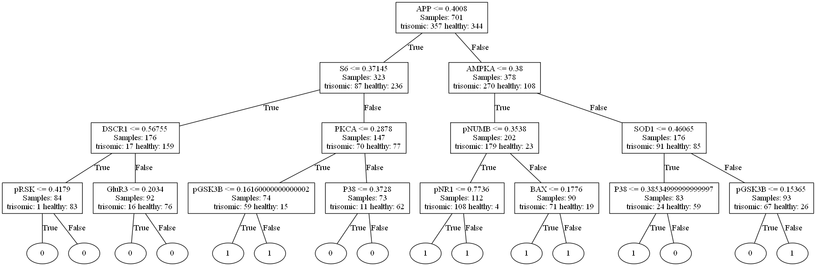
Group dependent Task
Labels Flipped: 61 / 701 Percentage: 0.087
Accuracy: 0.829 (Depth 3) Accuracy: 0.87 (Depth 7)

Slide 7
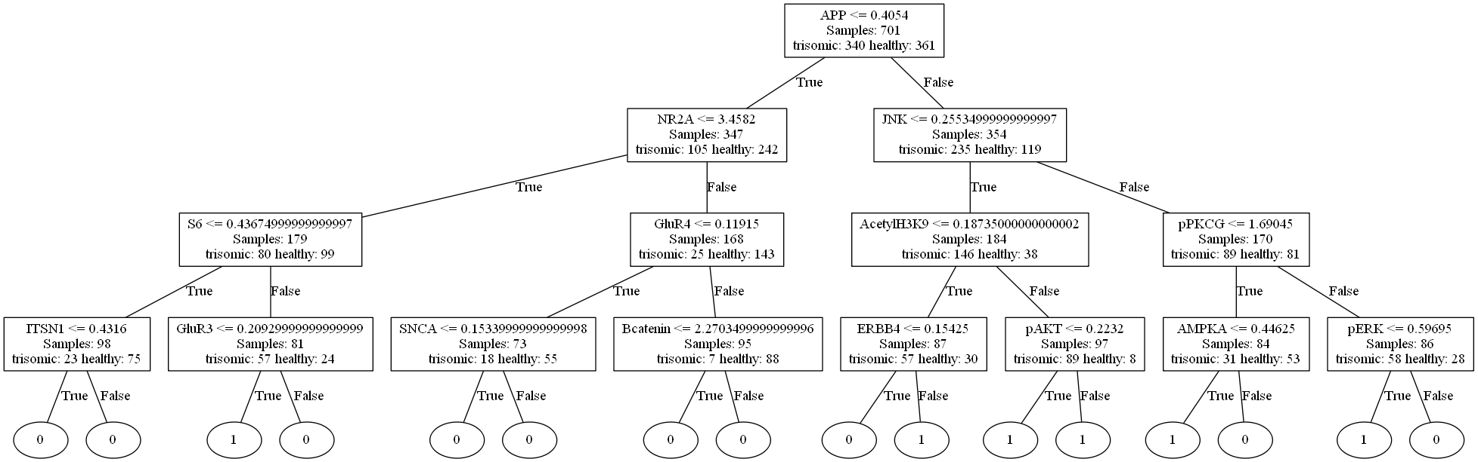
Group dependent Task
Labels Flipped: 194 / 701 Percentage: 0.2767475035663338
Accuracy: :0.795 (Depth 3) Accuracy: 0.777 (Depth 7)

Slide 8
Thank you for your kind attention.
Martin Schmitz
Paul Bryan Alexander Hinzen
_______________________
Group 20

