Slide 1

Leaflets three, let it be?
-- Mushroom edibility classification
Wanli Zhang
Martin Guyer
Shangjia Dong

Slide 2
Introduction
Task:
Classify mushrooms as poisonous or edible based on their physical attributes
Method
Machine learning: Binary classification
Categorical data distance
Naive Bayes

Slide 3
Introduction
Dataset:
Dataset characteristics: Multivariate
Attribute characteristics: Categorical
Instances: 8124
Attributes: 22
Missing value on some attributes
Not missing completely random
Treat missing values as another category

Slide 4
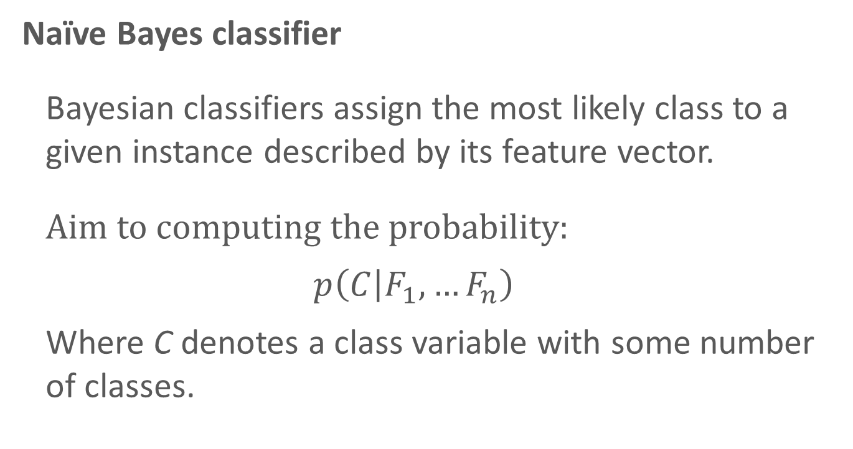
Methodology
Naïve Bayes classifier
Bayesian classifiers assign the most likely class to a given instance described by its feature vector.
Aim to computing the probability:
$$p\left(C | F_{1},…F_{n}\right)$$
Where C denotes a class variable with some number of classes.

Slide 5
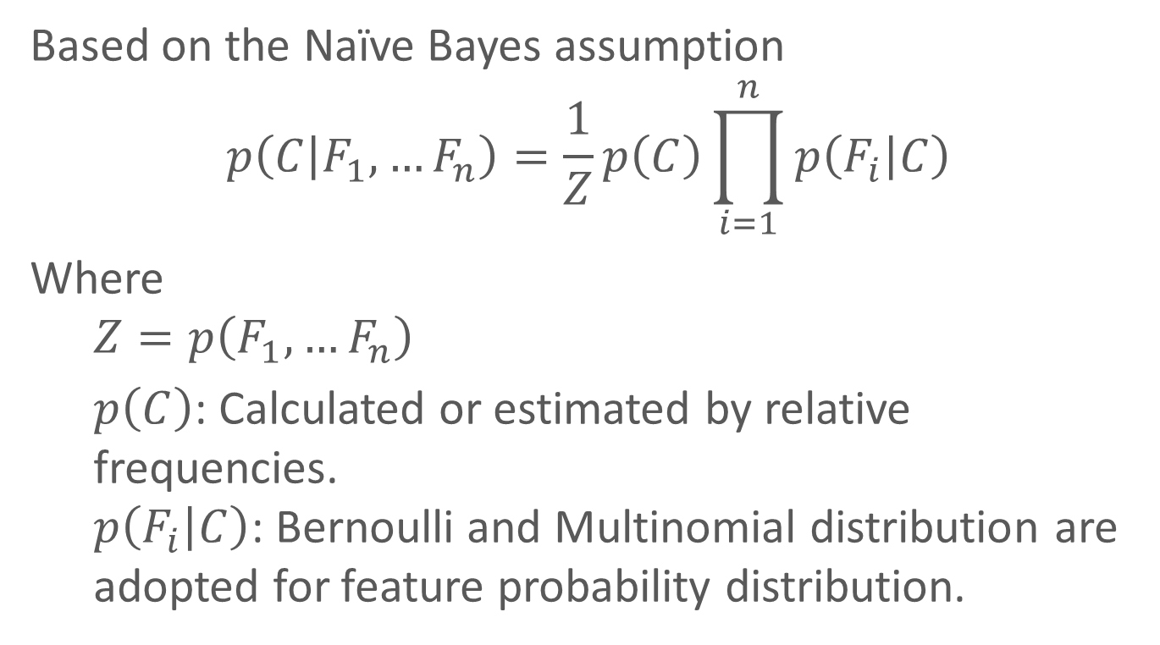
Methodology
Based on the Naïve Bayes assumption
$$p\left(C | F_{1},…F_{n}\right)=\frac{1}{Z}p\left(C\right)\prod_{i=1}^{n}{p\left(F_{i} | C\right)}$$
Where
$$Z=p\left(F_{1},…F_{n}\right)$$
$p\left(C\right)$: Calculated or estimated by relative frequencies. $p\left(F_{i} | C\right)$: Bernoulli and Multinomial distribution are adopted for feature probability distribution.

Slide 6
Methodology
Classification Rule
Maximum a Posteriori (MAP): An instance is placed in the most probable group.
In Binary classification, a threshold is utilized:
If the prediction probability falls above the threshold, the instance is labelled positive
If not, negative.

Slide 7
Methodology
Validation
K-fold cross validation
Dataset is split into six equally-sized subsets;
Apply Naïve Bayes six times
Each time: one test set, five training set.

Slide 8
Methodology
Receiver Operating Characteristics (ROC)
Select an optimal threshold to map instances to predicted classes
Apparent Error Rate (APER)
Fraction of misclassified sample observation
False Negative (FN)
The probability of classifying a poisonous (positive) mushroom as being edible (edible)

Slide 9
Methodology
R packages
library(e1071 )
Function: naiveBayes()
predict()
library(ROCR )
Function: pred()
performance()

Slide 10
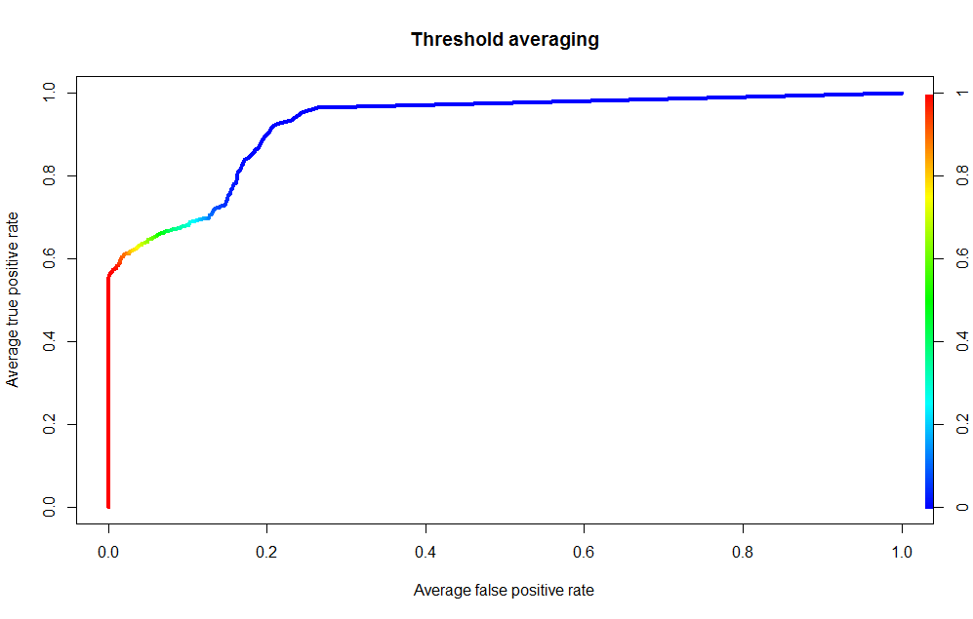
Findings
ROC graph depicts relative tradeoffs between benefits (TP) and costs (FP). The more “northwest” a point lies, the better the corresponding classifier performance.

Slide 11
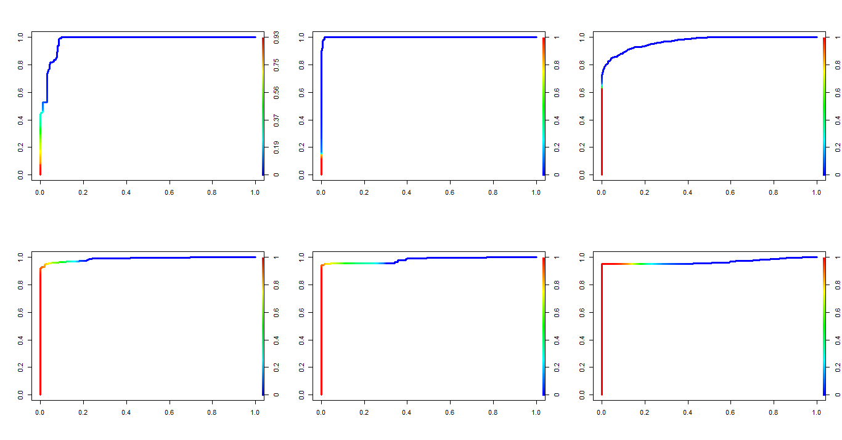
Findings

Slide 12
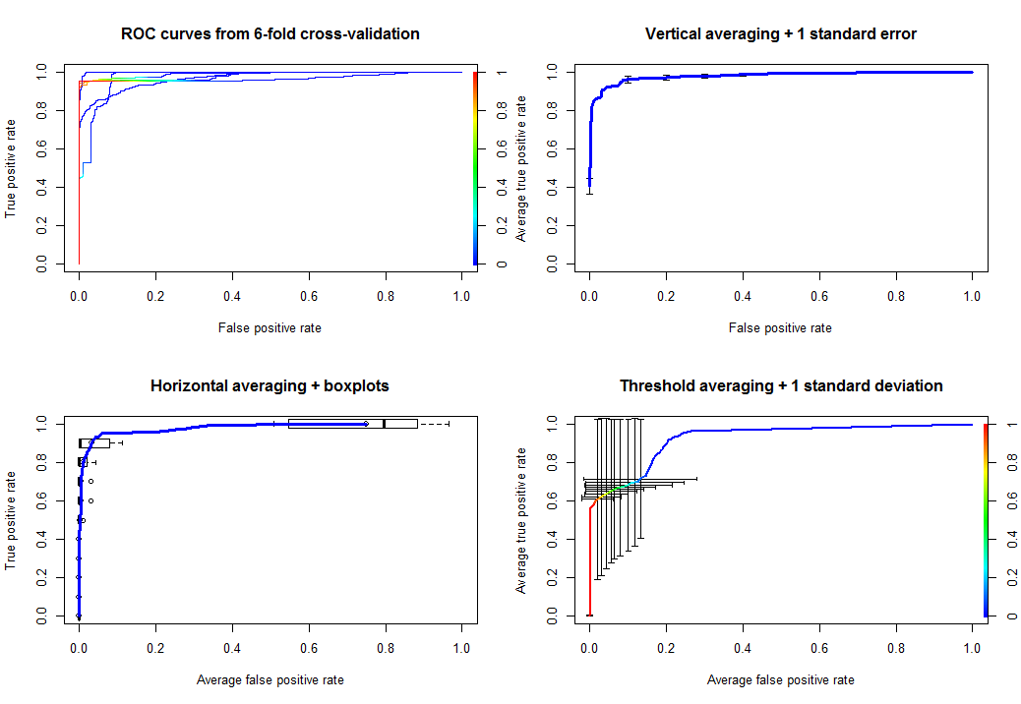
Findings

Slide 13
Findings
Run | APER | FNR
1 | 0.0798 | 0.0392
2 | 0.0214 | 0.2302
3 | 0.0805 | 0.2013
4 | 0.0517 | 0.0234
5 | 0.0805 | 0.0428
6 | 0.2349 | 0.0385
Avg | 0.0798 | 0.0392
Threshold = 0.005

Slide 14
Findings
With our choice of threshold (0.005), Naïve Bayes classifier mistakenly classifies 7.98% of mushrooms, and 3.92% of poisonous mushrooms are wrongly identified as being edible.

Slide 15
Discussion
Assumption
Main assumption of the report, also the assumption of Naïve Bayes classifier, is, independence between features given class labels. Although with a strong assumption, Naïve Bayes still have high accuracy in classifying. Its robustness remains an open question.

Slide 16
Discussion
Scaling to Big data
Run time of six fold cross validation took 6.13s. As sample size increasing, we expect run time would increase at lease linearly.
If a new categorical variable with k levels is added, assume a multinomial distribution, then extra k-1 parameter need to be estimated.

Slide 17
Discussion
Obstacles
Which classification method should we use?
Logistic regression: did not work, because iterative algorithm didn’t converge
K-nearest neighbors: did not work, because KNN does not take distance matrix as input, instead, it calculates a Euclidean distance matrix automatically

Slide 18


