Slide 1
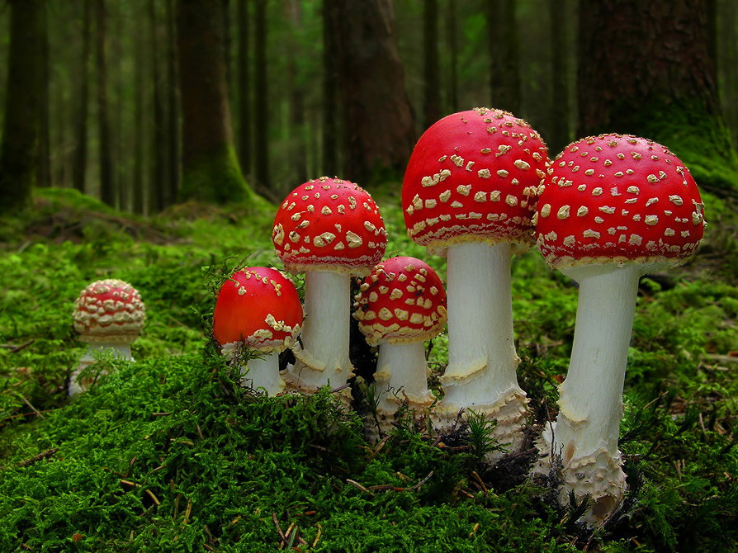
Leaflets three, let it be?
-- Mushroom classification
Wanli Zhang
Martin Guyer
Shangjia Dong

Slide 2
Introduction
Task:
Classify mushrooms as poisonous or edible based on their physical attributes
Dataset:
Dataset characteristics: Multivariate
Attribute characteristics: Categorical
Instances: 8124
Attributes: 22 (missing value on some attributes)

Slide 3
Introduction
Method
Machine learning: binary classification
Categorical data distance
Naive Bayes

