Slide 1

Leaflets three, let it be?
-- Mushroom edibility classification
Wanli Zhang
Martin Guyer
Shangjia Dong

Slide 2
Introduction
Task:
Classify mushrooms as poisonous or edible based on their physical attributes
Method
Binary classification problem
Naive Bayes

Slide 3
Introduction
Data set:
Response: Binary (poisonous/edible)
Attribute: Categorical
Instances: 8124
Attributes: 22
Missing value in one attribute (2480)
Not missing completely at random
Treat missing values as another category
Notes:
Note: For missing values, talk about missing value being related to other attributes. That is, instances with certain attributes are missing “stalkroot” value.

Slide 4
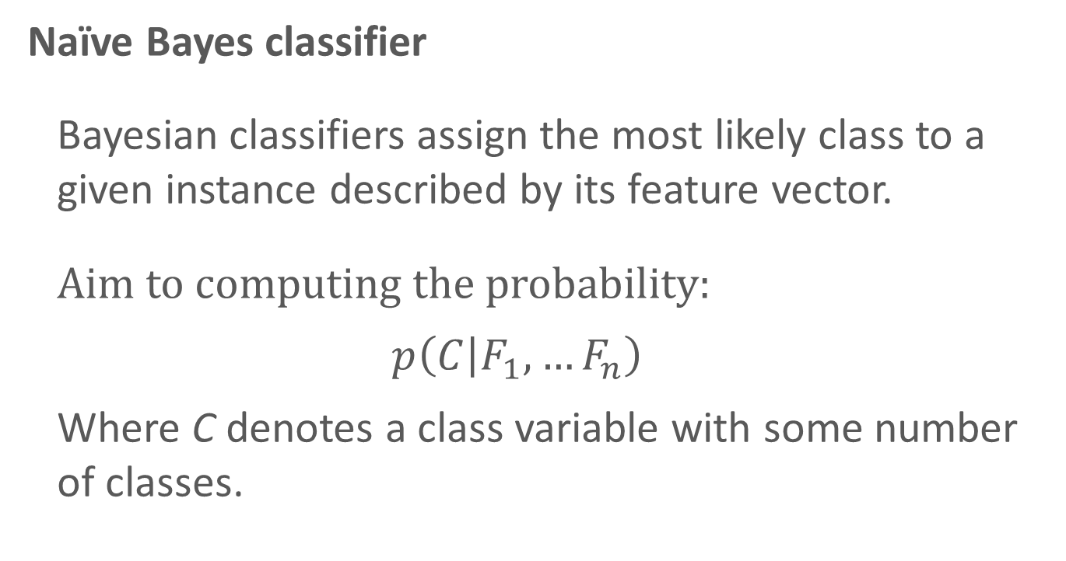
Methodology
Naïve Bayes classifier
Bayesian classifiers assign the most likely class to a given instance described by its feature vector.
Aim to computing the probability:
$$p\left(C | F_{1},…F_{n}\right)$$
Where C denotes a class variable with some number of classes.

Slide 5
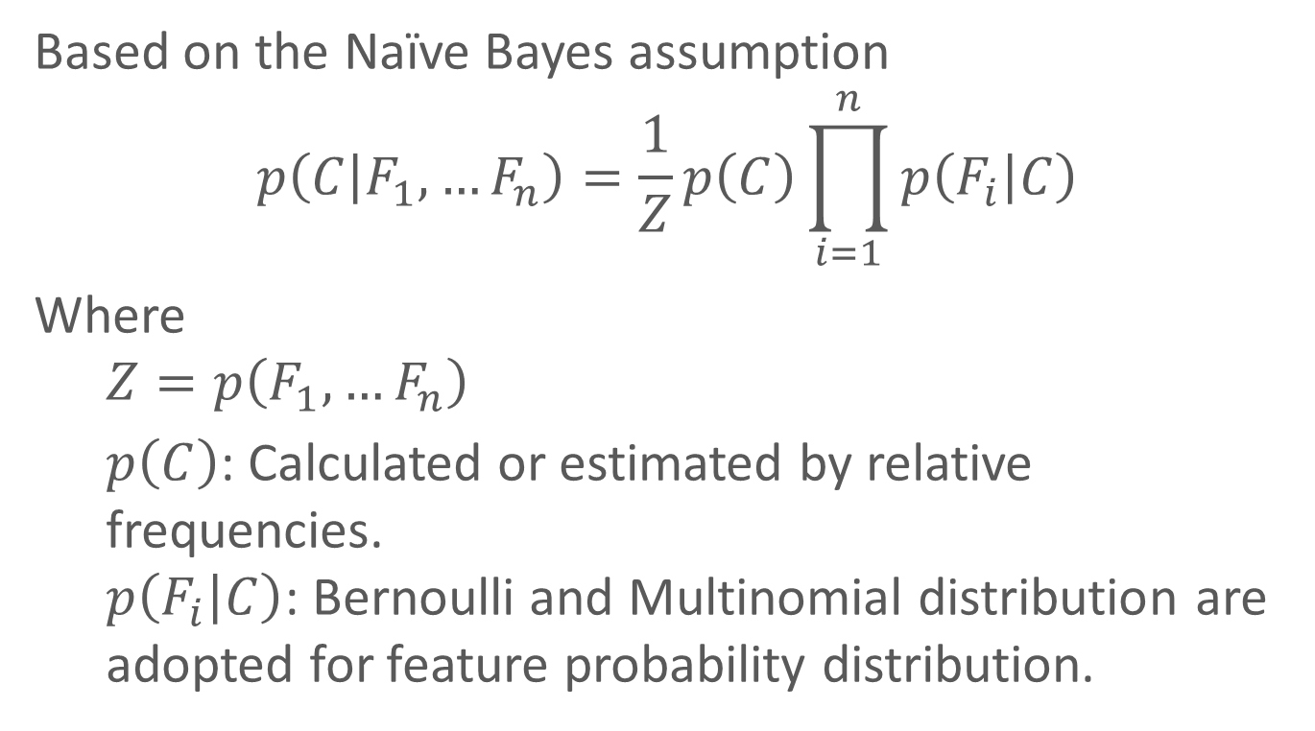
Methodology
Based on the Naïve Bayes assumption
$$p\left(C | F_{1},…F_{n}\right)=\frac{1}{Z}p\left(C\right)\prod_{i=1}^{n}{p\left(F_{i} | C\right)}$$
Where
$$Z=p\left(F_{1},…F_{n}\right)$$
$p\left(C\right)$: Calculated or estimated by relative frequencies. $p\left(F_{i} | C\right)$: Bernoulli and Multinomial distribution are adopted for feature probability distribution.
Notes:
Mention that the assumption is “independence between features”.

Slide 6
Methodology
Classification Rule
In Binary classification, a threshold is utilized:
If the prediction probability falls above the threshold, the instance is labeled positive (poisonous, in our case)
If not, negative (edible).
Multi-class:
Assign instance to most probable class
Notes:
Just talk about using a threshold for our study.

Slide 7
Methodology
Validation
K-fold cross validation
Data set is split into six equally-sized folds
Apply Naïve Bayes once for each run
Each time:
Five folds as training set
Remaining one as test set

Slide 8
Methodology
Receiver Operating Characteristics (ROC)
Select an optimal threshold to map instances to predicted classes
Apparent Error Rate (APER)
Fraction of misclassified sample observations
False Negative (FN) Rate
The probability of classifying a poisonous (positive) mushroom as being edible (negative)

Slide 9
Methodology
R packages
Naïve Bayes:
library(e1071 )
Function: naiveBayes()
predict()
ROC plot:
library(ROCR )
Function: pred()
performance()

Slide 10
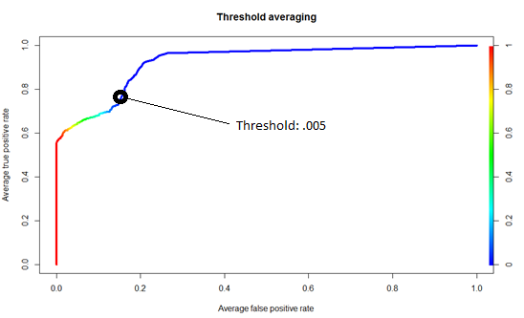
Findings
ROC graph depicts relative tradeoffs between benefits (TP) and costs (FP). The more top-left a point lies, the better the corresponding classifier performance.
Notes:
Should explain what axes are. X-axis: false positive rate. Y-axis: true positive rate. Point (0,1) has best possible performance.

Slide 11
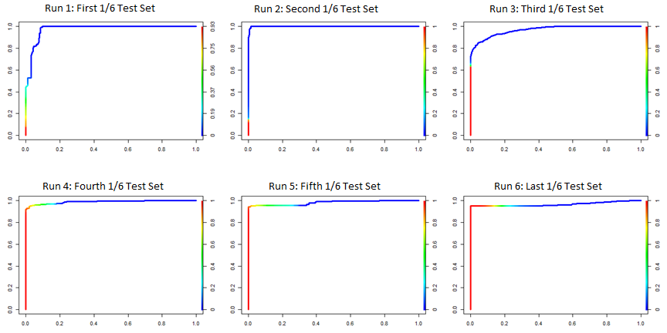
Findings
Notes:
ROC for each run of CV.

Slide 12
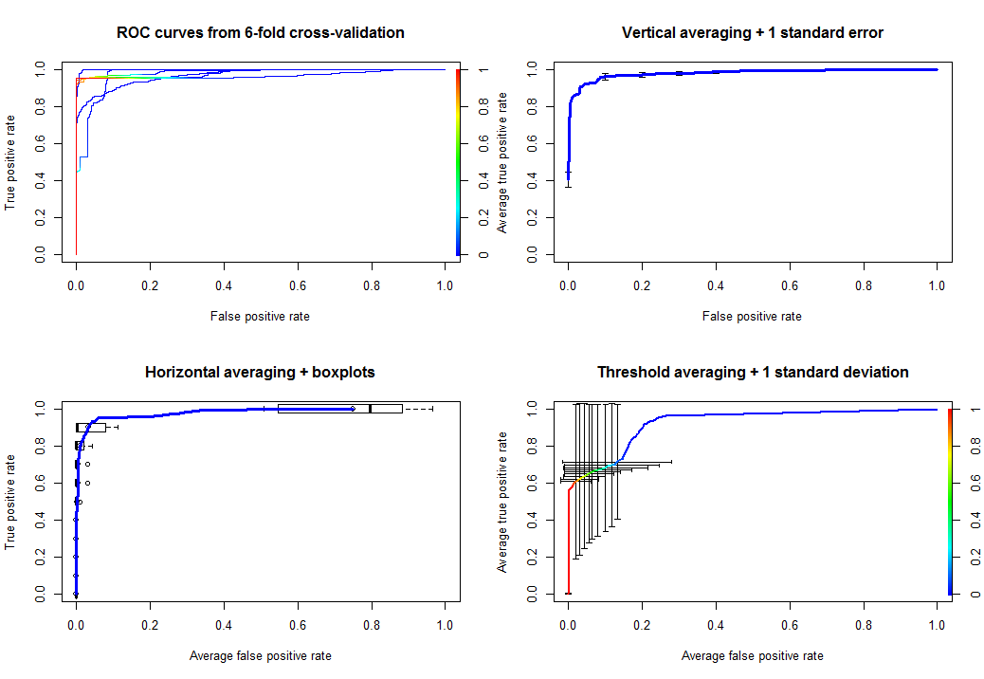
Findings
Notes:
Different ways of averaging the ROC curves.
Notice that averaging vertically or horizontally makes sense only if we can CONTROLL false positive or true positive rates for each run.
But we can’t. So we instead averaged at each threshold.

Slide 13
Findings
Finding optimal threshold by averaging over all runs:
Threshold | False Negative Rate | Apparent Error Rate
0.5 | 0.70588235 | 0.07976366
0.1 | 0.48366013 | 0.06351551
0.05 | 0.45751634 | 0.07828656
0.01 | 0.1633987 | 0.0760709
0.005 | 0.03921569 | 0.07976366
0.001 | 0.0000000 | 0.1329394

Slide 14
Findings
APER & FNR for each run:
Run | APER | FNR
1 | 0.0798 | 0.0392
2 | 0.0214 | 0.2302
3 | 0.0805 | 0.2013
4 | 0.0517 | 0.0234
5 | 0.0805 | 0.0428
6 | 0.2349 | 0.0385
Avg | 0.0798 | 0.0392
Threshold = 0.005

Slide 15
Findings
With our choice of threshold (0.005):
Naïve Bayes misclassifies 7.98% of mushrooms
Poisonous mushrooms identified as being edible 3.92% of time

Slide 16
Discussion
Assumption
Independence between features given class labels
Unrealistic in practice
Naïve Bayes gives good results even if assumption is not met
Reason behind robustness is an open question

Slide 17
Discussion
Scaling to Big data
Run time of 6-fold CV: 6.13s
Expect run time to increase with size of test set
1/6 training and 5/6 testing : 42.14s
Expect run time to increase with # of features
Assume multinomial distribution
Each new feature with k levels means an extra k-1 parameters to estimate

Slide 18
Discussion
Obstacles
Which classification method should we use?
Logistic regression: did not work, because iterative algorithm didn’t converge
K-nearest neighbors: did not work, because knn does not take distance matrix as input, instead, it calculates a Euclidean distance matrix automatically
Side: R doesn’t like a distance matrix of dim 8124 X 8124

Slide 19


