Slide 1

Aerospace Working Group
2025 Annual Update
Matthew Weber & Dr. Martin Halle
Aerospace · Automotive · Linux Features
Medical Devices · OS Engineering Process Safety Architecture · Space Grade Linux · Systems · Tools
Notes:
10 minutes retrospective
10 minutes looking forward
5 minutes call to action / Q&A.
Thank Steve and a quick Bio

Slide 2
Agenda
Look back at major milestones and achievements in 2024
Current focus and activities
What’s coming up in 2025 and areas and opportunities for collaboration
Onboarding resources and how to get involved
“The Aerospace Working Group shall develop use cases to inform and influence Linux architecture and related tools, work to derive technical requirements for avionics operating systems, and seek to enhance and expand avionics software lifecycle processes, practices, and tools to enable use of Linux in avionics systems that are certified to high design assurance levels.”
Aerospace · Automotive · Linux Features · Medical Devices · OS Engineering Process · Safety Architecture · Space Grade Linux · Systems · Tools

Slide 3

2024 Achievements
Active participation: (2023 vs. 2024)
45 unique members attended meetings
18 → 23 meetings
Average meeting attendance is up 7.1 → 8.91
Use case: “Cabin Lighting” draft architecture, requirements and test
Formation of Space Grade Linux (SGL) Special Interest Group(SIG) (https://elisa.tech/space-grade-linux-sig/)
Thank you Ramon Roche and Ivan Perez (NASA Ames) for leading this!
Aerospace · Automotive · Linux Features · Medical Devices · OS Engineering Process · Safety Architecture · Space Grade Linux · Systems · Tools

Slide 4
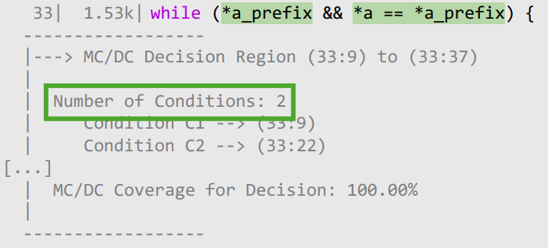
2024 Achievements
Webinars, Workshops, and Conference Presentations:
NASA Goddard Workshop – “Forming an ecosystem around open source in space!” (Dec)
Linux Foundation Plumbers (Sept)
Making Linux Fly: Towards a Certified Linux Kernel
Source-based code coverage of Linux kernel (Modified Condition/Decision Coverage (MC/DC))
Linux Foundation EOSS - “Measuring Code Coverage of the Linux Kernel in Accordance with RTCA DO-178C Considerations,” (Apr)
Seminar Series – “Making Linux Fly” (May)
Aerospace · Automotive · Linux Features · Medical Devices · OS Engineering Process · Safety Architecture · Space Grade Linux · Systems · Tools

Slide 5
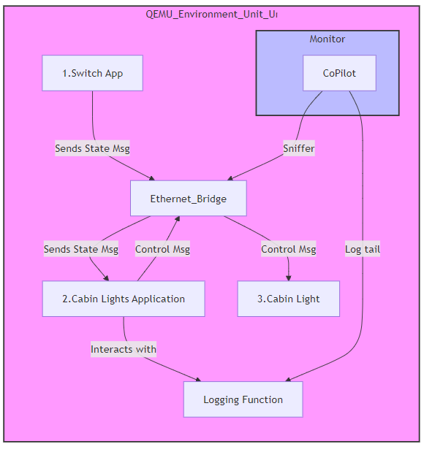
Current Focus and 2025 Activities
Use case: “Cabin Lighting” verification demos
Prebuilt images
Basic examples of current use case
Advanced examples
Adjusting test apps
Configuring operating system
Building test harness and monitors
Aerospace · Automotive · Linux Features · Medical Devices · OS Engineering Process · Safety Architecture · Space Grade Linux · Systems · Tools

Slide 6
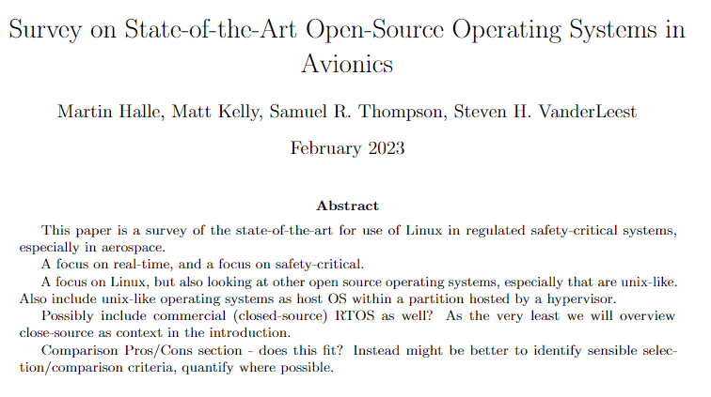
What’s Coming in 2025
Restart work on “Survey on State-of-the-Art Open Source Linux-Like Operating Systems in Avionics” white paper
Adding flight framework comparison (F’ / cFS / GERICOS / CAST / KubOS / …)
Survey on satellite use of Linux (SAT GUS / SuperDoves / …)
Aerospace · Automotive · Linux Features · Medical Devices · OS Engineering Process · Safety Architecture · Space Grade Linux · Systems · Tools

Slide 7
What’s Coming in 2025
Establishing code repositories
Licensing plan
Space Grade Linux has an example of the CC-BY-SA-4 and MIT license approach (https://github.com/elisa-tech/meta-sgl/blob/main/LICENSE)
Automation plan – Combination of GitHub and GitLab
Apply Linux Kernel Requirements and Test trace practice from ELISA Safety Architecture group
Aerospace · Automotive · Linux Features · Medical Devices · OS Engineering Process · Safety Architecture · Space Grade Linux · Systems · Tools

Slide 8


How to Get Involved
https://lists.elisa.tech/g/aerospace
Subscribe to email list
Join the Aerospace and Space Grade Linux meetings
https://github.com/elisa-tech/wg-aerospace
View meeting minutes
Use case and whitepaper documents
Use case Demos
Aerospace · Automotive · Linux Features · Medical Devices · OS Engineering Process · Safety Architecture · Space Grade Linux · Systems · Tools

