Slide 1





mortAAR: the analysis of archaeological mortality data in R
Christoph Rinne, Nils Müller-Scheeßel, Martin Hinz

Slide 2
mortAAR: the analysis of archaeological mortality data in R
The use of life tables in (bio-)archaeology
the use of life tables in demography go back as far as 1662
aim in demography: identifying current state and projecting future development of populations
aim in (bio-)archaeology: enabling comparisons of mortality patterns across time and space
differences in data: demographical research can fall back on state-governed census while (bio-)archaeology deals with skeletal populations
problems in (bio-)archaeological data:
ageing of adults is very problematic
representativeness of data can be questioned
assumption of stationary populations is questionable
consequence: life tables have somewhat gone out of fashion

Slide 3
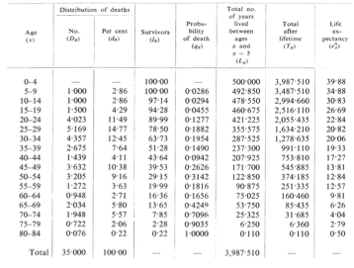
mortAAR: the analysis of archaeological mortality data in R
Advantages of life tables:
comparability
easily computable
different angles on the same data (e.g., dx vs. qx)
A typical life table (after Acsádi/Nemeskéri 1970, 166 tab. 46)

Slide 4
mortAAR: the analysis of archaeological mortality data in R
mortAAR – essential functions
prep.life.table: preparation of raw data (proportional partitioning of age ranges into single years)
life.table: generating the life table
plot: plotting diagnostic graphs

Slide 5
mortAAR: the analysis of archaeological mortality data in R
prep.life.table – options
dec: useful for already pooled data
group: categorisation of individuals (e.g., sex)
method: configuration of age cohorts (standard: 0, 1, 5, 10, 15 etc.)
agerange: depending on the age format, overlapping age categories can be avoided

Slide 6
mortAAR: the analysis of archaeological mortality data in R
life.table – options
neclist: output of prep.life.table
agecor: children < 5 do not tend to die in the middle of their age class, so the number of lived years should be downweighted
agecorfac: the default value for the correction factor is a/3

Slide 7
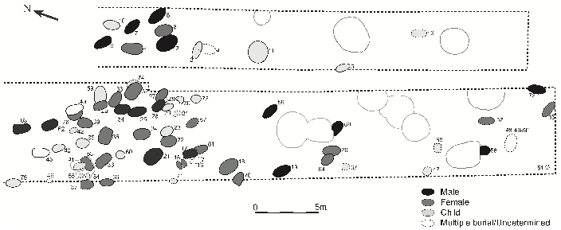
mortAAR: the analysis of archaeological mortality data in R
Putting mortAAR into action – An Early Neolithic cemetery
Female, 45+
Male, 45+
Examples of burials from the cemetery of Nitra (after Pavuk 1972, 9 fig. 4).
Plan of the LBK cemetery of Nitra (after Whittle et al. 2013, 138 fig. 4.20).
Individuals from the cemetery of Nitra (data after Whittle et al. 2013, 139ff. tab. 4.15).

Slide 8
mortAAR: the analysis of archaeological mortality data in R
Putting mortAAR into action – An Early Neolithic cemetery
Output of prep.life.table (data after Whittle et al. 2013, 139ff. tab. 4.15).

Slide 9
mortAAR: the analysis of archaeological mortality data in R
Putting mortAAR into action – An Early Neolithic cemetery

Slide 10
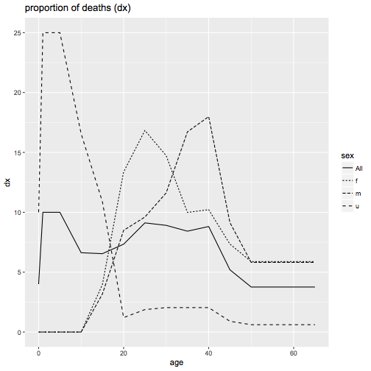
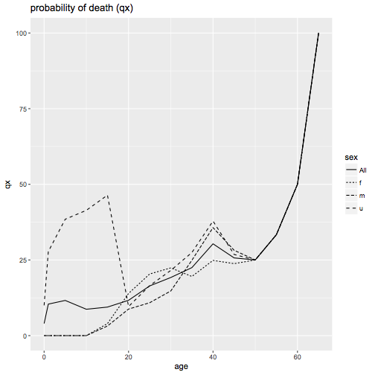
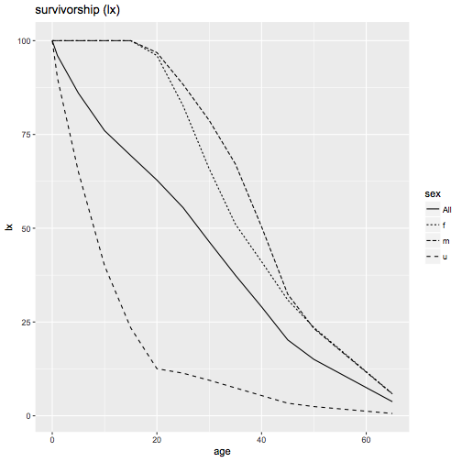
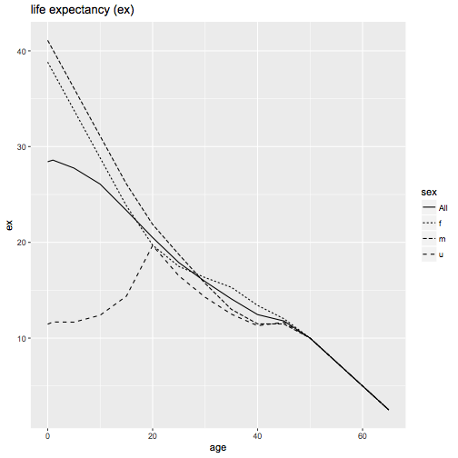
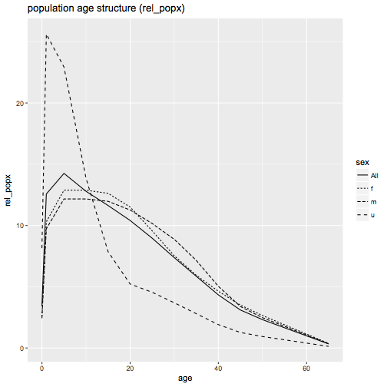
mortAAR: the analysis of archaeological mortality data in R
Putting mortAAR into action – An Early Neolithic cemetery

Slide 11
mortAAR: the analysis of archaeological mortality data in R
Life tables – Why are they still useful?
While we do not dismiss the problematics of life tables with their assumption of stationary populations, we still think that even in their simple form they provide useful information at least for the archaeologist. Even if the age-pattern is distorted, it still provides highly relevant information about cultural behaviour and preferences.
Archaeologists, anthropologists and paleodemographers should work closer together than they have in the past to get to grips with actual population developments, representation of burial data and possible sources of bias.

Slide 12
mortAAR: the analysis of archaeological mortality data in R
mortAAR
If our package helps in this process, we would be more than happy.
on github: https://github.com/ISAAKiel/mortAAR
on CRAN: https://CRAN.R-project.org/package=mortAAR

