Slide 1
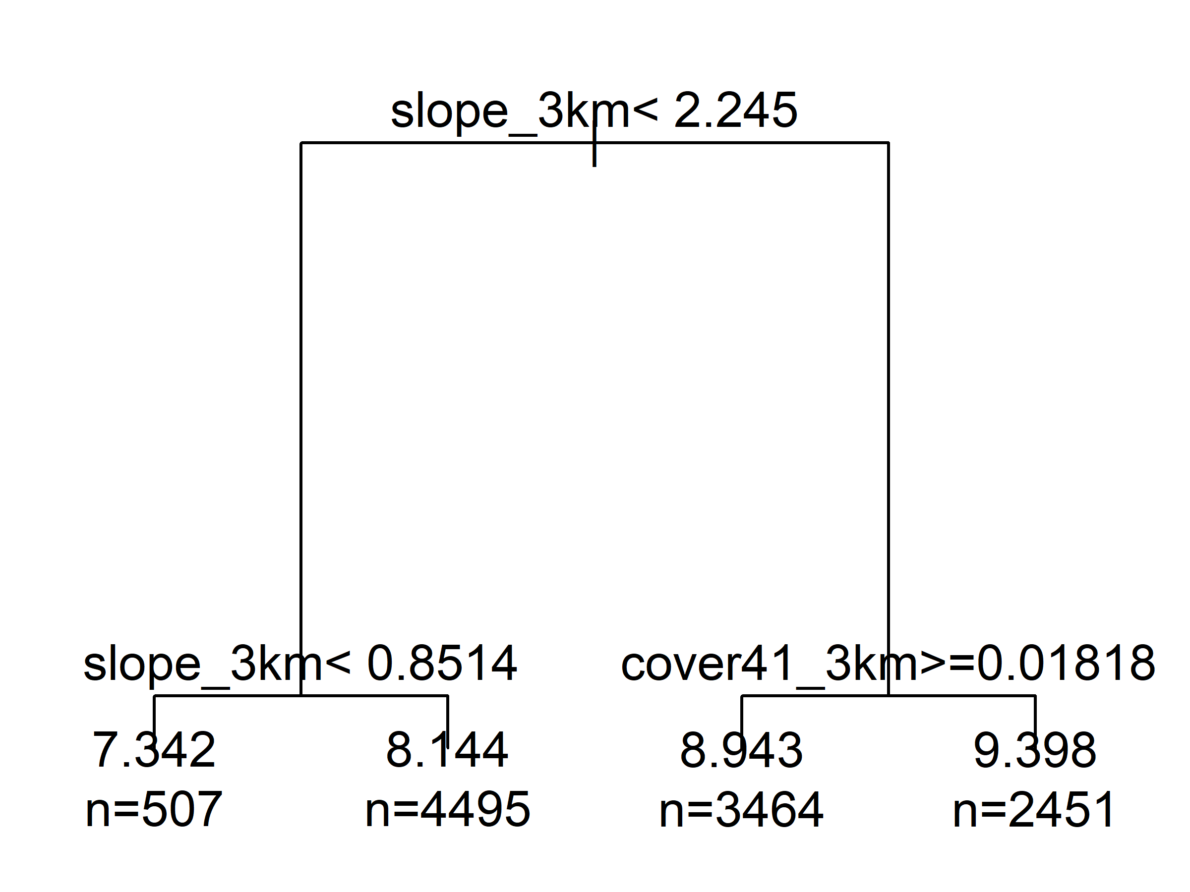
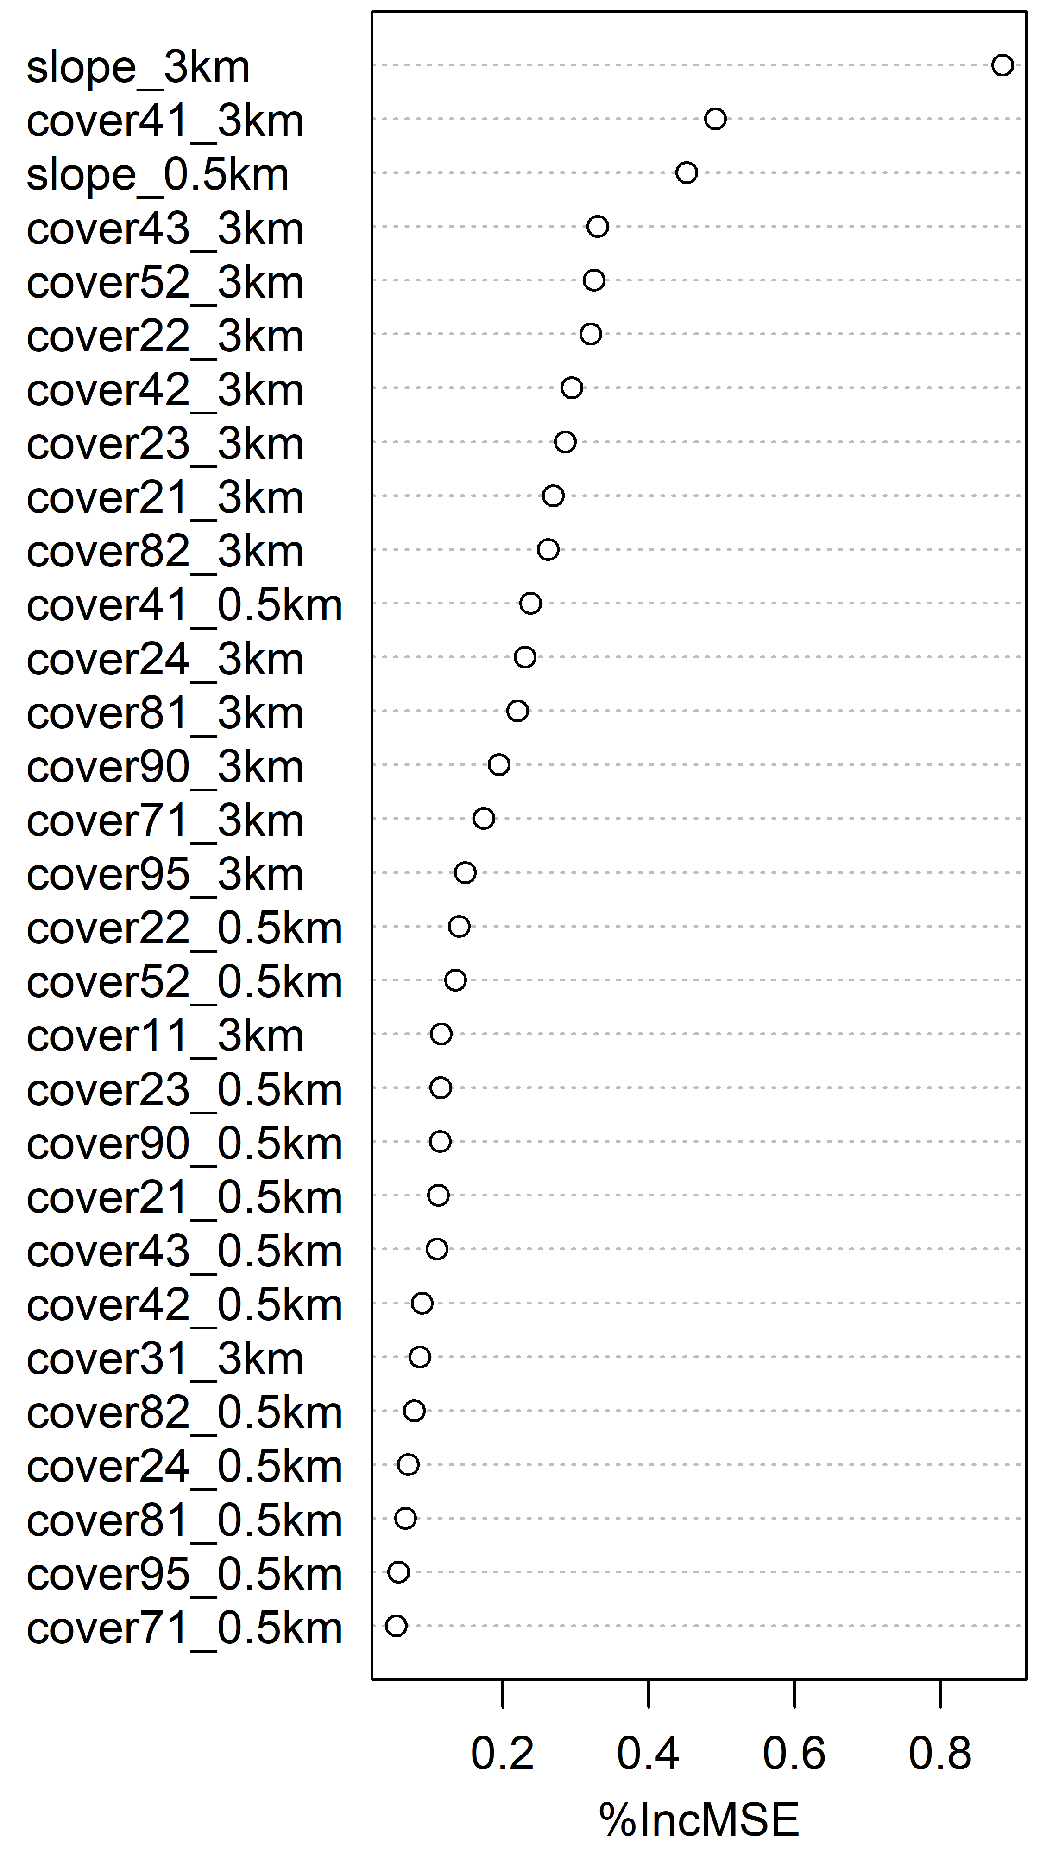
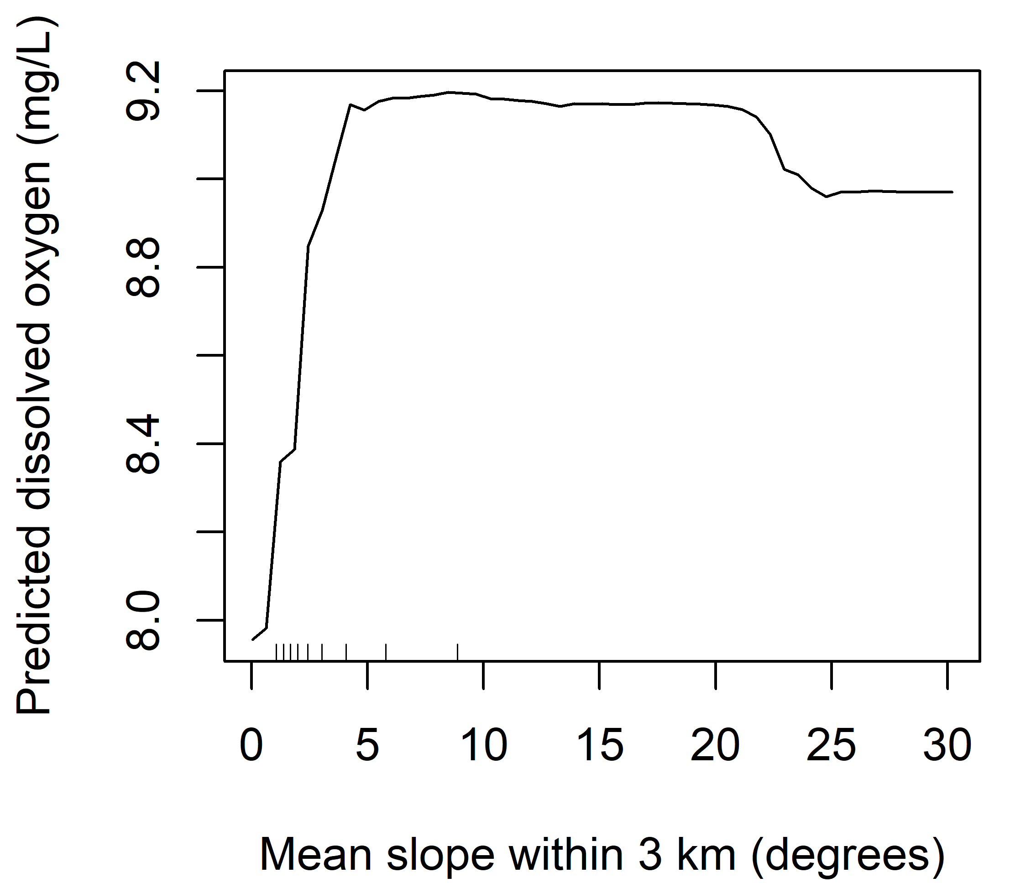
Modeling Dissolved Oxygen Concentration In Streams
Martin Holdrege*
Introduction
Table 1. Description of landcover classes.
Modeling:
Why focus on dissolved oxygen?
The response variable being modeled was mean dissolved oxygen content at a site.
Predictor variables were slope, and the proportion of pixels around a site that belonged to each of 15 land use cover classes (Table 1). Both mean slope and proportion of each cover class were calculated for a 0.5 km and 3 km radius around each site, creating a total of 32 predictor variables.
Ordinary least squares regression, Lasso regression, regression tree and random forest models were used.
Models were trained on 70% of data and tested on the remaining data.
Code used to run these models is available at: https://github.com/MartinHoldrege/water_qual_cs5665
Landcover class | Description
Cover11 | Open water
Cover21 | Developed, open space
Cover22 | Developed, low intensity
Cover23 | Developed, medium intensity
Cover24 | Developed, high intensity
Cover31 | Barren land (rock/sand/clay)
Cover41 | Deciduous forest
Cover42 | Evergreen forest
Cover43 | Mixed forest
Cover52 | Shrub/scrub
Cover71 | Grassland/herbaceous
Cover81 | Pasture/hay
Cover82 | Cultivated crops
Cover90 | Woody wetlands
Cover95 | Emergent herbaceous wetlands
Dissolved oxygen is important for stream health, and is a measure of the amount of oxygen (O₂) that is in water.
When dissolved oxygen levels become too low, fish and invertebrates cannot survive, because they use this O₂ to ‘breath’.
Dissolved oxygen is commonly measured and data is publicly available.
Land use (e.g. urban, farmland, forest etc.) may affect dissolved oxygen through impacting aquatic plant growth, and other disturbance. Slope may impact dissolved oxygen because faster running water is more easily aerated.
Fig 1. Pruned regression tree (pruned using ‘1 SE Rule’). Two splits are on mean slope within 3 km of site, and one is on proportion deciduous forest within 3 km
Objectives:
Predict dissolved oxygen concentration based on the average slope and the surrounding land cover classes.
Understand what variables are the strongest predictors of dissolved oxygen.
Compare the performance of multiple modeling techniques.
Data science:
Fig 2. Variable importance from random forest model. Higher values indicate greater increase in MSE if that variable were removed (i.e. more important variable).
This project falls under data science because I am using statistics (e.g. ordinary least squares regression) and hacking skills (e.g. working with large spatial data sets and building machine learning models), and I have substantive expertise (B.S. in Environmental Biology).
Fig 3. Partial dependence plot based on the random forest model, showing the relationship between slope and dissolved oxygen.
Methods
Results
Data acquisition:
No models predicted dissolved oxygen content very well (Table 2), which is evident since mean squared error (MSE) of predictions on test data of most models wasn’t that much lower than the MSE of the null model (i.e. an intercept only model, where the mean dissolved oxygen of the training data was used as the predicted value). However, of models used, random forest performed best followed by the regression tree.
Table 2. Mean squared error of predictions on the test data for each model.
Dissolved oxygen data was retrieved from the USGS National Water Information System using the dataRetrieval R package.
Over 300,000 measurements were retrieved from 15,597 sites across the contiguous U.S., 201 sites were excluded due to unrealistic values. When multiple measurements were available for a site, a mean for the site was calculated.
Land use data was acquired from the National Land cover Database using Google Earth Engine. This dataset consists of 30 x 30 m pixels covering the entire U.S. where one land cover type is assigned to each pixel. For each site the proportion of each land cover type within a 0.5 km and 3 km radius was calculated.
Google Earth Engine was used to calculated mean slope within 0.5 km and 3 km of each site using data from the Shuttle Radar Topography Mission digital elevation dataset.
Discussion
Primary challenges and subsequent learning opportunities included understanding what types of water quality data were available and understanding USGS metadata including quality control flags (i.e. what data shouldn’t be used). Additionally, it was a challenge starting to learn the basics of working with spatial data in Google Earth Engine, and how to use the tool to extract summary statistics (e.g. mean slope of pixels falling in a polygon around a site). It was valuable fitting the models and learning how to select an optimal lambda value for lasso regression using cross validation (on the training data).
Model | MSE
Null | 4.52
OLS regression | 4.37
Lasso | 4.37
Regression tree | 4.25
Random Forest | 3.79
Slope was the most important variable in predicting dissolved oxygen, with higher dissolved oxygen on steeper slopes (Figs 1, 2, 3).
Software
Summary statistics of landcover and slope data were calculated using Google Earth Engine. All other analyses were conducted using R with the following packages:, dataRetrieval, , glmnet, randomForest, rgeos, rgdal, rpart, sp and tidyverse.
*martin.holdrege@aggiemail.usu.edu

