Slide 1
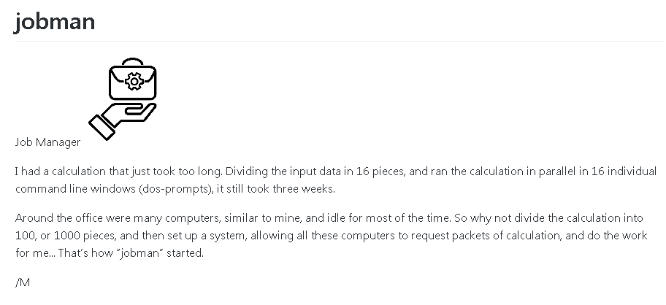
https://github.com/MartinHvidberg/jobman

Slide 2
1 Master (pool) – many Workers
worker
worker
Master
(pool)
worker
worker
worker

Slide 3
The Master
Master
(pool)
’Master’ is a directory *
Expect to make a separate masterdir for each separate production, e.g. "Slope a million tiles"
Establish a masterdir on a shared drive, where all workers can be granted Read and Write access
.../
.../Available jobs waiting to be processed
.../Busy jobs being ‘in process’ by a worker
.../Completed jobs returned successfully from a worker
.../Discarded jobs returned with error from a worker
.../Executables files necessary to run a job
.../Logging log files returned by a worker
.../Pause jobs being held back for some reason
(*) valid in JobMan ver 1.x, there are plans to make it a ’message que’

Slide 4
The Worker
worker
’worker’ is a directory *
Expect to make a separate workdir for each separate production.
Establish a workdir on a local drive: workdir = /
copy jobman.config and jobman.py from /masker
copy /master/Executables to /workdir/Executables
Adjust .config to reflect the dirs, hardware, etc. on your local computer…
Make a directory workers, that should be empty
Your workdir structure will now look like this
…/
…/jobman.config
…/jobman.py
…/Executables/
…/Executables/somefile.x
…/workers/
(*) valid in JobMan ver 1.x, there are plans to make it a ’message que’

