Slide 1
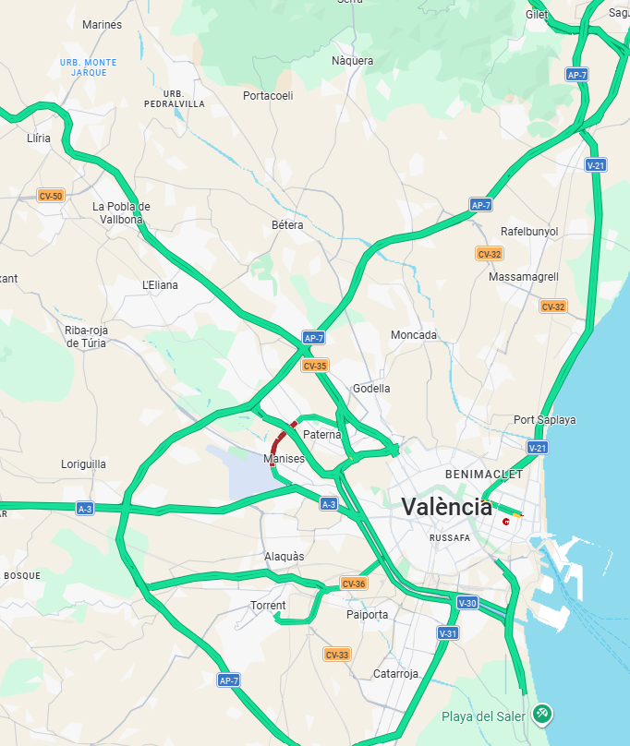
Start
zoomLevel = 1
Have a map file
Show squares for zoomLevel + 1
Class Map
getMapDetails() {}

Slide 2
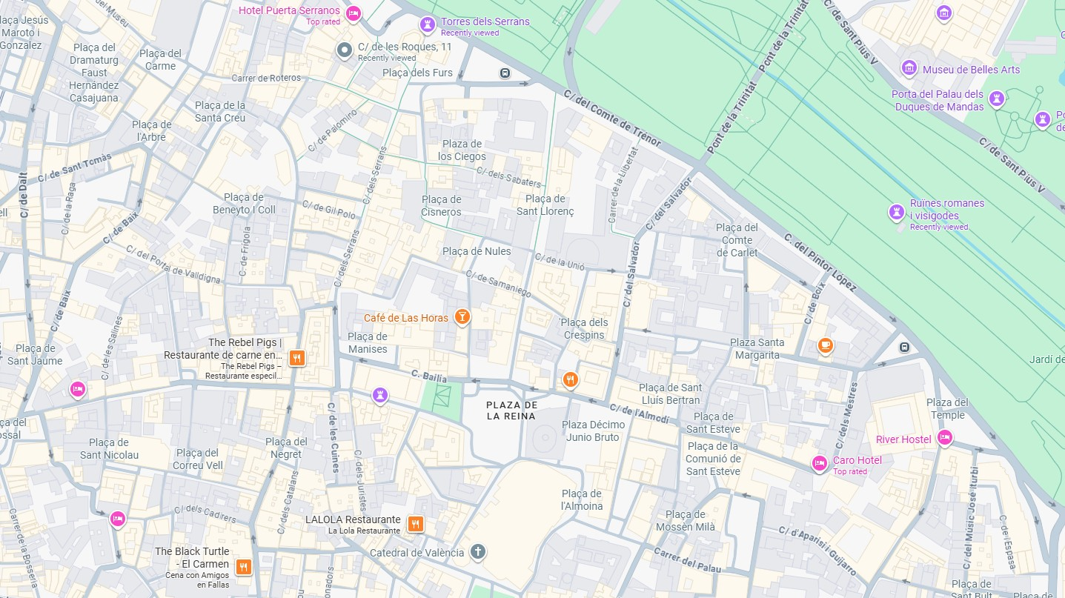
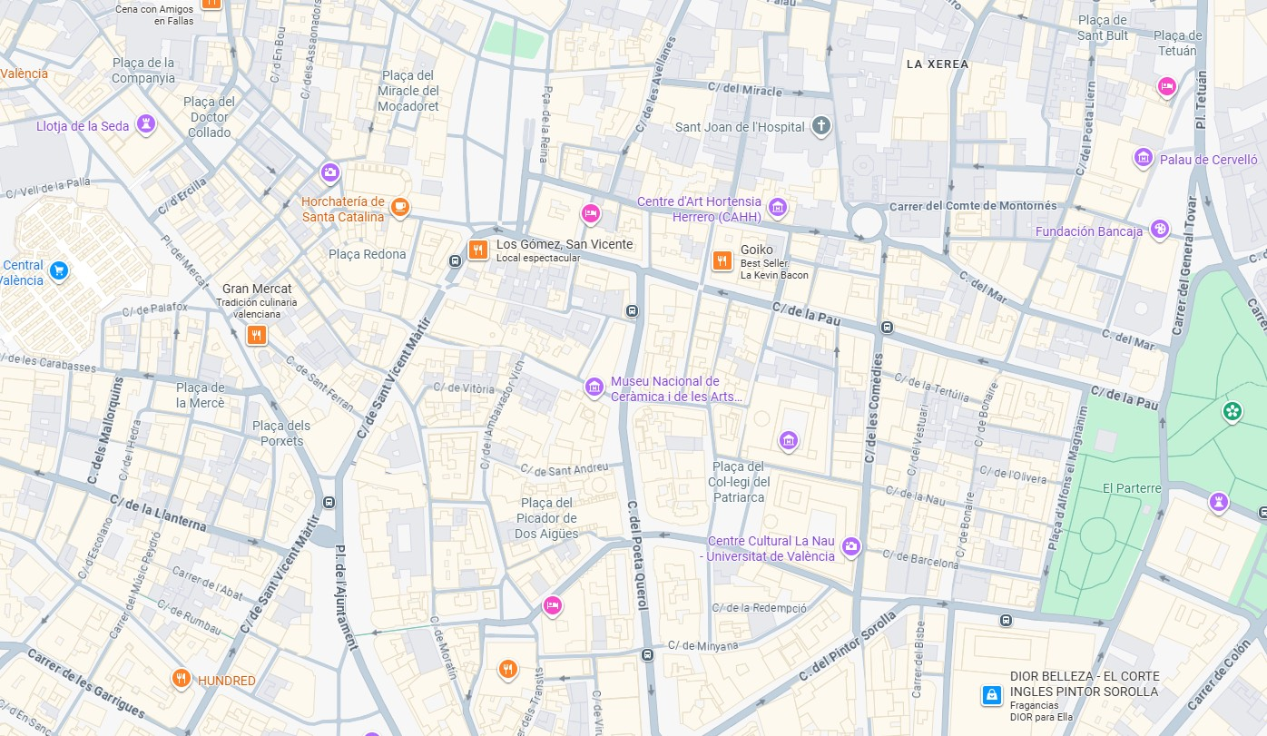
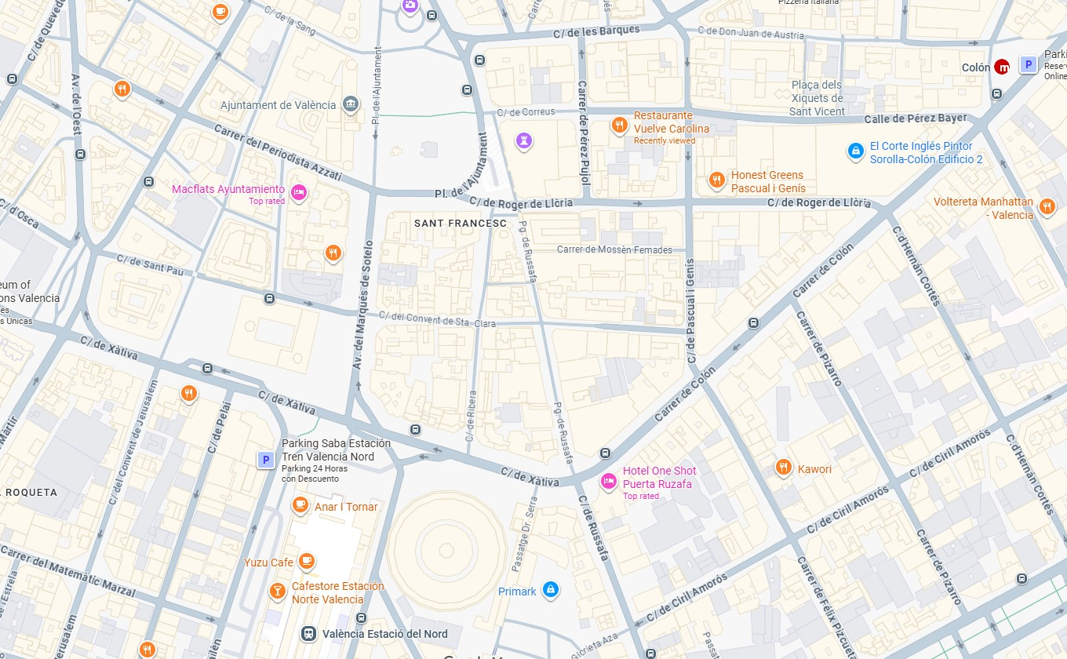

Slide 3
Data Files:
Landmarks
Paths
Maps
Classes
Map
+currentMapDetails
+zoomLevel
+mapMode
+map
+topLeft
+bottomRight

