Slide 1


How Much Event Data Is Enough?
A Statistical Framework for Process Model Discovery
Martin Bauer, Arik Senderovich, Avigdor Gal,
Lars Grunske, Matthias Weidlich

Slide 2

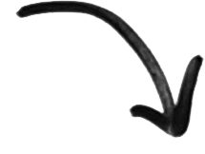

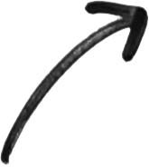

Processes and Events
Automated control
of business processes
Event logs:
Timestamps
Case IDs
Activity IDs
…
Recording of process
execution information

Slide 3
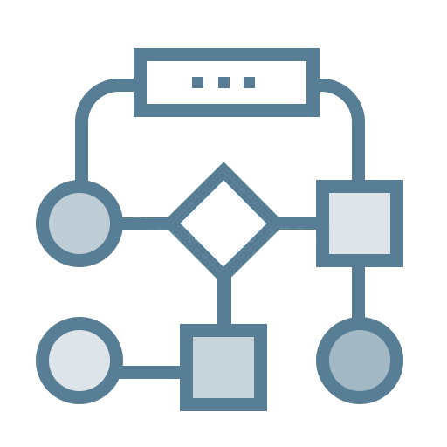

The Question of Process Discovery
Discovery
Event log
Process model
Efficiency of process discovery becomes increasingly important
  Pervasiveness of data sensing/logging
  => Large-scale event logs
  Tuning a large range of parameters of discovery algorithms
  => Repeated, exploratory analysis
  Software-as-a-Service solutions for process discovery
  => Online handling of event logs

Slide 4
A View on Related Work
Plethora of discovery algorithms [Augusto et al. 2017]
Striving for scalability
  By divide-and-conquer: Decompose the discovery problem [van der Aalst & Verbeek 2015]
  By parallelization and distribution [Wang et al. 2015, Evermann 2016]
Recently: Idea of sampling event data [Busany & Maoz 2016]

Slide 5



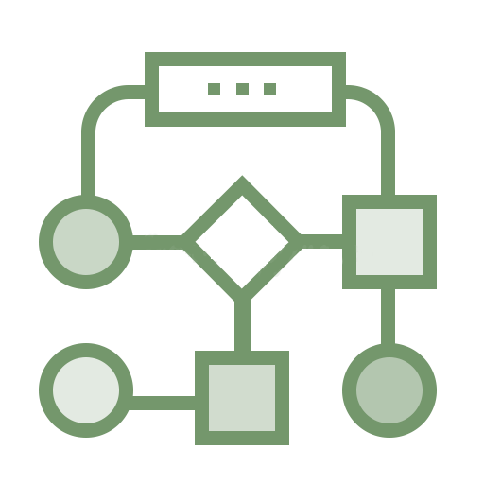

Daring the Gap
Discovery
Sampling
Guarantees?
Discovery
How to determine how much of an event log to use to discover a process model?

Slide 6
Agenda
Background and Related Work on Process Discovery
A Statistical Framework for Process Discovery
  Log sampling
  Framework definition
Instantiating the Framework
  For control-flow discovery
  For performance discovery
Experimental Results

Slide 7
Log Sampling
Observation: Only some information of a trace is used
Hence, some traces do not provide new information
  Sample of a log, may contain all information of full log
  The larger the sample, the more likely this is the case
(56, June 11, case 1, activity A, data1, data2, …)
(57, June 11, case 2, activity A, data1, data2, …)
(58, June 12, case 1, activity B, data1, data2, …)
<A,B>
<A>
L'⊆L is discovery sufficient, if for newly sampled trace ξ:
P(γ(L’,ξ) = 1) < δ
with γ(L’,ξ) denoting that trace ξ provides new information.

Slide 8

Minimum Sample Size
„The longer we see no new information, the more
likely it is that we have seen everything we need“
Sampling of a single trace: Binomial trial
    The sampled trace either provides new information, or not
    Under unbiased sampling: Probability to have k-consecutive traces without new information is bounded by the normal approximation to the bin. distribution
For α=0.01 and δ=0.05 => N_min=128
      After 128 consecutive trials without new information we stop

Slide 9
Sampling as multiple Binomial Trials
Trace # | Activities | New Info? | New binTrial? | Stop Sampling
1 | A,B,C | Yes | Yes | No (1)
2 | A,B,C | no | No | No (2)
3 | A,B,D | Yes | Yes | No (1)
4-120 | A,B,D | no | no | No (117)
121 | A,B,E | Yes | Yes | No (1)
122-250 | A,B,E | no | no | Yes (128)

Slide 10
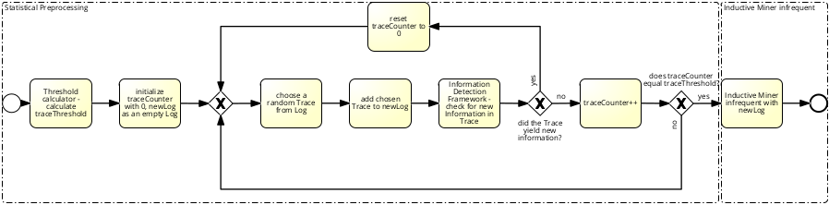
Framework
Calculate N_min
Sample trace
Apply discovery algorithm to sampled log

Slide 11
Agenda
Background and Related Work on Process Discovery
A Statistical Framework for Process Discovery
  Log sampling
  Framework definition
Instantiating the Framework
  For control-flow discovery
  For performance discovery
Experimental Results

Slide 12
Control-Flow Perspective
A notion of “new control-flow information”
  New activity
  New directly-follows dependency
  New initial or final activity
What about frequencies?
  Determine on sample (no guarantee on δ-similarity)
  Changes in relative frequencies are “new information”
Trace | New Information
A, B, C | Activity, Start, End, DF
A, B, D | Activity, End, DF
B, C, C | Start, DF
A, B, C, C | -

Slide 13
Performance Perspective
Focus on cycle time of a process, a fine-grained numerical value
A notion of “new cycle-time information”
  Cycle time is more than ε-different
  Measuring granularity:
    Per complete process
    Per individual activities
A (30 ms), A (30 ms), A (30 ms)
A (30 ms, A (30 ms)
A (30 ms), A (10 ms)
A (5 ms) A (25 ms)

Slide 14
Agenda
Background and Related Work on Process Discovery
A Statistical Framework for Process Discovery
  Log sampling
  Framework definition
Instantiating the Framework
  For control-flow discovery
  For performance discovery
Experimental Results

Slide 15

Setup
Datasets
  BPI Challenge 2012
    Loan/overdraft applications
    >262k events of >13k traces
  BPI Challenge 2014
    Incident management at Rabobank Group ICT,
    >343k events of >46 traces
Discovery algorithm
  Inductive Miner Infrequent [Leemans et al. 2013]
  Noise threshold set to 20%
Approach implemented as a ProM plugin (@Github)
Measures
  Pre-processing effectiveness: #traces sampled
  Actual efficiency: runtime, memory footprint
  Discovery effectiveness: fitness, approximated cycle time

Slide 16
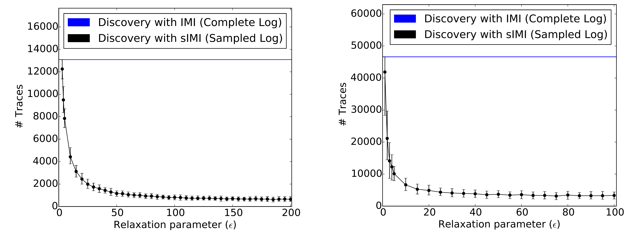
Pre-Processing Effectiveness
BPI-2012
BPI-2014
Drastic reduction of number of traces considered for discovery
Trend is consistent for different datasets

Slide 17
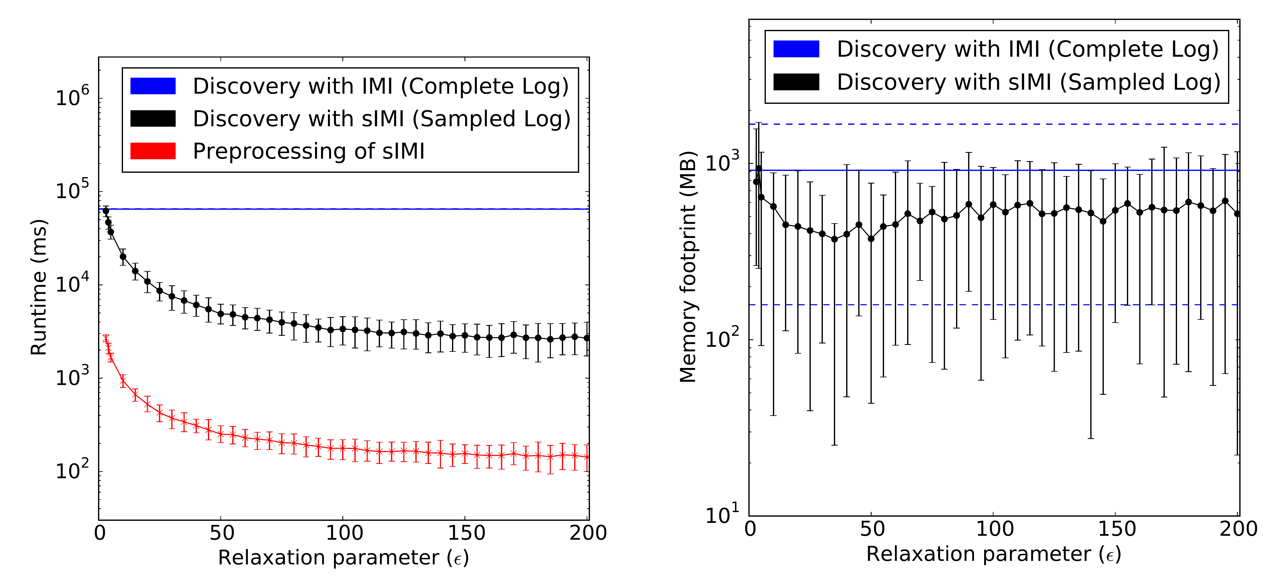
Runtime and Memory Footprint
Pre-processing is efficient
Significant reduction of overall resource utilisation

Slide 18
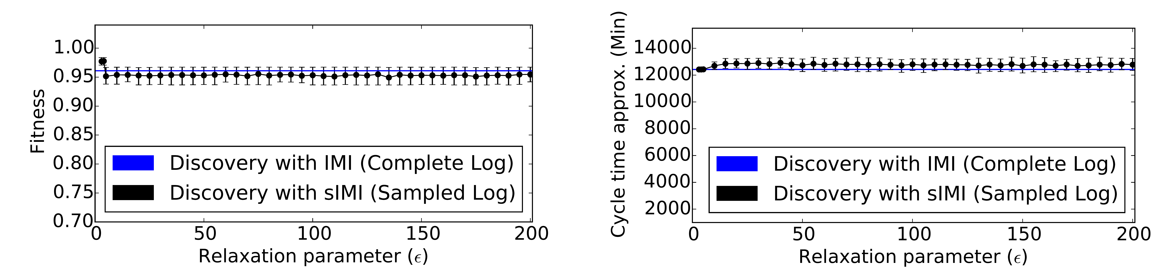
Discovery Effectiveness
Negligible degradation of discovery quality
  For control-flow fitness
  For the cycle time approximation

Slide 19
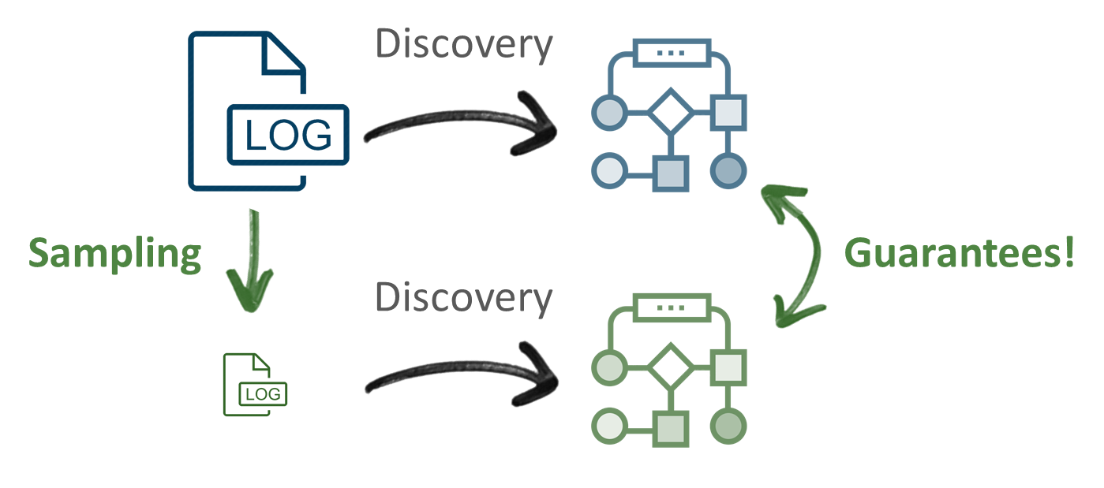
Conclusions
Framework for statistical
process discovery
  Sample an event log
  Guarantees on the
  introduced error
Instantiation for control-flow and performance aspects
Next: Additional model perspectives
Thank you!

Slide 21

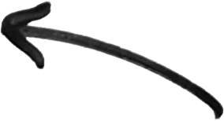
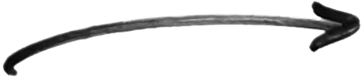


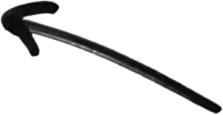
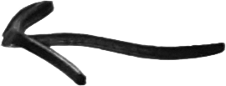
Notes:
Arrow Elements

