Slide 1


Single-cell RNA-seq data analysis
Martin Loza
Functional Analysis in Silico (FAiS) lab, The University of Tokyo

Slide 2
Lecture roadmap
50 minutes of content, followed by 10 minutes for questions
01
Bulk RNA-seq context
A short introduction to reads and count matrices
8 min
02
Single-cell workflow
Preprocessing, clustering, markers, and annotation
28 min
03
Multiple samples
Batch effects, integration, and validation
8 min
04
Spatial transcriptomics
Spots, SCTransform, and tissue maps
6 min
Notes:
Timing plan: 8 minutes for bulk context, 28 minutes for the single-cell workflow, 8 minutes for integration, 6 minutes for spatial transcriptomics, and 10 minutes for questions.

Slide 3
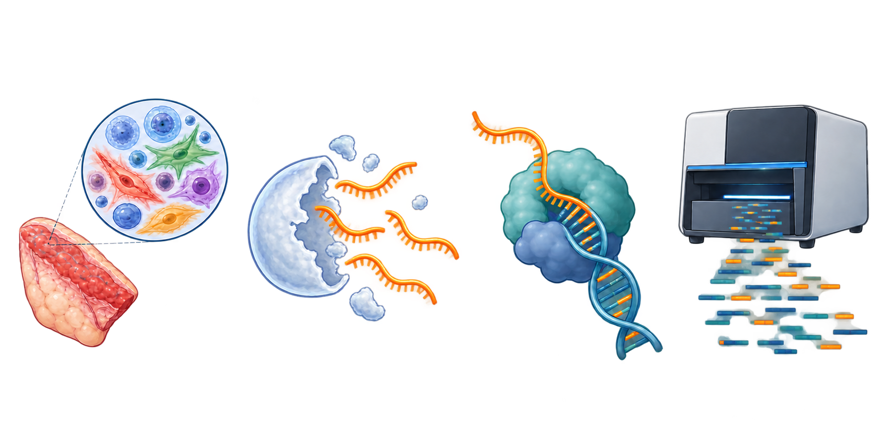
Bulk RNA-seq workflow
One measurement summarizes all cells in the sample
1
Tissue sample
2
Collect mixed RNA
3
Copy RNA into DNA
4
Sequence fragments
Bulk RNA-seq averages gene expression across every cell in the sample.
Notes:
Custom illustration generated for this workshop deck with OpenAI ImageGen.

Slide 4
What the sequencer gives back
A read is a short piece of sequence, between 150 - 300 letters (bases) long.
One sample gives millions of reads.
Each read came from one RNA molecule.
GATTACAGGCATTCCAGTACCGA
one read
The computer then looks for the place in the genome where each read fits (alignment).
That place tells us which gene the read came from.

Slide 5
From reads to a count matrix
Each read contributes to a gene count after alignment
1
Sequence reads
2
Align to the genome
3
Assign reads to genes
4
Build the matrix
Millions of short DNA fragments
Find the best matching genomic location
Use the aligned position to identify a gene
Rows are genes; columns are samples
Example
Gene A: 5 reads Gene B: 2 reads
Repeating this for every gene and sample produces the count matrix used in downstream analysis.

Slide 6
RNA sequencing data (bulk)
Sample 1
 | Gene 1 | Gene 2
Sample 1
Sample 2
Heatmaps
 | Gene 1 | Gene 2
Sample 1
Sample 2
1
2
5
2
0
5
Sample 2
Notes:
Pahse portrait
scRNA-seq is part of the Next-generation sequencing (NGS) technology. From which we can sequence/read entire targeted regions of RNA.
in a massively parallel way, that means we can obtain reads of thousands of genes from thousands of cells.

Slide 7
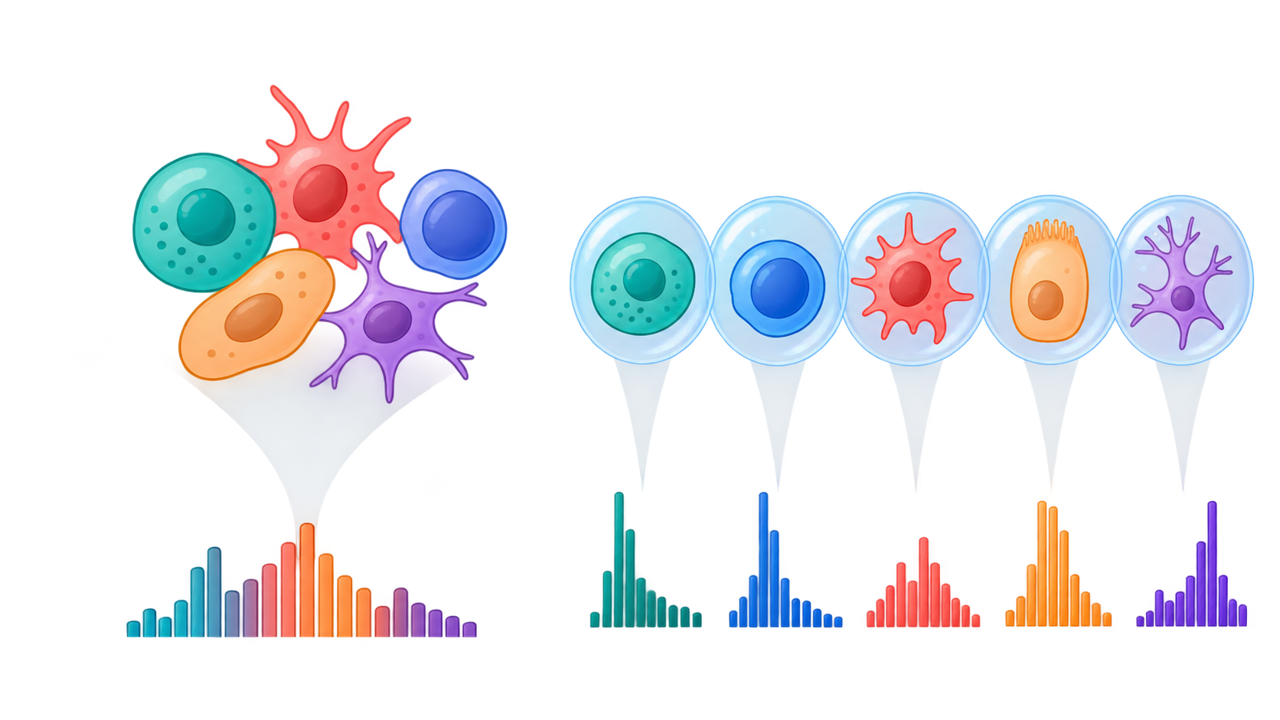
SECTION 2
Single-cell RNA-seq analysis
A separate expression profile for every cell reveals cell types and cell states that bulk averages hide.
Bulk average
Cell-by-cell profiles
Notes:
Timing: about 1 minute. This is the main section of the lecture. The remaining slides follow the order used in notebooks 01 and 02.

Slide 8
Single-cell RNA-seq data
G1
G2
G1
G2
4
3
5
1
G2
2
2
5
4
4
5
3
2
1
1
2
3
4
5
G1

Slide 9
Single-cell analysis workflow
The notebooks follow the same sequence from counts to biological labels
1
Seurat object
2
Quality control
3
Normalization
4
Variable
features
Scaling
5
9
Markers and labels
8
UMAP
7
Neighbors and clusters
6
PCA
Each step removes a technical obstacle or creates a representation needed by the next step.
Notes:
Timing: about 1 minute. Use this map to orient the audience. Source: https://github.com/MartinLoza/CIAD_workshop_sc/blob/main/notebooks/02_qc_and_clustering.ipynb

Slide 10
The Seurat object
One object keeps the measurements, cell information, and analysis results aligned
RNA assay
1
Metadata
counts
QC metrics, sample, cluster, and cell type
raw integers
2
Reductions
data
PCA and UMAP coordinates for every cell
normalized values
3
Graphs
Nearest-neighbor relationships used for clustering
scale.data
centered and scaled
4
Identities
The current grouping used by plots and marker tests
Notes:
Timing: about 2 minutes. Emphasize that the layers contain the same cells and genes with different numerical representations. Source: https://github.com/MartinLoza/CIAD_workshop_sc/blob/main/notebooks/01_seurat_object.ipynb

Slide 11
Quality control
Some droplets do not represent one healthy cell
Low-quality or empty
Usable cell
Possible doublet
Few genes
High mitochondrial fraction
Balanced counts
Many detected genes
Too many counts
Too many detected genes
Goal: retain droplets that behave like single, intact cells before downstream analysis.
Notes:
Timing: about 2 minutes. Explain empty droplets or damaged cells at one end and possible doublets at the other. Source: https://github.com/MartinLoza/CIAD_workshop_sc/blob/main/notebooks/02_qc_and_clustering.ipynb

Slide 12
QC metrics
Each metric reveals a different failure mode
nFeature_RNA
too few
usable range
very high may indicate a doublet
genes detected
nCount_RNA
too few
usable range
very high may indicate a doublet
total molecules
percent.mt
expected
inspect tissue-specific range
high may indicate a stressed cell
mitochondrial fraction
Thresholds come from the observed distributions and the biology of the sample.
Notes:
Timing: about 2 minutes. The notebook uses nFeature_RNA, nCount_RNA, and percent.mt. Avoid presenting thresholds as universal defaults. Source: https://github.com/MartinLoza/CIAD_workshop_sc/blob/main/notebooks/02_qc_and_clustering.ipynb

Slide 13
Sequencing depth distorts raw counts
Similar cells can yield different totals for technical reasons
Same relative expression
Gene A
Gene B
Other
Cell A
3,000 total counts
Cell B
9,000 total counts
The threefold difference comes from captured molecules, not a change in gene proportions.
Normalization reduces this depth-driven difference before cells are compared.
Notes:
Timing: about 2 minutes. Counts are illustrative. Source: https://github.com/MartinLoza/CIAD_workshop_sc/blob/main/notebooks/02_qc_and_clustering.ipynb

Slide 14
Log normalization
NormalizeData corrects depth and compresses very large values
1
2
3
4
Start with counts
Divide by cell total
Scale to 10,000
Apply log(x + 1)
Whole-number molecules for each gene
Correct for sequencing depth
Put every cell on a common scale
Reduce the influence of very large values
counts layer
data layer
remains unchanged
stores normalized values
Notes:
Timing: about 2 minutes. This is the exact LogNormalize sequence used in the notebook. Source: https://github.com/MartinLoza/CIAD_workshop_sc/blob/main/notebooks/02_qc_and_clustering.ipynb

Slide 15
Effect of normalization
Cell totals become comparable while relative expression remains visible
Before
After
Cell A
Cell A
Cell B
Cell B
Zeros remain zero, and the raw counts remain available in the counts layer.
Downstream plots use values that depend less on how deeply each cell was sequenced.
Notes:
Timing: about 2 minutes. The bar lengths are schematic. Emphasize the effect, not the exact values. Source: https://github.com/MartinLoza/CIAD_workshop_sc/blob/main/notebooks/02_qc_and_clustering.ipynb

Slide 16
Variable feature selection
FindVariableFeatures keeps genes that vary more than expected for their mean
selected genes
Why
Many genes change little between cells and add noise or computation.
Variability
Effect
The notebook keeps 2,000 informative genes for PCA and clustering.
Mean expression
Notes:
Timing: about 2 minutes. The scatter is schematic. The notebook uses selection.method = "vst" and nfeatures = 2000. Source: https://github.com/MartinLoza/CIAD_workshop_sc/blob/main/notebooks/02_qc_and_clustering.ipynb

Slide 17
Scaling
ScaleData gives each gene a comparable influence on PCA
Before scaling
After scaling
Gene A
Gene A
large numeric range
0
Gene B
Gene B
small numeric range
0
Gene C
Gene C
medium numeric range
0
Effect: each gene is centered at zero and scaled to unit variance.
Notes:
Timing: about 2 minutes. Explain that PCA responds to variance. Scaling prevents genes with large numerical ranges from dominating. Source: https://github.com/MartinLoza/CIAD_workshop_sc/blob/main/notebooks/02_qc_and_clustering.ipynb

Slide 18
Principal component analysis
A PC1–PC2 view can hide structure carried by another component
PC1 and PC2
PC1 and PC3
groups overlap
PC3 reveals the separation
PC 2
PC 3
PC 1
PC 1
Downstream analysis uses several PCs, not only the first two.
Colors reveal the hidden groups only for this teaching example.
Notes:
Timing: about 2 minutes. Use the two projections to explain that a PC1–PC2 scatter does not contain every useful pattern. FindNeighbors and UMAP use several selected PCs. The colors are teaching labels, not labels known before clustering. Source: https://github.com/MartinLoza/CIAD_workshop_sc/blob/main/notebooks/02_qc_and_clustering.ipynb

Slide 19
Neighbors and clustering
Nearby cells form a graph; dense communities become clusters
Selected PCs
FindNeighbors
FindClusters
1
2
3
The same cells gain edges, then cluster labels. Resolution controls how communities are divided.
Notes:
Timing: about 2 minutes. Clustering happens in PCA space through a nearest-neighbor graph. Source: https://github.com/MartinLoza/CIAD_workshop_sc/blob/main/notebooks/02_qc_and_clustering.ipynb

Slide 20
UMAP visualization
UMAP summarizes neighborhoods built from several PCs in two dimensions
PCA neighborhood graph
Two-dimensional map
same 18 cells
more space between communities
UMAP uses several PCs to preserve local neighborhoods. Clusters come from the graph, and spacing between clusters is not quantitative.
Notes:
Timing: about 2 minutes. Follow the same 18 cells from the PCA neighbor graph into the UMAP. Explain that UMAP uses several PCs, not only PC1 and PC2. Stress that UMAP displays the neighborhoods but does not define the clusters, and distances between clusters have limited meaning. Source: https://github.com/MartinLoza/CIAD_workshop_sc/blob/main/notebooks/02_qc_and_clustering.ipynb

Slide 21
Marker genes
FindAllMarkers identifies genes enriched in each cluster
Gene A
Gene B
Gene C
Gene D
3
1
0
1
Why
Cluster 1
Clusters only have numbers until their expression patterns are interpreted.
0
3
1
0
Cluster 2
1
0
3
2
Cluster 3
Effect
Marker genes provide the evidence used to assign a biological identity.
higher expression
Notes:
Timing: about 2 minutes. The heatmap is schematic. FindAllMarkers compares each cluster with the remaining cells. Source: https://github.com/MartinLoza/CIAD_workshop_sc/blob/main/notebooks/02_qc_and_clustering.ipynb

Slide 22
Cell-type annotation
Marker patterns are matched to known biology
Cluster
Characteristic markers
Biological label
1
MS4A1
B cell
2
CD3E, IL7R
T cell
3
LYZ, CD14
Monocyte
4
NKG7, GNLY
NK cell
The algorithm finds clusters and markers. Biological knowledge supplies the names.
Notes:
Timing: about 2 minutes. The examples are canonical PBMC markers used in the notebook. Cluster numbering can change with analysis choices. Source: https://github.com/MartinLoza/CIAD_workshop_sc/blob/main/notebooks/02_qc_and_clustering.ipynb

Slide 23
SECTION 3
Integrating multiple samples
Combine experiments while keeping biological differences and reducing technical shifts.
Sample 1
Sample 2
Shared analysis space
Goal: align shared cell states without inventing cells or erasing real differences.

Slide 24
Multiple samples, one analysis
Integration is a workflow with checks, not a single button
1
Create one object per sample
2
Inspect sample structure
3
Correct technical shifts
4
Cluster and annotate together
Keep sample labels and metadata attached
Plot cells by sample before correction
Align comparable cell states across batches
Recheck both sample mixing and cell identity
Quality check
Compare plots colored by sample and by cell type before and after correction.
Good integration mixes batches within shared cell states while preserving sample-specific populations.

Slide 25
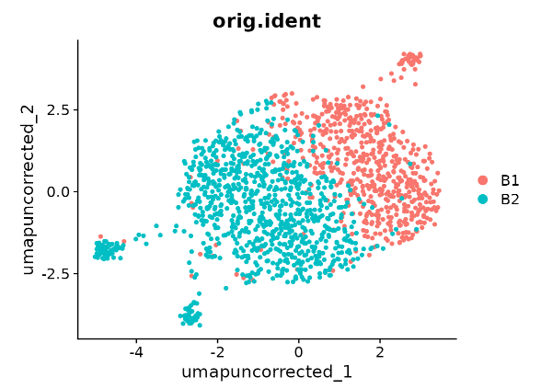
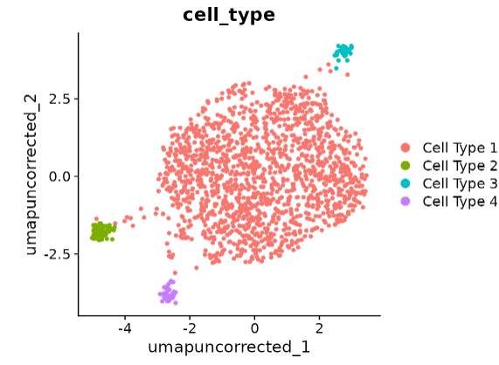
The batch effect
coloured by sample
coloured by cell type
The same cells, coloured two ways. One cell type splits into two clouds.
The split follows the batch, not the biology.

Slide 26
Three integration methods
The workshop compares corrections applied at the same point in the workflow
CCA
Harmony
Canek
Shared variation and anchors
Iterative adjustment in PCA space
Mutual nearest neighbors between batches
Creates integrated.cca
Creates harmony
Creates canek
A useful correction mixes batches within shared cell types while preserving biological separation.
Notes:
Timing: about 2 minutes. CCA uses Seurat IntegrateLayers; Harmony and Canek operate on PCA embeddings in this workshop. Source: https://github.com/MartinLoza/CIAD_workshop_sc/blob/main/notebooks/03_integration.ipynb

Slide 27
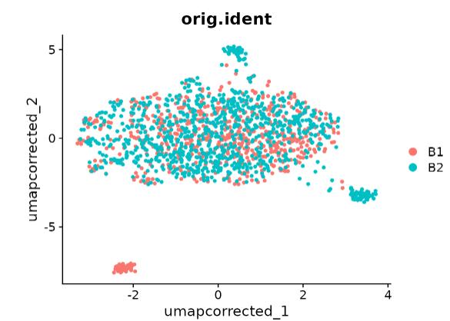
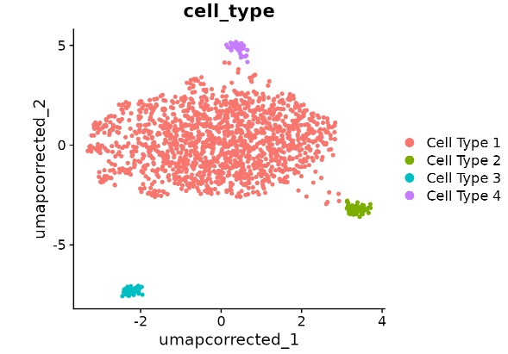
After correction
coloured by sample
coloured by cell type
The two samples now overlap. The group that exists in only one sample stays apart,
which is correct: integration must not invent cells that were not there.

Slide 28
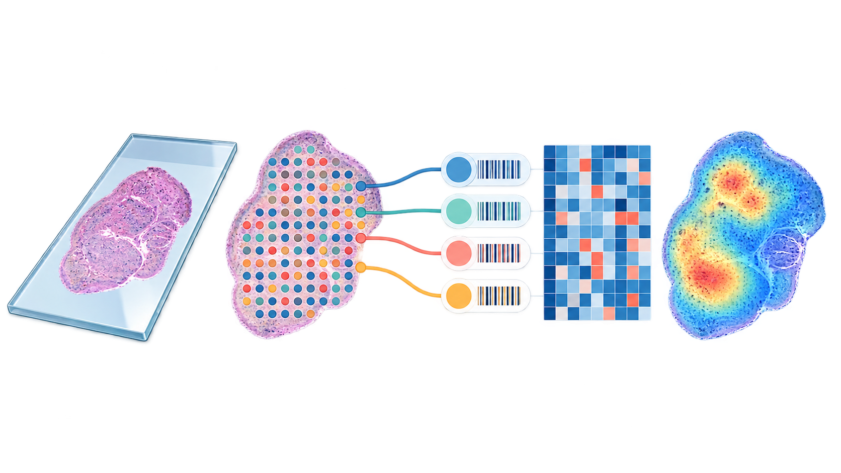
SECTION 4
Spatial transcriptomics
Gene expression remains linked to its position in the tissue, so molecular patterns can be interpreted in anatomical context.
Tissue
Capture spots
Count matrix
Spatial map
Notes:
Custom spatial transcriptomics illustration generated for this workshop deck with OpenAI ImageGen.

Slide 29
Counts with a position
The slide is covered with spots in a fixed grid.
Each spot has its own barcode, so we know which counts came from which spot.
We also keep the photograph of the tissue, and the x and y of every spot.
A spot is not one cell. In Visium one spot holds about 1 to 10 cells.
one tissue slide, covered with spots

Slide 30
Spatial QC and SCTransform
Count depth can follow anatomy, so spatial data require different judgment
Counts across the tissue
SCTransform
Models gene counts with a regularized negative binomial model
SCT assay
normalized values
Low counts may mark sparse anatomy rather than poor data.
Raw counts remain in the Spatial assay.
Notes:
Timing: about 2 minutes. The workshop asks participants to inspect counts in space before filtering, then uses SCTransform. Source: https://github.com/MartinLoza/CIAD_workshop_sc/blob/main/notebooks/04_spatial.ipynb

Slide 31
What stays the same, and what spatial data add
Same analysis backbone
Additional spatial information
Quality control and normalisation
Variable genes and PCA
Clustering and marker genes
An image of the tissue
An x and y coordinate for every spot
Expression plots overlaid on the tissue
The Seurat object now carries both the expression matrix and a table of spot coordinates.

Slide 32
Questions, then hands-on
The final ten minutes are reserved for discussion
10
min
Questions
What would you like to revisit before we open the notebooks?
Hands-on sequence
1
Seurat object
2
QC and clustering
3
Integration
4
Spatial analysis
github.com/MartinLoza/CIAD_workshop_sc
Notes:
Timing: reserve 10 minutes for questions, then use the four notebook labels as the transition into the practical session.

Slide 33
APPENDIX
Extra reference
Use the remaining slide only if questions arise about how Seurat displays expression distributions.
Violin plots

Slide 34
Appendix: violin plots
Gene1
Compares one gene across clusters or cell types
Width shows where many cells have similar values
Zeros and long expression tails remain visible
5
4
3
2
1
Condition 1
Condition 2
Notes:
Appendix only. The hands-on notebook uses VlnPlot to compare marker expression across clusters. Source: https://github.com/MartinLoza/CIAD_workshop_sc/blob/main/notebooks/02_qc_and_clustering.ipynb

