Slide 1
Systemd
Agenda
1. Verden før Systemd
2. Diskussionen om Systemd
3. Logging
4. Timers

Slide 2
tmux
tmux killed upon exist
https://github.com/tmux/tmux/issues/428
“With systemd 230 we switched to a default in which user processes started as part of a login session are terminated when the session exists (KillUserProcesses=yes).
Unfortunately this means starting tmux in the usual way is not effective, because it will be killed upon logout. There are a few option to avoid that, the best being:”
systemd-run --scope --user tmux

Slide 3
0day
systemd can't handle the process privileges that belongs to a user name that starts with number, such as 0day
(https://github.com/systemd/systemd/issues/6237)
[Unit]
Description=0day socat service
After=network.target
[Service]
User=0day
Restart=always
Type=simple
WorkingDirectory=/home/0day/
ExecStart=/usr/bin/socat TCP-LISTEN:18086,reuseaddr,fork EXEC:"/opt/run-elf"
[Install]
WantedBy=multi-user.target

Slide 4
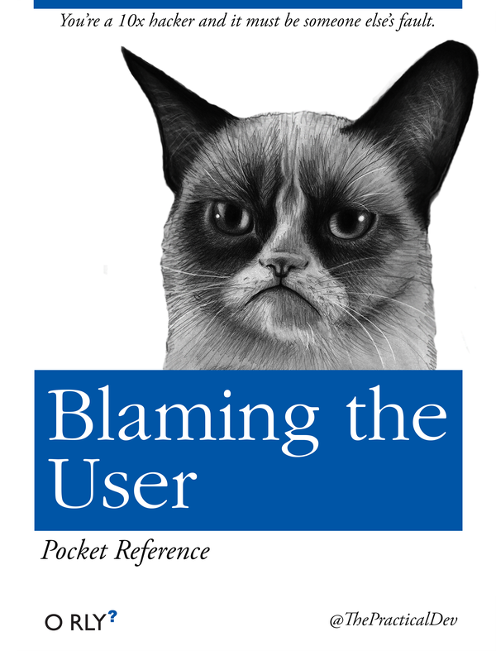
Systemd

Slide 5
0day
Answer:
Yes, as you found out "0day" is not a valid username. I wonder which tool permitted you to create it in the first place.
Note that not permitting numeric first characters is done on purpose: to avoid ambiguities between numeric UID and textual user names.
systemd will validate all configuration data you drop at it, making it hard to generate invalid configuration.
Hence, yes, it's a feature that we don't permit invalid user names, and I'd consider it a limitation of xinetd that it doesn't refuse an invalid username.

Slide 6
Debian
October 2014:
A group of “Veteran Unix Admins” reckons too much input from GNOME devs is dumbing down Debian, and in response, is floating the idea of a fork.
Spring of 2015: A target release will see users “be able to switch from Debian 7 to Devuan 1 smoothly, as if they would dist-upgrade to Jessie, and start using our package repositories.”

Slide 7
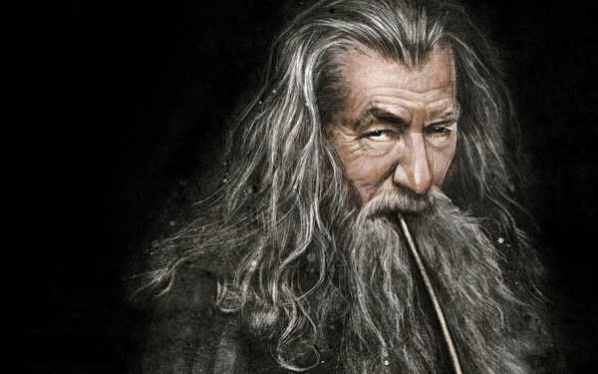
Debian

Slide 8
Debian / Devuan
May 2013 - Debian 7
April 2015 - Debian 8
May 2017 - Devuan 1.0.0 (Debian 8)
June 2017 - Debian 9

Slide 9
Større alternativer til Systemd
Devuan
Gentoo (OpenRC)
Slackware
*BSD

