Slide 1

DATA LEAK
Jiri Vana

Slide 2

DATA L O S S
DATA LEAK
What is the difference?
Why is it a problem?
How to prevent it?

Slide 3

DATA LOSS
Happens when you lose access to your data that you should have access to
Almost half of data loss are result of hardware failure
Possible causes include memory loses, power outages, mother nature
Data loss can also occur as the result of intentional or unintentional deletion, malware and hackers…
Loss can also happen when an employee takes his work home

Slide 4
DATA LEAK
Data leak or data breach
Defined as other people gain access to data, they should not have access to
Intentional or unintentional release of secure or private/confidential information to an untrusted environment

Slide 5


Slide 6
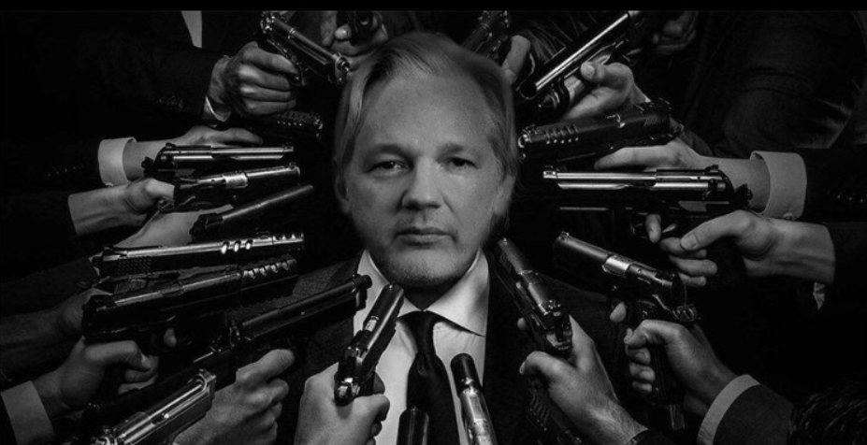

Slide 7

COST OF DATA LEAKAGE
For legal person
Legal, regulatory and financial impacts
Cost of digital leakage per year is measured in billions of dollars
Increasing number and complexity of regulations (GDPR)
Non-compliance with regulations or loss of data can lead to significant fines and/or jail time

Slide 8
COST OF DATA LEAKAGE
For legal person
Damage to image and credibility
Damage to public image and credibility with customers
Financial impact on company
Leaked email or memos can be embarrassing or even harmful on many levels

Slide 9
COST OF DATA LEAKAGE
For legal person
Loss of competitive advantage
Disclosure of strategic plans, mergers and acquisition info potentially lead to loss of revenue
Loss of research, analytical data and other intellectual capital

Slide 10
COST OF DATA LEAKAGE
For natural person
Unaddressed appropriately and in timely manner, can result
In physical, material or non-material damage, such as loss of control over personal data or limitation of rights, discrimination, identity theft or fraud, financial loss, damage to reputation, loss of confidentiality of personal data protected by professional secrecy
Any other significant economic or social disadvantage to the natural person concerned

Slide 11

THREE RISK AREAS
PII – Personally Identifiable Information
Birth date, employee numbers, social security / national numbers, credit card information, personal health information
IP – Intellectual Property
Source code, product design documents, research information, patent applications, customer lists
NPI – National Provider Identifier
Financial information, merges and acquisitions activities and information, executive communication, legal and regulatory matters, corporate policies

Slide 12

WHY DOES IT HAPPEN? WHO IS RESPONSIBLE?

Slide 13


MOST COMMON REASONS OF DATA LEAKS AND DATA LOSS
Ex-employees, partners, customers
Over 1/3 due to negligence
Nearly 30% of loss on portable devices
Increasing loss from external collaboration
Hackers, malware

Slide 14
5 INDUSTRIES MOST AT RISK OF DATA BREACHES

Slide 15
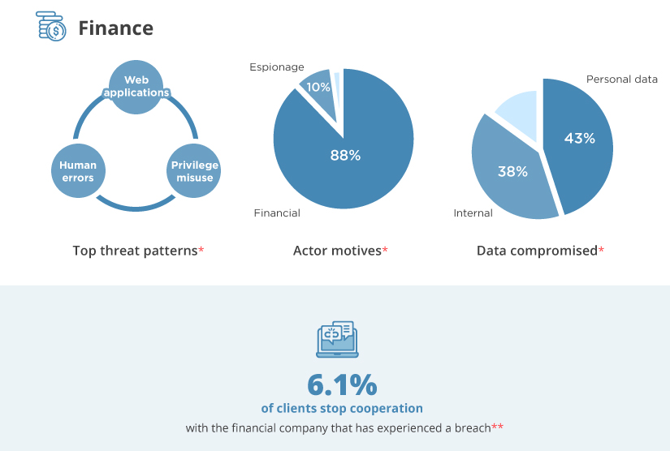

Slide 16
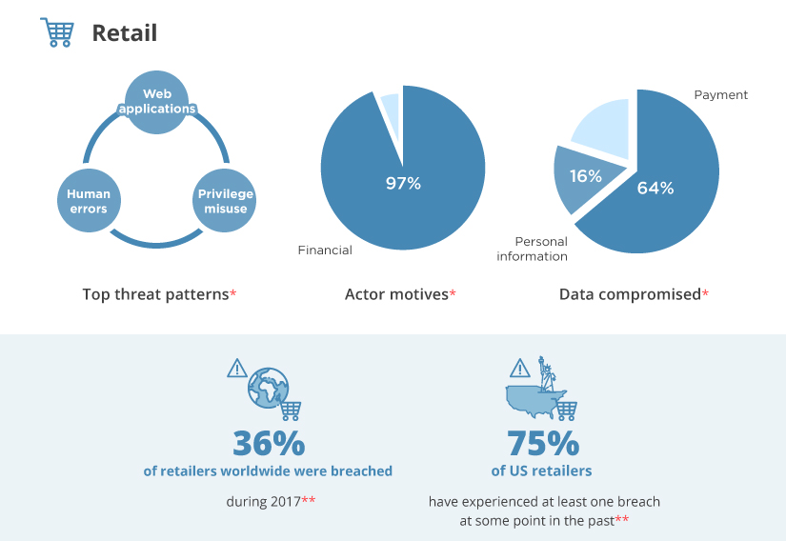

Slide 17
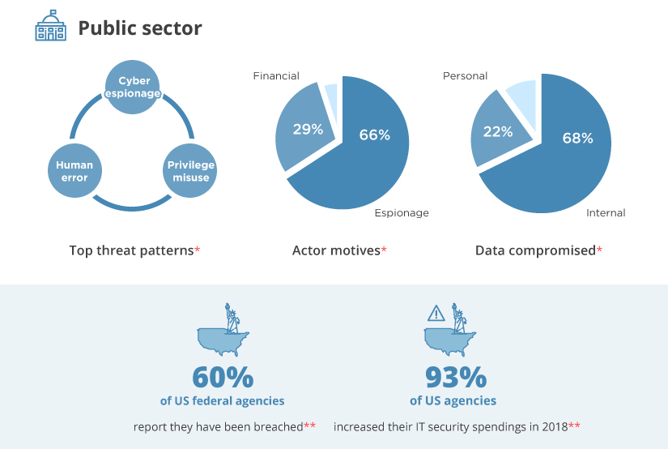

Slide 18
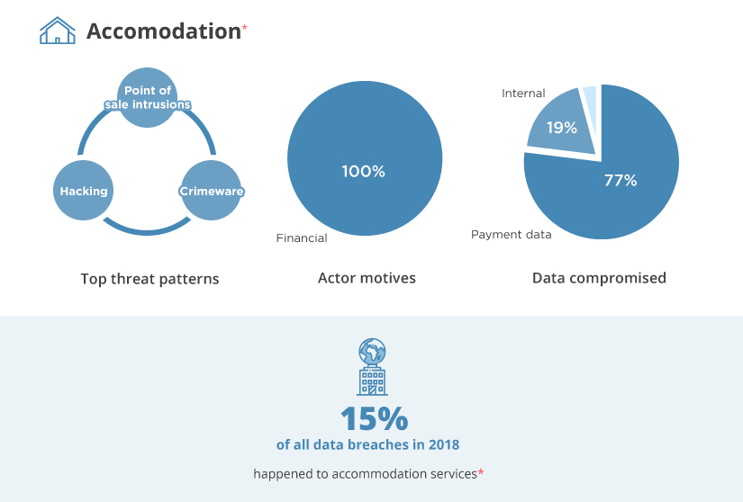

Slide 19
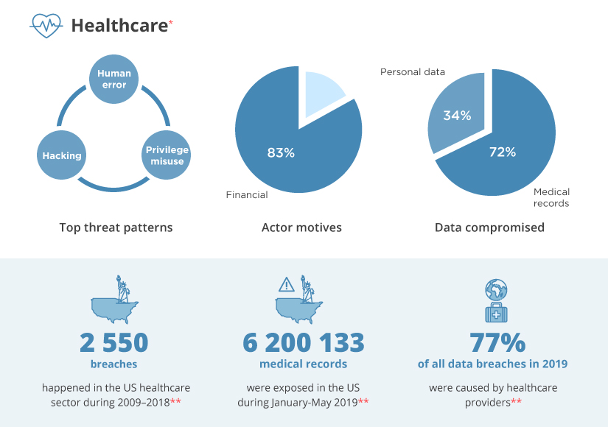

Slide 20

NOTABLE TARGET
Game industry
One of the most vulnerable industry
Players don’t like to be held up by security measures, account creations etc.
Due to nature of the business, primary focus is on development of new product, which leads to bugs, mistakes and vulnerabilities
Game companies these days very often store payment information (microtransactions, in-game purchases, subscription services)

Slide 21
BIGGEST DATA BREACHES EVER

Slide 22

FRIEND FINDER NETWORKS
Number of records affected: 412.2 million
Year: 2016
Reason: Poor security/hacking

Slide 23
MARRIOTT INTERNATIONAL
Number of records affected: 500 million
Year: 2018
Reason: Hacking

Slide 24
FACEBOOK
Number of records affected: 540 million
Year: 2019
Reason: Poor security

Slide 25
FIRST AMERICAN FINANCIAL CORP.
Number of records affected: 885 million
Year: 2019
Reason: Poor security

Slide 26
YAHOO
Number of records affected: 3 billion; 500 million
Years: 2013; 2014
Reason: Hacking

Slide 27
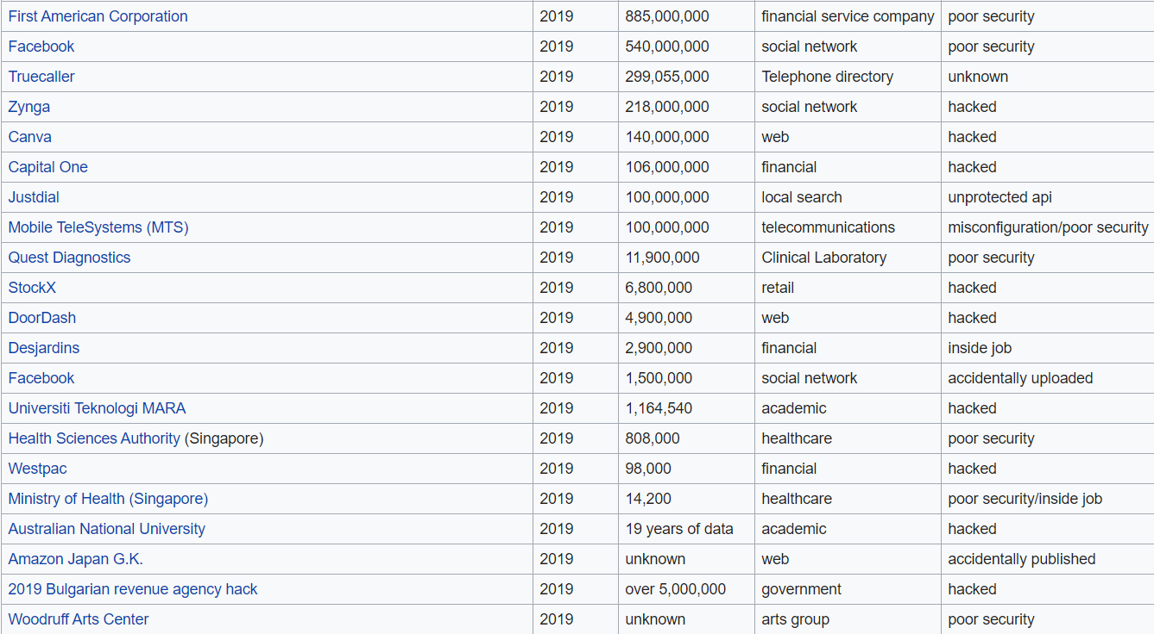
LIST OF NOTABLE 2019 LEAKS

Slide 28
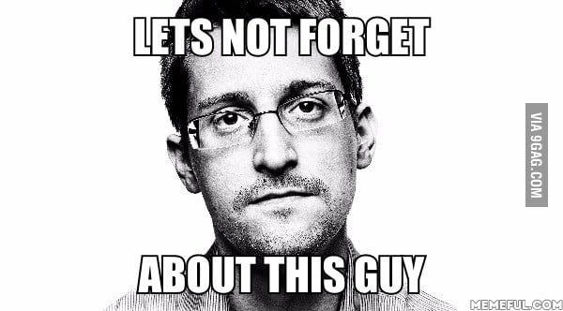

Slide 29
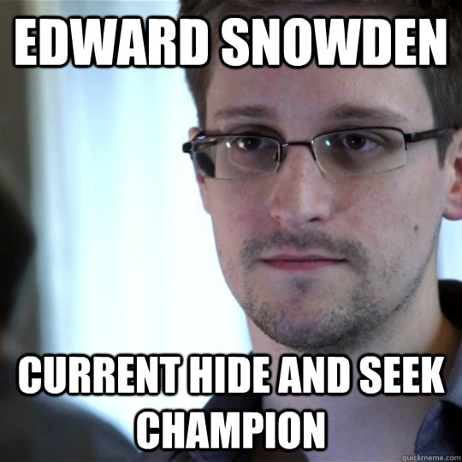
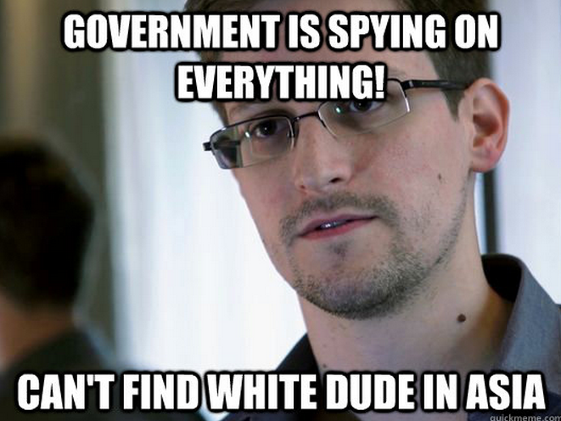
I PROMISED MEMES, HERE BE MEMES!

Slide 30
EDWARD SNOWDEN
American whistleblower who copied and leaked highly classified information from the National Security Agency (NSA) in 2013 when he was a Central Intelligence Agency (CIA) employee and subcontractor
Smuggled the data out of the building on MicroSD
Movie Snowden, worth watching
Joe Rogan Experience #1368 - Edward Snowden

Slide 31

OK, DATA LEAK IS A PROBLEM, BUT HOW TO FIGHT IT?

Slide 32

IMPLEMENT DATA LEAKAGE PROTECTION
Data leakage / loss prevention is a set of tools and processes used to ensure that sensitive data is not lost, misused, or accessed by unauthorized users

Slide 33
SECURITY MEASURES TO MINIMIZE DATA LEAK
It is important to remember that no solution is 100% fail-proof
There should always be a plan of action
identify all organizations assets, mark their critical value and impact to business
evaluate possible data leakage avenues
decide how this data should be protected and those avenues plugged
put effective DLP solution based on the analysis

Slide 34
SECURITY MEASURES TO MINIMIZE DATA LEAK
Train your employees how to protect data (do not open weird emails, no USB drives, portable hard drives etc.)
set of rules, how to function at workplace – no food, drinks at the table, leave phone out of the office, stronger passwords, lock-out computers whenever leaving desk, back up data

Slide 35
SECURITY MEASURES TO MINIMIZE DATA LEAK
Use secure websites (https), if not using https, get SSL certification
Should you use cloud, secure it the same way you would secure your workplace (passwords, encryptions)

Slide 36
AND FINALLY
It’s important to remember that usually:
To prevent data loss, you take measures that increase the risk of data leak.
Example: If you want to minimize data loss, you are taking backups and therefore you have higher chance that one of those backups will leak.
To prevent data leak, you take measures that increase the risk of data loss.
if you want to minimize data leak, you have minimum backup drives buried somewhere in concrete, then once you dig it up, it doesn’t work resulting in data loss.
LOSS
LEAK

Slide 37
AND FINALLY
It’s important to remember that usually:
To prevent data loss, you take measures that increase the risk of data leak.
Example: If you want to minimize data loss, you are taking backups and therefore you have higher chance that one of those backups will leak.
To prevent data leak, you take measures that increase the risk of data loss.
if you want to minimize data leak, you have minimum backup drives buried somewhere in concrete, then once you dig it up, it doesn’t work resulting in data loss.
LOSS
LEAK

Slide 38
IT IS IMPORTANT TO DETERMINE WHICH IS MORE IMPORTANT FOR YOU AND/OR YOUR BUSINESS AND GO FROM THERE
but remember…

Slide 39
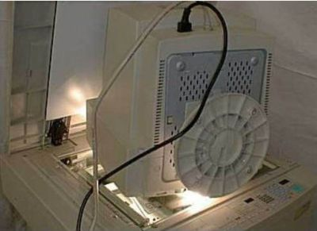
SOMETIMES EVEN THE BEST DLP FAILS YOU…

Slide 40
THANK YOU

