Slide 1
SQL Query Generator for Natural Language
Presented By :
Amit Kumar Jaiswal(001)
Vidya Sagar Singh(036)
Vivek Yadav(040)
Mentor
Er. Deepak Kumar Verma

Slide 2


1. Outline
Project Description
Motivation
Modules used in SQGNL application
Project Screenshots
Accomplishments
Conclusion

Slide 3
Project Description
Understanding Natural Language
Creating queries
Run queries on Relational database
SQL Query Generator For Natural Language (SQGNL) is Platform Independent
SQGNL application is programmed in Perl

Slide 4
Motivation
Accept Natural language questions
Help non-expert users to get result from database using SQL
Providing an interface for communication of user and system
Combining two research fields (NLP and SQL) into one application

Slide 5
Perl Modules
Set of related functions in a library file
Reusable by other modules or programs
Perl modules archived in CPAN
Perl modules are written in Perl
Perl runs on C compiler

Slide 6

Perl Modules
MODULE | FUNCTION
Parse::RecDescent | Module for SQGNL parser
DBI | Database functionalities
Tk | User Interface module for SQGNL
Date::Manip | Date manipulation routines
DBD::mysql | MySQL support for Perl
Lingua::EN::Inflect | Use to convert singular to plural. Select “a” or “an”

Slide 7
Parse::RecDescent Module
Provides Regex or Tokens
Non-contiguous productions for any rule
Full access to Perl within actions specified as part of the grammar
Precompilation of parser objects
Automated error reporting

Slide 8
DBI(Database Independent Interface) Module
Database access module
DBI provides default modules do the database specific work
Automatic error checking
Allows us to embed ‘hints’ into the SQL as comments

Slide 9
Tk Module
Graphical user interface toolkit
Tk GUI programming is event driven
Tk is an extension of Perl/Tk
A series of Widget Creation commands

Slide 10
Date::Manip Module
Date Manipulation routines
Supports time zones
Rewrite parsing for better language support
Extract any information using a format string

Slide 11
DBD::mysql Module
Perl DBI driver for access to MySQL databases.
DBD::mysql is completely thread safe.
DBD::mysql help us to ShowTable

Slide 12
SQGNL application Design and its screenshots
User Interface
Database Functionalities
Natural language translation

Slide 13
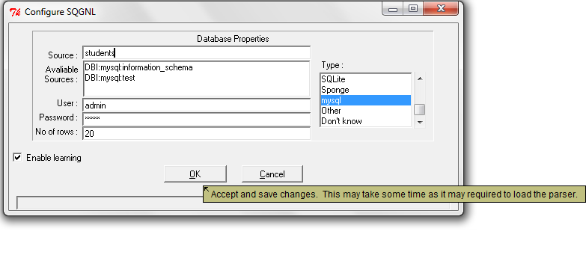
Database Configuration Window

Slide 14
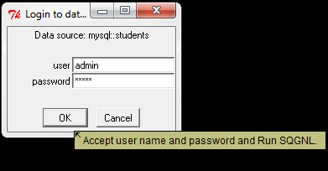
SQGNL Login Window

Slide 15
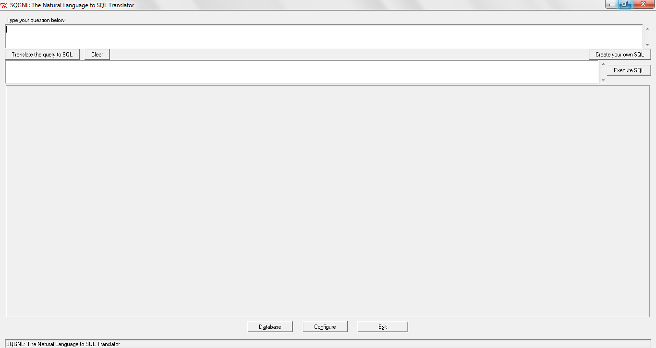
SQGNL Application Interface

Slide 16
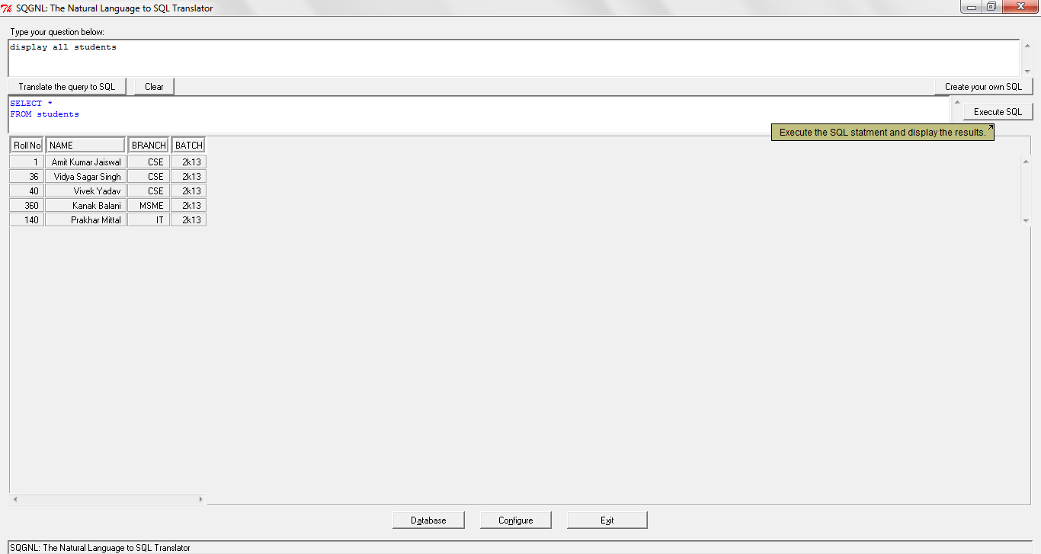
Generates SQL Query from Natural Language

Slide 17
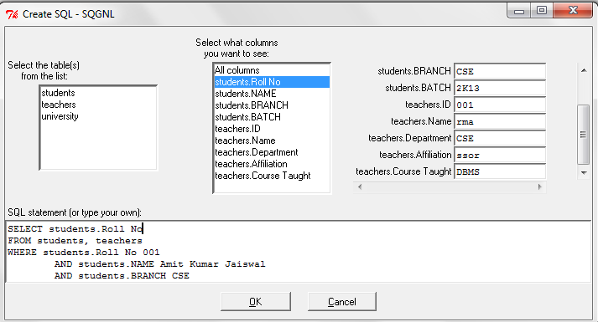
Generate SQL Query manually

Slide 18
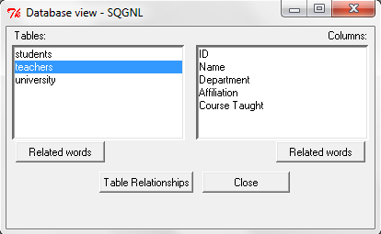

Slide 19
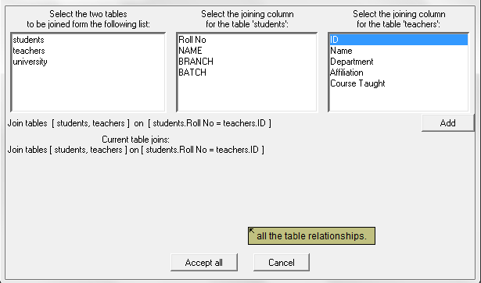
Table Relationship

Slide 20
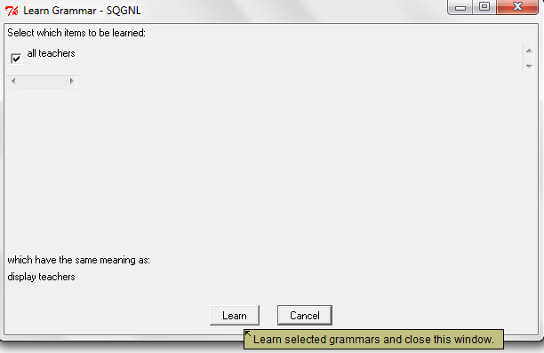
Enabled Grammar to learn at runtime

Slide 21
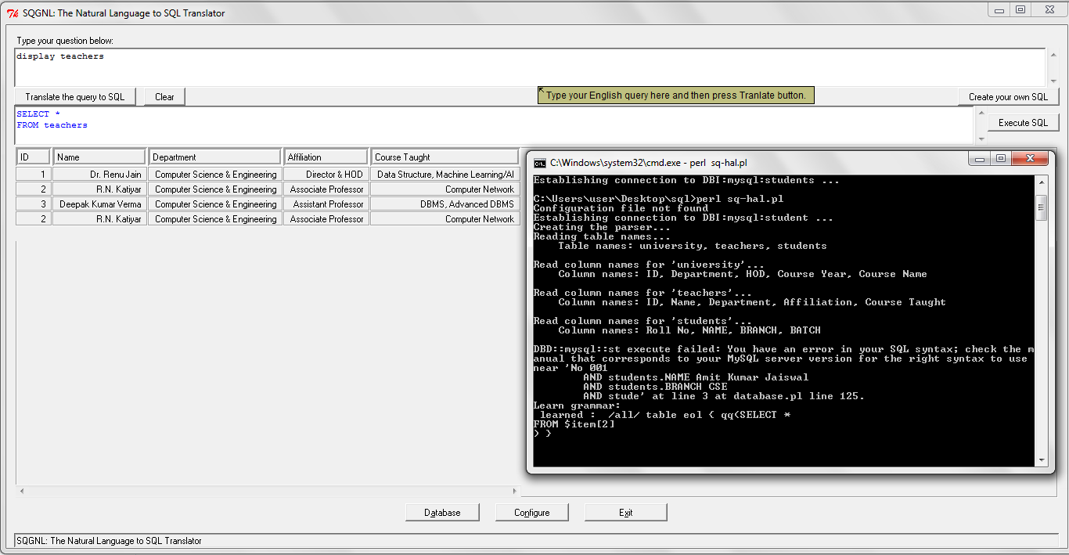

Slide 22
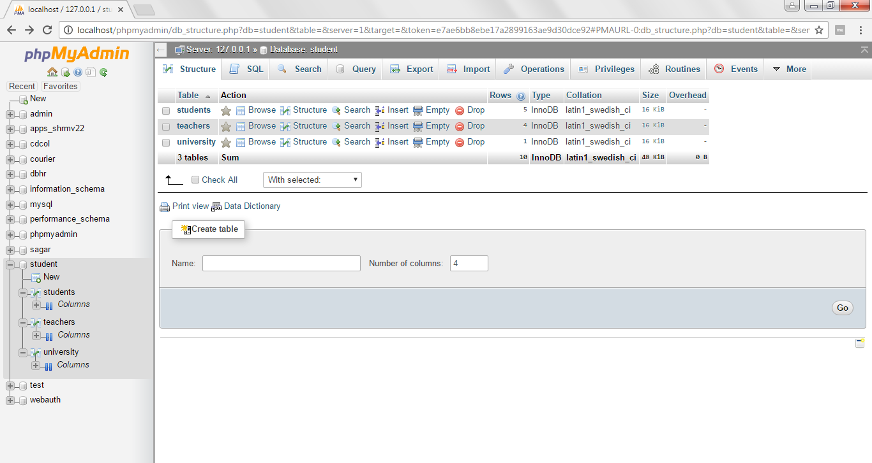

Slide 23
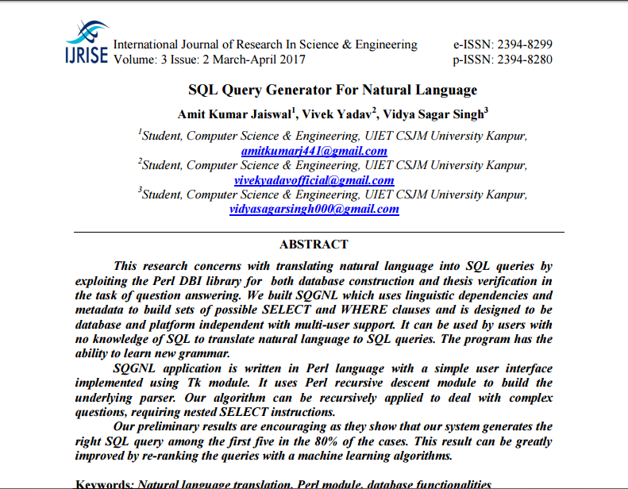

Slide 24
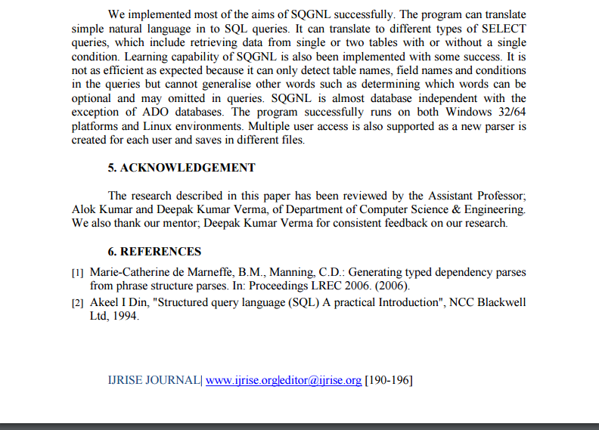

Slide 25
Conclusion
Most of the aims of SQGNL were implemented successfully. The program can translate simple natural language queries in to SQL. It can translate to different types of SELECT queries, which include retrieving data from single or two tables with or without a single condition. Learning capability of SQGNL is also been implemented with some success. It is not as efficient as expected because it can only detect table names, field names and conditions in the queries but cannot generalise other words such as determining which words can be optional and may omitted in queries. SQGNL is almost database independent with the exception of ADO databases.

