Slide 1


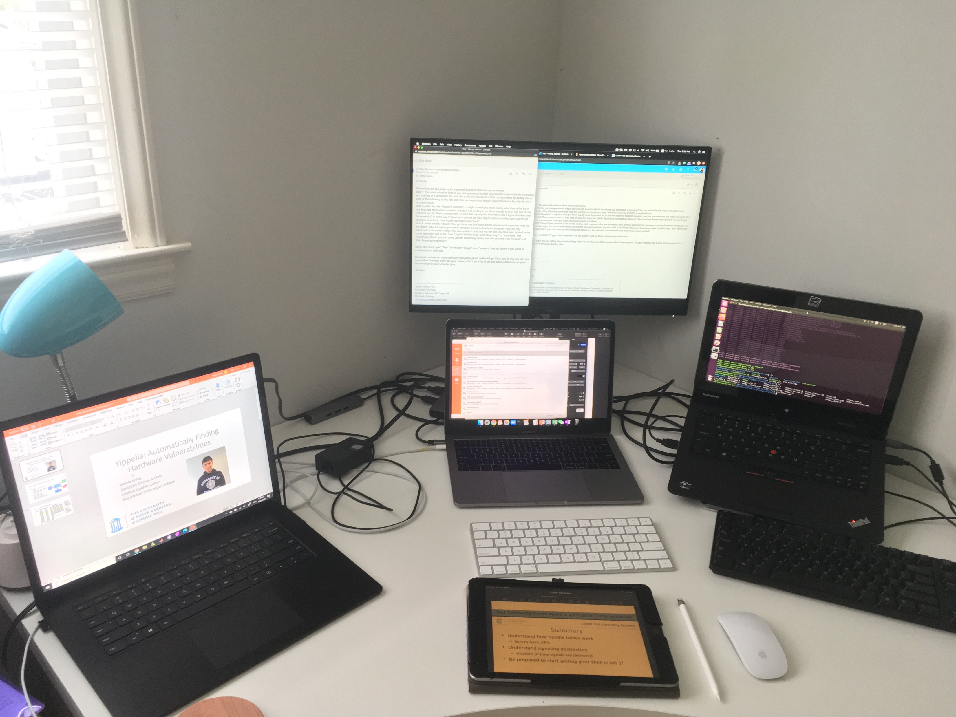
Automatically Finding Hardware Vulnerabilities
Martin Meng
Computer Science & Math
Advisor: Cynthia Sturton
Department of Computer Science

Slide 2
Research Question
Given security properties, how to efficiently find bugs in a processor design?
Importance: finding bugs efficiently in a new processor can speed up the processor development cycle by saving time on the verification stage.
Our tool: find all possible paths in 1 cycle of a processor design; stitch these paths to form a new path leading to a bug through a search algorithm.
Processor
Good
Our tool
Property
Buggy
Notes:
Old slide: Motivation
Verification tool for hardware design is important.
Current method is time-inefficient for exploiting a vulnerability consisting of a large number of clock cycles.
Problem formulation
Given a hardware design and a set of security critical properties,
Efficiently find a sequence of instructions that brings the processor to a state where a property is violated.

Slide 3
Results
Our tool can find deep bugs faster than best-known prior method.
Hardware designers can save time by using our tool to verify their designs.
Safer processors verified by our tool will be available to the world.
 | Our tool | Best-known prior method
Shallow bugs | 6.8 seconds | 3.5 seconds
Deep bugs | 8.3 seconds | > 4 hours
Table 1: an average-time comparison between our tool and the best-known prior method.
Notes:
Old slide: Experiments comparing Yippelia and a traditional method (Klee’s forward search) is performed on a toy processor.
Yippelia has better performance in finding the vulnerabilities spanning many clock cycles.

