Slide 1
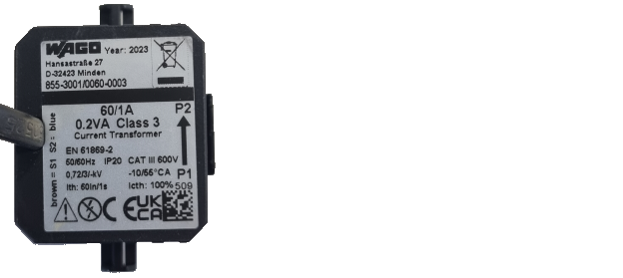
Direction of current measurement

Slide 2

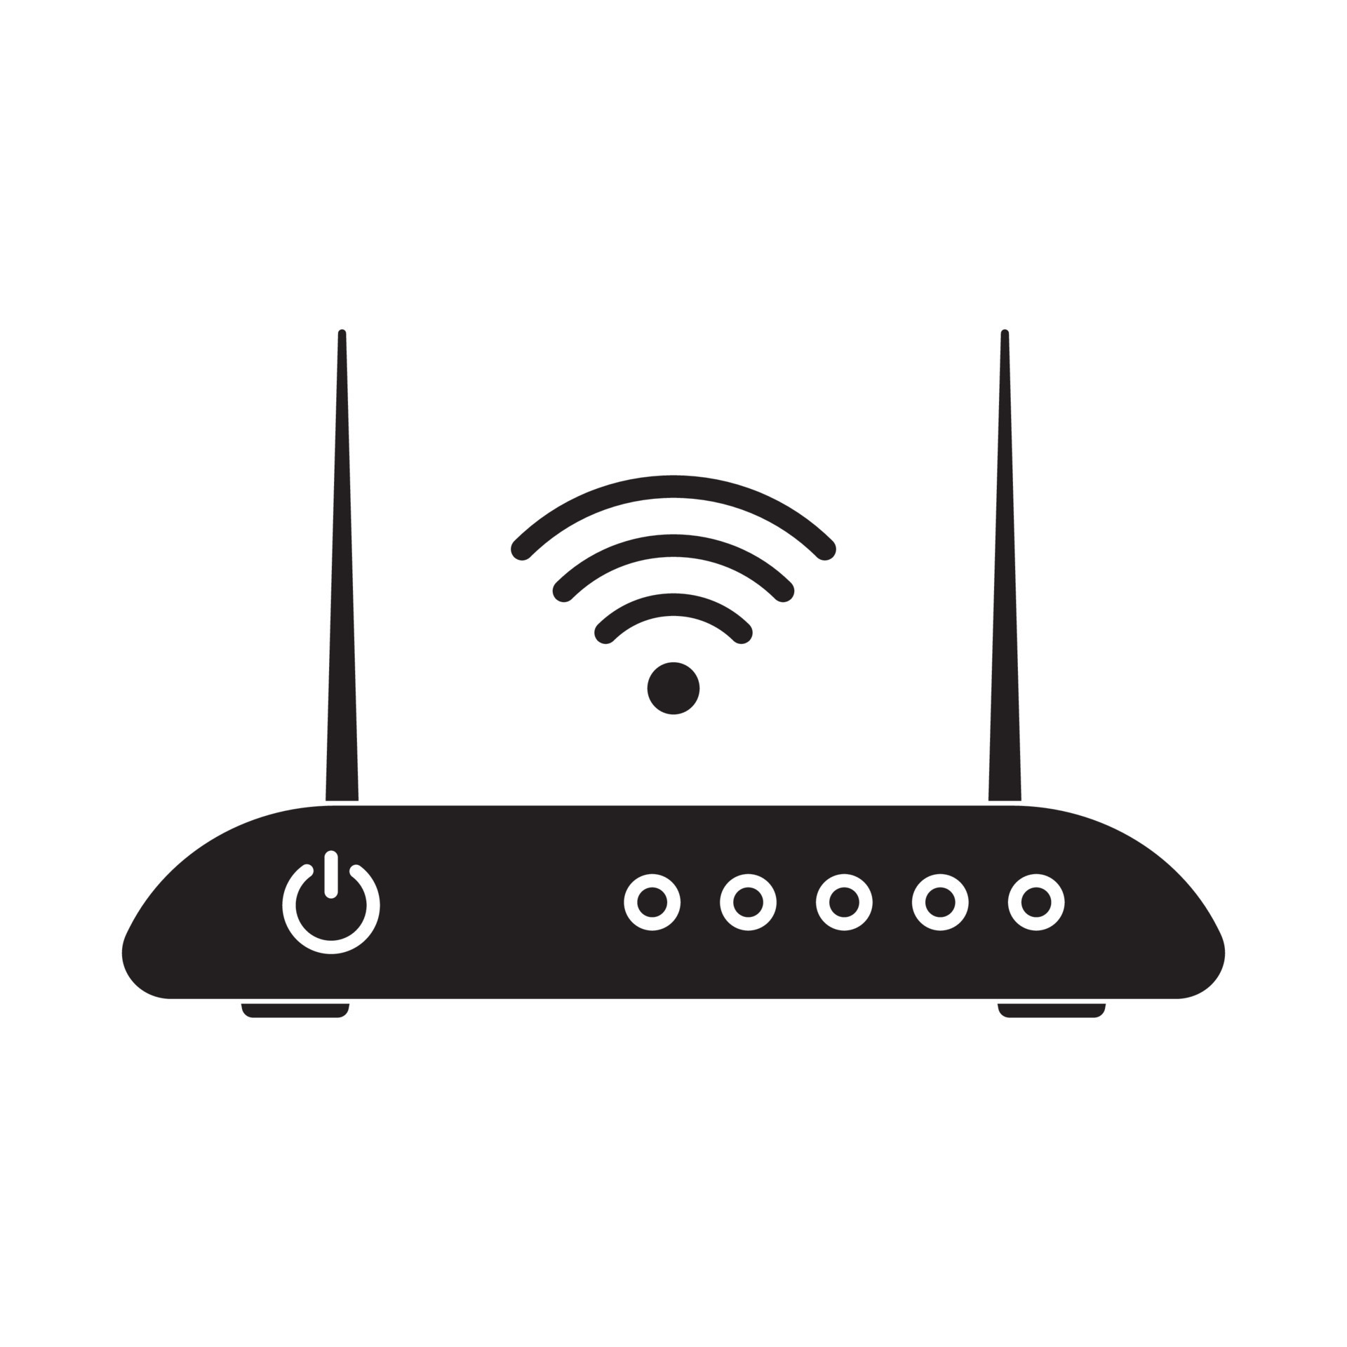
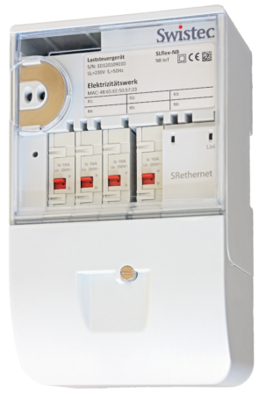



Customer router
Remote control contact of the load-shedding relay
Manufacturer Gateway

Slide 3
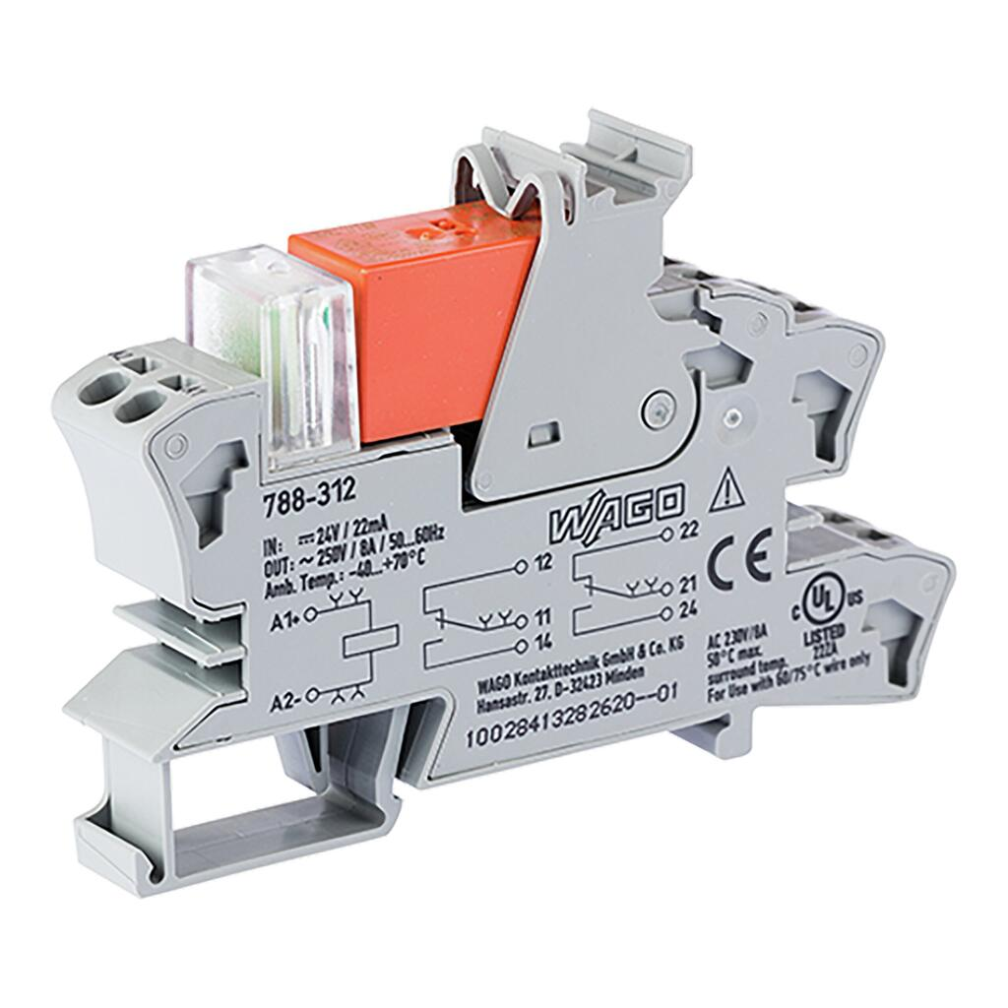
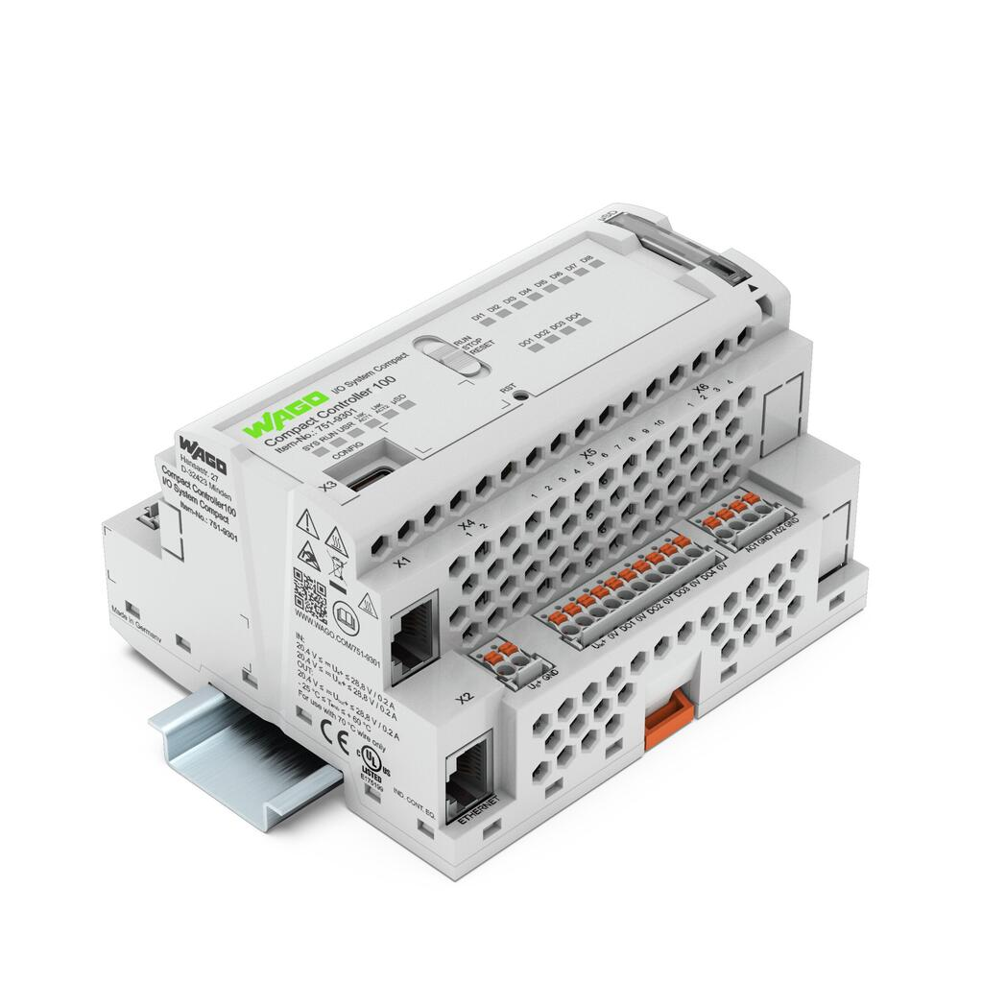
Remote control contact of the load-shedding relay
EVU
DI1
DO1

Slide 4
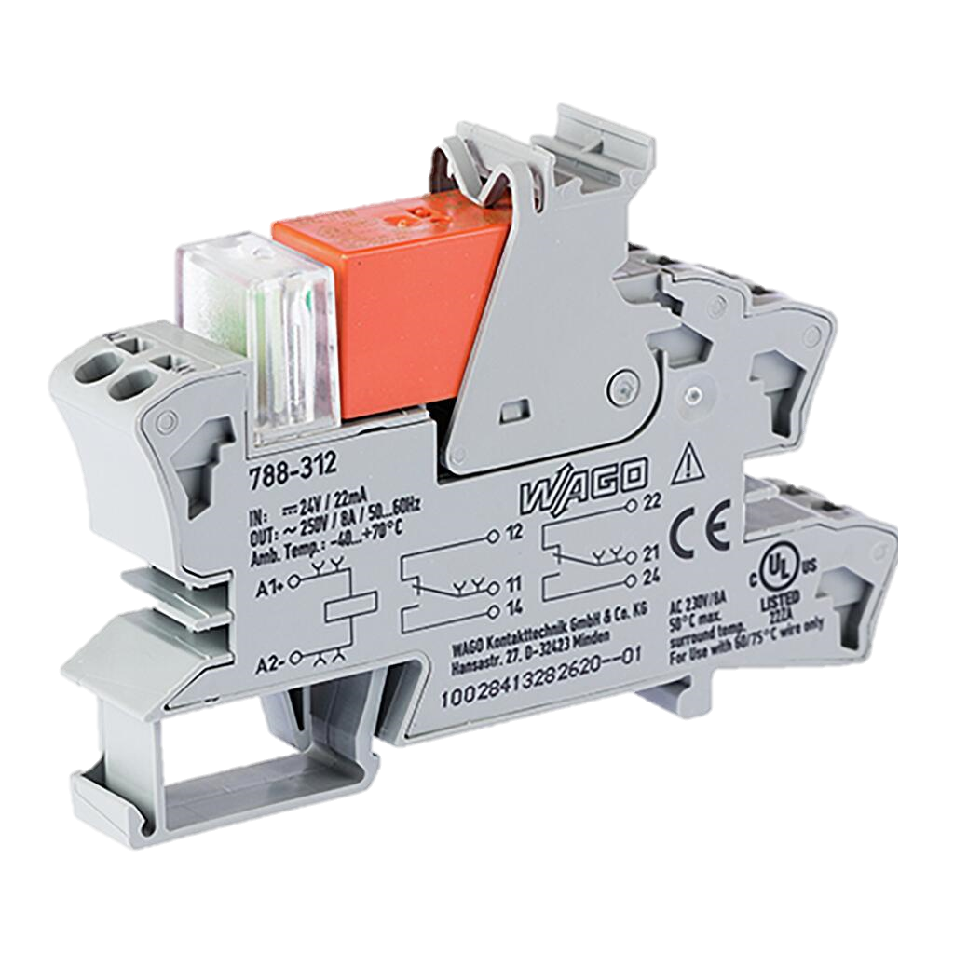
DO1
DO2
SG-1
SG-2

Slide 5
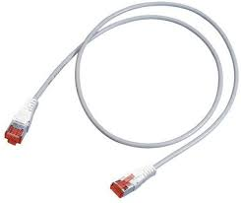
Customer router
Ethernet Patch Cable
Ethernet Patch Cable
Manufacturer Gateway
X2 Port

