Slide 1

GEOG0113 Lecture 010 Modelling Photosynthesis
P. Lewis
UCL Geography
& NERC NCEO

Slide 2
Aims of lecture
In this lecture, we will consider:
Farquhar approach
Modelling controls on photosynthesis

Slide 3
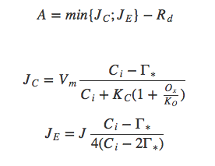
5. Modelling Photosynthesis
Farquhar approach:
Assim. Rate = min of electron transport limited rate and carboxylating rate JE, JC, & leaf dakr resp Rd; 𝚪* is CO2 compensation point without leaf resp. Vcmax = max carboxylation rate
Farquhar et al. (1980) Planta. 149(1):78-90. doi: 10.1007/BF00386231.
Notes:
In the ‘Farquhar’ approach (Farquhar et al. 1980), the non-limited photosynthetic rate A0 is calculated for a fixed value of intercellular CO2 concentration Ci,0 (Knorr, 1998). The actual carbon assimilation rate A: at the leaf level depends on the actual intercellular CO2 concentration Ci. For the C3 pathway it is calculated as a function of the electron transport limited rate JE and a carboxylating rate JC controlled by the enzyme Rubisco (units mol(CO2)m−2s−1) and the leaf ‘dark’ respiration rate Rd:
Here, Γ∗ (mol(CO2)mol(air)−1) is the CO2 compensation point without leaf respiration, KC is the Michaelis-Menton constant for CO2 (mol(CO2)mol(air)−1), Ox is the oxygen concentration (0.21 mol(O2)mol(air)−1), KO is the Michaelis-Menton constant for O2 (mol(O2)mol(air)−1), and J is the electron transport rate:
Jc, Je go up w Ci, Vcmax, down with Ox and Γ*

Slide 4
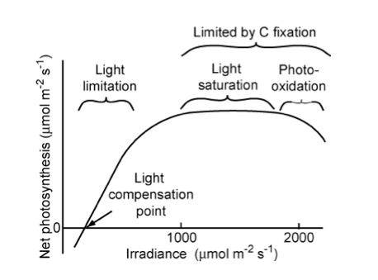
Notes:
“Relationship of net photosynthetic rate to photosynthetically active radiation and the processes that limit photosynthesis at different irradiances. The linear increase in photosynthesis in response to increased light (in the range of light limitation) indicates relatively constant light use efficiency. The light compensation point is the minimum irradiance at which the leaf shows a net gain of carbon.” Source: Chapin, 2011, PTEEChap5.ppt, fig. 5.5

Slide 5
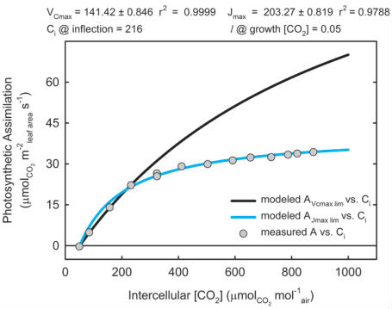
Notes:
“Figure of the photosynthetic response to increasing CO2. Glycine max (soybean) leaf was excised from experimental-garden grown plant and then light acclimated at 1500 Âµmol m-2 s-1 (saturating) in a lab. Experimental data (circles) was modeled using the equations of Farquhar, von Caemmerer and Berry (1980) for maximum velocity of carboxlation (VCmax, black line) and the maximum electron transport rate for RuBP regeneration (Jmax, cyan line). The intercellular CO2 (Ci) at which photosynthesis transitions from VC-limited to J-limited is 216 Âµmol CO2 mol-1 air. Stomatal limitation to photosynthesis (l ) is the effect of the stomata resistance restricting photosynthesis decreasing CO2 available for photosynthesis at growth CO2 concentration.” Source: johnmorris.com

Slide 6


Electron transport rate
depends on I, alpha, Jmax
I=IPAR/EPAR where IPAR (Wm−2) is the PAR absorption rate EPAR the energy content of PAR quanta (220 kJmol−1), Jmax the maximum electron transport rate, (mol(CO2)m−2s−1 and α the efficiency of photon capture (0.28).
NSCL is a Nitrogen scaling factor at maximum carboxylation rate and maximum electron transport rate.
Notes:
I=IPAR/EPAR where IPAR (Wm−2) is the PAR absorption rate EPAR the energy content of PAR quanta (220 kJmol−1), Jmax the maximum electron transport rate, (mol(CO2)m−2s−1 and α the efficiency of photon captupre (0.28).
NSCL is a Nitrogen scaling factor at maximum carboxylation rate and maximum electron transport rate.

Slide 7
Exploring Farquhar’s Eqn
Practical next week:
https://ucl-eo-geog0133.readthedocs-hosted.com/en/latest/notebooks/011_Photosynthesis_Modelling_Practical.html

Slide 8
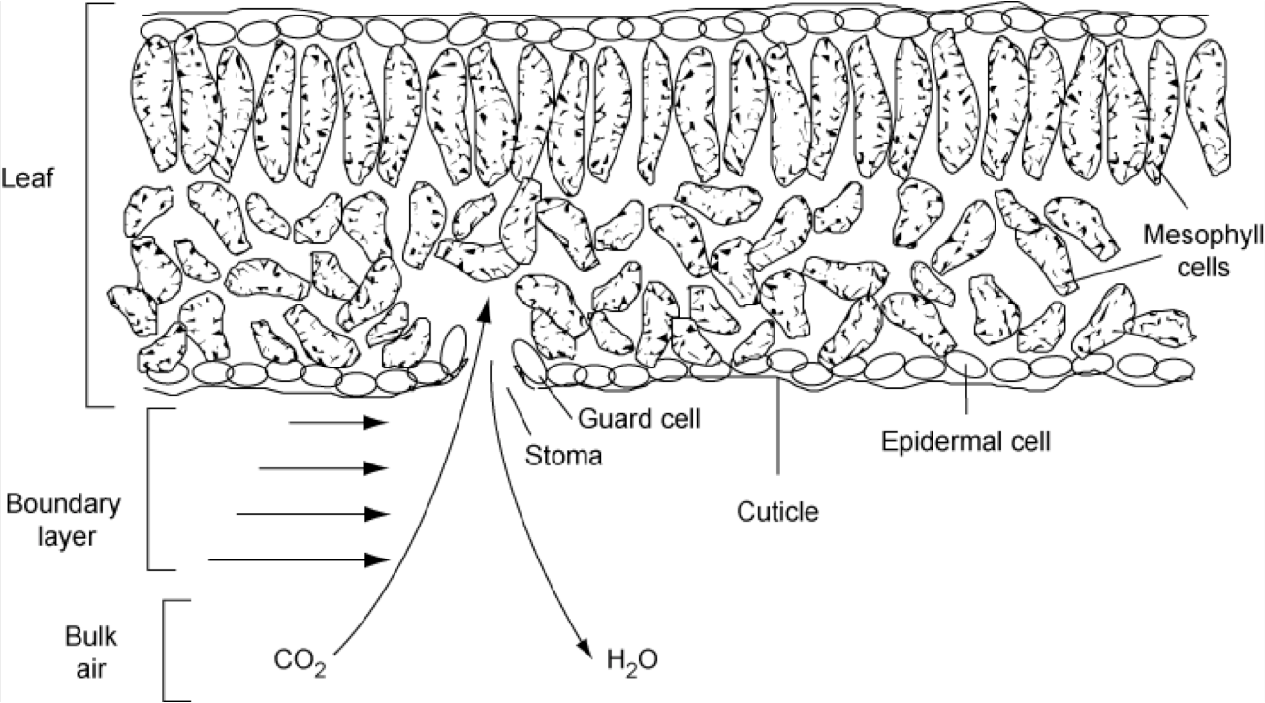
Stomatal conductance
when plants decrease stomatal conductance (increase resistance) to minimise water loss, photosynthesis declines redcuing the efficiency at which plants convert light to carbohydrates

Slide 9
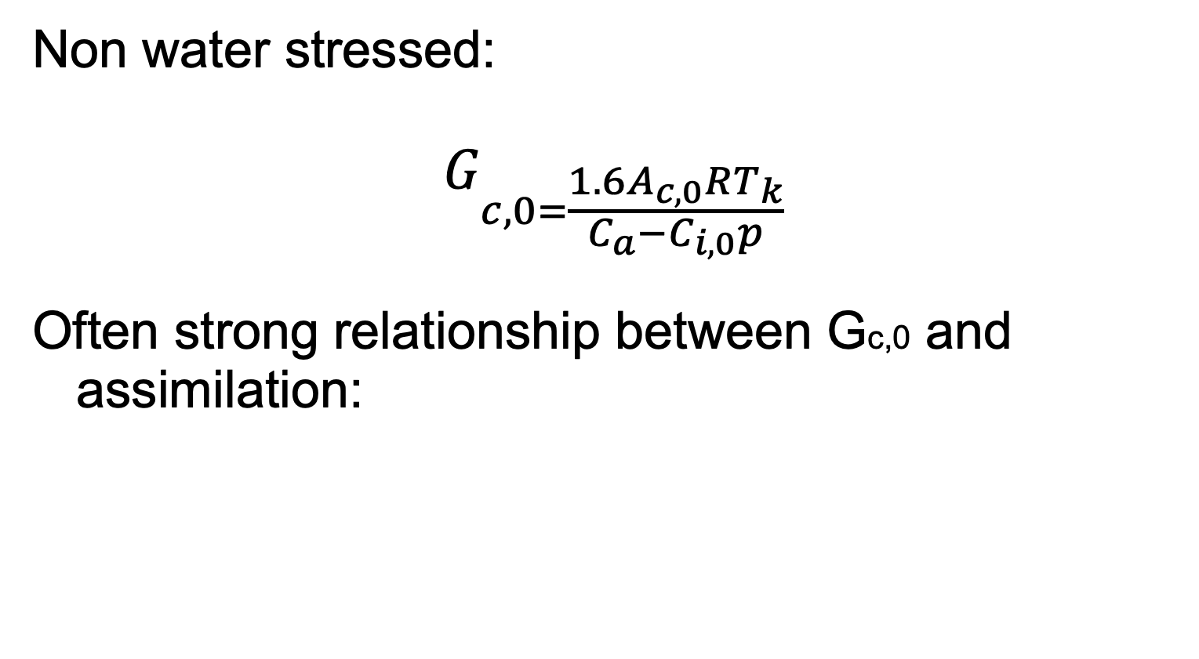
Model of stomatal conductance
Non water stressed:
$$G_{c,0=\frac{1.6A_{c,0}RT_{k}}{C_{a}−C_{i,0}p}}$$
Often strong relationship between Gc,0 and assimilation:
G_{c,0} = 0.883 A_{c,0}
Notes:
which is considered a function of leaf temperature (Tk, K), non-water-limited net leaf CO2 uptake rate(Ac0, umol m-2 s-1), Ca the atmospheric CO2 concentration (355 umol(CO2)/mol(air)) and standard non-stressed leaf- internal CO2 concentration, (Ci,0). R is the gas constant (8.3145 J/mol K, so units: kg m-2 s-2 mol-1 K-1), and p is the air pressure of the standard atmosphere (Pa, i.e. kg m-1 s-2), so that Gc0 is given in m/s (Knorr, 2000). The factor of 1.6 accounts for the different molecular diffusivities of water and carbon dioxide.

Slide 10
5. Modelling Photosynthesis
Summary
outlined the ‘Farquhar’ approach to modelling photosynthesis, that is used in this or related forms in most DGVMs.
Relates carbon assimilation rate to the minimum of two potentially limiting factors
the electron transport limiting rate and
a carboxylating rate,
with leaf ‘dark’ respiration subtracted.
it relates carbon assimilation to ambient CO2 concentrations.
outlined some concepts about what controls stomatal conductance.
important concept because it can limit carbon assimilation and relates to water use by the leaf (transpiration).

Slide 11
Recommended Reading
D. B. Clark, et al. (2011) The Joint UK Land Environment Simulator (JULES), model description: Part 2: Carbon fluxes and vegetation dynamics, Geosci. Model Dev., 4, 701-722, 2011, doi:10.5194/gmd-4-701-2011
Farquhar, G.D., S. von Caemmerer, and J.A. Berry (1980). A Biochemical Model of Photosynthetic CO2 Assimilation in Leaves of C3 species. Planta 149:78-90. [download]
Farquhar GD, von Caemmerer S. 1982. Modeling of photosynthetic response to environmental conditions. In Physiological Plant Ecology. II. Water Relations and Carbon Assimilation, Lange OL, Nobel PS, Osmond CB, Ziegler H (eds). Encyclopedia of Plant Physiology, vol. 12B, Springer-Verlag: New York; 549-587.
Knorr, W. (1997) Satellite remote sensing and modelling of the global CO2 exchange of land vegetation: a synthesis study. Max-Planck-Institut fur Meteorologie Examensarbeit Nr. 49, 185 pp. ISSN 0938-5177 (in German and English), Max-Planck-Institut fur Meteorologie, Hamburg, Germany. (available online ).
Knorr, W. (2000) Annual and interannual CO exchanges of the terrestrial biosphere: process-based simulations and uncertainties, Global Ecology & Biogeography (2000) 9, 225-252
Jarvis, P.G. (1976) The interpretation of variations in leaf water potential and stomatal conductance found in canopies in the field . Philosophical Trans- actions of the Royal Society of London, Series B, 273, 593-610.

Slide 12
Jones, H.G. (1983) Plants and microclimate. 323 pp. Cambridge University Press, Cambridge, UK. (also 1992)
Jones, H.G. (1998) Stomatal control of photosynthesis and transpiration J. Exp. Bot. (1998) 49(Special Issue): 387-398 doi:10.1093/jxb/49.Special_Issue.387
Chapin, F.S, Matson, P.A., and Mooney, H.A., (2002) Principles of Terrestrial Ecosystem Ecology, Springer: Chapters 5 and 6 .

