Slide 1
GEOG0113 Lecture 008 Production Efficiency Models
H. Heorton
UCL Geography
& NERC NCEO

Slide 2
Aims of lecture
In this lecture, we will consider:
vegetation modelling using PEMs
Concepts of PEMs

Slide 3

3. Production efficiency models
‘Monteith’ approach
The scalars represent multiplicative environmental constraints that are typically meteorologically derived (i.e. limiting factors).
Notes:
GPP is the Gross Primary Productivity (gCm−2), ϵ is the ‘light use efficiency’ (LUE) (g dry matter per MJ PAR), Cdrm is the carbon content of dry matter (0.45 gCg−1), fPAR is the fraction of PAR absorbed by the canopy (also known as fAPAR), and PAR is Photosynthetically Active Radiation (MJm−2) or the downwelling shortwave radiation multipled by the the PAR fraction of direct and diffuse illumination taken together. NPP is the Net Primary Productivity (gCm−2) and Ra is the autotrophic respiration (gCm−2).

Slide 4
PEMs
Attractions:
simple and
captures the ‘main effect’
C assimilation increases with increasing PAR absorption in the absence of limiting factors
including such limits as scalars
fAPAR is potentially accessible from satellite data, so a major part of the model can be driven by observations globally.

Slide 5
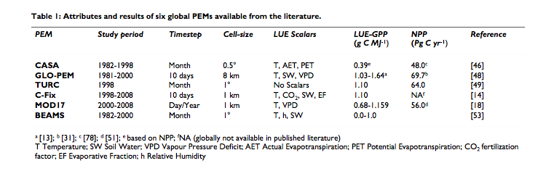
Some PEMs
Notes:
NB read see McCallum et al for review

Slide 6

PEM requirements
LUE often assumed constant
e.g. constant globally in CASA or
per biome via a land cover map as in MOD17.
GLO-PEM does not assume a constant LUE.
make use of satellite data (fAPAR),
But most also require climate data
(for APAR and to drive limiting scalars).
Only GLO-PEM runs on only satellite data (with the exception of attribution of C3 and C4 plants).

Slide 7
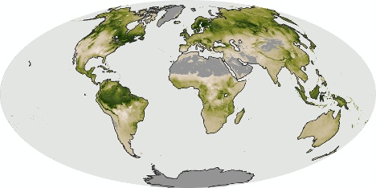
Going back to Lecture 003 NPP: July 2006 (MOD17 PEM)

Slide 8
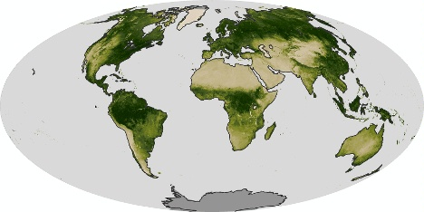
NDVI: July 2006

Slide 9
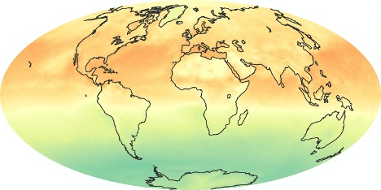
Net radiation: July 2006

Slide 10
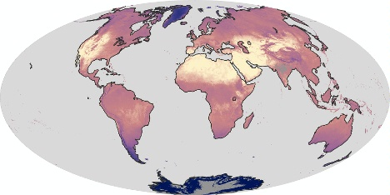
LST (Land Surface Temp.): July 2006

Slide 11
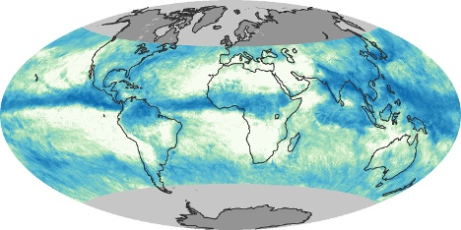
Precip.: July 2006

Slide 12
Some issues
LUE should not be assumed constant, but should vary by PFTs
would alleviate the need for many or all climate drivers. Results are strongly dependent on the climate drivers used for particular models (which also complicates intercomparison)
Further use of satellite data
PEMs should consider incorporating diffuse radiation, especially at daily resolution
PEMs should also consider the need to account for GPP saturation when radiation is high

Slide 13
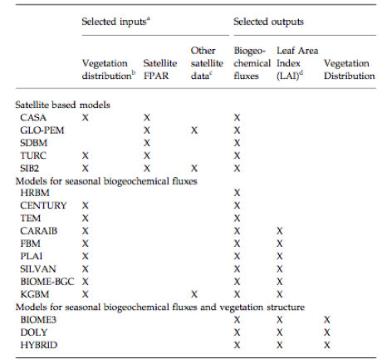
How good are these models?
Cramer et al. (1999) intercomparison
PEMs & other models

Slide 14
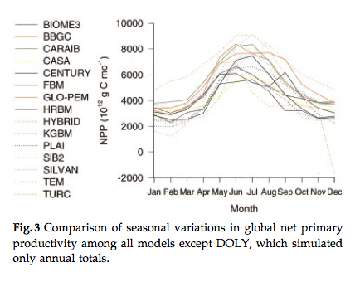
How good are these models?

Slide 15
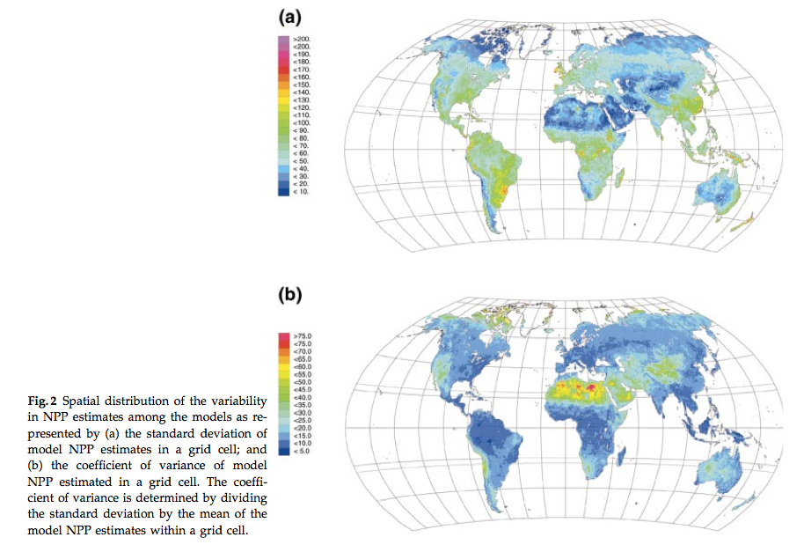
How good are these models?
Notes:
These results are claimed to be ‘relatively good’ considering this is a relatively poorly understood variable,and one thing the study highlights is degree of our current uncertainty of this quantity. Within this range of spread then, the PEMs performed no more poorly than other models and PEMs should be considered a viable semi-independent approach for NPP monitoring.

Slide 16
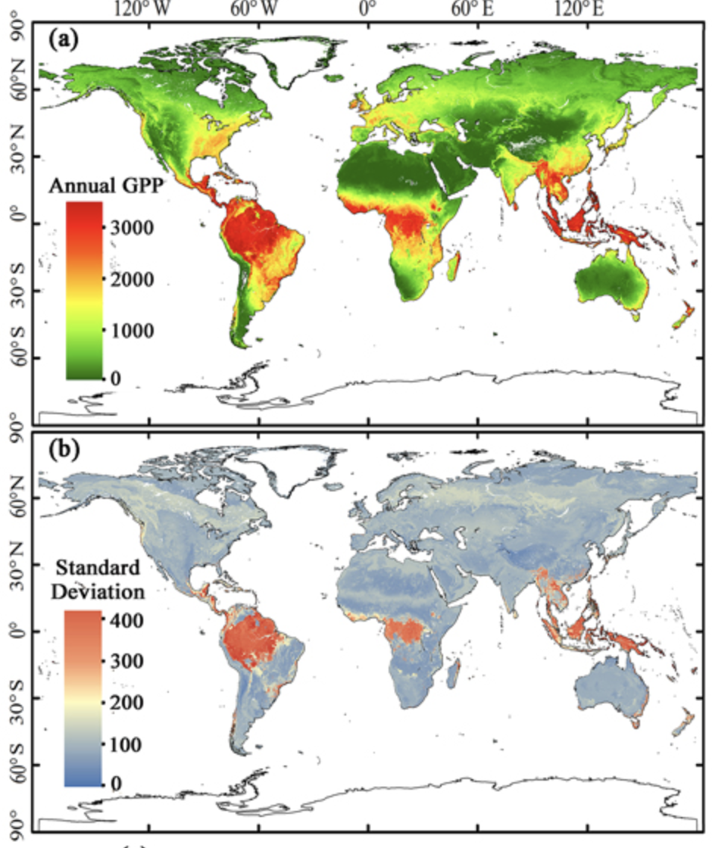
GPP From Solar-induced chlorophyll fluorescence
Data from NASA JPL SIF
Using NASA Orbiting Carbon Observatory-2 (OCO-2)
Using the phenomena of red fluorescent glow during photosynthesis
Based upon Li and Xiao (1999)

Slide 17
Summary
overview of PEM approach.
The key idea that non-limited carbon assimilation can be assumed a linear function of the capacity of a canopy to absorb shortwave (specifically PAR) radiation and the amount of downwelling PAR.
Models particularly useful as they can be largely driven by observations (or rather fAPAR, derived from satellite observations).
Several key issues in the use of such models are highlighted, but these models seem to perform ‘quite well’ in comparison to mechanistic approaches.
Since these models are driven by observations, they cannot directly be used in prognostic mode.

Slide 18
Recommended Reading
McCallum, I., et al., 2009, Satellite-based terrestrial production efficiency modeling, Carbon Balance and management, 4:8 doi:10.1186/1750-0680-4-8
Monteith JL: Solar radiation and productivity in tropical ecosystems. J Appl Ecol 1972, 9:747-766.
Monteith JL: Climate and the efficiency of crop production in Britain. Philos Trans R Soc London, Ser B 1977, 281:277-294.

