Slide 1
GEOG0113 Lecture 007 Dynamic Global Vegetation Models
P. Lewis
UCL Geography
& NERC NCEO

Slide 2
Aims of lecture
In this lecture, we will consider:
Global vegetation modelling
Production efficiency models
Phenology
Modelling Photosynthesis

Slide 3
Global vegetation modelling
Focus on linking measurements from Earth Observation and other sources with models of terrestrial carbon at regional and global scales.
motivation for models
to express current understanding of the controls on carbon dynamics as embedded in Earth System / Terrestrial Ecosystem models.
The role of observations is to test and constrain these models to enable:
(i) monitoring of terrestrial carbon dynamics;
(ii) improved prognostic models.
The main focus of the modelling and monitoring is on Net Primary Productivity (NPP).

Slide 4
Types of models
TEMs
Static vegetation representation
DGVMs
Dynamic vegetation
PEMs
Simplifications for ‘data driven’ model

Slide 5
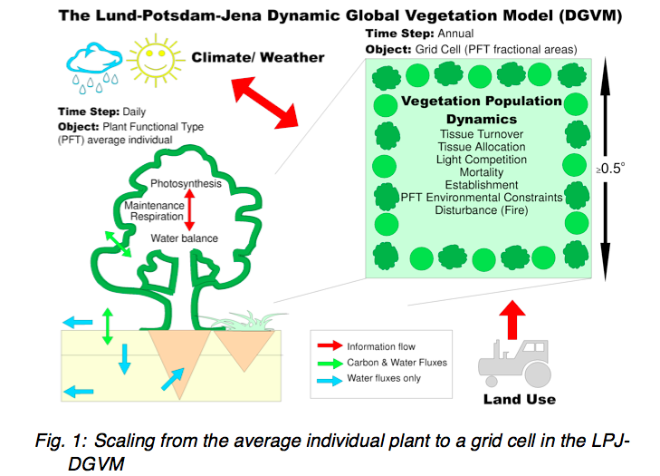
Dynamic Global Vegetation Models

Slide 6
DGVMs
Main components:
establishment,
productivity and competition for resources,
resource allocation,
growth,
disturbance and mortality

Slide 7
DGVMs
Key features:
allows for prognostic and paleo use
geared towards modelling potential vegetation
anthropogenic influences e.g. changes in land use incorporated by forcing these effects
e.g. prescribing land cover/PFT

Slide 8
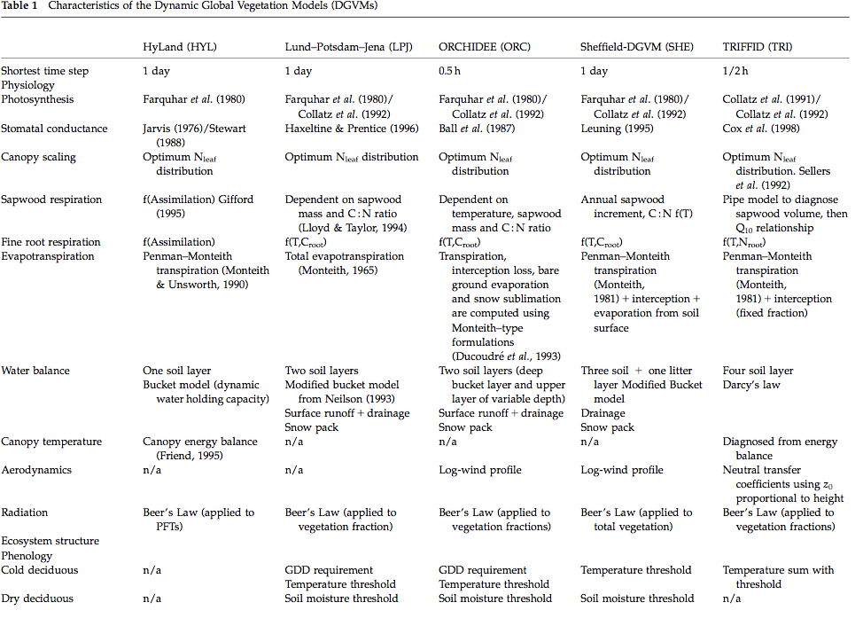
Notes:
Just mention the diff models & go through some of the processes they include, mentioning where they are different … eg beers law etc

Slide 9
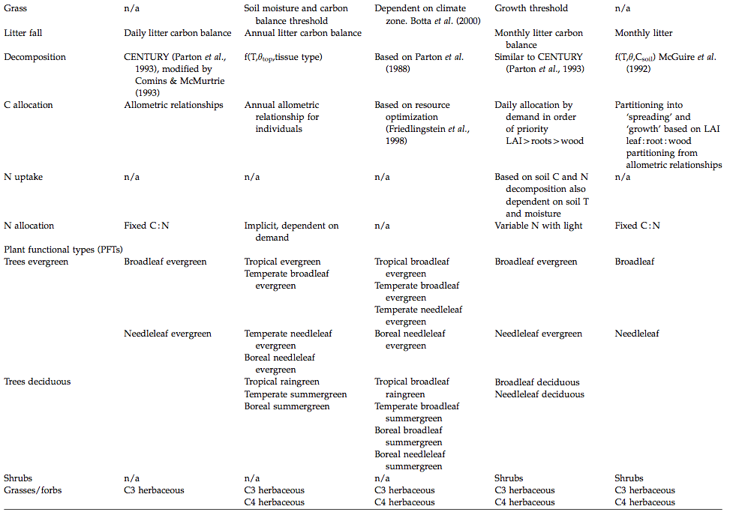
Notes:
Just mention the diff models & go through some of the processes they include, mentioning where they are different
eg few have N uptake models, different ways they have of partitioning the C

Slide 10
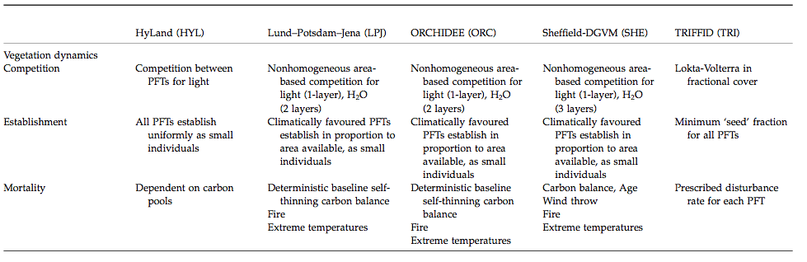
Dynamics, Establishment & Mortality
Notes:
Again, difft approaches applied

Slide 11
Plant Functional Types
Key simplification in DGVMs: PFTs
Group plant types by responses to resources and climate
Simplification allows global modelling
Limits number of parameters required
PFTs should:
represent the world’s most important plant types;
characterize them through their functional behavior;
provide complete, geographically representative coverage of the world’s land areas

Slide 12
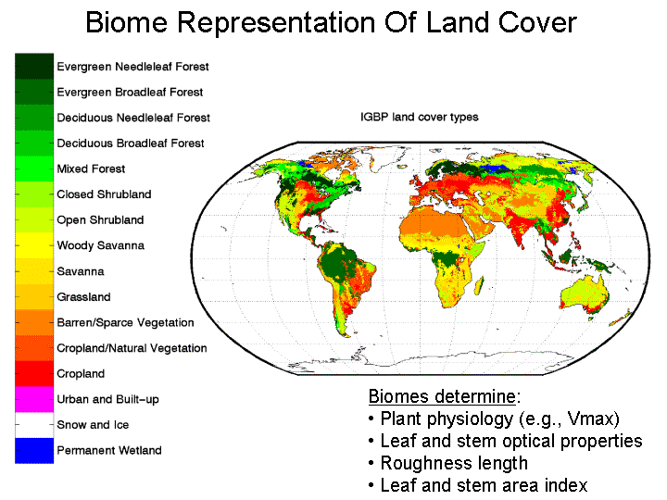
Notes:
Could try to group by biome, but what are the physiological parameters of complex systems such as savannas? So biome forms one basis for PFTs

Slide 13
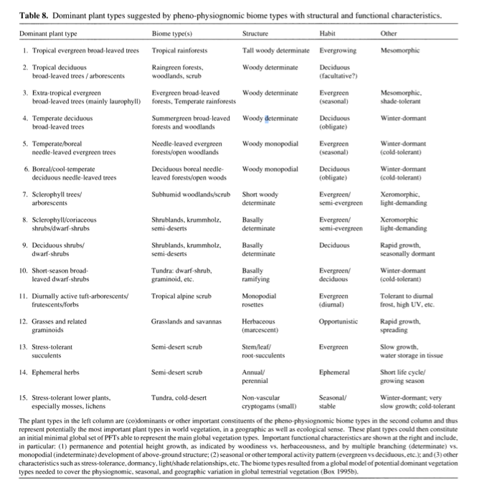
Box et al. PFTs
Notes:
Box (1996) suggests the following requirements for PFTs. They should:
represent the world’s most important plant types;
characterize them through their functional behavior;
and provide complete, geographically representative coverage of the world’s land areas

Slide 14
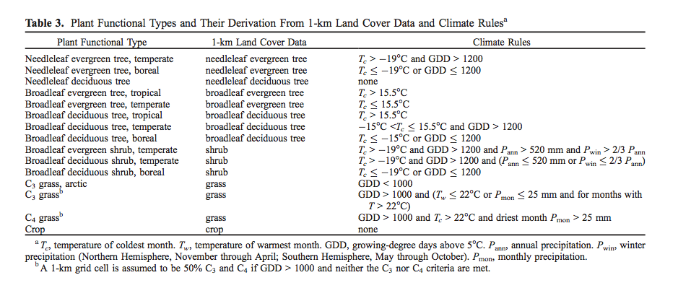
Or Bonan et al., biome/climate rules

Slide 15
PFTs
Some issues:
Uncertainty from land cover
Variations in mappings to PFTs
Assume parameters describing functioning constant over PFT
New evidence from traits databases

Slide 16
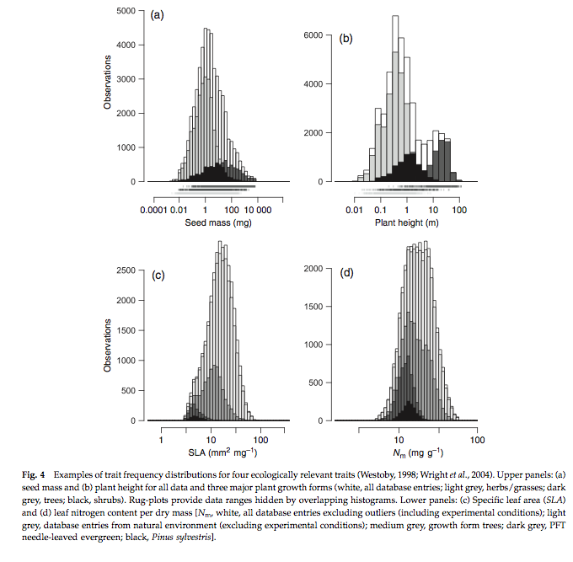
Notes:
Specific leaf area (SLA) and other terms from TRY traits database: Now have distributions of these traits over large number of samples
WHITE = all
L GREY = herbs/grasses
D GREY = trees
BLACK = shrubs

Slide 17
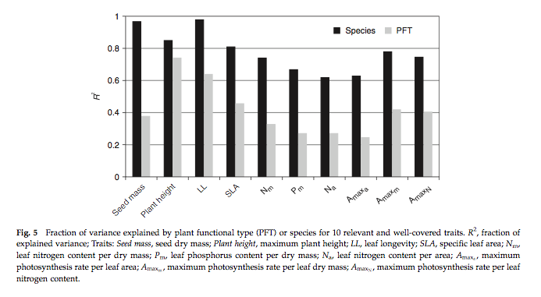
Analysis of species/PFT in TRY
http://try-db.org/pmwiki/index.php
Kattge et al. (2011) GCB
Notes:
here, we can see that for example for specific leaf area (SLA, one-sided leaf area per leaf dry mass) about 40% of the variation in SLA that exists in the database occurs between PFTs, also the variation in the mean between PFTs is similar to the within PFT variation for this trait.

Slide 18
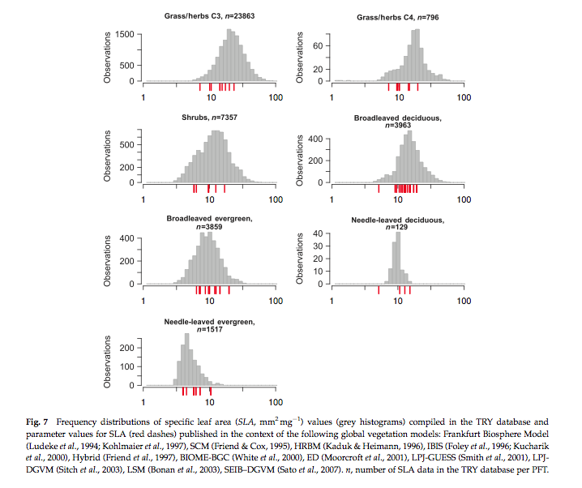
Notes:
The figure above shows frequency distributions of SLA for different PFTs. For some (e.g. needle leaf deciduous) the distribution is quite narrow (but a relative small sample number here) but for most, it is wide. Interestingly, the figure also shows the values of SLA used in different global vegetation models (in red) showing the very wide range of values assumed across different models.

Slide 19
How ‘good’ are these models?
Current benchmarking efforts
International Land Model Benchmarking – iLAMB
Previous (more limited)
Carbon-Land Model Intercomparison Project - C-LAMP
2 models (CASA’, CN)
global carbon sinks for the 1990s differed by a factor of 2
magnitude of net carbon uptake during the growing season in temperate and boreal forest ecosystems was under-estimated

Slide 20
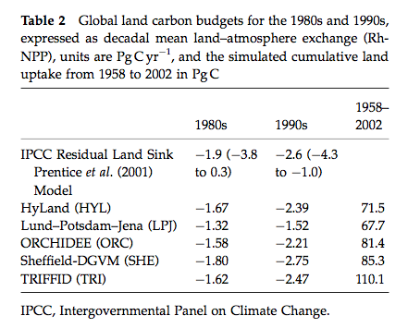
How ‘good’ are these models?
Model intercomparisons (e.g. Sitch et al., 2008)

Slide 21
How ‘good’ are these models?
models estimates within range of current knowledge of C budgets and relatively close to the mean IPCC values.
The models in general agreement about the cumulative land uptake over the last 50 years.
Models simulated the correct sign of response to ENSO events but differed markedly in magnitude.
have similar response of productivity to elevated atmospheric CO2 in agreement with field observations
The DGVMs are in less agreement in the way they respond to changing climate.
suggest a release of land carbon in response to climate
implying a significant positive climate-carbon cycle feedback in each case. This response is mainly due to a reduction in NPP and a decrease in soil residence time in the tropics and extra-tropics, respectively.

Slide 22
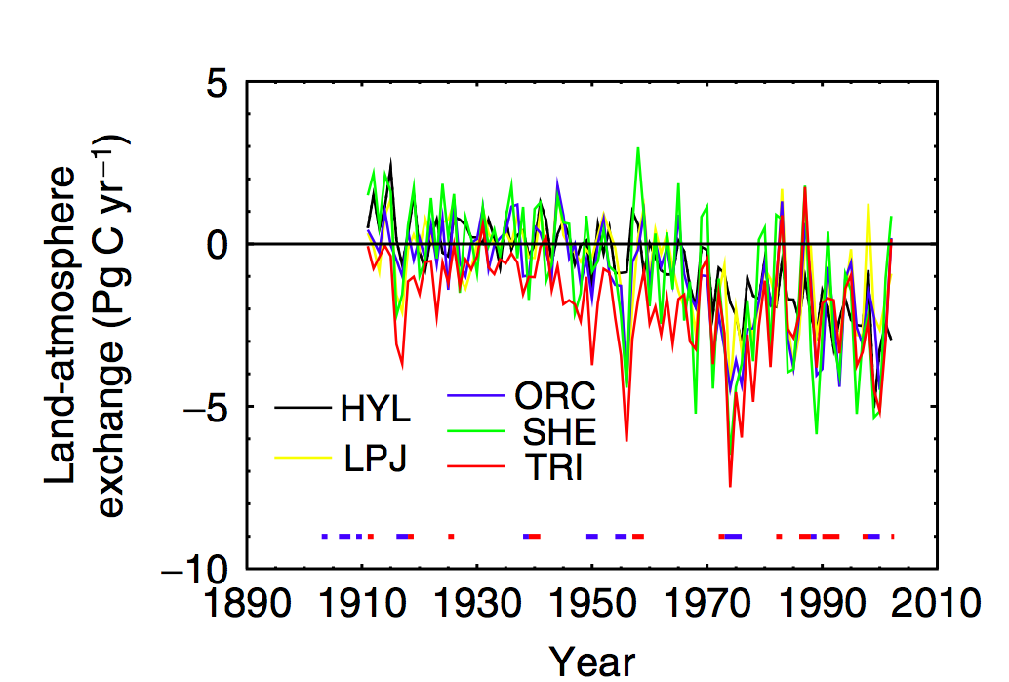
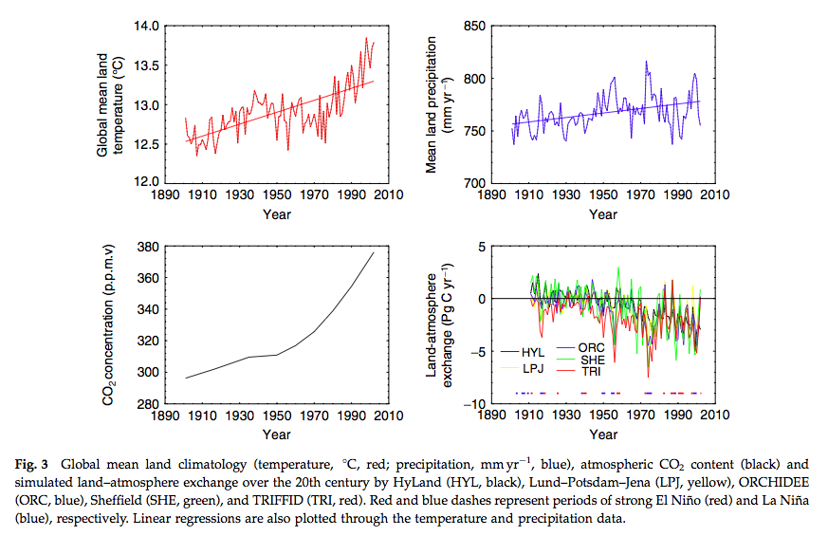
Notes:
But year on year responses quite different between models …We see, for example significant scatter on the year to year responses of the models when considering the land-atmospherie carbon exchange, particularly for ENSO years, although the general trends are similar (hence the level of agreement noted above for decadal or longer integrals).

Slide 23
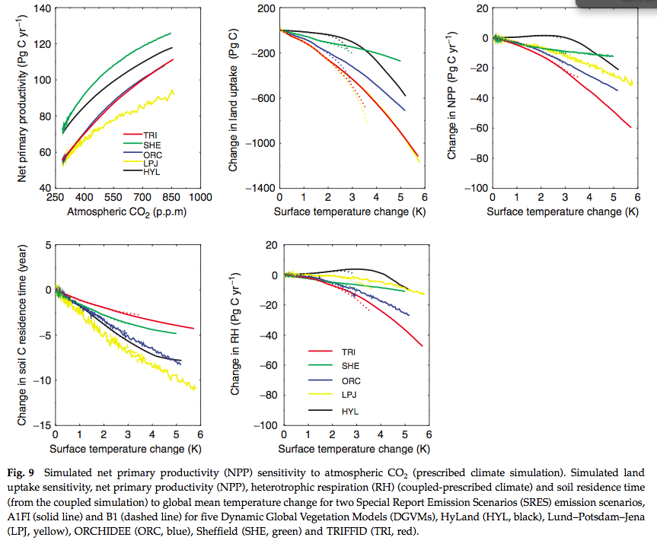

Slide 24
Summary
In this section,
noted that the two main types of model we are interested in are DGVMs and PEMs.
Outlined some of the main features of DGVMs and discussed some of the concepts they employ, such as PFTs.
Traits databases
We have also considered how we can tell how good these models are.

Slide 25
Recommended Reading
Woodward, F.I. Lomas, M.R. (2004) vegetation dynamics - simulating responses to climatic change, biol. Rev. 79, 643-670
scheiter, s., langan, l. and higgins, s.i. (2013), next‐generation dynamic global vegetation models: learning from community ecology. new phytol, 198: 957-969. https://doi.org/10.1111/nph.12210
Box., E.O. 1996, plant functional types and climate at the global scale, journal of vegetation science, vol. 7, no. 3 (jun., 1996), pp. 309-320
Bonan, G.B, s. Levis, L. Kergoat, and K.W. Oleson, 2002: landscapes as patches of plant functional types: an integrating concept for climate and ecosystem models. Global biogeochem. Cycles, VOL. 16, no. 2, 10.1029/2000gb001360, 2002
Sitch S, huntingford C, gedney N, levy PE, lomas M, piao S, betts R, ciais P, cox P, friedlingstein P, jones CD, prentice IC, woodward FI (2008) evaluation of the terrestrial carbon cycle, future plant geography and climate-carbon cycle feedbacks using 5 dynamic global vegetation models (dgvms). Global change biology 14:2015-2039, doi:10.1111/j.1365-2486.2008.01626.X
Sellers PJ, berry JA, collatz GJ, field CB, hall FG. 1992b. Canopy reflectance, photosynthesis and transpiration. Iii. A reanalysis using improved leaf models and a new canopy integration scheme. Remote sensing of the environment 42: 187-216.
Randerson, james t., Forrest M. Hoffman, peter E. Thornton, natalie M. Mahowald, keith lindsay, yen-huei lee, cynthia D. Nevison, scott C. Doney, gordon bonan, reto stockli, curtis covey, steven W. Running, and inez Y. Fung. September 2009. Systematic assessment of terrestrial biogeochemistry in coupled climate-carbon models. Global change biology, 15(9):2462-2484. Doi:10.1111/j.1365-2486.2009.01912.X. See also supporting information.

Slide 26
Recommended Reading
D. B. Clark, L. M. Mercado, S. Sitch, C. D. Jones, N. Gedney, M. J. Best, M. Pryor, G. G. Rooney, R. L. H. Essery, E. Blyth, O. Boucher, R. J. Harding, C. Huntingford, and P. M. Cox (2011) The Joint UK Land Environment Simulator (JULES), model description: Part 2: Carbon fluxes and vegetation dynamics, Geosci. Model Dev., 4, 701-722, 2011, doi:10.5194/gmd-4-701-2011
Prentice et al. The Carbon Cycle and Atmospheric Carbon Dioxide, 2001, IPCC AR3 WG1
Peng, C. (2000) From static biogeographical model to dynamic global vegetation model: a global perspective on modelling vegetation dynamics, Ecological Modelling, Volume 135, Issue 1, 25 November 2000, Pages 33–54
Kattge, J., et al. (2011), TRY: a global database of plant traits. Global Change Biology, 17: 2905-2935. doi: 10.1111/j.1365-2486.2011.02451.x
Bonan, G.B, S. Levis, L. Kergoat, and K.W. Oleson, 2002: Landscapes as patches of plant functional types: an integrating concept for climate and ecosystem models. Global Biogeochem. Cycles, VOL. 16, NO. 2, 10.1029/2000GB001360, 2002
Cramer W, Kicklighter DW, Bondeau A, Moore Iii B, Churkina G, Nemry B, Ruimy A, Schloss AL: Comparing global models of terrestrial net primary productivity (NPP): Overview and key results. Global Change Biology 1999, 5:1-15.
Sellers PJ, Tucker CJ, Collatz GJ, Los SO, Justice CO, Dazlich DA, Randall DA. 1994. A global 1 degree by 1 degree NDVI data set for climate studies. Part 2: the generation of global fields of terrestrial biophysical parameters from the NDVI. International Journal of Remote Sensing 15: 3519-3545.
Sellers PJ. 1992. Biophysical models of land surface processes. In Climate System Modelling, Trenberth KE (ed.). Cambridge University Press.

