Slide 1
Stock Prediction
Martín Molestina Luzuriaga
IronHack Data 04-2019
Final Project

Slide 2
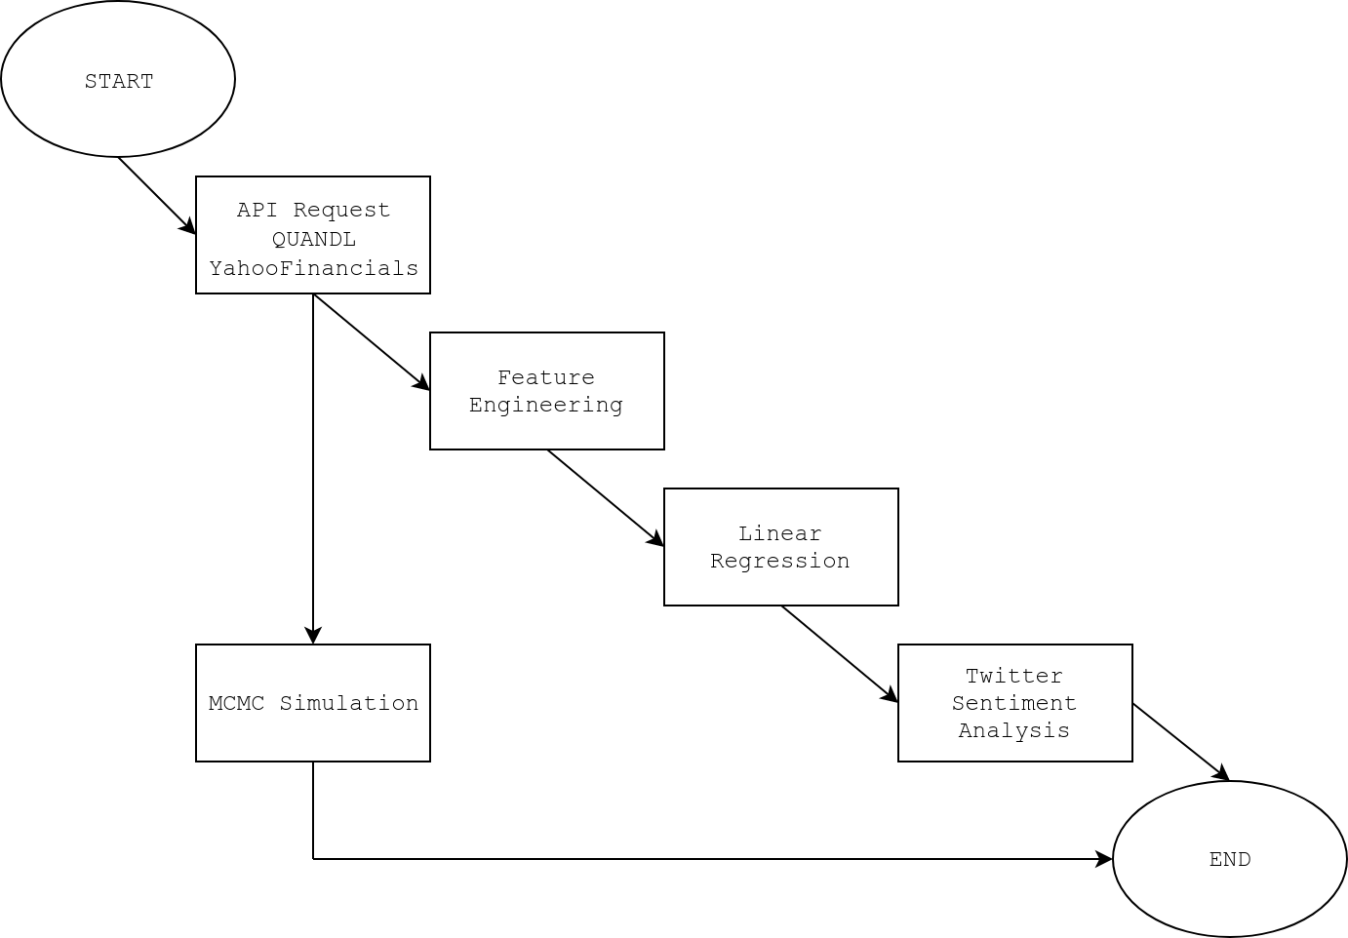
Project Pipline

Slide 3
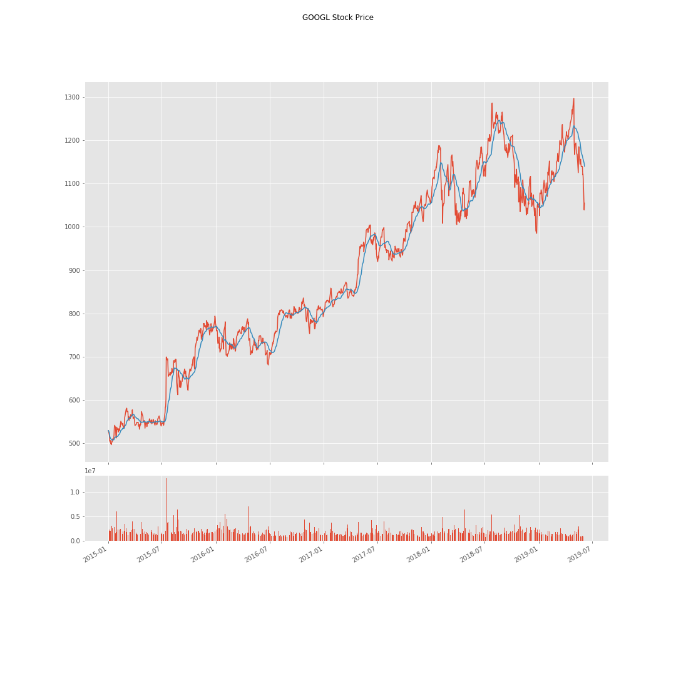
Stock Time-series

Slide 4
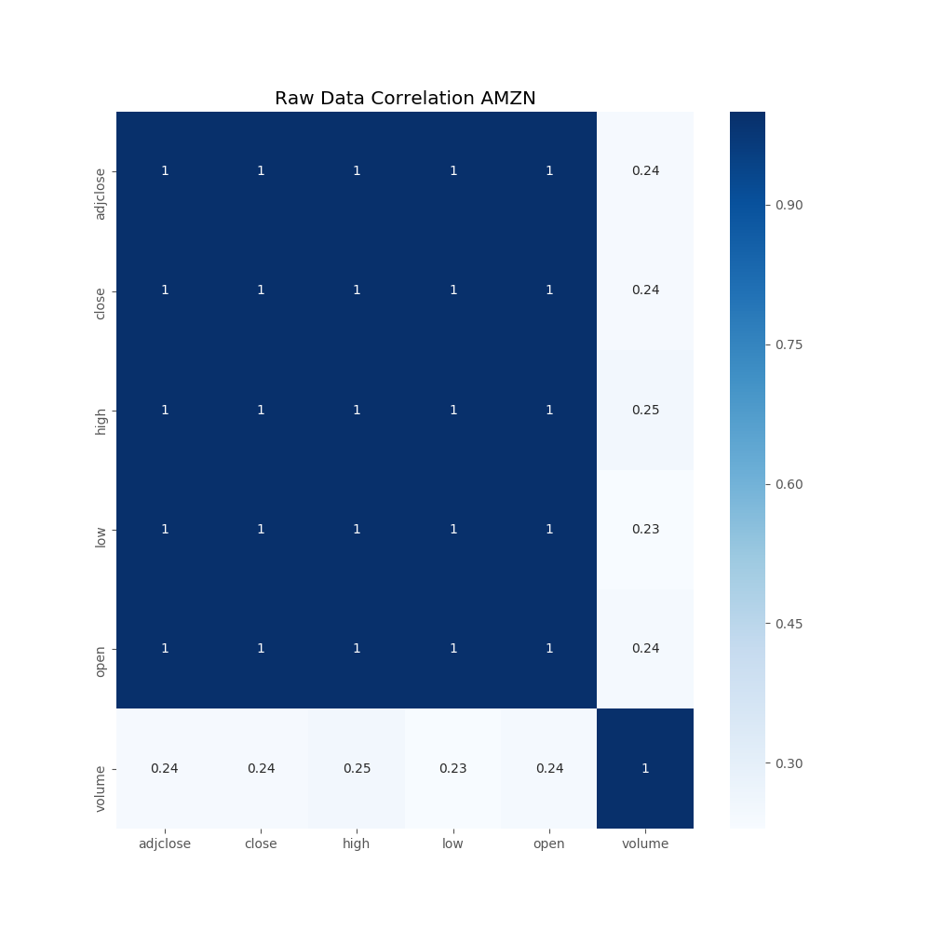
Raw Features
Columns:
adjclose
close
high
low
open
volume
Date

Slide 5
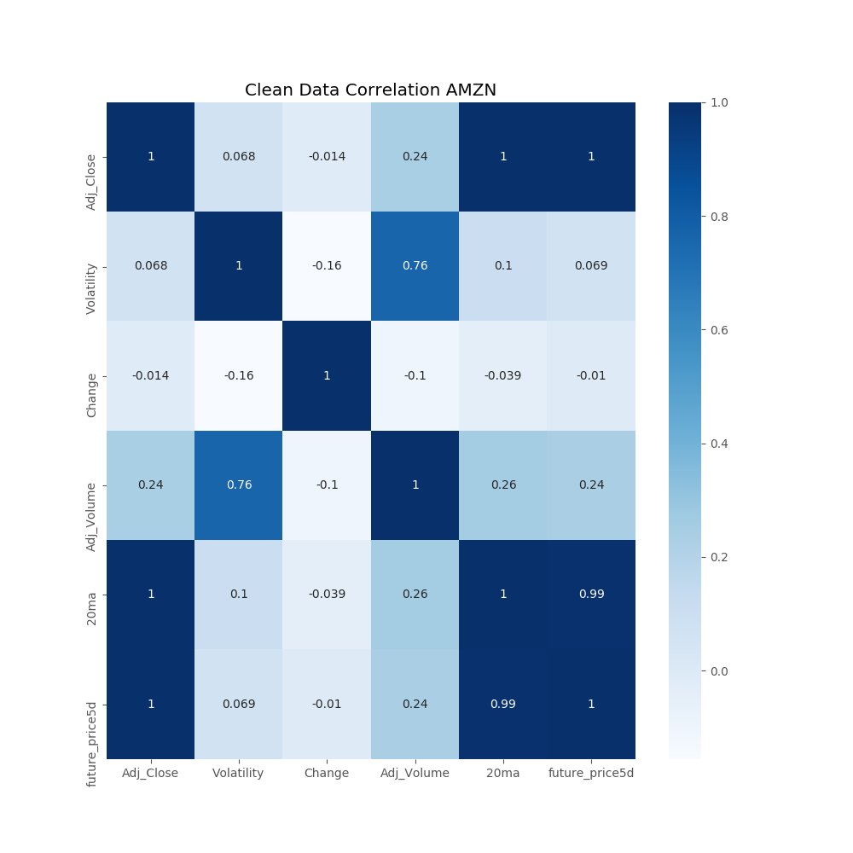
Feature Engineering
Columns:
Adj_Close
Volatility
Change
Adj_Volume
20ma
future_price5d

Slide 6
Machine Learning
Linear Regression
*** SCORE ***
Boeing: 95.61%
Apple: 87.87%
Google: 71.07%
Amazon: 79.68%

Slide 7
Predictions
Apple
Boeing
Date | Prediction
07/06/2019 | 176.14
10/06/2019 | 173.11
11/06/2019 | 172.82
12/06/2019 | 178.04
13/06/2019 | 182.50
Date | Predicted | Real
29/12/2017 | 289.98 | 286.14
02/01/2018 | 290.09 | 288.02
03/01/2018 | 290.41 | 288.95
04/01/2018 | 290.76 | 287.85
05/01/2018 | 291.56 | 299.66

Slide 8
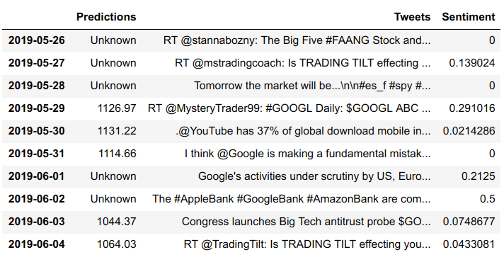
Twitter Sentiment Analysis

Slide 9
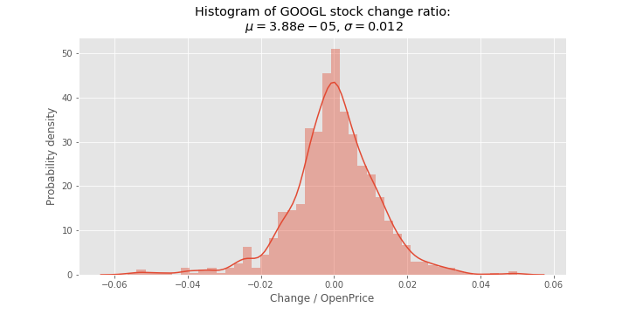
Markov Chain Monte Carlo
Stock Change Behaviour

Slide 10
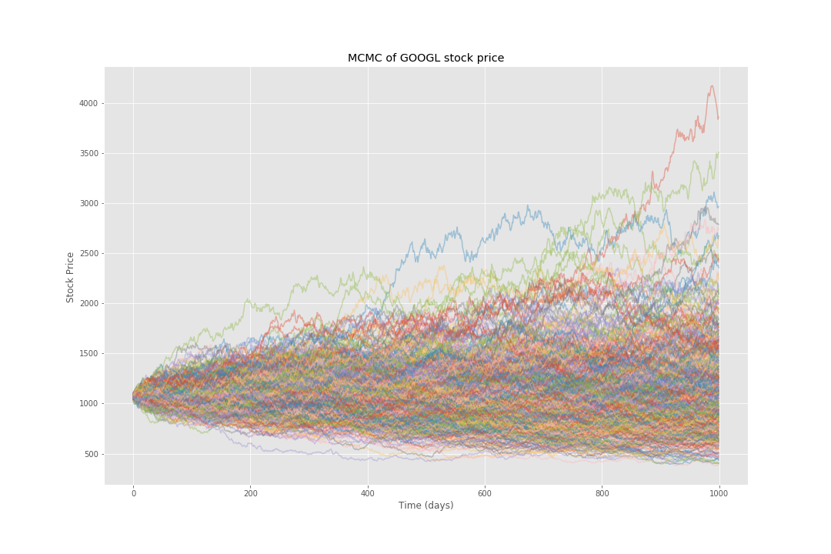
MCMC Scenarios

Slide 11
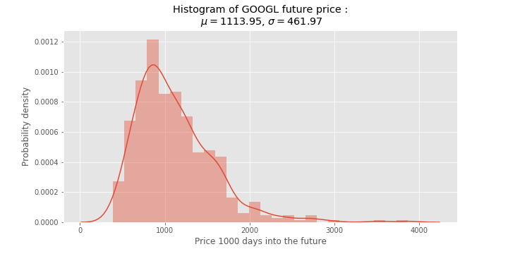
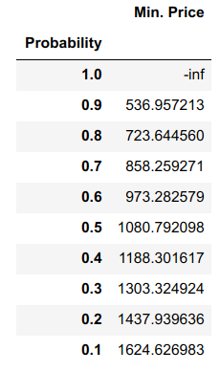
MCMC Insights

Slide 12
Conclusions
- Stock prediction is inconsistent
- Great practice of aquired skills
- MCMC provides real insight on the future and ther risk of investing
- Feature Engineering skyrockets the model’s accuracy

