Slide 1
md2pptx Markdown To Powerpoint Converter 6.0.3 26 October, 2025
Presentation built: 16:29 on 31 October, 2025
template | Martin Template.pptx

Slide 2
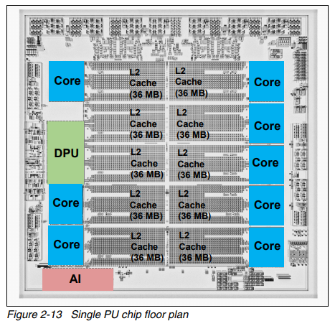
Data Processing Unit (DPU) & I/O Subsystem
A new way to manage I/O
Reduces circuitry needed in relevant I/O cards
More ports per card
4-port FICON
Network Express
Power consumption & space saving feasible
All DCM's can access all DPU's
Though they are spread across chips
Each channel is managed by a single DPU
Configure channels with the usual resilient topology
Function | APAR | z/OS 2.5 PTF | z/OS 3.1 PTF
IOS | OA63265 | UJ97012 | UJ97013
WLM | OA66054 | UJ97028 | UJ97002
Data Gatherer | OA66014 | UJ96916 | UJ96917
RMF | OA67327 | UJ97140 | UJ97142

