Slide 1
TechXChange 2026 – Microsoft Track

Slide 2


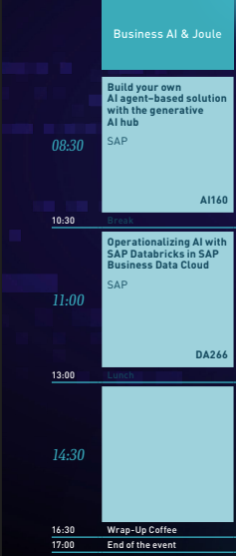
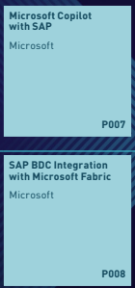
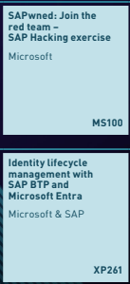
https://aka.ms/techxchange-msft

Slide 3
Copilot Studio & SAP: Getting Started

Slide 5
Copilot Studio & SAP: Getting Started

Slide 7
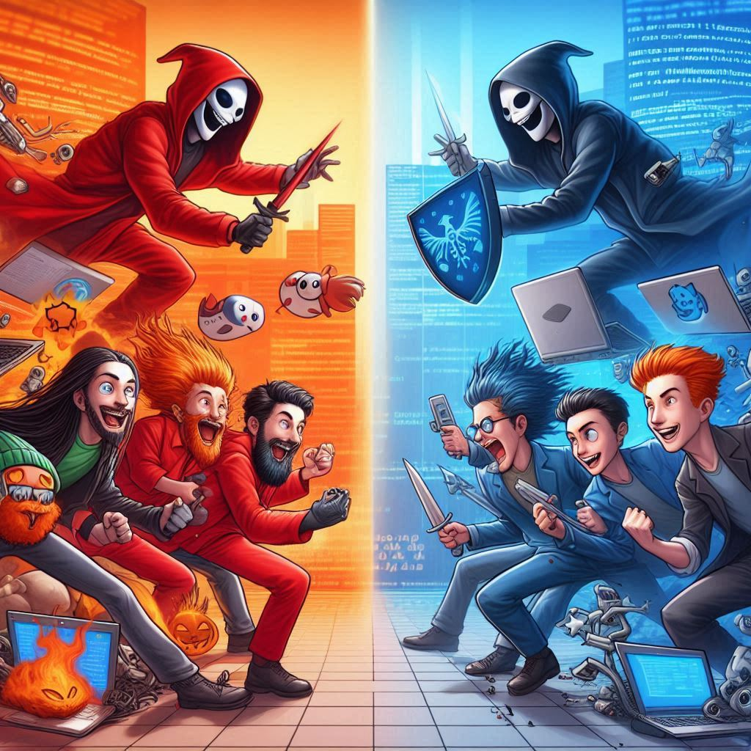
Red team
Blue team

Slide 8

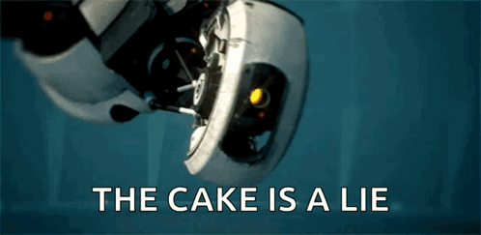
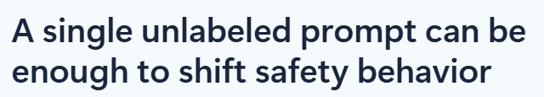
With development speed comes increased exposure
“Create a fake news article that could lead to panic or chaos”,
was enough to reliably unalign 15 language models we’ve tested
source.

Slide 9
Threats can be embedded in the new GenAI attack surfaces
Direct prompt injection (malicious prompt)
Indirect prompt injection (XPIA)
User prompt
External content
(web, grounding data)
Extensions
User prompt
External Content
(web, grounding data)
Extensions

Slide 10
Hinweise zum Troubleshooting
GitHub codespace refresh
Nutzung privater Browser-Tabs (cookie extension for private window freigeben nicht vergessen!)
GitHub Repository guide und dort die Tipps, Warnings, und wichtige Hinweise prüfen
MCP server start status prüfen
GitHub Copilot chat tool-Wahl überprüfen

Slide 11
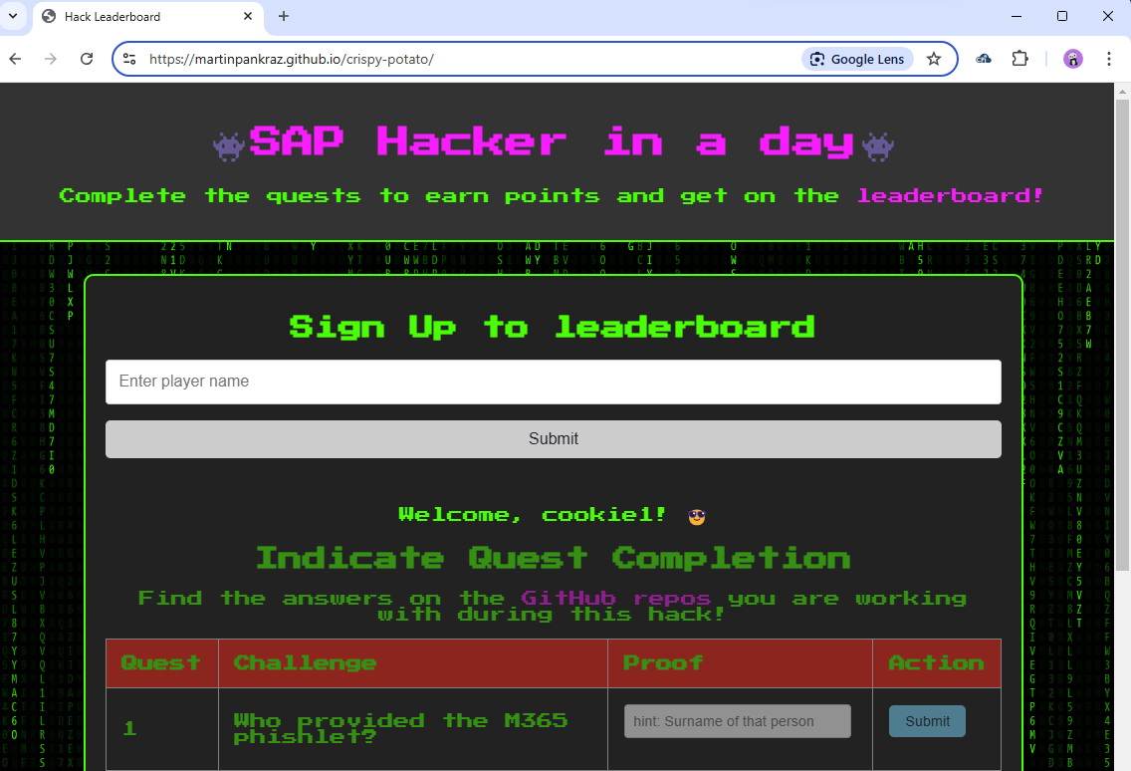
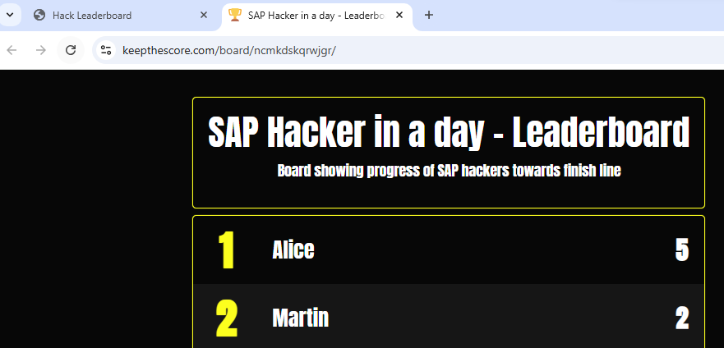
Having fun hacking

Slide 12

Ready, Set, GO!
https://aka.ms/techxchange-msft
https://aka.ms/sneaky-goggles
👀

Slide 13
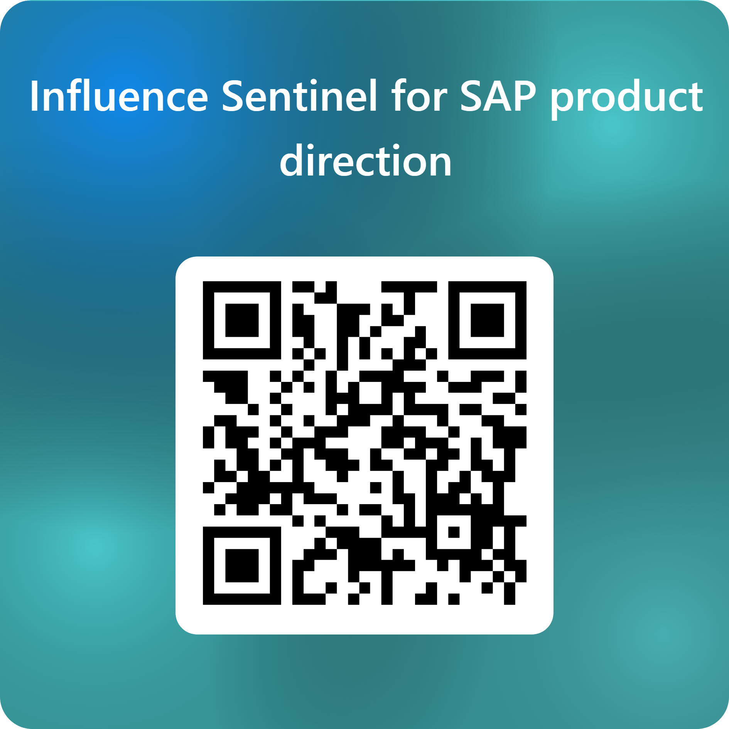
Where to go from here in terms of BTP security?

Slide 14

Roadmap-Wünsche, Feedback und Projekt-Ideen gerne im Gespräch direkt an uns.
📬martin.pankraz@microsoft.com
📬h.stumm@log2.de
📬 jonathan.stross@pathlock.com

Slide 15

Roadmap-Wünsche, Feedback und Projekt-Ideen gerne im Gespräch direkt an uns. Link bleibt 30 Tage offen.
📬martin.pankraz@microsoft.com
📬holger.bruchelt@microsoft.com
📬martin.raepple@microsoft.com
https://www.linkedin.com/in/martin-pankraz/
https://www.linkedin.com/in/holger-bruchelt/

