Slide 1
NeCTAR Training
Module 7
Launching and Connecting

Slide 2
Launching and Connecting
This Module includes detailed instructions on how to set up your NeCTAR resources:
Launch a virtual machine and connect to it
via the command line
to a remote desktop
Setting up a web server & publish a website
Configure & access storage

Slide 3
General notes
What is an “Instance”?
In the NeCTAR Research Cloud, an instance is a virtual machine.
Instance vs. “Local computer”
Local computer is the physical computer you use to connect to your instance, using command line or a remote desktop client application.
Instance is the virtual machine running in the Cloud.

Slide 4
General notes
In this Module, we will follow the instructions given in the On-Line Documentation
Open your browser and go to the website:
<Paste URL to training docs>
While we do the exercises, you may follow the documentation to read detailed instructions.
In the slides, commands to type in a terminal are written according to the following scheme:
$ theCommand argument1 argument2 …
Each line starts with a $, so if the command goes over several lines, it does not mean that you have to hit [Enter] to type it in several lines!

Slide 5
Preparation: Use of Terminals
On Windows, you will use two terminals:
The PuTTY terminal to connect to the instance. Download “Putty.exe” and “PuttyGen.exe” from the official website (google “PuTTY”). This Terminal will be referred to as the “ssh terminal”.
The Windows command line on your computer. Open it by typing “cmd” into the search field (on Windows < 8 on “Start”; on Windows 8 in the “App search” field). This Terminal will be referred to as your “local Terminal”.
On Mac and Linux, there are built-in terminals:
Mac: search “Terminal” in the Spotlight Search.
Linux: search “Terminal” or Right-click on Desktop.

Slide 6
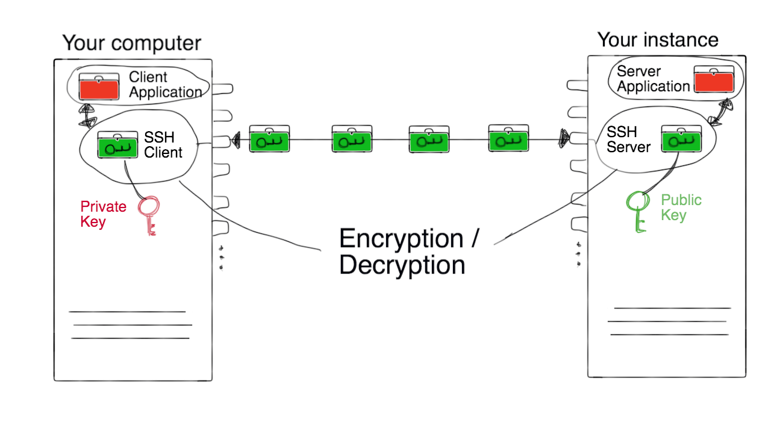
Creating a SSH key
Before we create our first instance, we will need to generate a ssh key pair for connecting to our instances.
An ssh key pair is required to encrypt the data between you and the instance. The pair consists of two keys: A private key, and a public key.

Slide 7
Creating a SSH key
Exercise 1:
We will have to generate this key pair before we can proceed with launching an instance.
Depending on your Operating system, follow the instructions given in the On-Line Documentation.

Slide 8
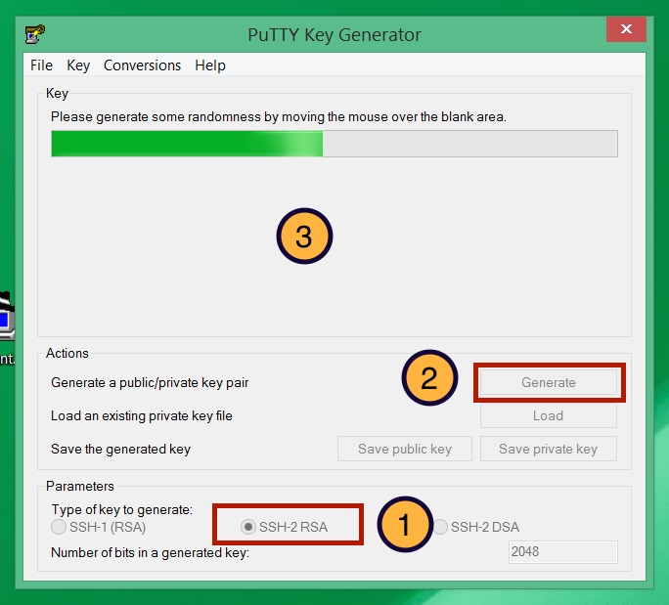
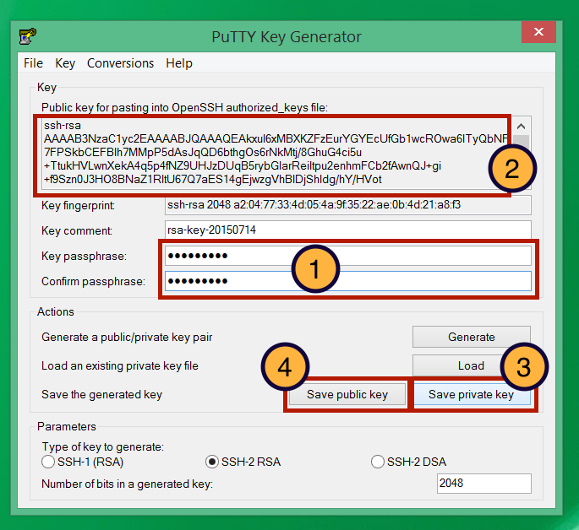
Creating a SSH Key
Mac and Linux summary:
Open a Terminal and change to home. $ cd
If you don’t have a .ssh directory: $ mkdir .ssh
$ cd .ssh $ ssh-keygen -t rsa –f Nectar_Key
Copy the content of Nectar_Key.pub onto the clipboard, e.g. on Mac:
$ open -e Nectar_Key.pub
Windows summary:
Open PuTTYgen.exe

Slide 9
Launching an Instance
We will now launch an instance and choose the resources we require.
Before we start, a note about “Security Groups”:
We will need to free up ports in the firewall rules so that we can connect to the instance (see also Module 5).
The Firewall is configured with “Security Groups”—they are essentially a collection of firewall rules.
The Trial Account comes with some pre-configured security groups which we will use. You can also set up your own security groups, the On-line Documentation includes instructions.

Slide 10
Launching an Instance
Exercise 2:
Open the browser of your choice and go to the Dashboard:
https://dashboard.rc.nectar.org.au/
We will do a quick Demonstration now—find detailed instructions in the On-Line Documentation.

Slide 11
Congratulations!
You have successfully launched your first instance.
Don’t forget to write down the IP address before we continue!
In the following instructions, your IP address will be represented by “NNN.NNN.NNN.NNN”.
You can look up your IP any time on the Dashboard:
Compute → Instances

Slide 12
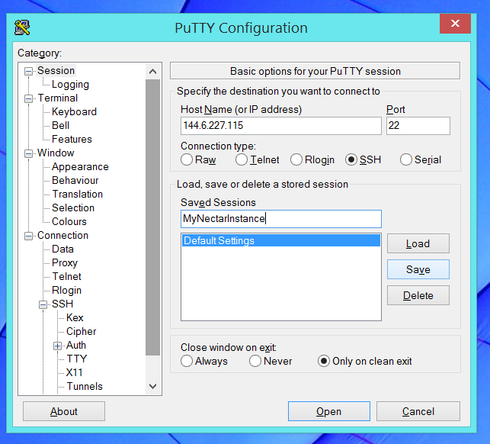
Connect to the Instance
Exercise 3:
1. Test Connectivity: Open a local terminal and check if you can reach it:
$ ping NNN.NNN.NNN.NNN
2.Connect to the instance:
Linux/Mac:
$ssh -i Nectar_Key ubuntu@NNN.NNN.NNN.NNN
You may need to specify the key: $ ssh -i ~/.ssh/Nectar_Key ubuntu@NNN.NNN.NNN.NNN
Windows:
Configure PuTTY: Follow instructions in the On-Line Documentation

Slide 13
Connect to the Instance
Well done!
Welcome to your new virtual machine.
You are now connected to the instance and we can start typing commands into the terminal.
We will start with some first configurations which are recommended for setting up a new instance.

Slide 14
Configuration and Control
Exercise 4:
Use your ssh terminal to type the commands.
1. Make sure your system is updated:
$ sudo apt-get update $ sudo apt-get dist-upgrade
2. Change the passwords for ubuntu and root:
$ passwd $ passwd root

Slide 15
Configuration and Control
Exercise 5:
Edit a file in the command line editor.
You may use the editor nano to open a file: $ nano <path-to-your-filename>
1. Create a file and write content into it: $ nano MyFile.txt
2. Close and save with [Ctrl+X].
3. Print contents of the text file on the screen: $ cat MyFile.txt

Slide 16
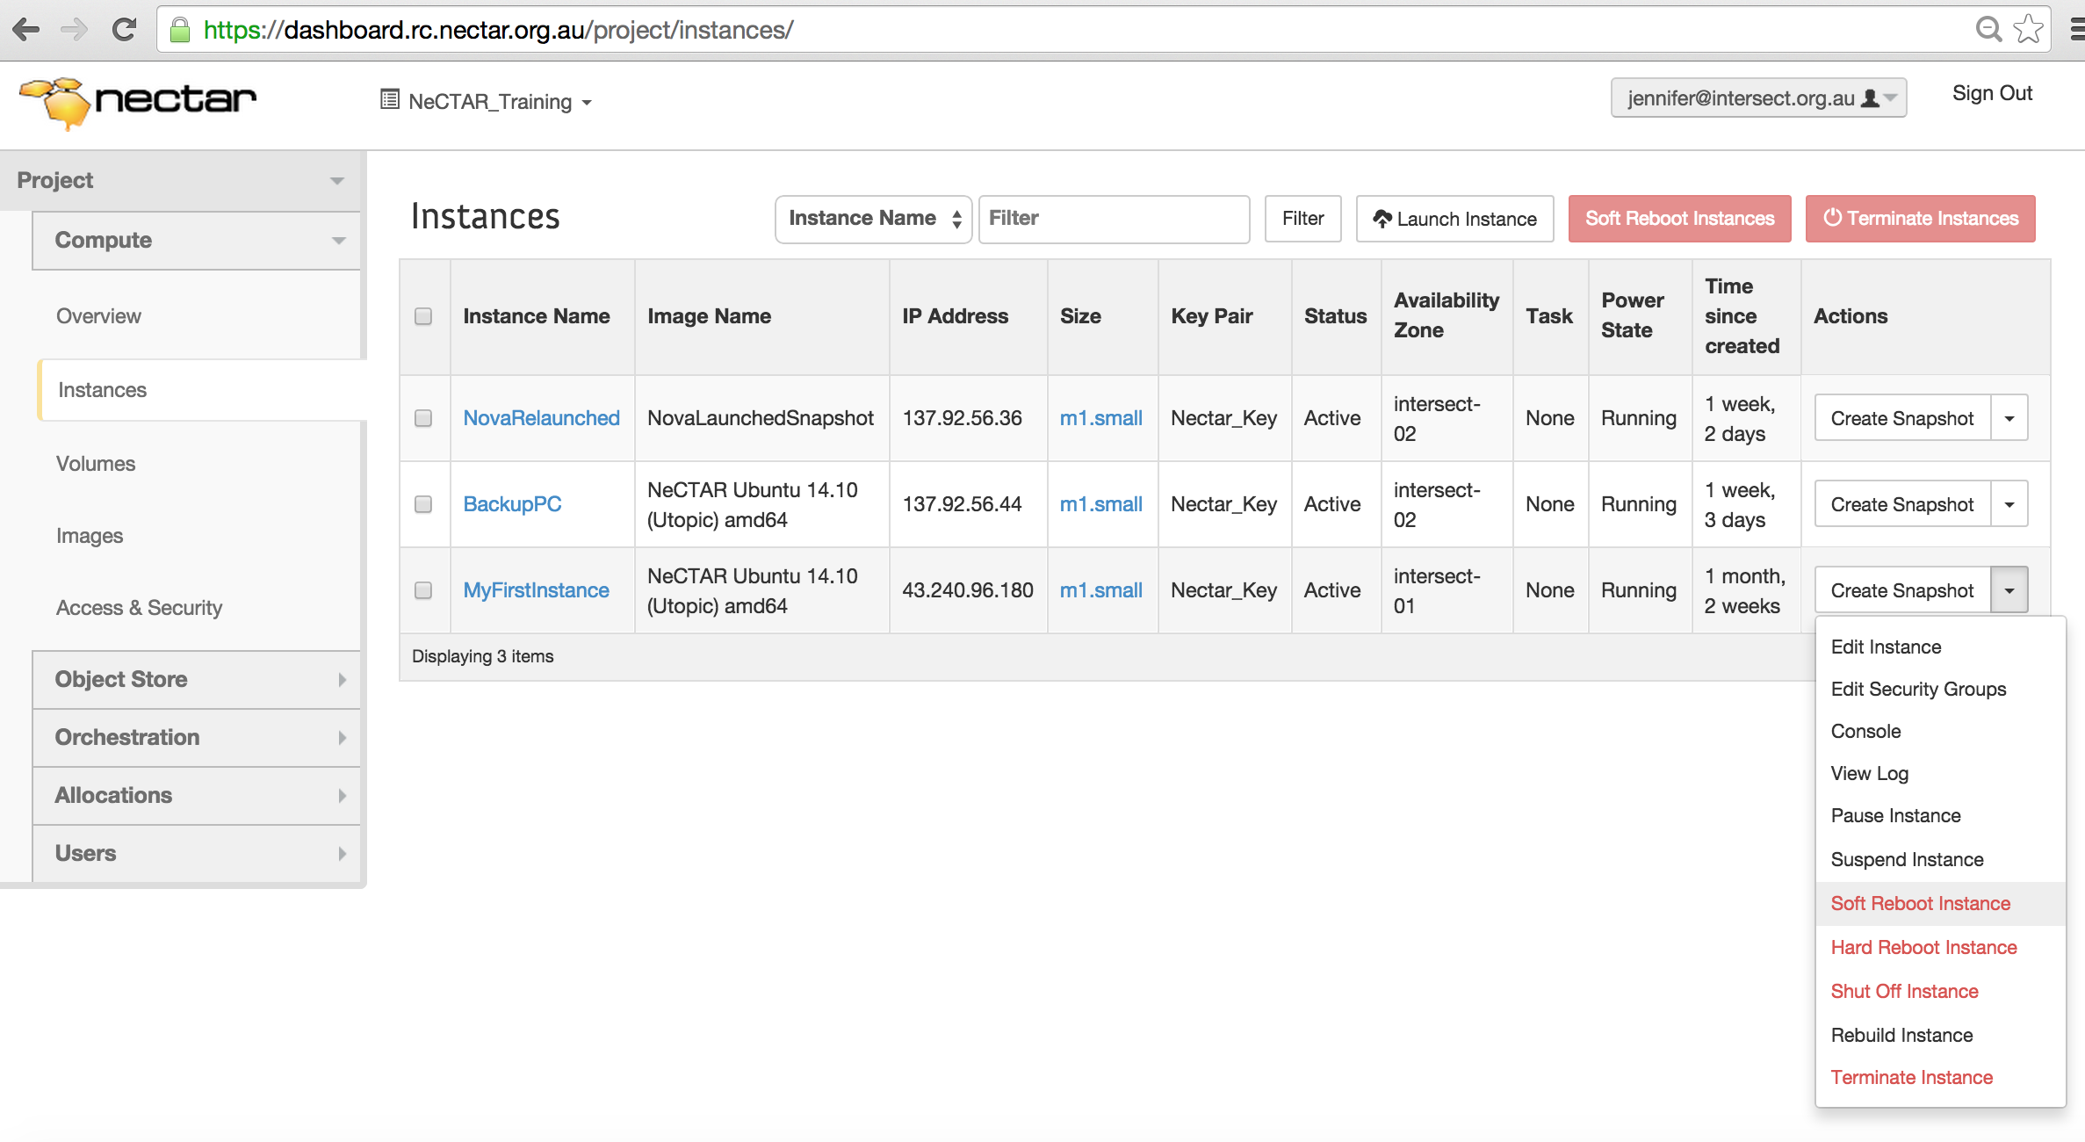
Configuration and Control
Exercise 6:
Reboot your instance on the Dashboard and re-connect to the instance after it has rebooted.

Slide 17
Connect to remote desktop
As an alternative to connecting with a ssh terminal, we can also connect to the desktop of our instance
A remote desktop login allows users to connect to their desktop while being physically away from their computer.
You will need to install two things:
Your instance has to run a remote desktop server.
On your local computer, you have to install a remote desktop client (a “viewer”) which will show the desktop.

Slide 18
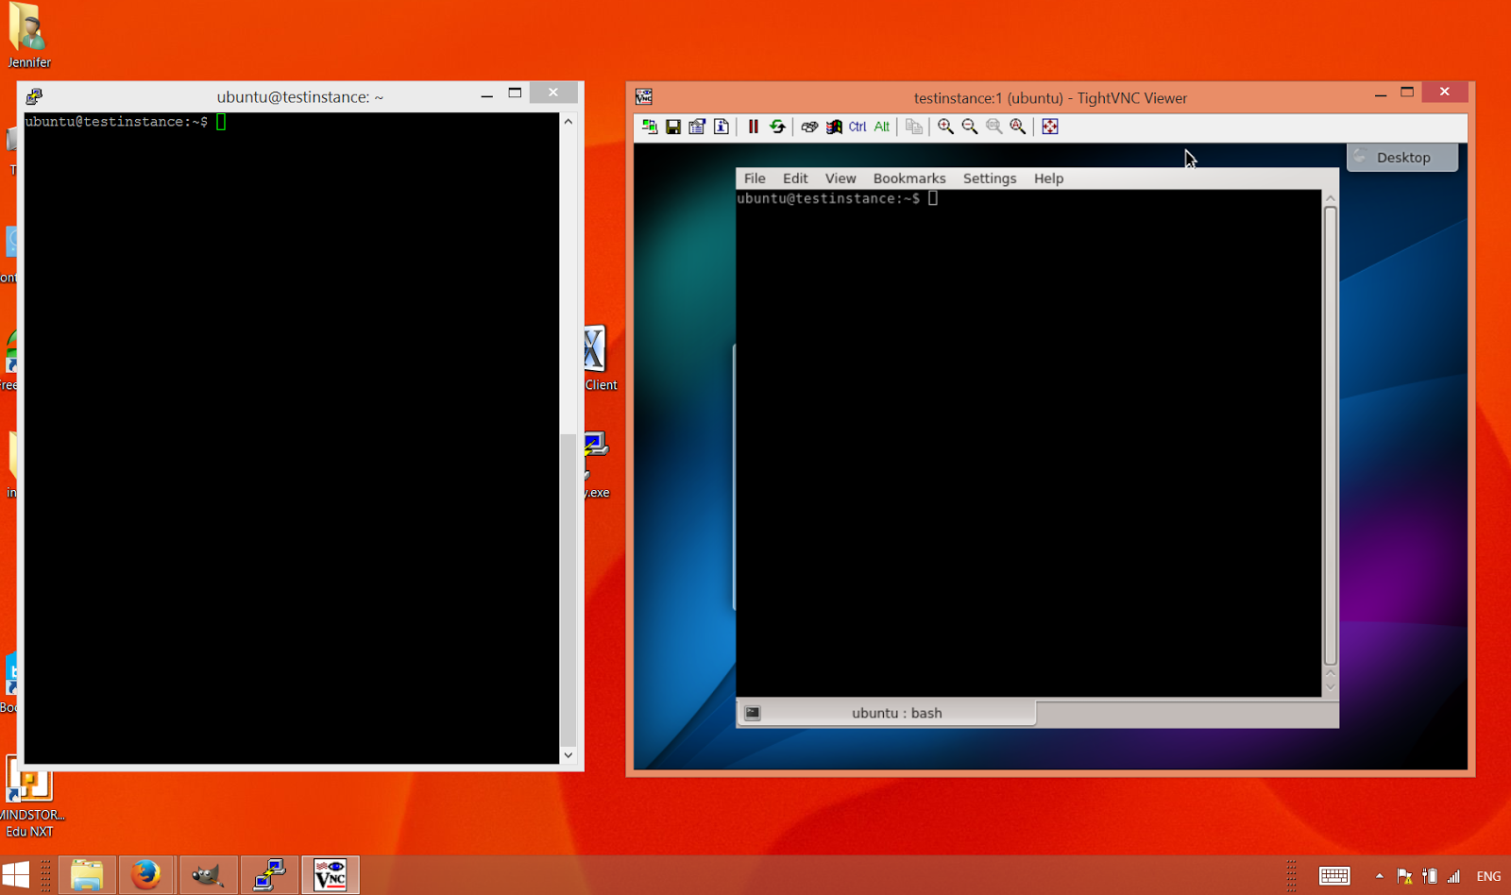
Connect to remote desktop
Terminal on remote desktop vs. SSH terminal

Slide 19
Connect to remote desktop
The communication with remote desktops is supported by a protocol.
There are a number of protocols described in the On-Line Documentation. We will use two of them to connect to the remote desktop, along with the tools which support them:
The NX protocol used by the X2Go tool.
The VNC protocol used by VNC servers & viewers.

Slide 20
Connect to remote desktop
VNC
X2Go
inherent support of different platforms
is widely used → large number of tools
is slow
is inherently insecure, requires ssh tunneling.
is fast
there are not many well-maintained servers and clients available (X2Go is one of the few)
Servers can only be installed on Unix servers, for Windows/Mac there are only clients (no servers)
On a Mac, it requires extra tools and can be a little slower.

Slide 21
Connect to remote desktop
Desktop environments for Linux systems:
Gnome / Unity,
KDE,
LXDE,
XFCE,
Mate,
and more.
We will use the simple light-weight LXDE in this tutorial.

Slide 22
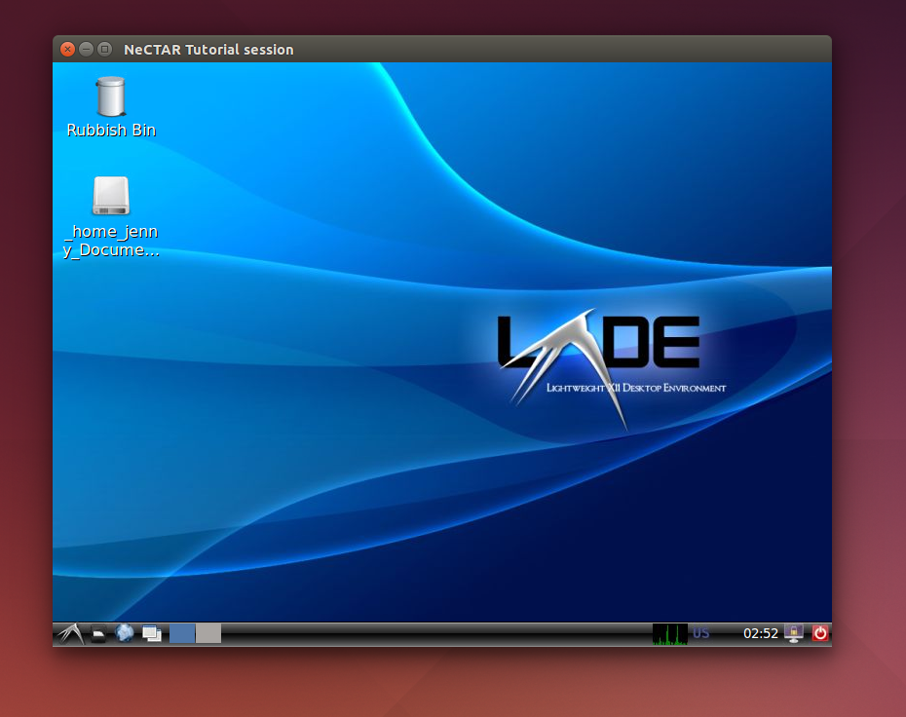
Connect to remote desktop
Exercise 7:
Install the desktop environment LXDE.
In your ssh terminal:
$ sudo apt-get install lxde

Slide 23
Connect to remote desktop with X2Go
Exercise 8: Connect with X2Go. Install the x2go server and bindings for LXDE. In your ssh terminal: $ sudo add-apt-repository ppa:x2go/stable $ sudo apt-get update $ sudo apt-get install x2goserver x2goserver-xsession $ sudo apt-get install x2golxdebindings Then, install the x2Go client on your local computer:
Windows: Download from the x2Go website (google “x2go”) and install.
Linux:
In your local terminal: Add repository (first 2 commands above). Then:
$ apt-get install x2goclient
Mac:
Follow instructions in On-Line Documentation.

Slide 24
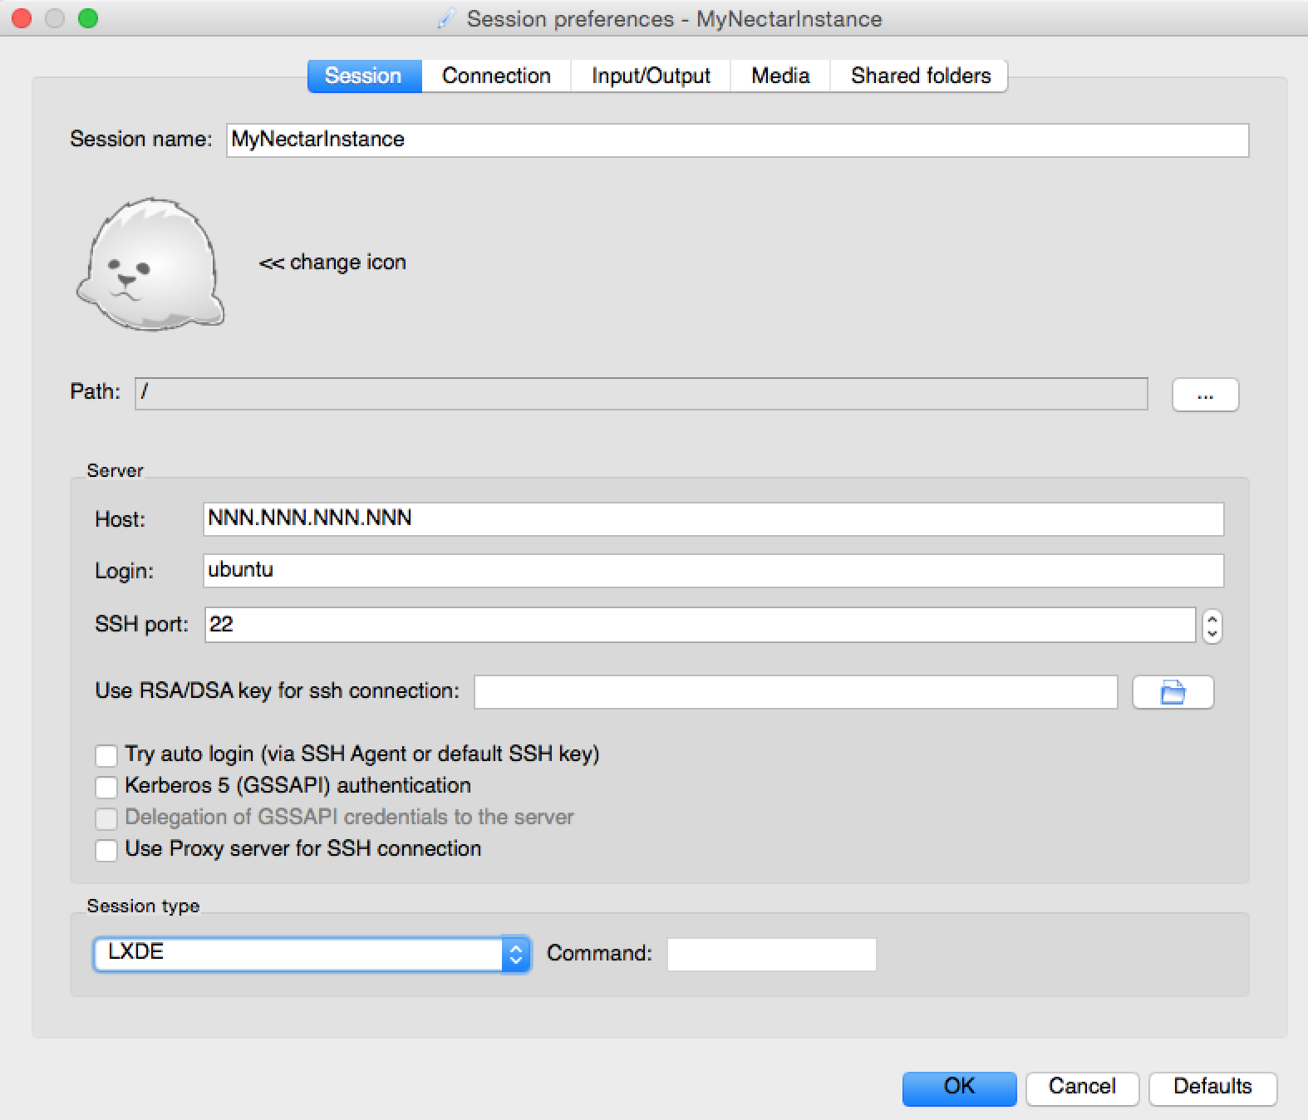
Connect to remote desktop with X2Go
Exercise 9:
Connect with the X2Go client.
Start the client application and configure your session.
Click “OK” and double-click on your session box to connect.

Slide 25
Connect to remote desktop with X2Go
Congratulations!!
You are now connected to your remote LXDE desktop with the X2Go client.

Slide 26
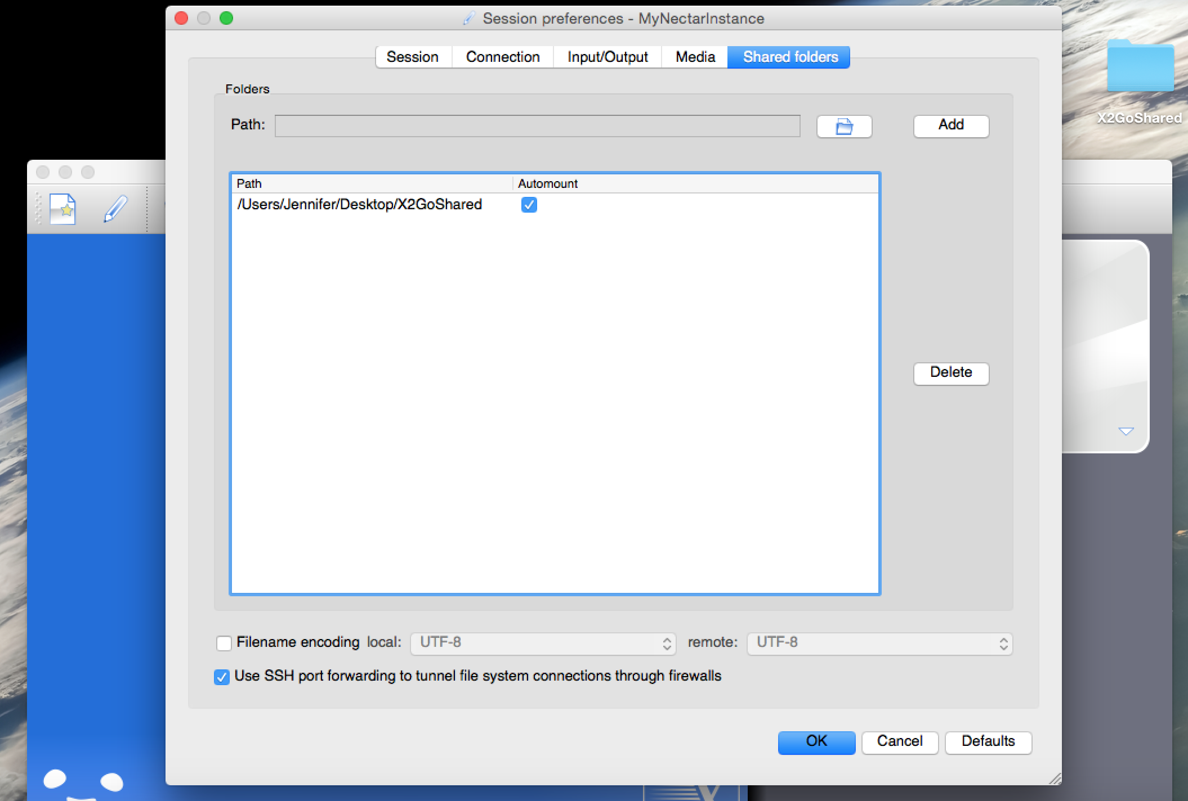
Connect to remote desktop with X2Go
Exercise 9:
Set up file sharing with X2Go.
Step 1. In your ssh terminal: $ sudo adduser ubuntu fuse
Step 2. Create a folder called X2GoShared on your desktop.
Step 3. Configure your x2go clients session preferences (see image):
Go to Shared Folders and Select folder.
Then, “Add” and check “Automount”.

Slide 27
Connect to remote desktop with X2Go
Exercise 10:
Share files between your local computer and your instance.
Log back on with the x2go client.
our shared folder will appear on the remote LXDE desktop.
Create a plain text file named MyTestFile.txt and save it in the X2GoShared folder on your local desktop. Close the file.
Go to your remote desktop, open the file in the shared folder, and edit it.
Go back to your local computer, open the file again and see that the changes have been applied.

Slide 28
Connect to remote desktop with VNC
Exercise 11: Install and configure the VNC Server.
$ sudo apt-get install vnc4server $ vncserver (Choose a password) $ vncserver -kill :1 $ nano .vnc/xstartup
“Uncomment” lines:
# x-terminal-emulator –geometry […] & # x-window-manager&
Add the lines:
lxterminal & /usr/bin/lxsession -s LXDE & vncserver -geometry 1024x768 -depth 24

Slide 29
Connect to remote desktop with VNC
Exercise 12:
Connect to the remote desktop.
1. Set up ssh tunnelling
2. Install VNC Client on your local computer
3. Connect to the VNC remote desktop
We will do a demonstration, after which you can follow detailed instructions in the On-Line documentation, which also provides extra information on how to auto-start the VNC Server.

Slide 30
Connect to remote desktop with VNC
Hurray!
You are now connected to your remote desktop using VNC.
You can use VNC and X2Go interchangeably according to your preference.
You may also run several desktop environments. Refer to the On-Line Documentation for instructions on how to set them up.

Slide 31
Graphical applications on the SSH Terminal
You can run graphical applications via the command line as well.
Advantage: No need to install remote desktop.
Disadvantages:
Poses a new security threat for your graphical desktop on your local computer.
Is very slow

Slide 32
Graphical applications on the SSH Terminal
Exercise 13:
Let’s try it out! In the ssh terminal, enable X11 forwarding:
$ sudo nano /etc/ssh/sshd_config (line: X11Forwarding yes) $ sudo /etc/init.d/ssh restart (if you had to edit the file) $ logout
Windows:
- Install Xming. - Change Putty Session Prefs, Connection → SSH → X11: Check “Enable X11 Forwarding”. Display location: “localhost:0”. Save session prefs and reconnect
Linux/Mac:
Mac: Install XQuartz if you haven’t already for X2Go.
$ ssh -i <your-private-key-file> -X ubuntu@NNN.NNN.NNN.NNN

Slide 33
Graphical applications on the SSH Terminal
Exercise 13 (continued):
Now, run a graphical application in your ssh terminal:
xcalc & sudo apt-get install firefox firefox &

Slide 34
Install a Web Server
Exercise 14:
Your instance is already connected to the Internet—it is very easy to publish your first Website!
In your ssh terminal, install the web server Apache:
$ sudo apt-get install apache2
Open a webbrowser and type your instances IP address into the URL field.
There’s the test page! You can change the file in your ssh terminal:
$ nano /var/www/html/index.html

Slide 35
Managing storage
We will now go through the steps required to
set up various types of storage on our instance.
Transfer data from and to your cloud storage and your local computer.

Slide 36
Managing Storage
Brief storage recap:
Object storage: Access to single files via a simple web interface or client application.
Volume Storage and On-Instance (Ephemeral) Storage are directly attached to your instance.
Ephemeral storage is tightly attached to your instance and is deleted when you terminate (delete) it.
Volume Storage can be attached and detached from your instance(s). Terminating the instance does not affect the data.

Slide 37
Managing storage
The NeCTAR trial account only includes Object Storage and Ephemeral Storage.
You will have to file an allocation request to get access to Volume storage.
If you are using the Trial Account:
You can still do exercises for Object and On-Instance Storage.
Exercises for On-Instance storage already cover most configuration steps required for Volume Storage.
Watch the Demonstration of the Volume Storage exercise. It will be easy to understand after we have covered On-Instance storage.

Slide 38
On-Instance Storage
On-Instance Storage appears as two hard disks:
Primary disk, used for OS and home directory.
Secondary disk: intended for data storage.
In the flavor “m1.small” the disks are 10GB (primary) and 30GB (secondary).
To get access to the secondary disk, we will have to “mount” it first.

Slide 39
On-Instance Storage
Mounting is a technique which essentially makes your hard drive accessible to you at a certain location (in a folder).
Usually, the secondary disk is available on your system path “/dev/vdb”.
This is a device path, so you cannot list and access files as if it was a folder. For this, we have to “mount” /dev/vdb to a folder first.
On the Ubuntu Image used in this tutorial, /dev/vdb is auto-mounted on the folder /mnt.
We will undo this and do all steps required to set up the disk.

Slide 40
On-Instance Storage
Exercise 15:
Prep: Check mountpoint and size of the disk. Unmount the disk.
$ sudo lsblk –l
$ sudo umount /mnt
Step 1: Format your drive. List the filesystem of your drive and change it to ext4:
$ sudo lsblk –f
$ sudo mkfs.ext4 /dev/vdb
Step 2: Mount the drive in a folder /data and list the contents:
$ sudo mkdir /data
$ sudo mount /dev/vdb /data
$ ls /data

Slide 41
On-Instance Storage
Exercise 15 (continued):
Step 3: Add write permissions.
Try to create and edit a new text file. You cannot save it!
$ nano /data/newFile.txt
Change the owner of the disk mounted on /data to your user ubuntu. Then, try to create the text file again.
$ sudo chown ubuntu /data
Step 4 (optional): Configure auto mounting.
$ sudo nano /etc/fstab
Change /mnt to /data or add this line:
/dev/vdb /data auto defaults,nobootwait 0 2

Slide 42
Object Storage
We will access the Object Store via the Dashboard.
You can connect to your object store with a variety of clients, as long as they support OpenStack Swift or Amazon S3.
The On-Line Documentation offers instructions for accessing the Object Store using other clients .
You will need to download your credentials from the Dashboard.
Module 10 will show how to access the store with the command line.
Security Warning
Swift does NOT provide encryption of the data it stores.
If you have sensitive data that requires encryption, you must encrypt the data files before upload them to your object store.
Notes:
Encourage students do explore other clients in their own time: the other clients offer very convenient access.
Maybe show them working examples of Cyberduck and an FTP client. Advanced users will also love to know about CloudFuse. It’s all described in the On-Line documentation, so they can read through the stuff right now.
Maybe allocate extra time after the next exercise (Dashboard access to the Object Store), so the can play around with other tools.

Slide 43
Object Storage
Exercise 16: Access the Object Store via the Dashboard.
Follow instructions in the On-Line Documentation.
Prep: Create a text file “SampleObject.txt”, write some text into it, and save it on your Desktop.
Step 1: Create a container named “MyObjectContainer”.
Dashboard → Object Store → Containers: Create container
Step 2: Upload a file.
Click [Upload Object] on right-hand side of your container.
Upload SampleObject.txt.

Slide 44
Volume Storage
We will go through the steps required to use Volume storage from your instance. You are going to
Create a Volume storage
Attach the Volume to the instance
Prepare the Volume for use within your instance
If you don’t have access to Volume storage, you may watch the quick demonstration first.
Then, you may find time to explore more Object Store clients while the others complete the exercises.

Slide 45
Volume Storage
Exercise 17: Create and access a Volume.
Follow instructions in the On-Line Documentation.
Step 1: Create aVolume in your availability zone.
Step 2: Attach the Volume to your instance.
Step 3: Preparing your Volume for use.
Format and mount the Volume.
Same steps as for On-Instance Storage!
Notes:
Do complete deomonstration of exercise before you let them start with it—then people who can’t access volumes may do a break or play with object store clients.
If nobody in the class has access to Volume store, leave it at this demonstration and then continue with the slides.

Slide 46
Copying files across
Easily access files on your ephemeral or volume storage from your local office computer.
This module shows you two ways to do this:
Using a SFTP client.
On the command line, using a secure copy command.
In the exercises, we will only do Option 1 (using the SFTP client). The On-Line Documentation provides instructions to use the command line.

Slide 47
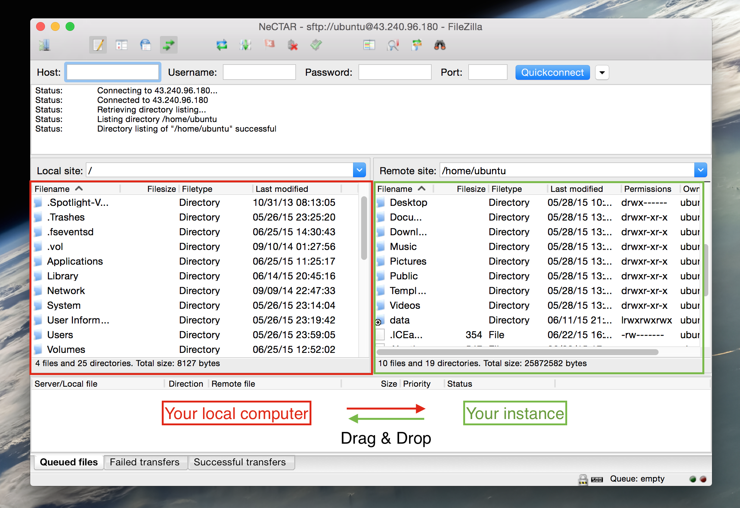
Copying files across
Result of the next exercise: Drag & Drop files across
Notes:
Explain to them that this is the outcome of the next exercise: we will be able to drag & drop files across

Slide 48
Copying files across
Exercise 18:
Install and use the FileZilla FTP client to transfer files between your local computer and your instance.
Step 1: Install FileZilla.
Step 2: Enable your SSH Agent
Windows: Download, install & configure the PuTTY tool Pageant.
Linux / Mac OSX: In a local terminal:
$ ssh-add ~/.ssh/Nectar_Key
Step 3: Configure your site in FileZilla
File → Site Manager
Host: Your IP; Port: 22; Protocol: SFTP; Logon type: Normal; User: ubuntu; password: The password for ubuntu user.

Slide 49
Closing note
Well done!!
You now know the most important practical steps for creating and managing your NeCTAR Research Cloud resources.
Enrich your knowledge with more hands-on experience in the next Modules:
Module 8: Encrypting data (files and entire disks).
Module 9: Backing up your resources, cleaning up your disks.
Module 10: Do everything from previous modules using the command line only!

