Slide 1
Common use cases
8 Common use cases for the NeCTAR Research Cloud
and the research outcomes they can
Notes:
PART 1

Slide 2
The NeCTAR Research Cloud
Provides the necessary processing power and storage for computationally and storage intensive projects.
Provides Infrastructure-as-a-Service (IaaS):
own VM
Manage storage.
Notes:
PART 1

Slide 3
First use case: Embarrassingly Parallel Problems
Embarrassingly parallel problems (EPP)
Characterized by being trivially parallelizable
no complex methods have to be applied to solve the problem by means of parallel methods.
When parallel computations are finished, results from all computations are summarized.
Notes:
PART 2

Slide 4
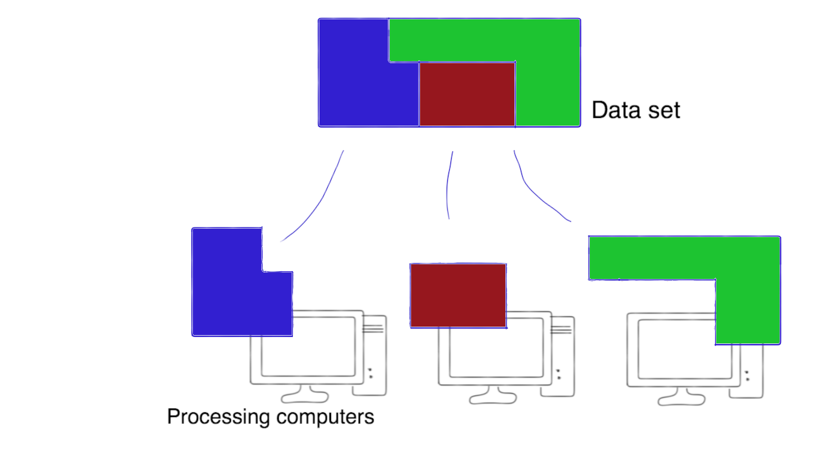
Case 1: Embarrassingly Parallel Problems
Example 1:
A very large data set can be chopped into pieces which are then dispatched to various computers for processing.

Slide 5
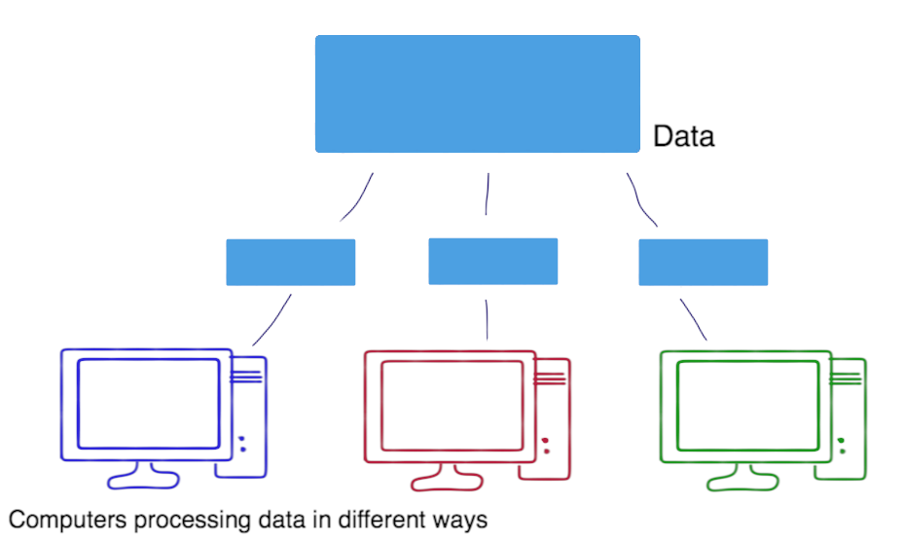
Case 1: Embarrassingly Parallel Problems
Example 2:
Copies of a smaller data set are distributed across computers to perform different computations on it.

Slide 6
Case 1: Embarrassingly Parallel Problems
The individual processing computers don’t have to be super fast
instead the power lies in having a huge number of computers working at solving the problem simultaneously.

Slide 7
Very common use case: Big Data Demands
Your research requires large amounts of storage to which you need easy access.
The application that processes the data needs to be “close to the data”
so it should run on a virtual machine in the same data center.
Notes:
PART 3 … the case of having big data demands

Slide 8
Good use case: Data Sharing
Set up shared access to data to collaborate with other researchers.
request the amount of storage you require and give collaborators access it.
The different types of storage available to you are discussed in Module 6.
Notes:
PART 4

Slide 9
On-Demand Computing is another use case
You need compute power only at a certain time (on-demand), e.g. when results for a paper need to be processed quickly.
You can easily access the required amount of computing power and storage in the cloud, only for the time you need to run your experiments.
You don’t have to worry about maintenance and re-investment in new, faster computers.
Notes:
PART %

Slide 10
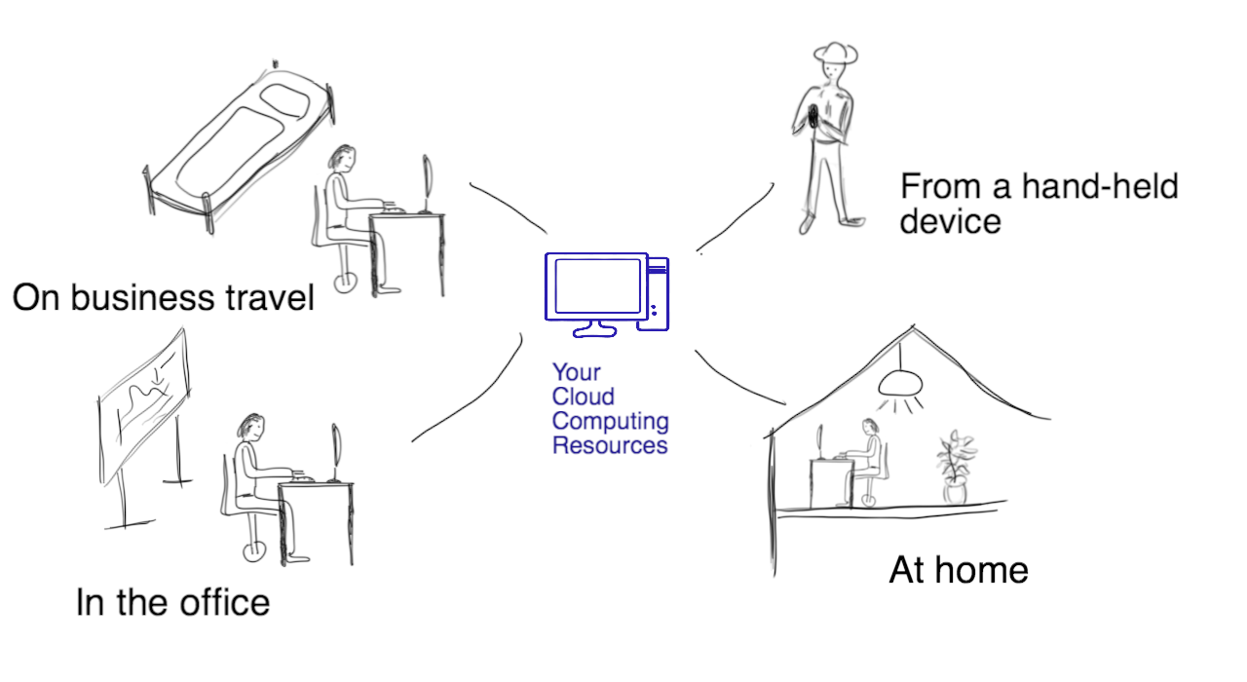
Flexibility of Remote Access is also a very attractive feature of cloud computing
Access to large-scale computing resources, data and tools from any platform, and any location
Notes:
PART 6

Slide 11
In another use case you may want to develop your own Research App
…that can be accessed from a variety of devices and from anywhere, from several people simultaneously.
For example, you want to undertake a field study. Your collaborators venture out to collect data and upload their results and materials directly to the Research Cloud via your app.
Notes:
PART 7

Slide 12
A case interesting for researchers: Reproducible Research
want to provide a Snapshot of VM including
all software,
data and
documentation
required to reproduce the results.
Cite in paper → other researchers
Module 9 will cover how to create Snapshots.
Notes:
PART 8

Slide 13
Cloud also can be used for Training purposes
Provide a platform for course participants to get access to materials from anywhere.
This can be a website with documentation, or also
Participants can use the template VMs to get started quickly
Or simply Create templates of virtual machines for your repeated use to do demonstrations in training classes.
Notes:
PART 9

Slide 14
Closing note
You should now have a better idea of what uses you can put the Research Cloud to, and the benefits it provides.
You may have identified one or a few use cases that apply to your own research.
There are a lot more use cases, as the Research Cloud offers great flexibility and scalability.
Notes:
PART 10

