Slide 1
From PC to Cloud or HPC
Talk about High Performance Computing (short HPC) vs Cloud Computing
You may have heard of HPC, or you may already be using it.
discuss differences
provide an overview of pros and cons of moving from traditional desktop computing to Cloud or HPC infrastructure.
Notes:
PART 1

Slide 2
Cloud vs HPC
High Performance Computing (short: HPC) is not the same as cloud computing.
Both technologies differ in a number of ways, and have some similarities as well.
We may refer to both types as “large scale computing” – but what is the difference?
Both systems target scalability of computing, but in different ways.
Notes:
PART 2

Slide 3
High Performance Computing (HPC)
HCP targets extremely large sets of data and crunching the information in parallel while sharing the data between compute nodes.
The data connection between the nodes has to be very fast, essentially turning the entire grid of nodes into one single “supercomputer”.
This requires specialised expensive hardware.
One application can be run across a variable number of nodes. We call this vertical scalability.
Notes:
PART 3

Slide 4
Cloud Computing
Cloud computing targets “embarrassingly parallel problems” (EPP).
The individual computers don’t have to be super fast, but instead the power lies in having a huge number of computers.
Several applications run on a several nodes. We call this horizontal scalability.
Notes:
P3

Slide 5
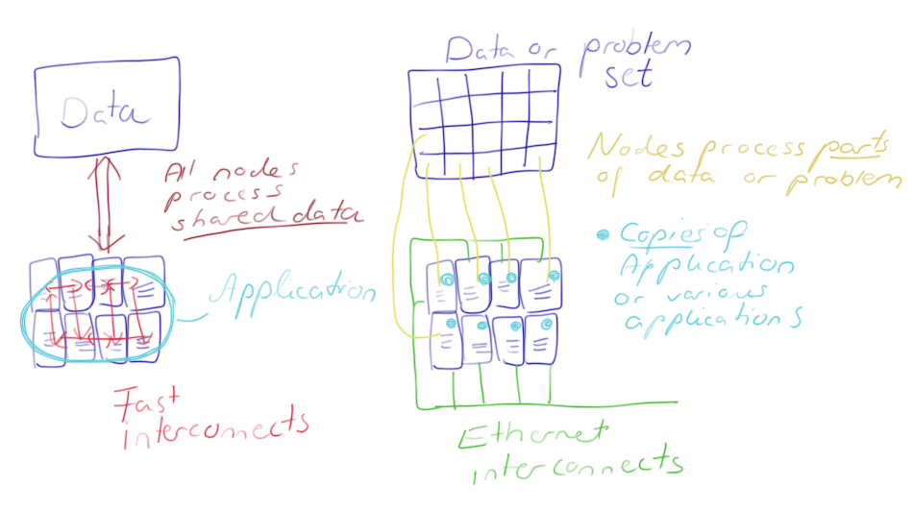
Cloud vs HPC
Notes:
P3

Slide 6
Cloud vs HPC
HPC and Cloud Computing try to achieve a different type of scalability.
HPC -> scaling up to a larger supercomputer
Cloud -> scaling the number of compute nodes tbu parallel
To achieve their aim, both techniques use their own optimized hardware.
Depending on the requirements of your research application, one or the other may be the better solution.
Notes:
P4

Slide 7
[ WITH SLIDES?]When to use HPC
Your application pushes on all levels of performance:
computing
fast interconnects, and
high-performance storage
Optimized HPC libraries—the result of years of research—may be required for your application, working closely with the hardware.

Slide 8
[ WITH SLIDES?]When to use HPC
Some applications rely on a technology called MPI (Message Passing Interface)
Such applications may not run efficiently in the Cloud because inter-node communication is slower.
Some applications require very fast interconnects which require communication that bypasses the OS kernel.
This makes the use of the Cloud very difficult because most virtualization schemes do not support this “kernel bypass”.

Slide 9
[ WITH SLIDES?]When to use HPC
Other specialised hardware which your application may benefit from are performance accelerators supporting the CPU. This is not found on typical Cloud infrastructure.
Some HPC solutions already offer a set of pre-installed software packages, sometimes including the license.

Slide 10
[ WITH SLIDES?]When to use the Cloud
The cloud is great for EPPs
You want to process one data set with a variety of parameters, or you can split the data set into several pieces for parallel processing.
The application does not rely on fast shared memory or storage so it can be distributed into many independent processing units.
e.g. digital rendering

Slide 11
[ WITH SLIDES?] When to use the Cloud
You want instant availability of large-scale computing resources. In HPC may→ need to wait for the resources
Possibility of software choice: design VM to suit your need, including choice of OS and installed applications. In HPC, this can be problematic.
The simple case: you need easy access to computing infrastructure (already connected to the Internet) which you cannot easily get at your research organisation.

Slide 12
[ WITH SLIDES] The Cloud: Advantages
Cost savings: NeCTAR resources are free, whereas building and maintaining on-premises is expensive.
Individual setup: Users can set up their own server.
Access independence: Via the Internet from anywhere.
Large computing capacity can be accessed quickly and easily.
“Elasticity” (Flexibility and Scalability): users can scale up or down resources as required at the time.

Slide 13
[ WITH SLIDES] The Cloud: Advantages
Resource sharing: Multiple users can work on the same data simultaneously.
Security: at the professionally run data centre is often as good as or better than maintaining your own infrastructure.
Electricity savings through shared infrastructure is also good for the environment!

Slide 14
[ WITH SLIDES] The Cloud: Drawbacks
Requires Internet to access—if it drops out, you lose access.
Indirect access control: The ISPs and telecommunication companies control your Internet access. ISPs may even charge for higher bandwidth demands.
Service outage: When there are problems at the cloud service provider, it can take out all your services.
Concerns about ownership: Who owns the data you store online: you, or the company storing it? Policies among Cloud providers vary. NeCTAR never lays any claims on your data!
Service charge is based upon usage with most cloud providers. However NeCTAR services are free to researchers across Australia.

Slide 15
Closing note
You should now have a good idea about the difference between Cloud and HPC.
If you have found that the Research Cloud is great for your purposes—enjoy the rest of the course, you will find lots more useful information in the following modules.
You may have found that HPC is the right choice for you
Contact your local IT department to enquire about your options.

