Slide 1
The Research Cloud Lifecycle
This module provides a high-level overview of the processes involved when using the Research Cloud.
Topics will include:
How to get onto the Research Cloud.
Cover all you need to to do to keep your VM secure –
Cover what you need to know on how to mitigate risks.
Refer to this as general housekeeping
Terminating services without losing anything, and
how to get support.
Notes:
PART1

Slide 2
NeCTAR Project Trial
Every researcher has access to a small Project Trial allocation:
2 instances and 2 cores for 3 months
To obtain a larger allocation you need to submit an allocation request.
You can run VMs of various sizes in the Research Cloud, from 1—16 cores, and up to hundreds of VMs.
Notes:
Part 2

Slide 3
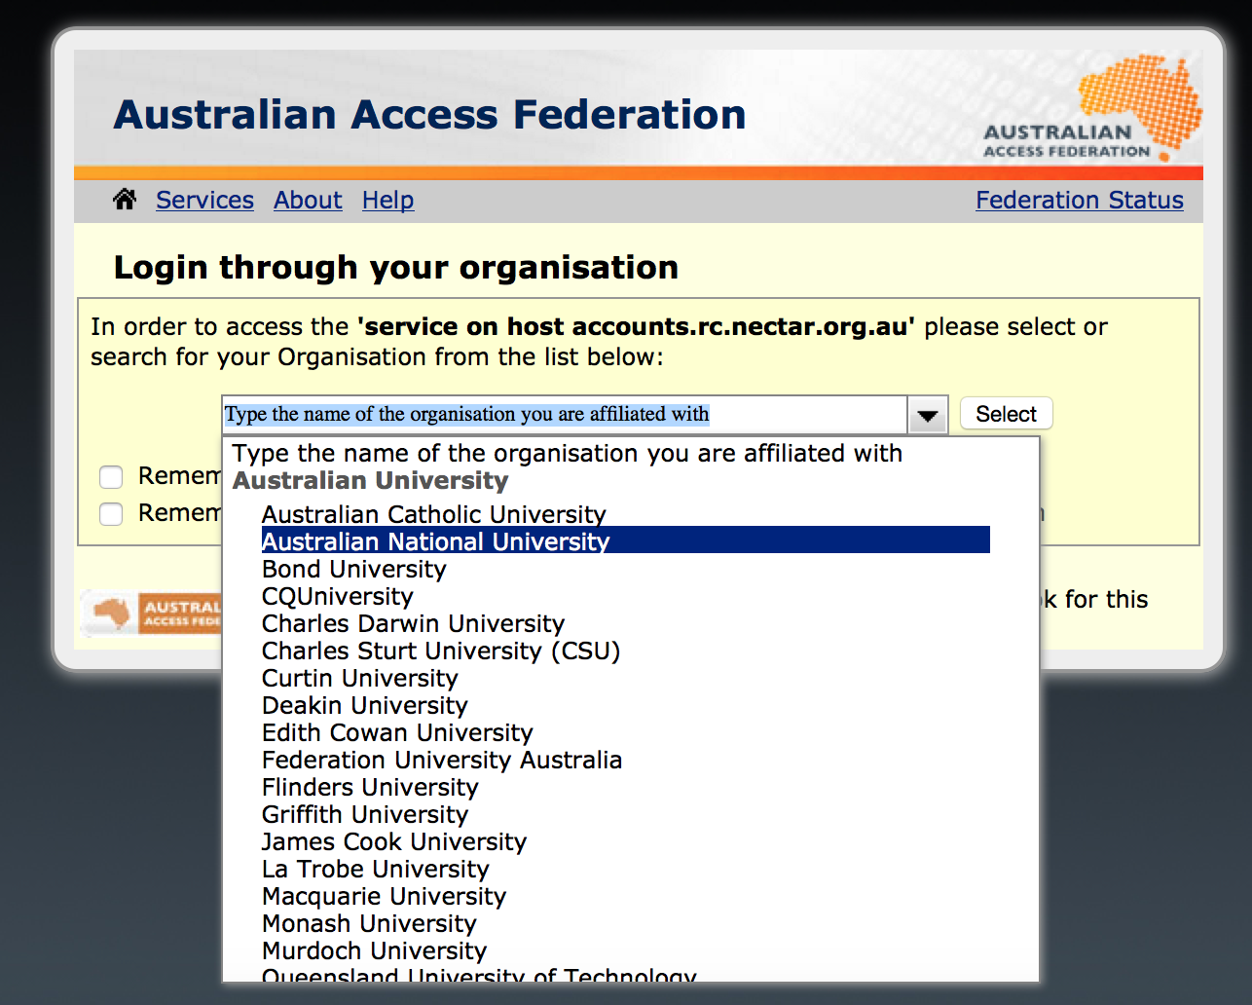
[DONE WITH SLIDES] Connecting
You can easily get onto the Research Cloud via the web Dashboard. You can use your institutional login to connect.

Slide 4
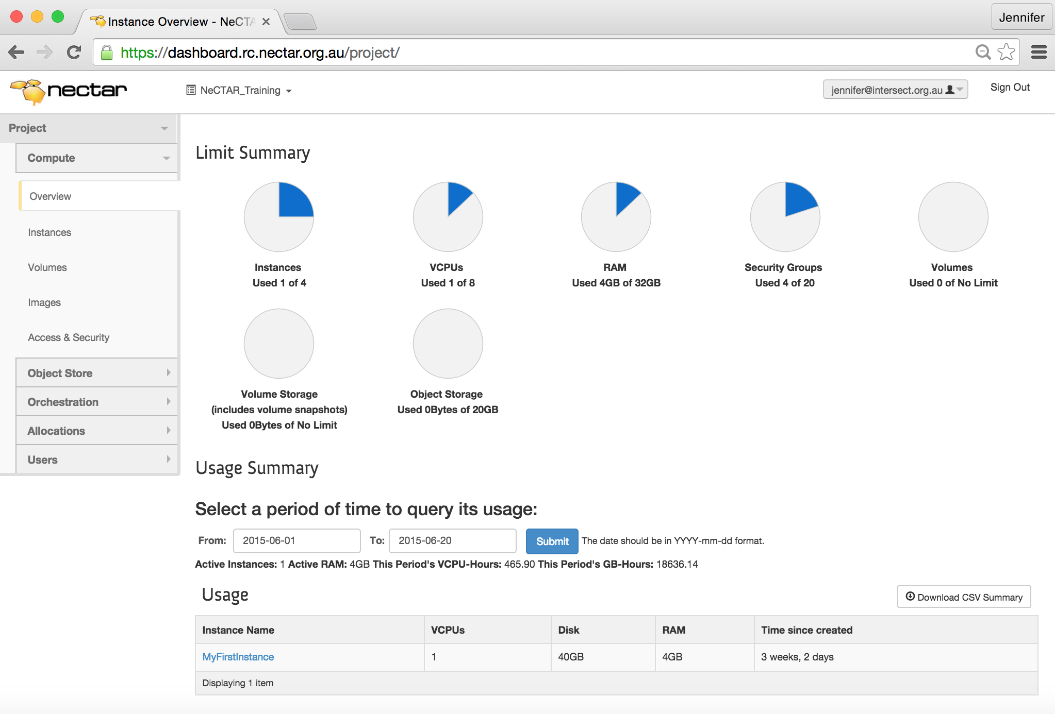
[DONE WITH SLIDES] Connecting

Slide 5
[DONE WITH SLIDES] Connecting
Once you have logged onto the Dashboard for the first time, your Project Trial will be activated. Project Trials have names like pt-12345.
You may launch virtual machines on the Dashboard.
You, and anyone else you allow access to the virtual machine, can then log on to it and use it just like a regular server.
Refer to On-Line documentation for process!!

Slide 6
Connecting
We will refer to a Virtual Machine as an Instance (running virtual machine)
Instances originate from Images.
files which capture the configuration of a computer system.
To create VM, you will have to select an Image.
NeCTAR has a few pre-configured Images that make the set-up of a new instance much easier.
Starting base!
Notes:
PART 3
An instance is a running virtual machine (VM) on the NeCTAR Research Cloud. Instances running inside the Research Cloud are just like real-life computers, but in a remote location.
An Image which can be used to launch instances captures the configuration of a computer system, including the Operating System, and stores it in an Image file.
Mention that the NeCTAR images can be used as a starting base, upon which individual configurations can be made.

Slide 7
Connecting
To suit your purposes, the instance may need some tweaking, configuration changes and installing of software.
You can create your own image

Slide 8
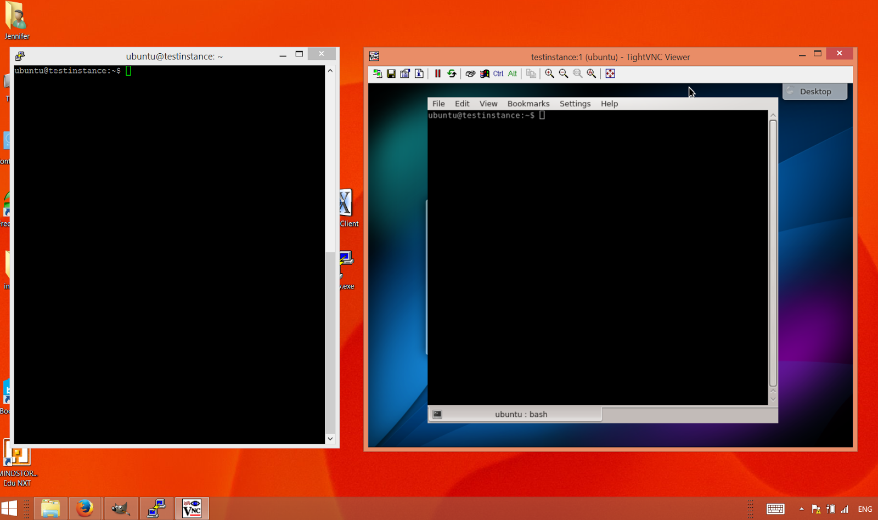
[DONE WITH SCREENCASTS] Connecting
Virtual machines can be accessed via
the command line terminal (left), or
using a remote desktop (right).
In Module 7 we will take a closer look at these two methods.

Slide 9
Housekeeping
Treat as real computer – need to do regular house keeping
Updating OS
Applying newest security patches
Backing up your data at regular intervals
NeCTAR does not automatically back up your VMs and Data – see Module 9
Notes:
PART 4
So, lets now talk about housekeeping.
Once you have got your VM up and running, you should take care of keeping it secure.
First of all, treat your VM as if it was your real computer – for which you also need to do regular housekeeping in order to keep it secure.
This includes updating the OS, applying the newest security patches, and backing up your data at regular intervals.
NeCTAR does not back up…

Slide 10
Mitigating risks: Passphrases
You will need to choose passphrases at several occasions.
For example, you will have to create keys encrypt the connection to the VM. -> generated with passphrase
Always choose secure passphrases!
Combinations of numbers, letters and special characters.
It should be at least 10 characters long, and it should be hard to guess.
You should be able to remember it, or save it in a secure place!
You should never share your password with anyone!
Notes:
PART 5
To keep your VM safe, you should also choose secure passphrases for accessing it.

Slide 11
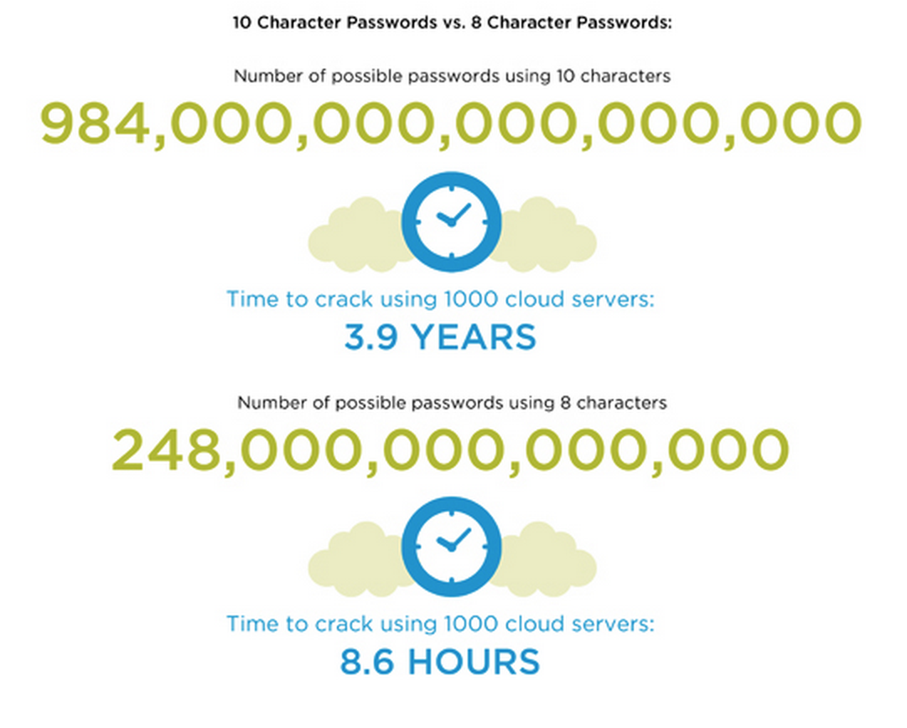
[DONE WITH SLIDES] Mitigating risks: Passphrases
Notes:
Explain how passwords can be cracked by using a large amount of computers required to achieve the task.
The numbers in the figure show what a dramatic difference secure passphrases do when it comes to time required to crack them.

Slide 12
Mitigating risks: Firewall
One important measure…
Good news: Firewall protection already in place the moment you launch your NeCTAR instance.
By default, the firewall allows no access
The Dashboard allows you to set the firewall rules for the VM – we call these “Security groups”
you will have to free up Ports to be able to connect.
Notes:
PART 6
One important measure to keep your VM secure is the use of a firewall to block hacking attempts from outside.
The good news is that your VM already comes with a firewall protection in place at the very moment you launch it.
This firewall by default blocks ALL inbound network traffic to your instance – which also includes you yourself who is trying to connect to the instance!
So the first thing you’ll need to do is open up access for yourself, otherwise you won’t be able to connect.
The Dashboard allows you to set the firewall rules for the VM – we call these “Security groups”.
A firewall rule opens up “Ports” on a computer’s network interface so that network traffic is allowed to go in.

Slide 13
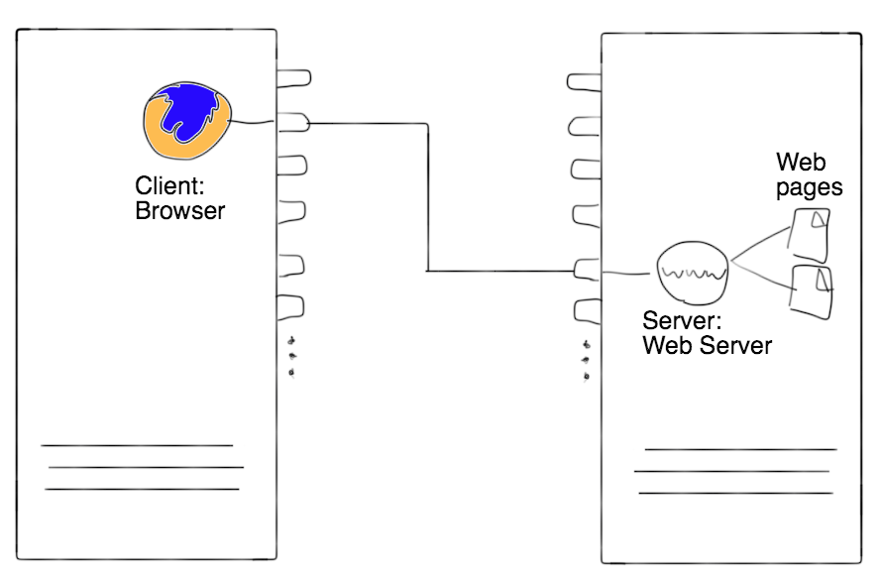
Mitigating risks: Firewall
Think of a Port like a plug: a network connection between two applications is established when two plugs are connected.
The two applications communicating are the server application and the client application.
Notes:
PART 6

Slide 14
Mitigating risks: Firewall
A firewall blocks all ports, unless they are explicitly opened.
Each free Port is also a potential entry point to the instance!
Connections to a Port are only possible if a server application is “listening” on that Port
Make sure your server application is secure!
Notes:
PART 6

Slide 15
Mitigating risks: Secure access
Naturally, you would like to the connection between you and the VM to be secure!
always use an encrypted connection.
It is possible to set up insecure connections if you allow this on your firewall rules of your virtual machine—don’t do this!
Notes:
PART 7
--- make sure everything that goes through “this connection” (from plug to plug on drawing) is encrypted.

Slide 16
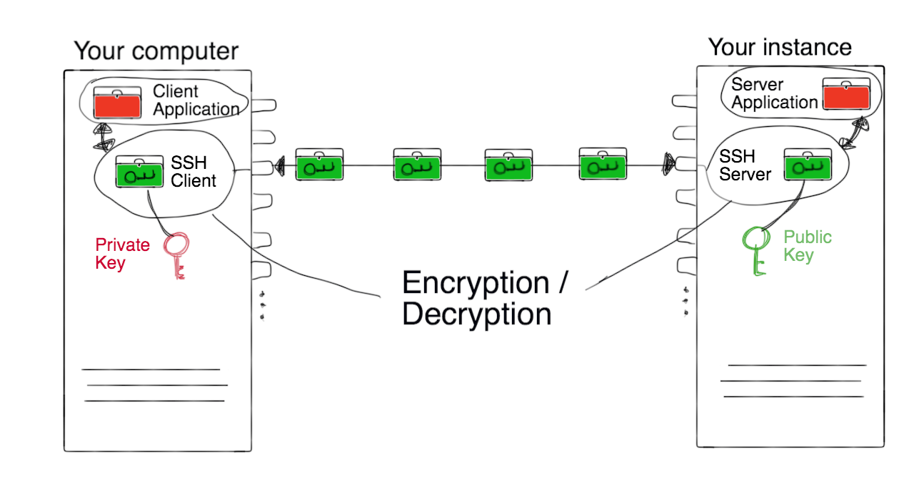
Mitigating risks: Secure access
SSH (“Secure Shell”) encrypts connections.
Two keys are required: The private and the public key.
Notes:
PART 7
the ssh client (on the local computer) uses the private key (it’s private because it’s not meant to be shared!) to encrypt/decrypt data packages to and from the client application. The public key is on the server and does the same – however the encrypted connection can only be established with both keys (i.e. having only the public key is useless).

Slide 17
Secure access
In Module 7, we will learn how to establish a secure connection via SSH.
Many applications use ssh to secure a connection.
A simple client/server application is the ssh shell, which we will use in Module 7 to communicate with the instance.
Notes:
PART 7

Slide 18
SSH Tunneling
Some applications do not support encryption with ssh
We can still secure connection through the use of ssh tunneling.
This technique operates through the ssh client and server.
The application does need to know that encryption is used—this is handled by ssh client and server.
Notes:
PART 8
unencrypted packages arrive at the application’s usual port. Use graphic on next slide to explain.

Slide 19
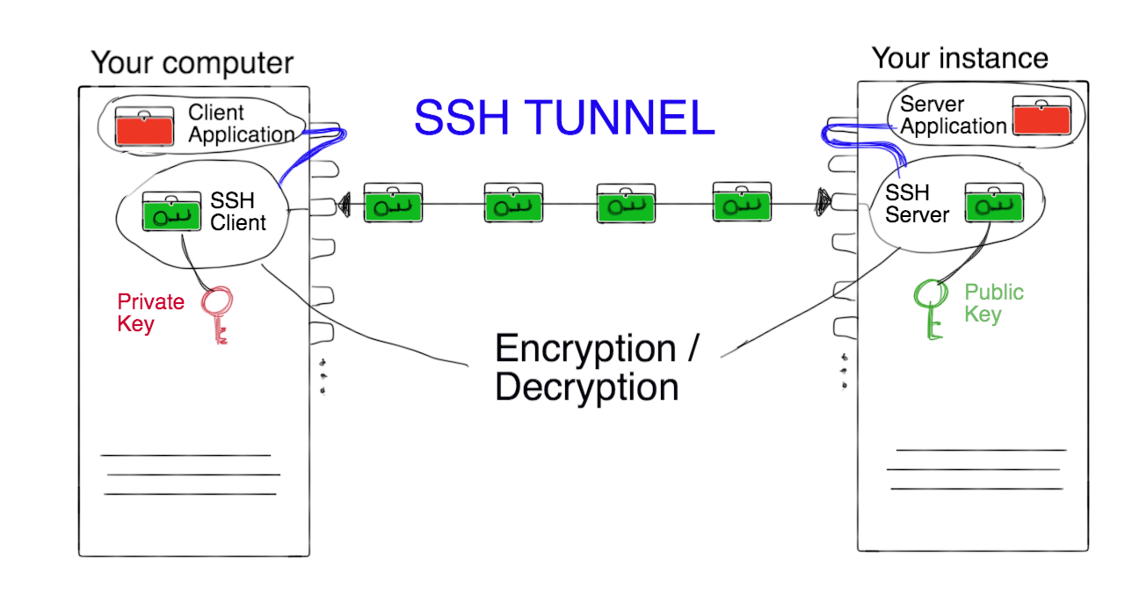
Mitigating risks: SSH Tunneling
Notes:
PART 8
The data packages are forwarded to ssh client/server from the application end points. The applications “think” they are using their designated port, when in fact the connection is deviated via the ssh encryption on port 22. This way we can have lots of applications operating on various ports, but the firewall only needs to have port 22 open, as all connections are deviated via this ssh tunnel.
This is a good way to keep your VM safe!

Slide 20
[DONE WITH SLIDES] Mitigating risks: Limiting access
Only grant access to your virtual machine to people you trust!
Each user of the instance should ideally
Have their own user account and password, and
Use their own ssh keys—Module 7 will show how to do this.

Slide 21
[DONE WITH SLIDES] Mitigating risks: Protection Software
Linux, Unix and other Unix-like computer operating systems are generally regarded as very well-protected against computer viruses, but they are not immune.
Your VM is already protected by a firewall, but you may also want to install an Anti-Virus protection.

Slide 22
[DONE WITH SLIDES] Mitigating risks: Keep things tidy
Know your virtual machine! You can recognise when something abnormal happens.
Many types of attacks specifically target Web servers: Use separate virtual machines for them.

Slide 23
[DONE WITH SLIDES] Keep things tidy
Purge (erase) residual data from your storage before you shut your instance down or delete the storage. Module 9 will show how you can do this.
Prevent untidy machines: Don’t re-provision virtual machines constantly, rather keep optimising one and then make Snapshots of it (Snapshots will be done in Module 9).

Slide 24
Mitigating risks: Data encryption
Encrypt sensitive data before you upload or download it to or from your instance
unless you are already using an encrypted connection to copy files (e.g. scp or sftp).
Module 8 will show how you can encrypt your data.
Before encrypting a file, be aware of the risk added:
lose the encryption key or forget the passphrase.. Lose forever!
Notes:
PART 9
A potential risk in general when you upload or download sensitive data via the Internet is that someone grabs your data being transferred via the network and gets access to it. So, all data that you upload or download should be encrypted, so if somebody gets hold of it, it is useless to them without the encryption key.
There are secure methods to upload or download data, for example scp and software using the sftp protocol – we will get back to this in Module 7.
However, not all tools you may use to upload/download data support encryption.
We will see one example in Module 6.
In such cases, you should encrypt the data BEFORE you upload it online – that does not only apply to the NeCTAR RC, but in general to any place on the web to which you upload your sensitive data!
Module 8…
However be aware of the before encrypting…

Slide 25
[DONE WITH SLIDES] Mitigating risks: Summary
In summary, things to watch out for to mitigate risks:
Use secure passphrases.
Carefully configure the firewall.
Always use secure methods of access (e.g. ssh logon terminals or ssh tunneling).
Limit access only to trusted users.
Know your virtual machine and keep things tidy.
Encrypt your data.

Slide 26
Cleaning up
When you are finished with your work and don’t need the virtual machine any more, you should terminate it, so
It does not take up any more of your allocated resources.
resources become available to other researchers.
You can easily terminate an instance on the Dashboard.
Don’t forget: back up your instance and data before you terminate it!
Module 9 will get into detail with this.
Notes:
PART 10
Now we have talked about almost all “housekeeping” task you should perform to keep your VM secure – safe one, which is a very important one actually: Cleaning up behind you!

Slide 27
Cleaning up
If you don’t need your NeCTAR data storage any more, you should delete it. Storage is discussed in detail starting from Module 6.
Don’t forget: Before you delete your storage, back up your data and securely erase the drives!
Module 9 will show how you can do this.
Notes:
PART 10

Slide 28
[SLIDES] Getting support
There are several ways to get support:
For general advise, first contact your local eResearch office or IT services.
The NeCTAR project also offers online user guides and technical support through the support site
support.nectar.org.au
Notes:
POINT OUT: Please read the information given on the support website.
First read the known issues and FAQ, and search the support website and the community forum for a solution.

Slide 29
Closing note
In this module you have learned about processes to:
Get onto the Research Cloud.
Launch an instance and connect to it.
Do housekeeping in order to mitigate risks.
Clean up after you by terminating VMs and deleting storage.
Get support.
Notes:
PART 11

