Slide 1
Structured in 10 Modules
what cloud computing is and how it can benefit your research
types of services NeCTAR offers
Aim at keeping video short

Slide 2
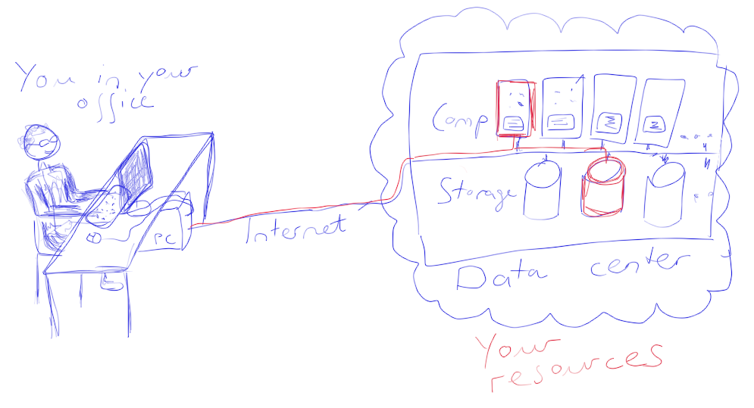
What is Cloud Computing?
Simply put, cloud computing means storing and accessing data and programs over the Internet instead of on your own computers hard drive.
Your local computer is only used to control your resources from remote and display things on your screen — the data and compute servers are actually “in the cloud”

Slide 3
Wha t is cloud computing?
Origins go back to 50ies. Early forms were..
Today, cloud computing operates on the…
It is not officially clear where the term..
So, how can we sum up…
storing and accessing data and programs over the Internet instead of on your own computers hardware.
Local computer, which is… used to control your resources from remote and display things on your screen

Slide 4
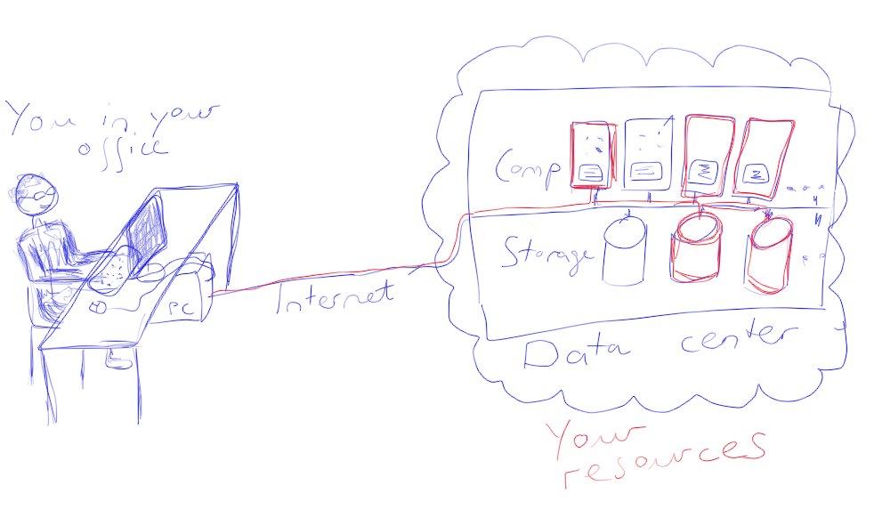
So why is this good? Is it not better…
Go through lengthy process to obtain access
Maybe wait significant time
Purchasing infrastructure eat up budget
Here, advantages of cloud come into play…
Easily scale up : Access several computers and large amounts of storage practically in an instant

Slide 5
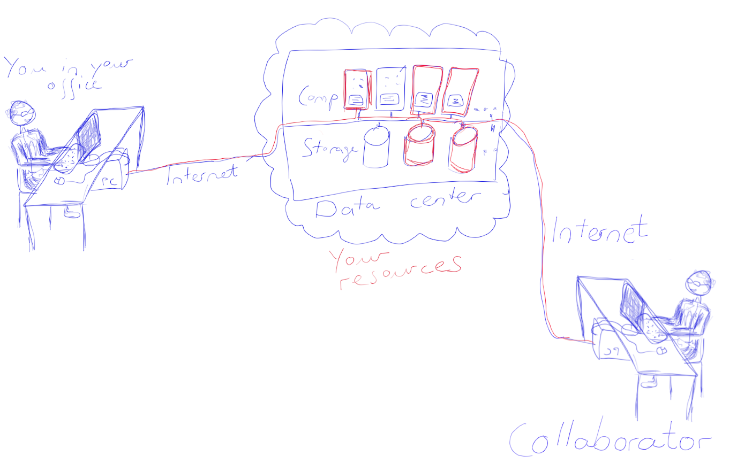
Why is this good?
Model known as “Pay per use”
Nice thing about NeCTAR.. Free!
Another advantage:
resources available over the internet
Easily grant access to collaborators
Save time synchronizing your work.
might prove more complicated to achieve for infrastructure located on your premises
Of course, the fact that resources are accessible.. Modules 5 and 8!
Other advantages and drawbacks…

Slide 6
Cloud Computing
Five main characteristics:
On-demand self-service
consumers can provision resources like computing power and storage
Broad network access
Allows access of compute and storage services through a variety of devices
Resources are “pooled”
Consumers can choose the data center, but not the specific strg dev or comp.
The term “elasticity” refers to the resources being scalable.
Request more resources when needed
Cloud computing is a “Measured service”
The amount of resources consumers use can be monitored and metered.

Slide 7
Cloud Computing
With this, cloud computing enables IT infrastructure to be
More flexible:
As resources can be provisioned according to current requirem.
Cloud computing is also easy to use:
Provision resources quickly and easily, conumer does not have to worry about maintenance of infrastructure.
Cloud computing also aims at saving the consumer costs:
Which would be required for local infrastructure.

Slide 8
Common Cloud Services
Provision of computing power in form of virtual machines
Storage
Database engines
Various software services
Development & Deployment platforms
Tools for developers to integrate and deploy their software

Slide 9
Example Cloud Services
Cloud services that you have most likely already used include
Google services, e.g. Google Drive, Google Docs
Apple iCloud
Dropbox
The Chromebook is an example of very heavily cloud-based device

Slide 10
Types of Cloud Services
Cloud services can be characterized as different types as well. These are
Software-as-a-Service (SaaS)
customer subscribes to an application which they then access over the Internet
Dropbox, Google Applications
Platform-as-a-Service (PaaS)
which includes the Development and Deployment platforms mentioned earlier
for example Windows Azure, Google App Engine
Most importantly for this course it the type
Infrastructure-as-a-Service (IaaS)
in which computing resources (like computers and storage) are provided to the consumer.
The NeCTAR Research Cloud is an IaaS service. We will learn much more about this in this c.

Slide 11
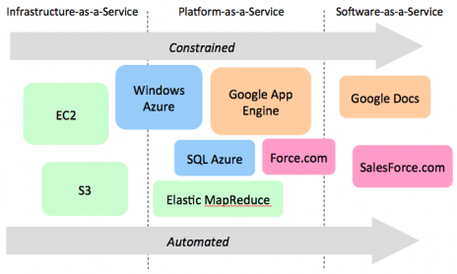
Types of Cloud Services
It is easier to recognise the distinction of these 3 types in a graphic. Two properties characterise the types: Constrainedness and Automation.

Slide 12
On the left side, there is less constrainedness, that is the amount of control you have about how your services run. But the less contained a service is, the less automation it also provides. So on the left of the graphic we can place the IaaS services in which you have a great amount of control, but have to do a bit more work in setting up your services, as there is less automation.

Slide 13
Towards the right side, there is more automation, so SaaS services like Google Docs and Dropbox are easy to set up, but you cannot control how they work.
In the middle ground, we can place the development and deployment platforms in the PaaS services.

Slide 14
As a researcher, you will probably find the IaaS services most useful, while SaaS services are broadly useful for individual work and collaboration, for example setting up a shared dropbox folder with your collaborators.

Slide 15
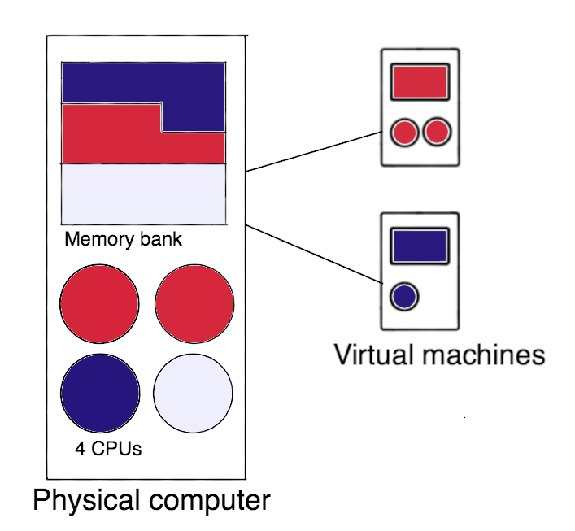
Virtualization
The main technology enabling IaaS services is called Virtualisation.
hardware is “simulated”.
We can simulate a whole computer incl. the OS.
simulated hardware uses parts of the actual hardware of the more powerful computer.
Several virtual computers can run on one larger, more powerful computer
cloud computing provider has several… provide a larger number of little less powerful computers….
Notes:
Say that a VM is utilising (parts of) the real hardware to simulate virtual hardware.

Slide 16
Virtual Machine
We call one such simulated computer…
Throughout this course…. Instance
Instance running in the cloud appear to you just as..
an operating system, network access (a real IP address), and hard disk storage.
You as a user can’t see that the HW is actually running on top..
Differences:
VM → no hardware maintenance → cheap and easy
You can take a “Snapshot”

Slide 17
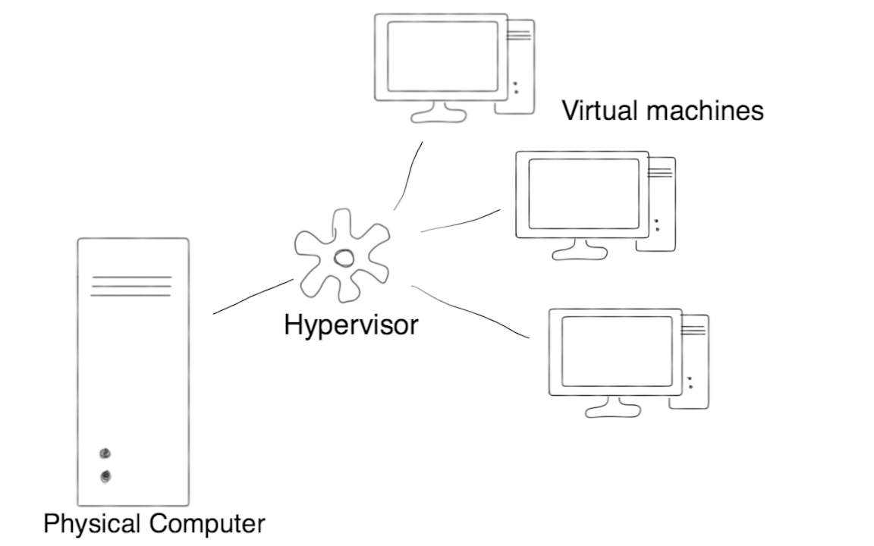
Hypervisor
The Hypervisor or Virtual Machine Manager is the software that manages communications between the physical hardware and and the VMs running on it.
The Hypervisor enables the technology — but also brings new vulnerabilities. We will discuss how they are addressed in Module 8.

Slide 18
Common concerns
Common concerns include:
possible interruptions of the cloud services,
Privacy & Security
problems migrating the users resources to the cloud.
Module 8 will discuss security related information in more detail.
For now, lets just say that not all common concerns are necessarily justified, as users often don’t have sufficient knowledge to assess the actual risks.
- can provide benefits
- ..aims at providing the necessary information in order to understand the risks of cloud computing and learning what can be done to mitigate them.

Slide 19
National eResearch Collaboration Tools and Resources
is an Australian Government project.
aiming at making it simple for researchers to access IT resources.
The NeCTAR project aims to support what we call the “connected researcher”
Infrastructure for enhanced research collaboration

Slide 20
NeCTAR Services
NeCTAR is building 3 products:
Virtual Laboratories
provide online platforms for research activities in several research discipline areas
eResearch Tools
provide online software tools which are available for common research tasks.
These two .. more detail in module 2. The rest of this course will focus on the 3rd p.— The Australian Research Cloud (the IaaS)

Slide 21
Research Cloud
currently consists of 8 data centers “Nodes”
Across the 8 nodes, 32.000 processor cores distributed across Australia.
The Research Cloud deploys one of the significant cloud management software today, called OpenStac
Free access → Australian Access Federation (AAF).
Notes:
Mention that the AAF lets you access your services using your institutional login details (e.g. the normal university login)

Slide 22
Benefits for your research
Don’t have to worry about costs of your IT infrastructure and maintenance
Being able to share infrastructure → easier collaboration.
Lots of things you can do in the cloud, otherwise harder to achieve:
Module 3… to illustrate this
Particularly useful.. Snapshot. Reproducible research.
Notes:
See Tutorial / Documentation for elaboration of usage models – say one sentence or two to each point.

Slide 23
Sum up
services and resources which are located and run in a data centre and that you access via the network
Cloud computing fast on its way to becoming a standard technology…. Advantages
Cost savings
Easy access
Enhanced collaboration
Means to achieve reproducible research

Slide 24
Sum up
While there are lots of concerns
many such fears are based on insufficient knowledge.
Impossible to avoid risks 100%.... Cloud computing can offer security benefits
Rest course:
build on knowledge
Hands-on

