Slide 1
Resource requirements for computing and storage
Different types of storage available in the NeCTAR cloud
Key factors which help determine the amount of required resources.
How many VM do you need?
How many cores?
What type of storage?
Notes:
PART 1

Slide 2
Storage
Distinguish two most commonly used storage systems are:
Filesystem storage
Commonly deployed as Network Attached Storage (NAS).
Great for transfer of individual files over a network
Notes:
PART 1

Slide 3
Storage
Block level storage
A Block is a chunk of data which may contain several files.
Appears to the system and the user as attached drives.
Required storage type for most applications, and for running things like databases
Notes:
Part 1

Slide 4
Storage
A scalable system has been designed, based on the principle of filesystem storage, which is well suited for Big Data demands:
The Object Storage scales up nicely.
Block-level storage is also available for you, we also refer to at as “Volume” storage. This will be a block of data which you can attach to your instance.
Notes:
Part 1

Slide 5
[SLIDES] Storage
NeCTAR offers 3 different types of storage:
On-Instance storage
A type of Block storage that comes with the instance and is ephemeral: its lifetime is limited to the instances’.
Two disks: Primary and secondary disk.
Volume Storage (Block Storage)
Persistent block storage which can be attached to a VM.
Object Storage
Individual data files can be uploaded to the object store.
Files are replicated across several physical locations.
Files can be accessed from the VM or from anywhere via the Internet (e.g. using a Web Browser).

Slide 6
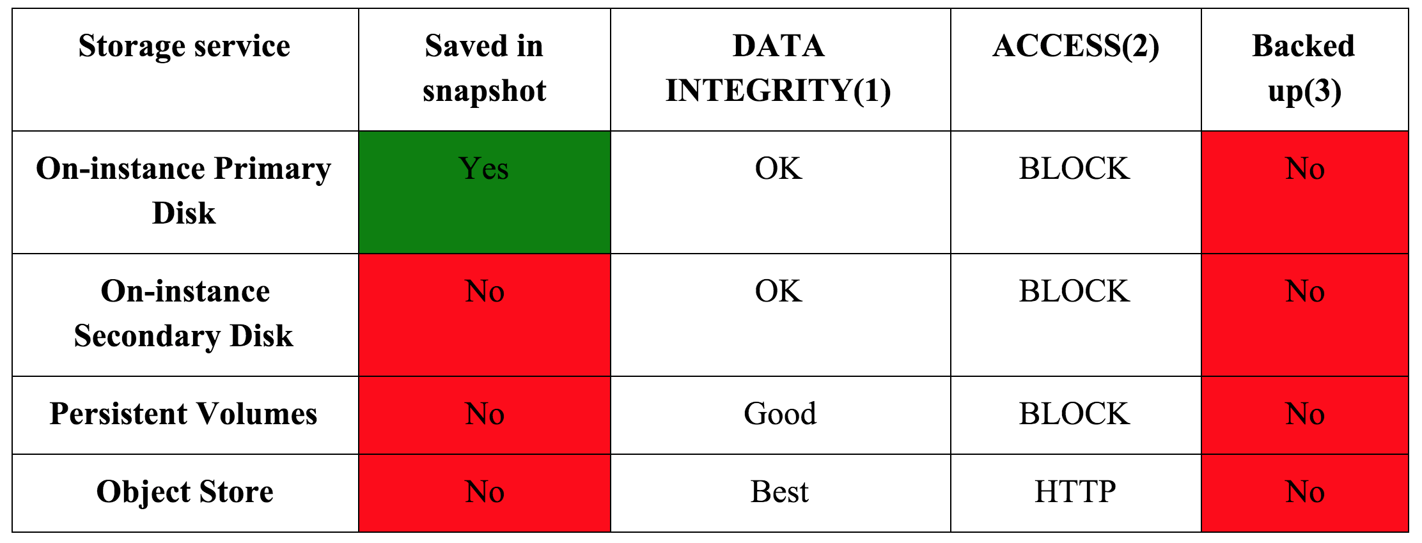
[SLIDES] Storage
Not all storage is created equal, and the different types of storage differ according to performance, persistence and data safety.

Slide 7
[SLIDES] Storage
Each instance comes with a certain amount of On-Instance storage (also called ephemeral storage), which appears as two separate hard disks:
The primary disk.
Contains the OS and your home directory.
Backed up with Snapshots.
The secondary disk.
Sizes between 30GB—480GB available.
Not backed up with Snapshots.

Slide 8
[SLIDES] On-Instance Storage
Important!
On-instance storage is regarded as ephemeral — when you terminate your VM, or an unplanned re-start of the Hypervisor takes place in the NeCTAR Node, the data will be lost and cannot be recovered!
You should treat it as scratch space and keep important data in either volumes or the object store.

Slide 9
[SLIDES] Volume Storage
Think of Volume Storage as a section of a large hard-drive which has been assigned for your use.
Volume storage can live outside your instance: It can be attached and then accessed from any of your instances (we will do this in Module 7).
Data on a Volume is retained when terminating VMs.
Volumes also offer a Snapshot feature which can be used to make convenient backups (see Module 9).

Slide 10
[SLIDES] Object Storage
Per-file object-based storage is easier to manage than Volume storage, and it can be distributed.
Access to the store is independent of the existence of instances.
An “object” is defined as the data file along with its unique ID and all its metadata.
Unlike files in traditional hierarchical file systems, objects are stored in a flat structure (a “pool”).

Slide 11
[SLIDES] Object Storage
Multiple copies of all object data is stored over a distributed system, while the storage still acts as one.
Object Storage therefore
is highly fault tolerant,
scales up nicely, and
offers great data integrity.

Slide 12
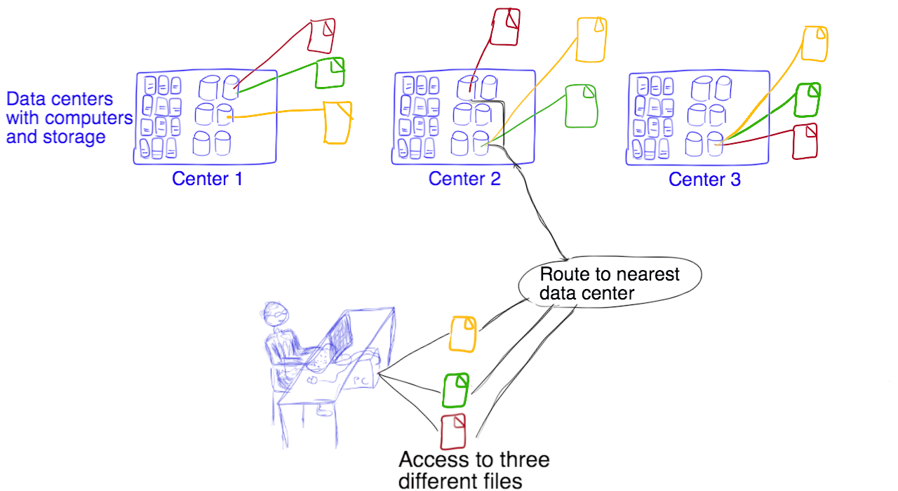
[SLIDES] Object Storage

Slide 13
[SLIDES] Object Storage
Because Object Storage scales nicely, you may get access to large amounts of storage.
You may upload as many files as you like, as long as your allocation is not exceeded.
The size of the files is not limited, however due to limits in the http protocol it is not recommended to upload files larger than 1GB.
The NeCTAR trial account has a 10GB object storage quota—when requesting and allocation, you have to explicitly ask for object storage.

Slide 14
[SLIDES] Object Storage
Suitable use for the Object Storage:
Object Storage is not a traditional file-system or real-time data storage system.
It’s designed for mostly static data that can be retrieved, leveraged, and then updated if necessary.
Example: A dataset of several files that is read and analysed many times, but in general doesn’t change.
In general, the object store is great for data you write once and read many times, but not suitable for applications like databases.

Slide 15
[SLIDES] Object Storage
Important!
While Object Storage has high data integrity through geographical distribution of files, it does not have a “traditional” dedicated backup system — it merely provides a means to increase availability and integrity of your data by keeping multiple copies.
You still have to back up your data.

Slide 16
[SLIDES] Object Storage
The OpenStack component to manage the object store is called Swift.
With your credentials you can request Swift to create storage and upload/download files.
The object store can be accessed via the Dashboard and other graphical clients which support Swift. More about this in Module 7.
It is also possible to use a command line client to access the object store, which is subject to Module 10.

Slide 17
[SLIDES] Object Storage
Security Warning:
Swift does NOT provide encryption of the data it stores. When you upload/download data to/from the object store, this will happen without encryption.
If you have sensitive data that requires encryption you must encrypt the data files before upload.

Slide 18
[SLIDES] Object Storage
In summary, the object store:
offers the safest place for your data on the NeCTAR Cloud.
has great performance.
is great for data you write rarely and read many times.
does not require a running instance to access.
can be accessed from anywhere via the Internet.
objects can be transferred to and from your instance with a variety of tools.

Slide 19
[SLIDES] Volumes vs Object Storage
File Access
Volume storage contains a lot of files in one continuous block. Files are accessed with traditional file access methods.
In the Object Storage, files may be spread out over several hard-drives. An object is accessed using a http based interface.
Distribution
Object Storage is a per-file based storage system which stores each file at several locations.
Volume Storage is one block of storage which contains several files, located at one location.

Slide 20
[SLIDES] RDSI Storage
One more storage type which may be available to you is the storage offered by the Research Data Storage Infrastructure (RDSI): www.rdsi.edu.au
Aim of RDSI: research usage and manipulation of significant “collections” of data that were previously either unavailable or difficult to access.
The RDSI Project will deliver a national infrastructure able to hold significant collections of research data.

Slide 21
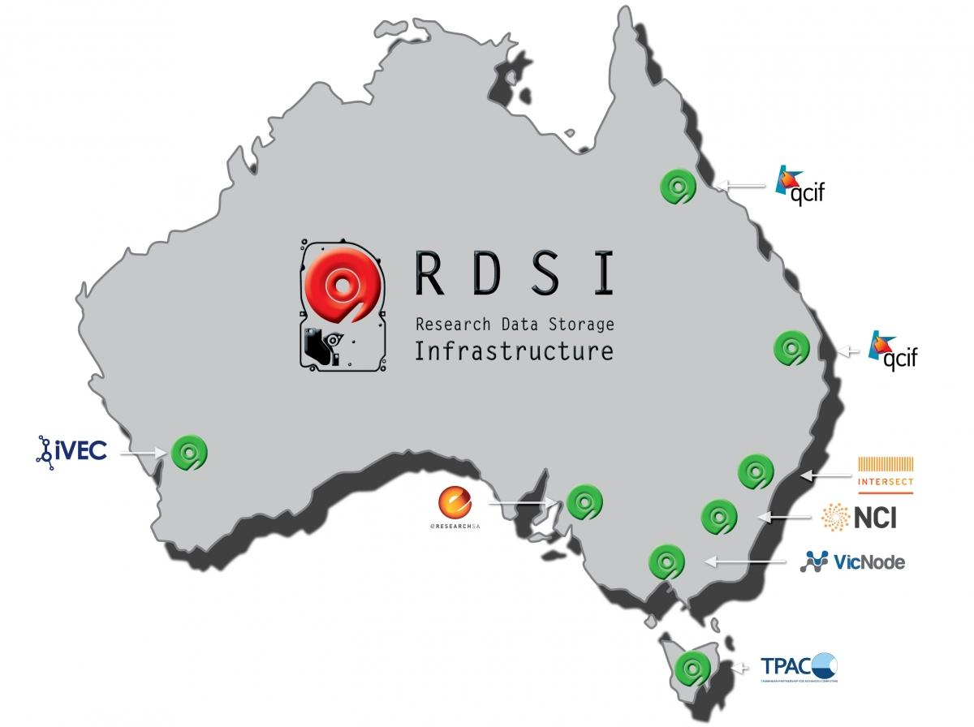
[SLIDES] RDSI Storage
Infrastructure made up of several high-capacity Nodes which contain multiple petabytes of data.
High-speed inter-connection low-latency network for data transfer between Nodes

Slide 22
[SLIDES] RDSI Storage
NeCTAR storage may not be sufficient for your purposes:
The largest “flavor” will give your 480GB of On-Instance storage
to get access to a large Volume storage, you need good reasons in your allocation request.
Contact your local RDSI node to find out about the form of access they use, which may be:
an Object Storage,
a Volume Storage,
a specific VM which has access to the storage,
NFS storage, or
other forms of access.

Slide 23
Storage: Recommendations
Use On-Instance Storage as “scratch space” and/or to keep copies of data (e.g. websites).
Use Volumes or the Object Store for all data which should survive an instance termination.
Use Volumes for data which needs to be accessed by programs using traditional file access methods.
Use the Object Store for easy access to individual files from anywhere, which is great for sharing with collaborators.
For very large data demands, you may consider using Volumes, or try to get an RDSI allocation.
Notes:
Part 2

Slide 24
Storage: Recommendations
Important: Back up your data!!
Most urgently, backups should be done of On-Instance Storage and of Volumes, but it is also recommended to back up Object Storage.
Back up at regular intervals, for example at important stages of the data life cycle.
Module 9 will guide you through a few options to back up and restore your data.
Notes:
Part 2

Slide 25
Suitable number of cores
Virtual machine instances in the Research Cloud are available in “Standard” sizes:
[REST WITH SLIDE]
Small (1 core), Medium (2 cores), Large (4 cores), Extra-large or XL (8 cores), XXL (16 cores).
Per core, a VM gets 4 GB of memory (RAM) and 30 GB of local disk storage (On-Instance secondary drive).
Example: an XL VM instance has 8 processing cores, 32 GB RAM and 240 GB of On-Instance storage.
Notes:
Part 3

Slide 26
Suitable number of cores
So which flavor is suitable for your purposes? How many cores will you need?
You will have to take a closer look at your application to find out how much you can benefit from several cores.
Some applications are single-threaded—you won’t benefit from more than 1 core.
Others are multi-threaded—you may benefit from several cores.
Notes:
Part 4

Slide 27
Suitable number of cores
A multi-threaded application supports a certain number of threads.
A thread is essentially a parallel process.
Depending on how many threads your application uses, you may benefit from maximum one core per thread.
Notes:
Part 4

Slide 28
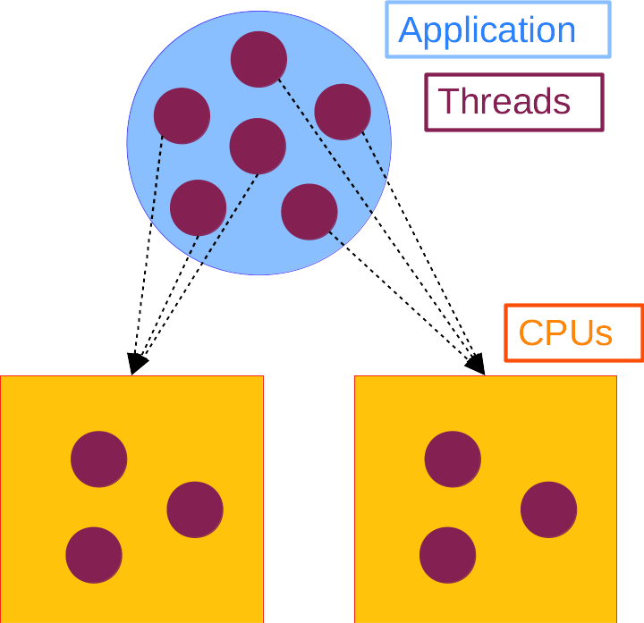
Suitable number of cores
Example:
An application supports 6 threads.
Choosing 6 cores gives you the maximum performance, as each thread uses one full core.
Choosing 2 cores will distribute the work of the 6 threads onto the 2 cores: The application runs at 1/3 of maximum performance (2 cores divided by 6 threads).
Notes:
Part 4

Slide 29
[SLIDES] Suitable number of cores
Some applications use OpenMP, meaning they are multi-threaded.
OpenMP is an API that can be used for multi-thread handling on shared memory systems (all CPUs access the same memory).
OpenMP is slightly more automated than low-level thread libraries as pthread.
If your application uses OpenMP, same guideline about the number of cores hold: Choose one core or less per supported thread.

Slide 30
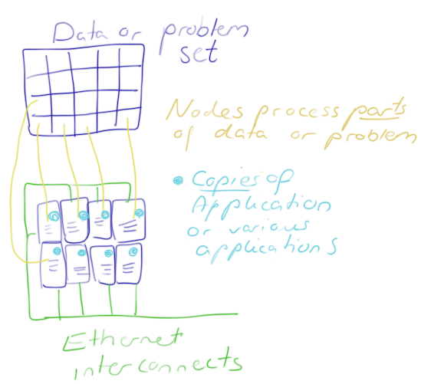
Suitable number of VMs
Horizontal scalability was introduced in Module 4.
entails that you may run several instances of your application on separate virtual machines
But how many instances will you benefit from?
Notes:
Part 5

Slide 31
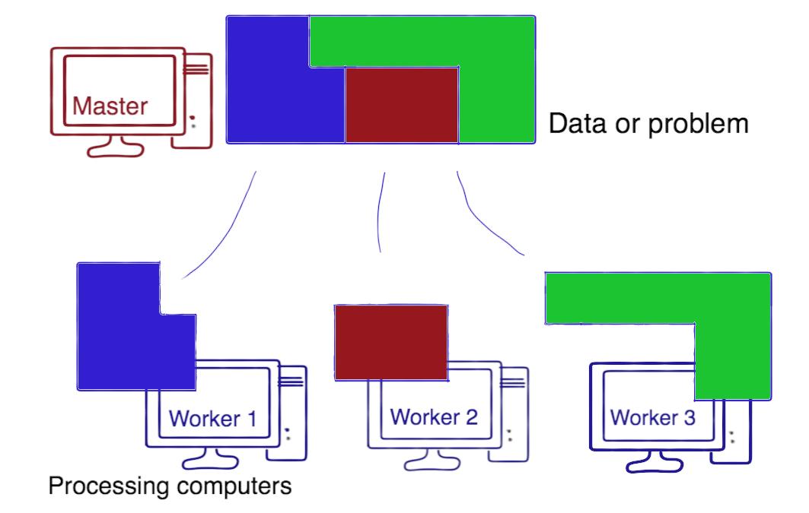
Suitable number of VMs
You can partition the data set or problem. How many instances you benefit from, depends on how the problem can be split.
Notes:
Part 5

Slide 32
[SLIDES] Suitable number of VMs
A software framework like MapReduce can be used to split and dispatch your problem set.
MapReduce is a framework for processing parallelizable problems across huge datasets using a large number of computers (nodes).
For use with OpenStack, you may Apache Hadoop (industry standard and widely adopted MapReduce implementation) through the OpenStack Sahara Project.

Slide 33
Suitable number of VMs
Sometimes, you just need to replicate your resources, or auto-scale your resources, at times when heavy workloads are experienced.
Example: When a Web-server is used at full capacity, a second (third, etc.) is automatically launched to distribute the workload.
Notes:
Part 6

Slide 34
[SLIDES] Suitable number of VMs
The OpenStack framework provides a means to “orchestrate” your resources with the Heat engine:
You specify a template which describes which resources to launch.
Heat then manages the entire lifecycle of your infrastructure and applications.
Heat Auto-scaling: You can define “Alarms” which trigger resource management actions (e.g. scaling up).

Slide 35
[SLIDES] Suitable number of VMs
Or your application may be using MPI (Message Passing Interface), which makes it potentially eligible for parallel processing:
MPI is a technique which is widely spread in parallel programming.
With MPI, you can spread the processing of your application over several instances.
The applications running on the instances communicate over the network to synchronise their processes—this depends on what the application is trying to do. Therefore, synchronisation has to be built into the program code.

Slide 36
[SLIDES] Suitable number of VMs
Are applications using MPI suitable for the NeCTAR Cloud?
You may benefit from several instances—however, your better choice may be to go for a HPC solution (see Module 4).
MPI performs poorly on common OpenStack networks because communication between the nodes is slow.
If fast interconnects are not crucial, you can still benefit from running MPI programs in the Cloud.
Notes:
NOTE: MPI broadcast and multicast are not supported in OpenStack.
NOTE: Can use MPI in the cloud only if your instances can communicate with each other over their fixed IPs and the used MPI ports.

Slide 37
[SLIDES] Suitable number of VMs
In summary, you may use several instances, but it depends on the application whether this is beneficial.
You may split the problem or data set and distribute it, for example using MapReduce frameworks.
You may configure auto-scaling for your resources with Heat in order to adapt to current workload demands.
You may be able to run your MPI application on the Cloud.
NOTE: The on-line course material provides a list of related literature for more details about parallel programming.

Slide 38
Closing note
The storage options available on the NeCTAR Cloud.
How to find the optimal amount of cores for your application.
Options to run your application across several instances.
Ready for more?
In the next Module, you will finally get some hands-on experience with using the NeCTAR Cloud!
Notes:
Part 7

