Slide 1
Launching and Connecting
Finally get some hands-on experience!
In a series of step-by-step instructions we will show you how to set up your NeCTAR services.
Launch a virtual machine and connect to it
via the command line
to a remote desktop
After connecting to VM:
Set up storage
How to access it from VM
Copying files to and from VM
Notes:
Part 1

Slide 2
General notes
What is an “Instance”?
In the NeCTAR Research Cloud, an instance is a virtual machine.
Instance vs. “Local computer”
Local computer is the physical computer you use to connect to your instance, using command line or a remote desktop client application.
Instance is the virtual machine running in the Cloud.
Notes:
Part 2

Slide 3
General notes
This Module is based on On-Line Documentation
Open your browser and go to the website:
<Paste URL to training docs>
While we do the exercises, you may follow the documentation to read detailed instructions.
Notes:
Part 2

Slide 4
Preparation: Use of Terminals
If you haven’t used, it’s ok, we are going to learn
On Windows, you will use two terminals:
The PuTTY terminal to connect to the instance. Referred to as the “ssh terminal”.
The Windows command line. This Terminal will be referred to as your “local Terminal”. Open it by typing “cmd” into the search field. On-line Doc -> more detailed instructions when you will need it.
On Mac and Linux, there are built-in terminals:
Mac: search “Terminal” in the Spotlight Search.
Linux: search “Terminal” or Right-click on Desktop.
Notes:
Part 3

Slide 5
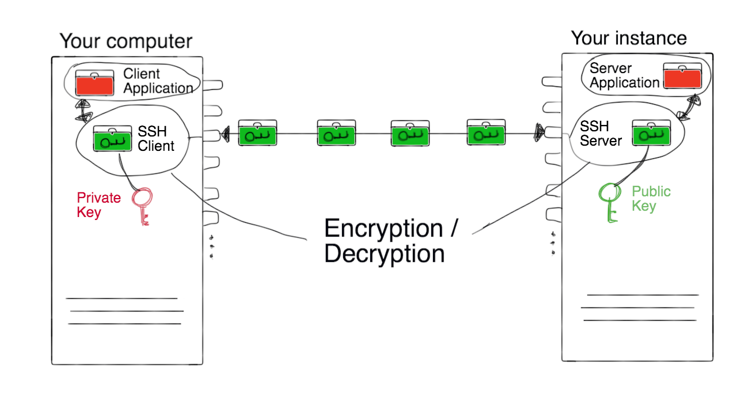
Creating a SSH key
Before we create our first instance, we will need to generate a ssh key pair.
An ssh key pair is required to encrypt the data between you and the instance. The pair consists of two keys: A private key, and a public key.
Notes:
Part 4

Slide 6
Managing storage
We will now go through the steps required to
set up various types of storage on our instance.
Transfer data from and to your cloud storage and your local computer.
Notes:
PART 5

Slide 7
Managing Storage
Brief storage recap:
Object storage: Access to single files via a simple web interface or client application.
Volume Storage and On-Instance (Ephemeral) Storage are directly attached to your instance.
Ephemeral storage is tightly attached to your instance and is deleted when you terminate (delete) it.
Volume Storage can be attached and detached from your instance(s). Terminating the instance does not affect the data.
Notes:
PART 5

Slide 8
Copying files across
Easily access files on your ephemeral or volume storage from your local office computer.
The On-Line doc describes you two ways to do this:
Using a SFTP client -> in the exercises in this video
On the command line, and a secure copy command -> in OnLine doco
Notes:
PART 6

Slide 9
Closing note
Congratulation!
You now know the most important practical steps for creating and managing your NeCTAR Research Cloud resources.
Notes:
PART 7

