Slide 1
Backing up & packing up
How to back up data and your VM (so take snapshots)
How to “pack up” and release resources
Terminating an instance
Securely erasing storage
Releasing storage
Notes:
PART 1

Slide 2
Backing up & Packing up
Why is it important to release resources?
Terminating instances
Deleting volumes
Running VMs and existing volumes block the resources to other researchers!
You want to play fair and release resources to others.
Your running VMs will use up your allocated CPU hours!
It is easy! Save your instance and volumes, release the resources, and re-launch your instance and volumes in exactly the same state when you need it again at a later time.
Notes:
PART 2
NeCTAR experiences resource shortage problems from time to time, which is largely due to that most NeCTAR instances are seriously underutilized (they are idle).
It has been observed that the average CPU utilization rate across the NeCTAR federation is less that 5%, and many large instances sit idle for days, weeks or months at a time.

Slide 3
Snapshots
Saves the state of your virtual machine. At a later time, you can reboot it in exactly the same state the same state:
Snapshots of an instance can be used like other Images to start new instances.
Snapshots only include data on your primary ephemeral drive.
It is also possible to take Snapshots of Volumes in the same fashion.
Notes:
PART 3
Mention that while “live snapshots” can be done, possible issues can be avoided by shutting down the instance first (see documentation online)

Slide 4
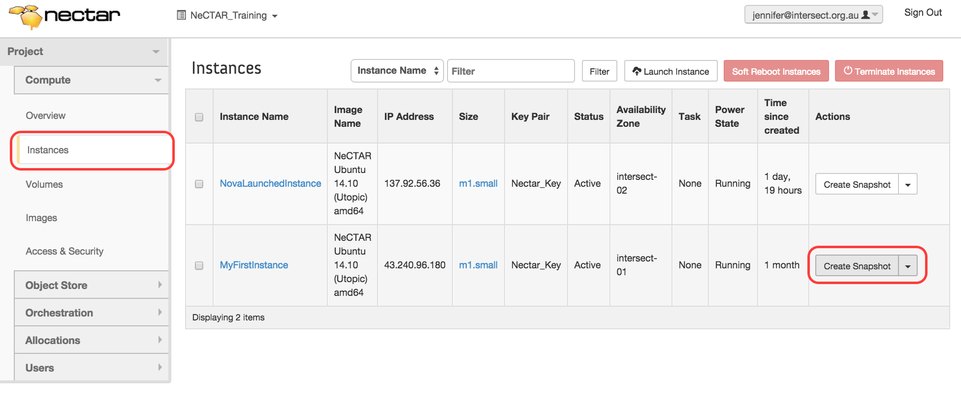
[SCREENCAST] Snapshots
Exercise 1
Take a snapshot of an instance on the Dashboard

Slide 5
[SCREENCAST] Snapshots
Exercise 2
Launch a new instance from the snapshot
Go to Dashboard > Compute > Images
Select the Project filter on the top of the list, and you will get an overview of all your own Images.
Find the Image you would like to launch a new instance from, and click Launch, which brings up the familiar launch dialogue.
Notes:
Explain how you have to select availability zone, ssh key etc. Keep the flavor or choose a larger one.

Slide 6
[SCREENCAST] Snapshots
Snapshots of Volumes
A Volume Snapshot creates a 1:1 copy of the state of a Volume.
A Snapshot creates an Image which can be used to create new Volumes – NOT restore existing Volumes!
Takes up significant disk quota the same size of your Volume.
The original Volume on which the Snapshot was based must still exist, or the Snapshots of it become useless.
If you want to delete a volume, you have to delete all snapshots of it first!
You may prefer other forms of backup discussed later.

Slide 7
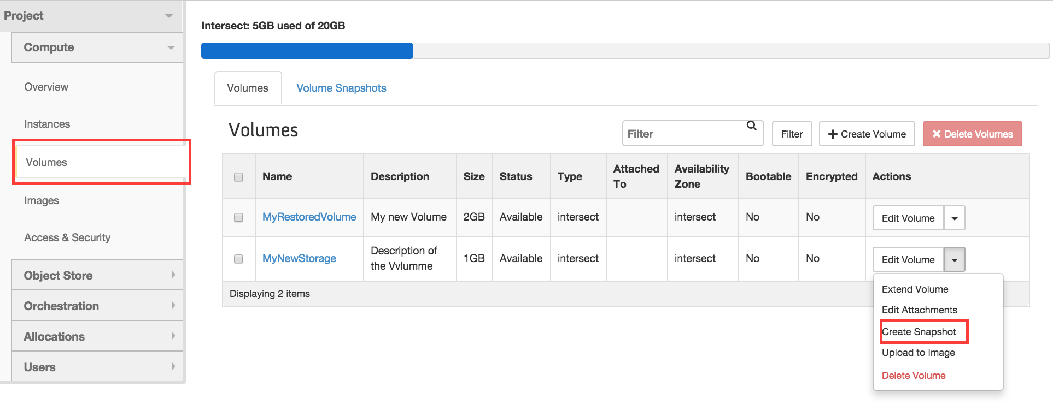
[SCREENCAST] Snapshots
Exercise 3: Create a Volume Snapshot
First, make sure the Volume is detached and in Status available.

Slide 8
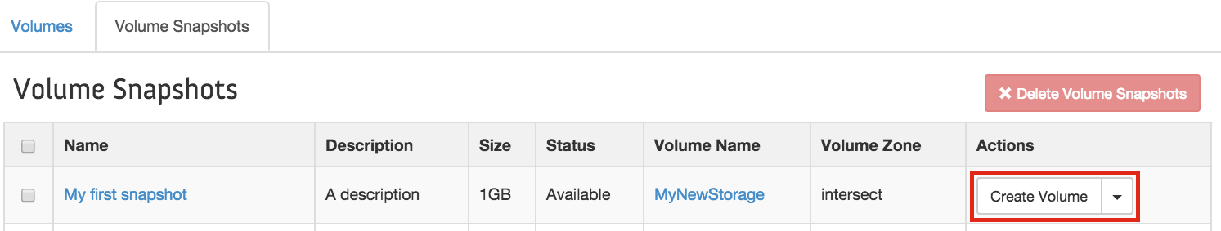
[SCREENCAST] Snapshots
Exercise 4: Create a new Volume from a Snapshot
Go to Dashboard > Compute > Volumes and click on “Create Volume”
Notes:
Point out that the size of the new volume should be at least the size of the original snapshotted volume. The original size can be looked up in the “Volume Snapshots” details by clicking on the name. But the dialogue should pre-fill the correct size already.

Slide 9
Backing up
While, NeCTAR does take measures against data loss, e.g. often through the use of RAID backed storage system,
there’s no guarantee this is the case.
The guideline is “all care taken, no guarantees given” — part of ensuring your data won’t be lost is your responsibility: Back it up!
You may back up your data
On the cloud
Off-line (keep copies on your premises)
Notes:
PART 4

Slide 10
[SLIDES] Backing up
Object storage is quite robust against data loss
Use clients like CyberDuck or FTP clients like FileZilla to copy your files across manually (see Module 7).
Write scripts for automated backups with OpenStack command line tools discussed in Module 10.
For backing up the secondary ephemeral disk and Volume storage, there are a number of different tools, e.g.
OpenStack Volume backups
rsync command line utility
dd command line utility
BackupPC
Tar/zip archives and secure copy commands.
… and more.
Notes:
Mention again that data replication contributes to data safety.
Describe the listed tools as in the On-Line documentation to give an overview.
Say that we will discuss OpenStack Volume backups and rsync in this course. Please refer to the On-Line Documentation for details about the others.

Slide 11
[SLIDES] Backing up
You can create “Backups” of Volumes using OpenStack tools.
Backup vs. Snapshot
Snapshot:
Creates 1:1 copy of entire volume (same size!).
Is stored as Image on the NeCTAR Image Server.
Snapshot can be used to create NEW volume.
Snapshots depend on the existing volume.
Backup:
Creates backup of used data on the volume.
Is stored in Object Storage.
Backup can be used to create NEW volumes or RESTORE an existing volume.
Backups are independent of original volume existence.
Notes:
Please be aware that Snapshots are not suitable to create regular backups, as it takes a lot of storage space and uses up your quota. Snapshots are also only usable while the original Volume still exists, which limits your flexibility to delete the volume. You should only use snapshots for significant states for your Volumes which you want to use to easily create new volumes from.

Slide 12
[SLIDES] Backing up
In the near future, you will be able to do Backups via the Dashboard, similar to Snapshots.
For now, you need to use the openstack command line client. This is part of Module 10.

Slide 13
[SCREENCAST] Backing up
Rsync command line utility
Rsync is a Unix command line tool which maintains a copy of a local directory on a (typically) remote system, in a traditional “mirror” fashion.
The contents of the two folders, which we call source and destination folders, are synchronized.
Source and destination folders can be on the same computer, or on separate computers that are accessible over a network.
Notes:
In the most typical backup scenario, the source would be the disk which is mounted on your NeCTAR instance, and the destination would be a server at your research organization onto which the data will be backed up. The destination folder can also be on your local computer, though this is not a robust backup location, so it is recommended to use a dedicated backup server.

Slide 14
[SCREENCAST] Backing up
Rsync command line utility
creates incremental backups: only what has changed in the directory since the last backup will be copied to the backup folder.
Can compress and encrypt data streams during the backup process.
Notes:
Rsync creates incremental backups, which means only what has changed in the directory since the last backup will be copied to the backup folder, so not every time a backup is performed all files have to be transferred again. This speeds up the backup process, especially with slow network connections.
Rsync can also compress and encrypt data streams during the backup process, which is important if the data being backed up has to travel through the internet to reach the server which maintains the backup copy.

Slide 15
[SCREENCAST] Backing up
Rsync command line utility
A good choice for you if:
You want to create a backup of the most recent state of your volume or secondary ephemeral drive
And save the backup on your local computer, or another computer onto which you can log on to with a terminal.

Slide 16
[SCREENCAST] Backing up
Rsync command line utility
Advantages:
incremental per-file copies enable a generally fast backup.
easy for you to access (and even edit) your files offline and then synchronize.
Uses ssh for a secure connection.
Drawbacks:
difficult to maintain backups of multiple time points. Rsync is more suitable to keep a backup of the most recent state.
if something goes wrong while the rsync process in ongoing, the backup will contain a mix of old and new files.
It is s a bit more complicated to set up automated backups.
Notes:
Automated backups: you can do this using cronjobs; But the easiest is if you do the backups manually each time you want to back up your data.

Slide 17
[SCREENCAST] Backing up
Installation of Rsync on your local computer:
Linux: On many distributions, rsync is already installed. If it is not, install for example on Ubuntu/Debian: $ sudo apt-get install rsync
On Mac OSX, rsync is available by default.
Under Windows, rsync can be installed as part of the cygwin package and used from the command line.
This is a bit more complicated, so if you are using a Windows system, rsync is maybe not the right choice.

Slide 18
[SCREENCAST] Backing up
Exercise 5 (Linux and Mac users)
Usage of rsync, automatically using your ssh keys: $ rsync -av <source directory> <destination directory> (Manually specify ssh key with option -e '-i <path-to-private-key>’)
1. Create a test file with some text in your ssh terminal, e.g. in the /data folder. Then, synchronize in your local terminal: $ rsync -av ubuntu@NNN.NNN.NNN.NNN:/data/ dataCopy/ $ ls dataCopy
2. Create a test file with some text in your local dataCopy folder. In your local terminal: $ rsync -av dataCopy/ ubuntu@NNN.NNN.NNN.NNN:/data/ In your ssh terminal: $ ls /data
Notes:
Windows users can grab a coffee ;)
Or they can read online instructions for other backup tools in the meantime.

Slide 19
Cleaning up
Be responsible and have your instance and volume storage up and running only when you really need it
Or your resources will sit idle, and you will be using up your CPU hours and block the resources to other researchers.
We will now learn how to
Terminate instances
Securely erase data
Delete volumes
Notes:
PART 5

Slide 20
Cleaning up
Securely erasing data
Just removing all files from your secondary ephemeral drive or your Volumes won’t do the job.
To securely erase the data, you have to overwrite all bits with other (random) bits.
To make absolutely sure nobody ever gets access to your data, you should encrypt it!
Notes:
PART 6
Only removing files just removes the index of the files (think of it like a table of contents), but the actual bits of the files will still be on the harddrive, so it is possible to restore them when using special tools.
Overwriting data: You even have to repeat the overwriting several times to be sure nothing can be recovered. Some people even argue the only way to really, really ensure the data is erased is to burn up the hard drive — an option we don’t have in this case, so we will have to be satisfied with overwriting the data several times.

Slide 21
[SCREENCAST] Cleaning up
A number of tools can be used to securely erase data:
The dd command line utility
$ sudo dd if=/dev/urandom of=<device file> bs=4K
The shred command line utility
$ sudo shred -v <device file>
.. and more.
See On-Line Documentation for more details.

Slide 22
[SCREENCAST] Cleaning up
Exercise 6:
Use dd to erase a volume or 2ndary ephemeral drive.
Find out your device file name. In your ssh terminal:
$ sudo lsblk –l
Unmount your device, e.g.
$ sudo umount /dev/vdc
Erase the drive:
$ sudo dd if=/dev/urandom of=/dev/vdc bs=4K
This is finished when dd reports the error “No space left on device”

Slide 23
[SCREENCAST] Cleaning up
Terminating instances on the Dashboard
First make sure you have securely erased the data on the secondary ephemeral disk.
Go to Dashboard > Compute > Instances and find the instance you want to terminate in the list.
In the right-hand side drop-box next to the instance, select Terminate instance.

Slide 24
[SCREENCAST] Cleaning up
Deleting Volumes on the Dashboard
First, make sure you have securely erased all data.
Detach the Volume from any instance.
go to Dashboard > Compute > Volumes and find the volume you want to delete in the list.
In the right-hand side drop-down menu, select Delete Volume.

Slide 25
Closing note
Good on ya!
You are now ready to apply your knowledge about the Research Cloud to your research!
If you like using the command line to get things done, you will love the extra information given in the last Module.
Notes:
PART 7

