Slide 1
Industrial production line test analysis
Statistical analysis of prediction line test results and prediction using machine Learning algorithm.

Slide 2
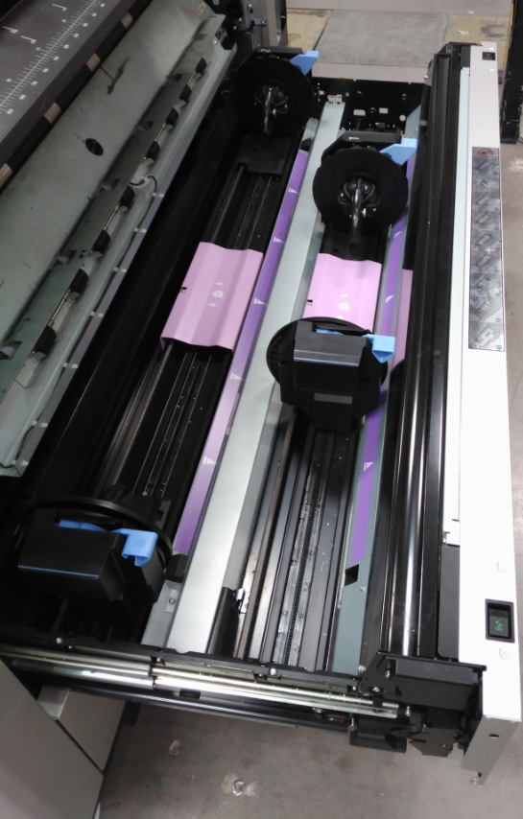
Project introduction
Product: Production printer paper roll feeder.
Object of analysis: End of line tests:
Motor 1 calibration. (AKA. Rewinder Calibration or RW)
Motor 2 calibration. (AKA. Transport roller or TR)
Back tension test. (AKA. BT)

Slide 3
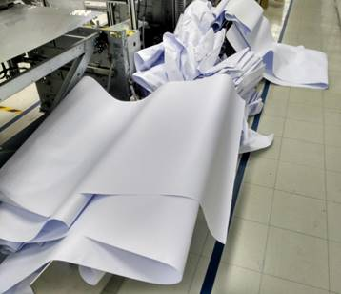

Project introduction
Process:
Paper is fed to the printer with TR motor
RW motor keeps tension in paper
Objective: Reduce environmental impact.

Slide 4
INDEX
-Rewinder test statistical analysis
-Data cleaning and transformation
-Model predictions
-Next steps

Slide 5
Rewinder test statistical analysis
Test done without paper and with full roll in each position (front and rear)
Several speeds tested in each case to create the linear regression.
Previous statistical analysis defined PASS/NO PASS limits.
I(A)
WITH PAPER
A R2R2W RollSpeed
NO PAPER
A R2R2W
A RollSpeed
A Indep
w(rpm)

Slide 6
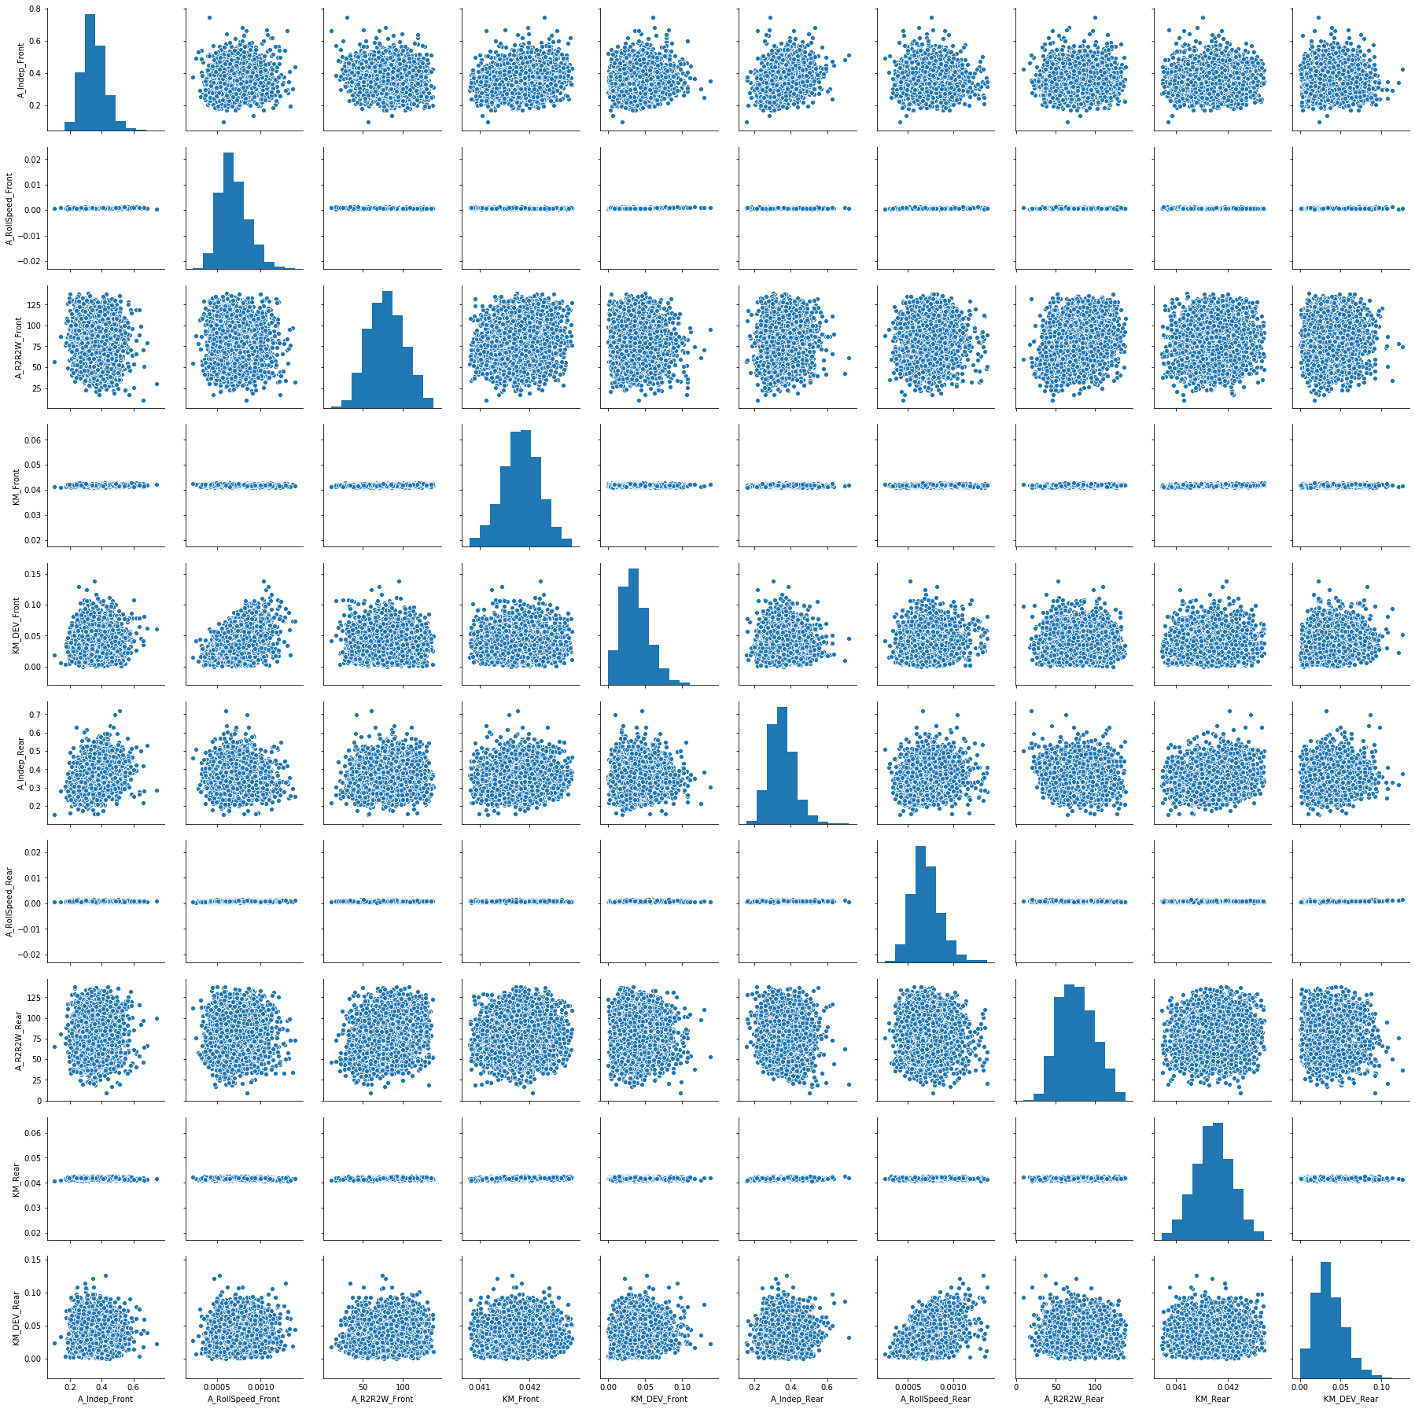
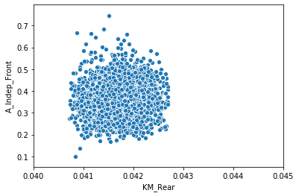
Rewinder test statistical analysis
Relevant data:
A R2R2W is always 0.
Low correlation between variables.
Left skewed distributions.

Slide 7
Rewinder test statistical analysis
Conclusions:
The system has a high variability.
Maybe the motor behavior is not linear.

Slide 8

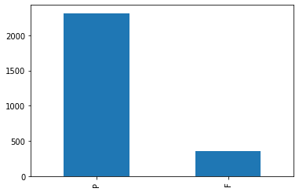
Data cleaning and transformation
Objective: Merge TR and RW datasets to predict BT results.
In RW and TR keep only one PASS record per SN.
IN BT we keep only the test result (Pass or Fail) for the each SN.
Final size:
Oversampling process

Slide 9
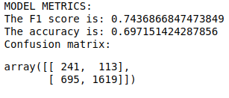
Model predictions
Two models:
RFC: ~70% accuracy
KNN: Overfit.
Not successful models

Slide 10
Next Steps
3 types of output: PASS / FAIL / DOUBTS
Test only with RW
Look for missing data

