Slide 1
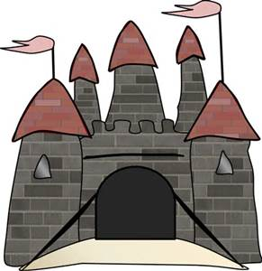
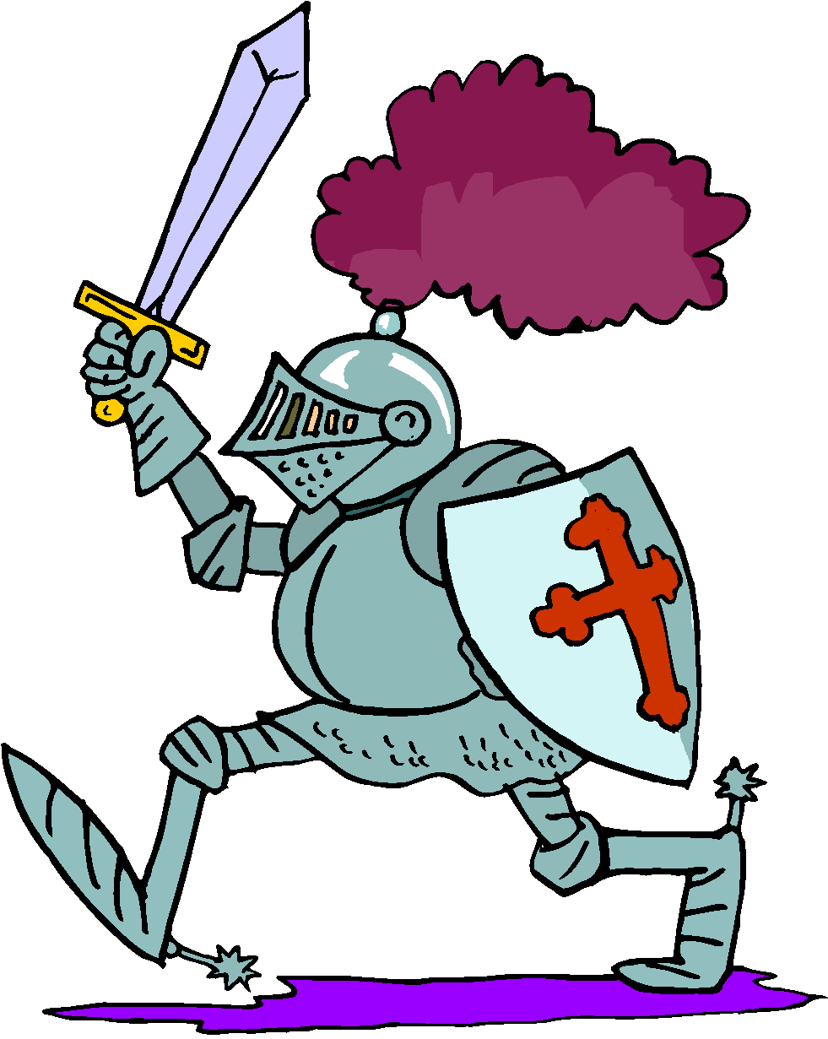
Castle Siege
Martin Rudzki Yusuf Mulyo
Git: MartinRudzki Git: YusufSM

Slide 2
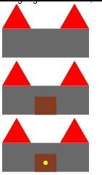
Castle
Sample Image
In Racket
Unit 1
Cost:1
Income per turn: 0
Territories owned: 0
Concept
Unit 2
Cost: 3
Goal of the game:
To spread your units across the land and capture 9 territories.
How to play:
- Each turn you get income from the amount of territories you control.
- To capture a territory your unit must be on the square by your next turn.
- At the beginning of your turn you will receive income for the total amount of territories you control.
- You can only have one unit on a territory at a time.
Bridge | Bridge | Bridge
Bridge | Bridge | Bridge
Water
Water
Water
Water
Racket Libraries
(require 2htdp/universe)
(require 2htdp/batch-io)
(require 2htdp/image)
Castle
Income per turn: 0
Unit 1
Cost:1
Income per turn: 0
Territories owned: 0
Unit 1
Unit 2
Cost: 3
Unit 2

Slide 3
Game Flow
Start Game
Add Territories
Reset Unit Movement
If it equals 9, game over.
Buy Unit
- Move Units
- Attack
- Spend Income
Unit moves on to territory
Enemy unit on territory
Select a bridge to place unit.
End turn
Next player
Can it move there?
Yes: Set territory color to player
Take both units and battle.

Slide 4
Game Objects
Player
----------------------
Income increase
Income decrease/ buy unit
Set territory count
Set active player
Set inactive player
--------Variables----------
Income count
Territory count
Boolean: Current player active
Static: Player 1,2
Territory
----------------------------
Add space occupied/color
Remove space occupied/color
(Fight object1 object2)
--------------Variables-------------
Ownership/color
Boundaries of rectangle (Top, bottom, left, right)
Is Current space occupied/ Object Unit
Units
--------------------------
Reset movement
Consume movement
------------Variables-------------
Static: Ownership of unit
Static: Max movement
Static: Unit class
Movement remaining
Unit Picture

Slide 5
Group Responsibilities
Martin Rudzki @MartinRudzki
Making the PowerPoint slides art
Implementing the territory class
Implementing the board Drawing the background/UI
Drawing the castle and units
Implementing the rules
Yusuf Mulyo @YusufSM
Looking into the library for the game engine
Implementing the unit class
Implementing the board
Implementing the rules
Implementing human interaction

