Slide 1


2018-12-03
DEVELOPMENT OF A
MUSICAL INSTRUMENT TUNING APP
CEE 5984 – Signal Processing and Experimental Methods
Martin Scavone

Slide 2
Contents:
Problem Statement
Experiment 01: Development of a Musical Tuning App
Experiment 02: Microphones Test

Slide 3
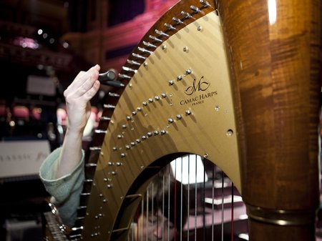
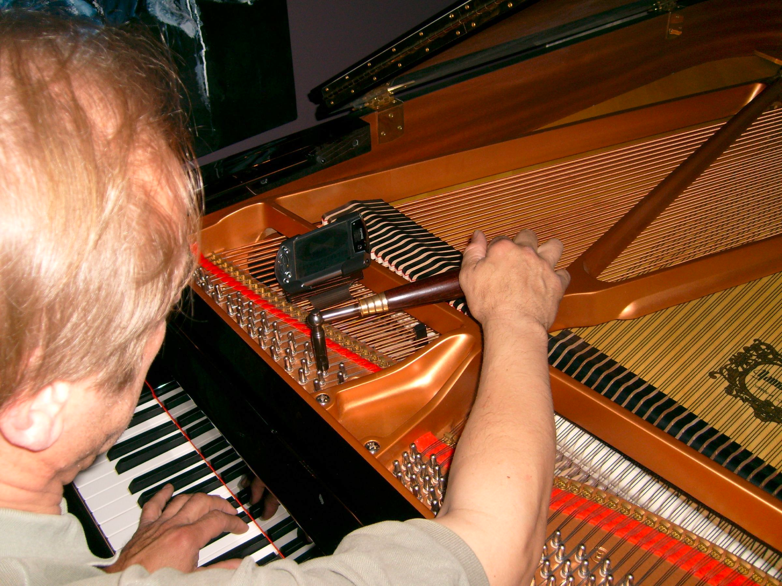
Problem Statement
Chord musical instruments require to be tuned regularly:
  Chords are put in tension to vibrate at given sound frequencies [that of notes]
  Creep of the strings over time leads to tension being released – the instrument goes out of tune
  Tuning consists of applying/releasing tension to the strings until sound is produced at target frequency
Image credit: Classic FM (Harp tuning) – Wikimedia (Piano tuning)

Slide 4
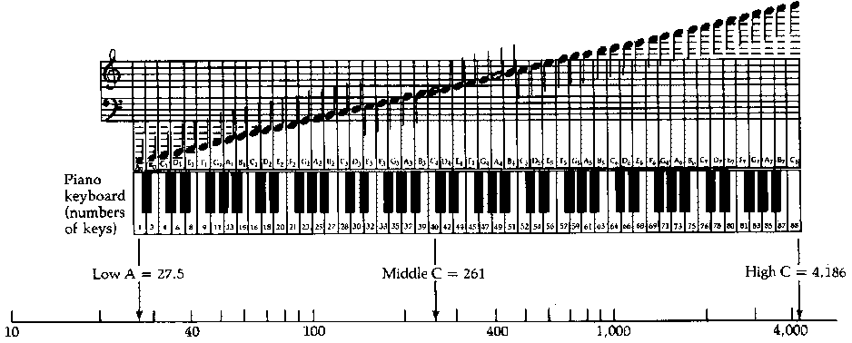
Problem Statement: Tuning frequencies for select isntruments
 | ID | Freq [Hz] | Note
Guitar | 1 | 82.41 | E2
 | 2 | 110 | A2
 | 3 | 146.83 | D3
 | 4 | 196 | G3
 | 5 | 246.94 | B3
 | 6 | 329.63 | E4
Violin | 1 | 196 | G3
 | 2 | 293.66 | D4
 | 3 | 440 | A4
 | 4 | 659.26 | E5
 | ID | Freq [Hz] | Note
4-string Bass guitar | 1 | 41.204 | E1
 | 2 | 55 | A1
 | 3 | 73.416 | E2
 | 4 | 97.999 | G2
 | ID | Freq [Hz] | Note
5-string Bass guitar | 1 | 30.868 | B0
 | 2 | 41.204 | E1
 | 3 | 55 | A1
 | 4 | 73.416 | E2
 | 5 | 97.999 | G2
Image credit: Piano keyboard and notes: http://acoustics.mie.uic.edu

Slide 5
Problem Statement: ...some of all this also applies for human voice
 | Freq. Low | Freq. High | Note low | Note high | Range
Male adult voices | 82.41 | 329.63 | E2 | E4 | Bass
 | 110 | 440 | A2 | A4 | Baritone
 | 130.81 | 523.25 | C3 | C5 | Tenor
 | 164.81 | 659.25 | E3 | E5 | Countertenor
Female adult voices | 174.61 | 698.46 | F3 | F5 | contralto
 | 220 | 880 | A3 | A5 | Mezzo-soprano
 | 261.63 | 1046.5 | C4 | C6 | soprano
The very same frequency analysis tools to detect the notes played by an instrument apply to analyze a singer’s voice range!

Slide 6
Prjoect objectives
EXPERIMENT 01
OBJECTIVE: Program a matlab-based app for instrument tuning and voice range recognition.
EXPERIMENT 02
OBJETIVE: Compare performance of various mics to low frequency sounds (<100Hz)
  Instruments: Guitar, bass guitar, violin, piano
  Voice: Male and female adults
  Note recognition based on FFT analysis
Motivation: How suitable are commercially available mics for instrument tuning?
Compare full range mics and microphones for VoIP

Slide 7
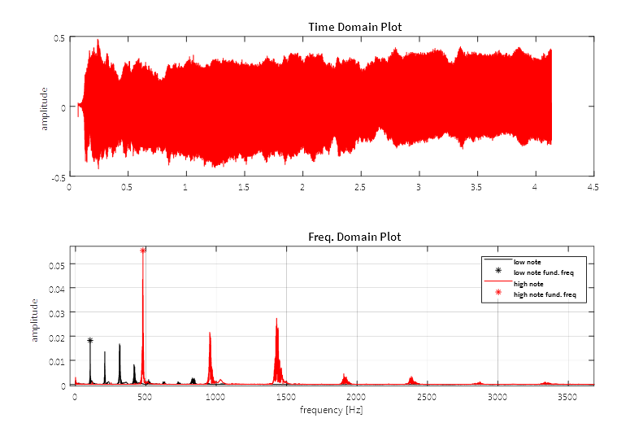
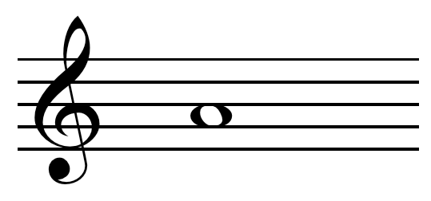
Experiment 01: Assumptions
Musical sounds and human voice can be analyzed in the frequency domain and will have peaks at their fundamental frequencies and muliples thereof
The the perceived sound’s fundamental frequency is its matching musical note
The musical instruments to be analyzed would not produce sub-harmonics
Tuning to comply with the equally-tempered scale, and A₄ at 440Hz (ISO 16)
440Hz
Image credit: Wikimedia [A4 in musical staff]

Slide 8
Experiment 01: Sampling frequency and resolution
Sampling frequency
  Need to cover 25-4186Hz range → fs ≥ 8.4 kHz [default 16kHz]
  Digital resolution: 16 bits
Frequency resolution and signal retrieval time
  Frequency resolution [in cents] is a user input
  Sampling time is set to achieve desired resolution
  Sampling time is instrument-dependent!

Slide 9
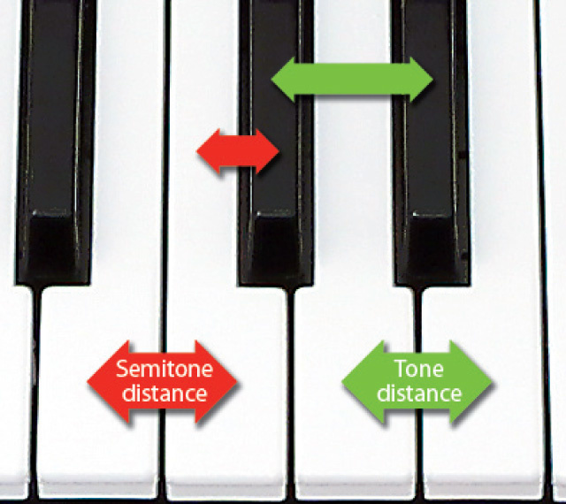
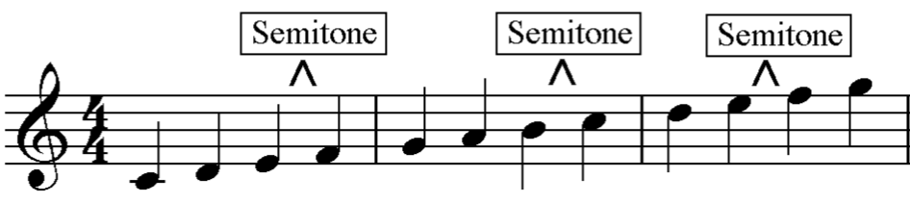
Experiment 01: Sampling frequency and resolution [cont’d]
Frequency resolution (δf) target
  1 semitone = 100 cents (definition)
  Max. resolution: Human ear resolution ~5 cents
  But the “size” of an interval depends on the notes’ frequencies
Sampling time is the inverse of δf
  The lower the note, the longer sampling time
  Each instrument would have its own lowest note
  The finer δf, also the longer sampling time
Image credit: ThoughtCo (semitone on keyboard) – onlinepianocoach.com (octave in music staff)

Slide 10
Experiment 01: Sampling frequency and resolution [cont’d]
 |  | Target frequency resolution [Hz] |  |  | Target sampling time [sec]
 | Lowest Freq [Hz] | 30 cts. | 10 cts. | 5 cts. | 30 cts. | 10 cts. | 5 cts.
Guitar | 82.41 | 1.47 | 0.49 | 0.25 | 0.68 | 2.04 | 4.08
Violin | 196 | 3.50 | 1.17 | 0.58 | 0.29 | 0.86 | 1.72
4-string Bass guitar | 41.204 | 0.74 | 0.25 | 0.12 | 1.36 | 4.08 | 8.16
5-string Bass guitar | 30.868 | 0.55 | 0.18 | 0.09 | 1.82 | 5.45 | 10.90
Piano | 27.5 | 0.49 | 0.16 | 0.08 | 2.04 | 6.12 | 12.23
Male Voice | 82.41 | 1.47 | 0.49 | 0.25 | 0.68 | 2.04 | 4.08
Female Voice | 174.61 | 3.11 | 1.04 | 0.52 | 0.32 | 0.96 | 1.93

Slide 11
Experiment 01: How the fundamental frequency is recognized
Record sample of desired length
Perform FFT
Remove infra-sound components (< 20Hz)
Peak detection rule:
  Start from point of maximum amplitude and move to lower freqs.
  A peak at freq = f is such if amp(f) > μ_{amp} + 6 x σ_{amp}
  If no point is detected → pass point of maximum amplitude as fundamental freq.
  Otherwise, pass f as fundamental freq.

Slide 12
Experiment 01: Test drive!!!
I may need a volunteer

Slide 13
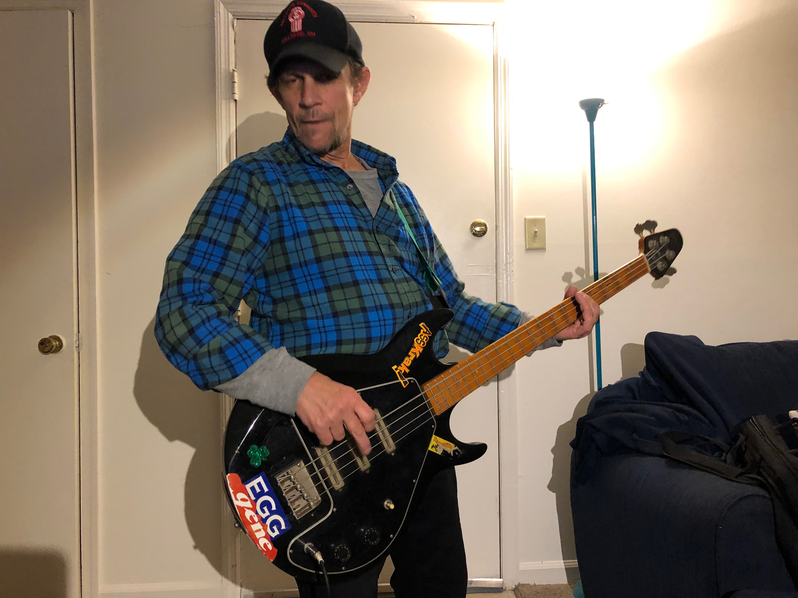
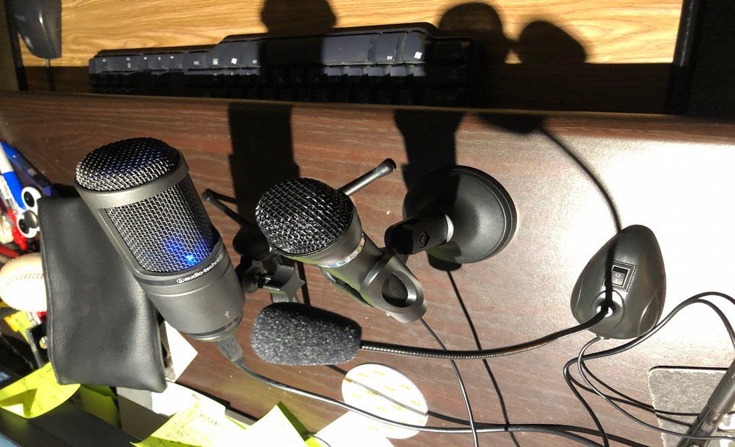
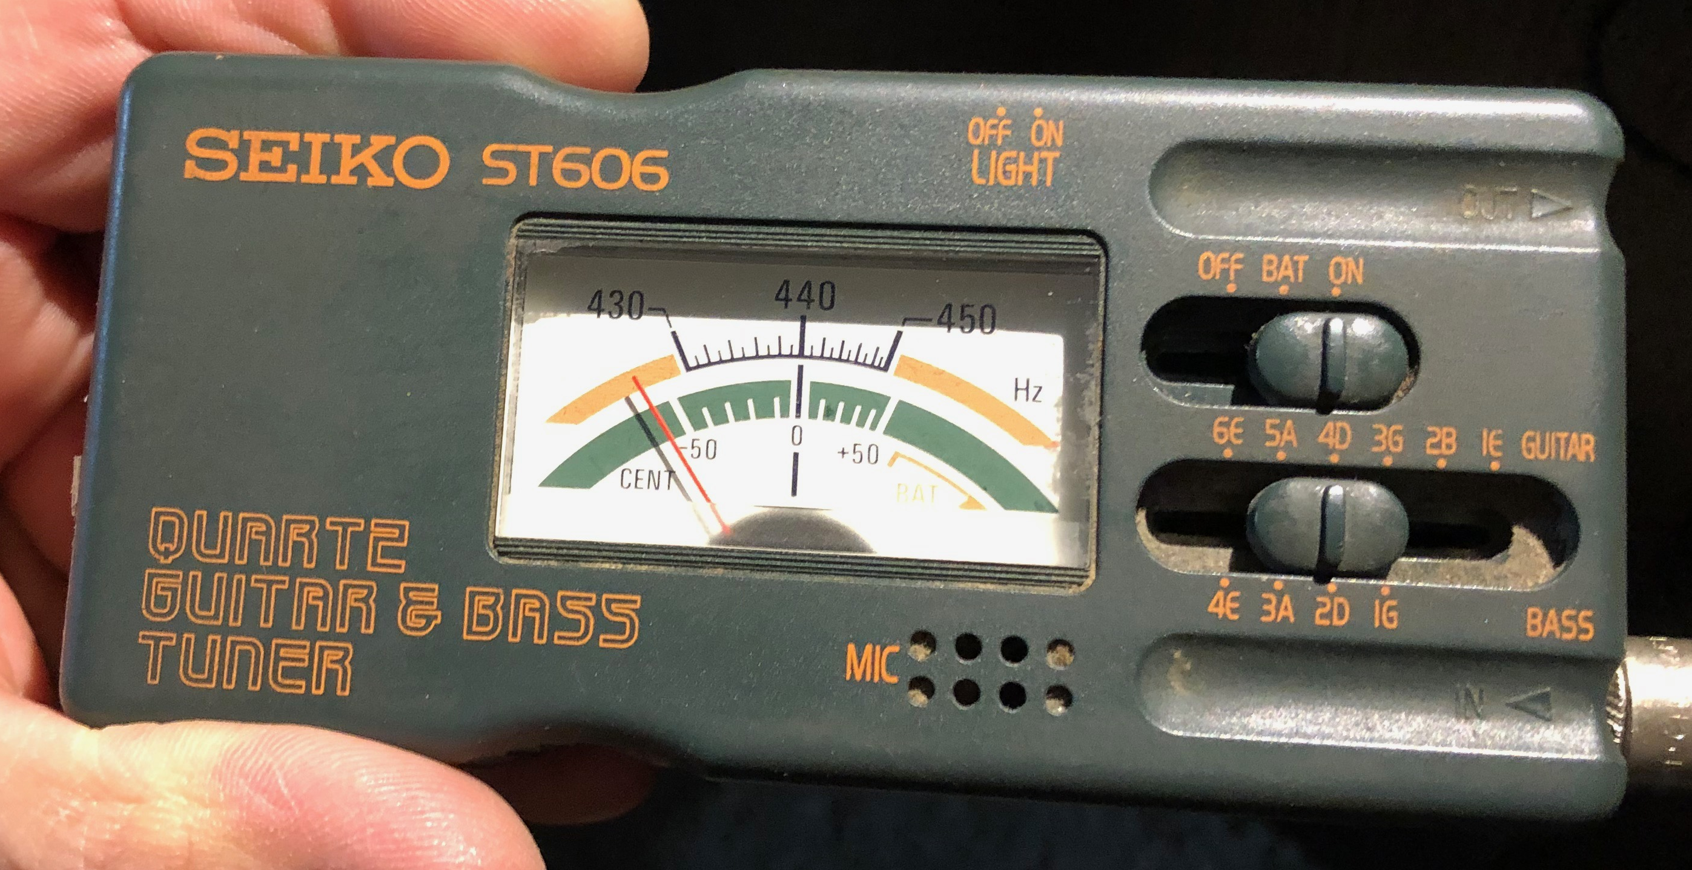
Experiment 02: Materials and methods
Microphones
  Professional condenser mic
    20Hz-20kHz // Sensitivity: 37 dB
  Budget full-range mic
    20Hz-20kHz // Sensitivity: 58 dB
  Budget VoIP mic
    100Hz-16kHz // Sensitivity: 60 dB
  PC built-in mic + Laptop built-in mic
    Specs unknown
Musical instrument
  Gibson 4-string bass guitar (previously tuned)
  Record it playing the four tuning note freqs. With the 5 microphones [@ 16 kHz, 16 bit, 10 seconds]

Slide 14
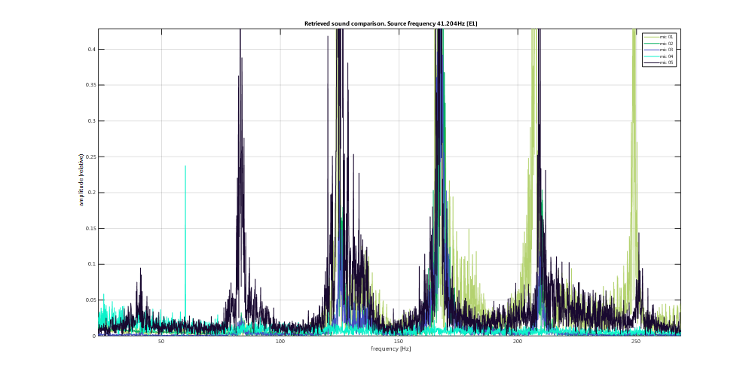
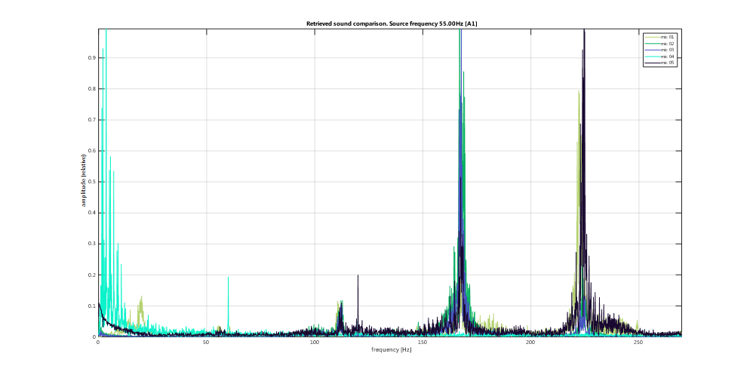
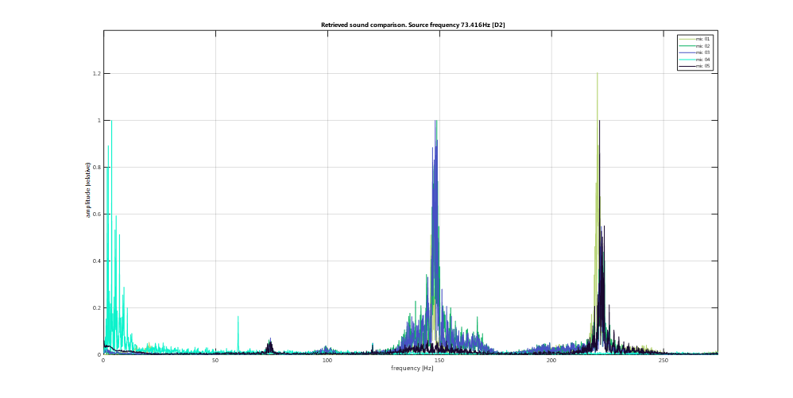
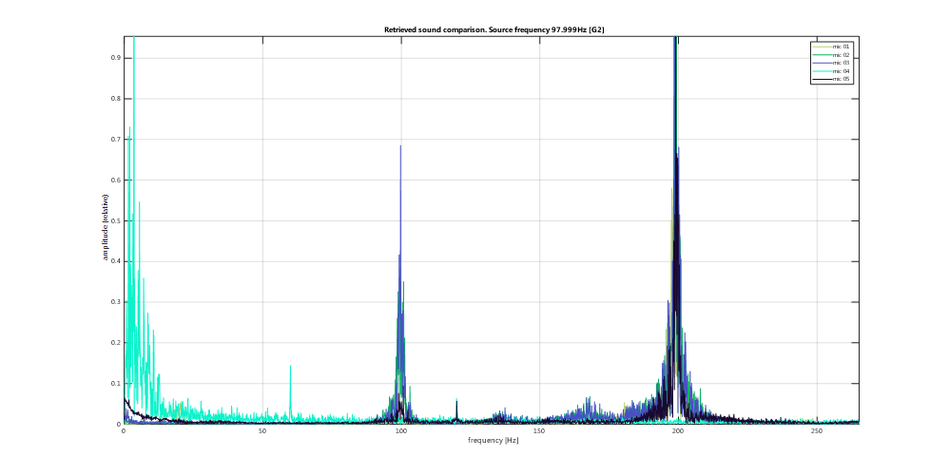
Experiment 02: Findings
F.Freq. 41.2 Hz
F.Freq. 55.0 Hz
AC hum on mic 04!
[60Hz and harmonic]
F.Freq. 98.0 Hz
F.Freq. 73.4 Hz

Slide 15
Experiment 02: Peak frequency analysis
ANOVA-based
Compared all mics against the target value
Assumed deviation from target frequency is normally distributed
Source | Target Freq. | DF | Sum of Squares | F Ratio | Prob > F
NOTE 01 | E1 / 41.2Hz | 1 | 0.231 | 0.87 | 0.4038
NOTE 02 | A1 / 55.0 Hz | 1 | 0.076 | 0.0522 | 0.8305
NOTE 03 | D2 / 73.4 Hz | 1 | 0.626 | 3.0087 | 0.1578
NOTE 04 | G2 / 98.0 Hz | 1 | 1.826 | 3.2237 | 0.147
Note: Tukey’s pairwise comparisons didn’t either show differences among microphones for all 4 notes

Slide 16
Experiment 02: Peak amplitude analysis - Attenuation
mic | Note 1 | Amp. | multiplier over stdev | prob | peak at 95%
1 | 41.6 | 0.001 | 2.087 | 0.982 | peak
2 | 41.9 | 0.001 | 0.844 | 0.801 | noise
3 | 41.7 | 0.000 | 0.499 | 0.691 | noise
4 | 40.5 | 0.000 | 3.803 | 1.000 | peak
5 | 41.1 | 0.021 | 5.115 | 1.000 | peak
mic | Note 2 | Amp. | multiplier over stdev | prob | peak at 95%
1 | 55.6 | 0.000 | 0.122 | 0.548 | noise
2 | 55.7 | 0.001 | 0.823 | 0.795 | noise
3 | 54.9 | 0.001 | 1.521 | 0.936 | noise
4 | 53.1 | 0.000 | 4.024 | 1.000 | peak
5 | 56.2 | 0.010 | 2.195 | 0.986 | peak
mic | Note 3 | Amp. | multiplier over stdev | Prob (peak) | noise at 95%
1 | 73 | 0.002 | 2.289 | 0.989 | peak
2 | 73.7 | 0.005 | 4.213 | 1.000 | peak
3 | 74.4 | 0.003 | 4.826 | 1.000 | peak
4 | 73.5 | 0.000 | 1.279 | 0.899 | noise
5 | 74.3 | 0.033 | 7.022 | 1.000 | peak
mic | Note 4 | Amp. | multiplier over stdev | Prob (peak) | noise at 95%
1 | 99.7 | 0.002 | 1.510 | 0.935 | noise
2 | 99.5 | 0.034 | 30.181 | 1.000 | peak
3 | 99.7 | 0.036 | 51.719 | 1.000 | peak
4 | 98.9 | 0.000 | 2.440 | 0.993 | peak
5 | 100.7 | 0.051 | 10.789 | 1.000 | peak

Slide 17
Results: In conclusion
Experiment 01
Experiment 02
Version 1.0 to be released!
Possible enhancements
  Add the Railsback curve for pianos
  Change the fundamental Frequency Detection logic for a harmonics- based algorithm
All 5 microphones detected the same notes (no statistically significant difference in peak frequencies)
Built-in laptop and PC mics are sensitive enough to <100Hz peaks (95% level)
PC microphone subject to AC hum – not advised for tuning around 60Hz
Budget desktop microphones are not sensitive enough to low frequencies (<70Hz) – even if the manufacturer says so!
Professional mic held mixed results (signal too weak?)

Slide 18
Thank you for your attention!

