Slide 1

Reddit WSB Comment Network Analysis
Group 12
Arda Tekin, Nikolaos Georgiadis, Martin Schmauch
"Dieses Foto" von Unbekannter Autor ist lizenziert gemäß CC BY-SA-NC

Slide 2
Overview
Motivation and Background
Data Extraction
Visualization
Network Analysis so far
Outlook and Roadmap ahead

Slide 3
Motivation & Background
General
Comment analysis in a social network
Who is an influential user regarding reply engagement
Goal
WallStreetBets very influential Subreddit -> GME short squeeze
How can we find most influential users here?
Analyze series of posts in most common subreddits
-> in a certain time span

Slide 4
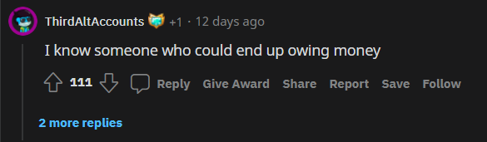
Data Extraction
PRAW library – Reddit API Wrapper
Extract reddit objects from URL
MoreComments object:
post.comments.replace_more(limit=None)
Submission object (comment thread for a post)
Comment object (from CommentForest)
Attribute | Description
author | Provides an instance of Redditor.
clicked | Whether or not the submission has been clicked by the client.
comments | Provides an instance of CommentForest.
created_utc | Time the submission was created, represented in Unix Time.
distinguished | Whether or not the submission is distinguished.
edited | Whether or not the submission has been edited.
id | ID of the submission.
is_original_content | Whether or not the submission has been set as original content.
is_self | Whether or not the submission is a selfpost (text-only).
link_flair_template_id | The link flair’s ID.
link_flair_text | The link flair’s text content, or None if not flaired.
locked | Whether or not the submission has been locked.
name | Fullname of the submission.
num_comments | The number of comments on the submission.
over_18 | Whether or not the submission has been marked as NSFW.
Attribute | Description
author | Provides an instance of Redditor.
body | The body of the comment, as Markdown.
body_html | The body of the comment, as HTML.
created_utc | Time the comment was created, represented in Unix Time.
distinguished | Whether or not the comment is distinguished.
edited | Whether or not the comment has been edited.
id | The ID of the comment.
is_submitter | Whether or not the comment author is also the author of the submission.
link_id | The submission ID that the comment belongs to.
parent_id | The ID of the parent comment (prefixed with t1_). If it is a top-level comment, this returns the submission ID instead (prefixed with t3_).
permalink | A permalink for the comment. Comment objects from the inbox have a context attribute instead.
replies | Provides an instance of CommentForest.
saved | Whether or not the comment is saved.
. . .
. . .
. . .
. . .

Slide 5
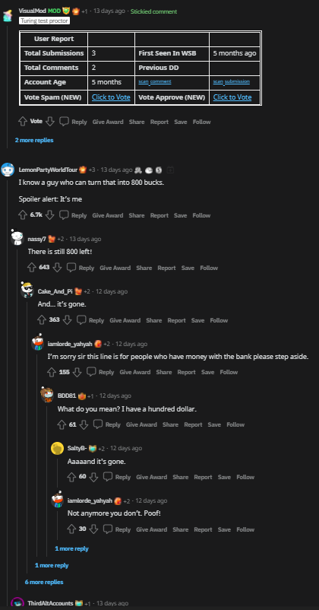
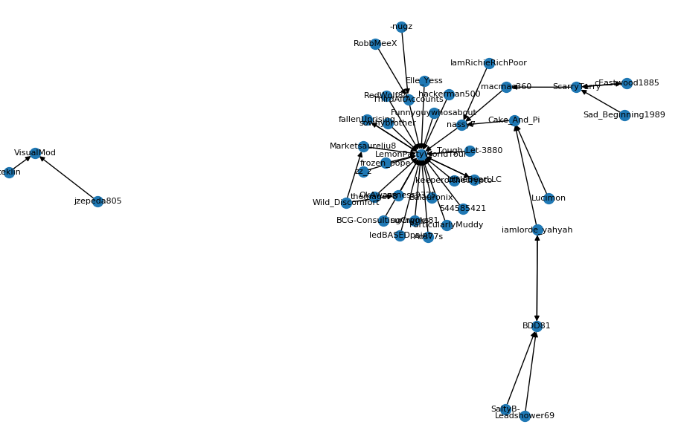
Data Visualization
„user 1 comments on comment from user 2“
user1
user2
index | source | target
0 | jzepeda805 | VisualMod
1 | ceklin | VisualMod
2 | nassy7 | LemonPartyWorldTour
. . .
. . .
. . .

Slide 6
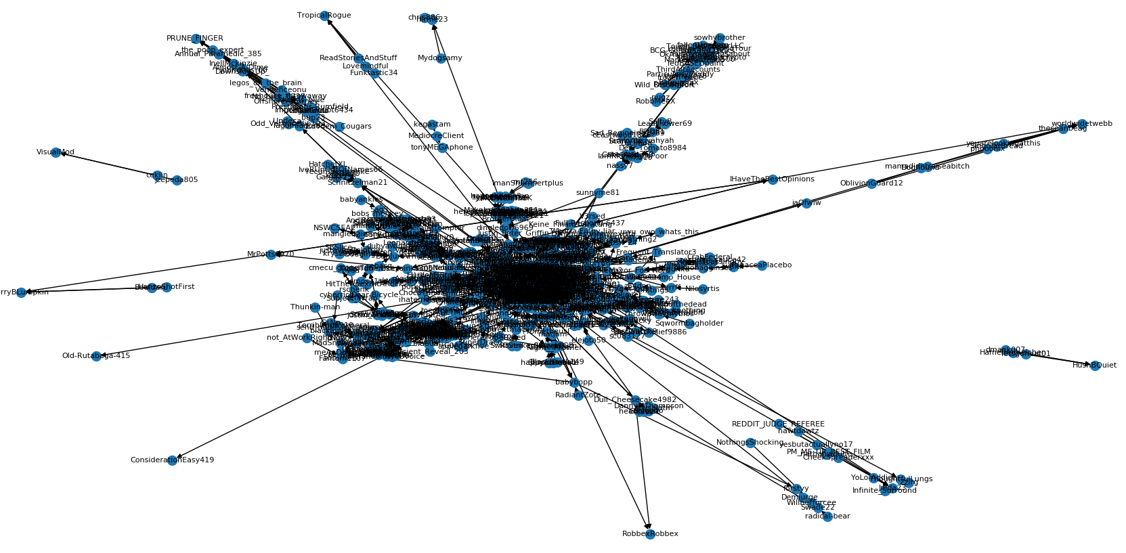
First 20 major comments network from post https://www.reddit.com/r/wallstreetbets/comments/u7wtfh/5k_to_100k_overnight_nflx_put/?utm_source=share

Slide 7
Class overview
commentExtractor
edgeList
main
Oauth Login using praw.ini file
Get reddit instance
Get CommentForest for every top level comment
Store comments in tree structured lists
Create edge list from tree structured list
Create Graph
Create Dataframe
Plot/Save graph

Slide 8
Outlook
Questions:
Edge weight – what to include here?
Export extracted data to file -> format? (pickle/csv/…)
Slow program -> extract data every time from reddit
Roadmap ahead:
Find suitable reddit post series to analyze
„What are your moves (trading) for tomorrow?“ post series
Graph analysis -> get conclusions on most active users
Define what a „influencial“ user is – e.g. avg. number of replies per comment
Include more comment meta data (timestamp, upvotes,…)

Slide 9
Thank you!

