Slide 1
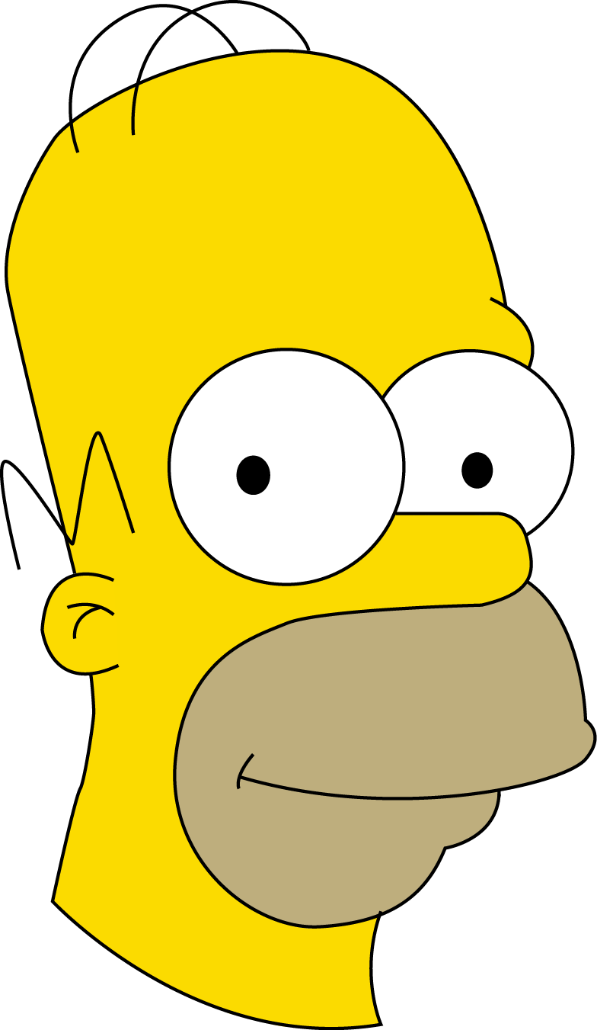
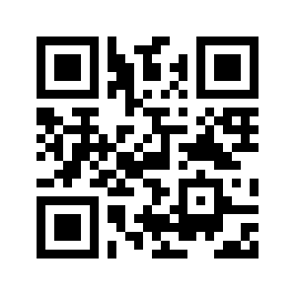
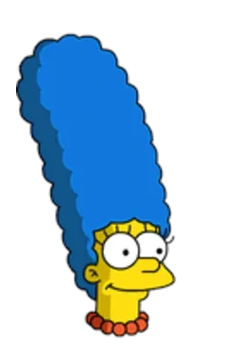
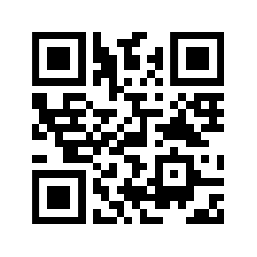

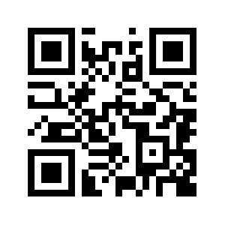
K-Nearest-Neighbor 3D Tutorial Card 1
Name: Homer Simpson
Gender: Male
Weight: 90kg
Height: 1,80m
Hairvolume: 2%
K-Nearest-Neighbor 3D Tutorial Card 2
Name: Marge Simpson
Gender: Female
Weight: 70kg
Height: 1,70m
Hairvolume: 100%
K-Nearest-Neighbor 3D Tutorial Card 3
Name: Rick Sanchez
Gender: Male
Weight: 70kg
Height: 1,90m
Hairvolume: 30%
QR Payloads:
„KNN 3D Tutorial Card 1“
„KNN 3D Tutorial Card 2“
„KNN 3D Tutorial Card 3“

Slide 2
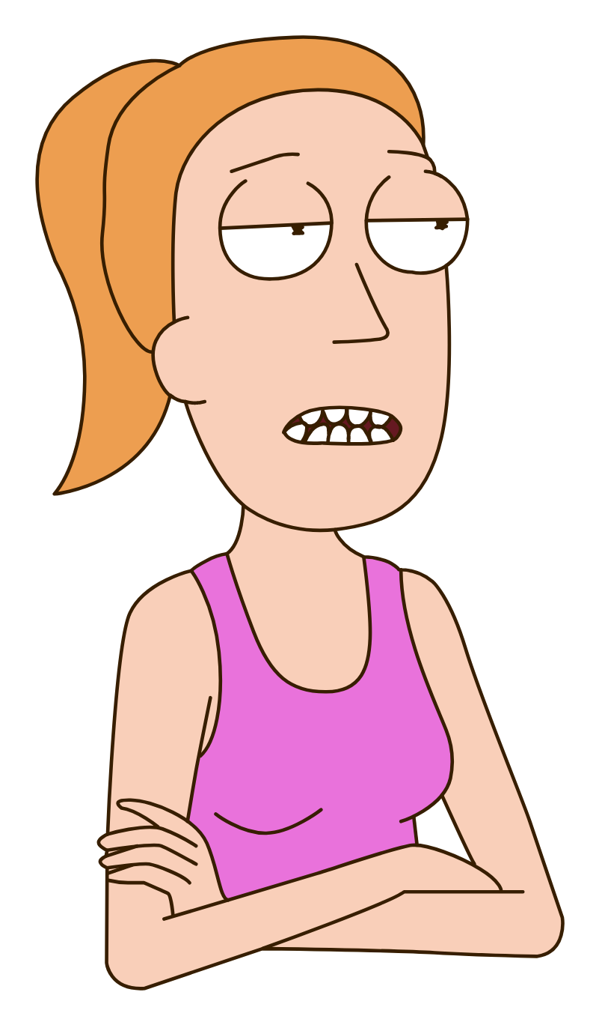
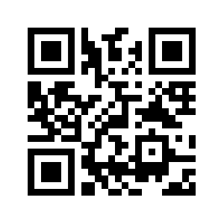

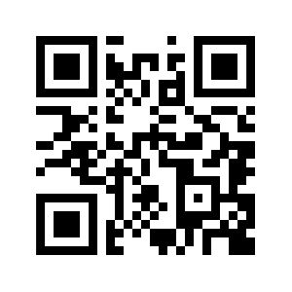
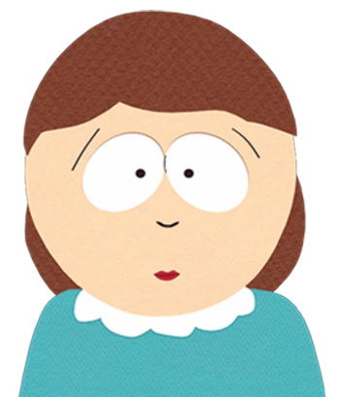
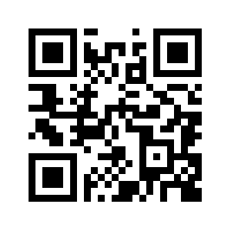
K-Nearest-Neighbor 3D Tutorial Card 4
Name: Summer Smith
Gender: Female
Weight: 70kg
Height: 1,80m
Hairvolume: 80%
K-Nearest-Neighbor 3D Tutorial Card 5
Name: Randy Marsh
Gender: Male
Weight: 80kg
Height: 1,70m
Hairvolume: 40%
K-Nearest-Neighbor 3D Tutorial Card 6
Name: Liane Cartman
Gender: Female
Weight: 60kg
Height: 1,50m
Hairvolume: 70%
QR Payloads:
„KNN 3D Tutorial Card 4“
„KNN 3D Tutorial Card 5“
„KNN 3D Tutorial Card 6“

Slide 3
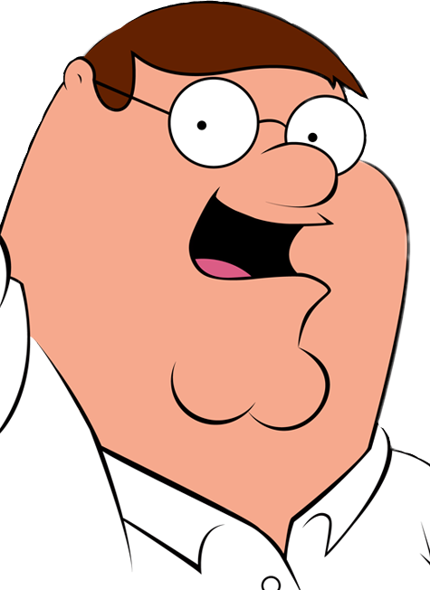
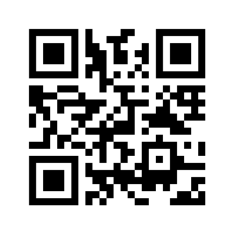

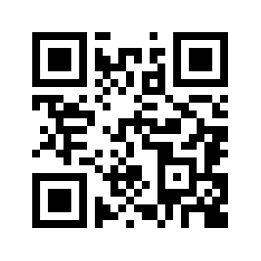
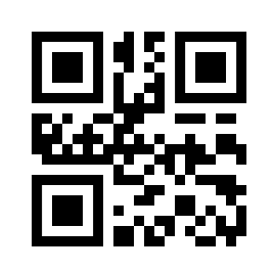
K-Nearest-Neighbor 3D Tutorial Card 7
Name: Peter Griffin
Gender: Male
Weight: 100kg
Height: 1,80m
Hairvolume: 50%
K-Nearest-Neighbor 3D Tutorial Card 8
Name: Lois Griffin
Gender: Female
Weight: 65kg
Height: 1,60m
Hairvolume: 70%
K-Nearest-Neighbor 3D Reset Card
QR Payloads:
„KNN 3D Tutorial Card 7“
„KNN 3D Tutorial Card 8“
„KNN Reset“

Slide 4
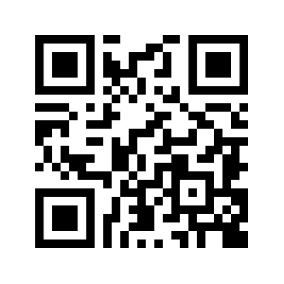

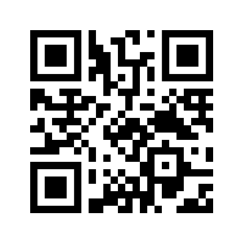
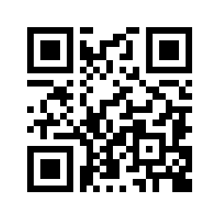
K-Nearest-Neighbor 3D Test Card 1 with k=1
Name: ?
Gender: ?
Weight: 80kg
Height: 1,80m
Hairvolume: 50%
K-Nearest-Neighbor 3D Test Card 1 with k=2
Name: ?
Gender: ?
Weight: 80kg
Height: 1,80m
Hairvolume: 50%
K-Nearest-Neighbor 3D Test Card 1 with k=3
Name: ?
Gender: ?
Weight: 80kg
Height: 1,80m
Hairvolume: 50%
QR Payloads:
„KNN 3D Test Card 1 1“
„KNN 3D Test Card 1 2“
„KNN 3D Test Card 1 3“

Slide 5
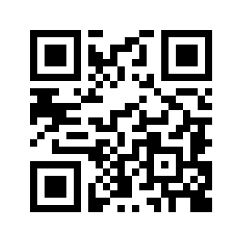
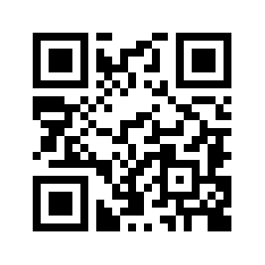
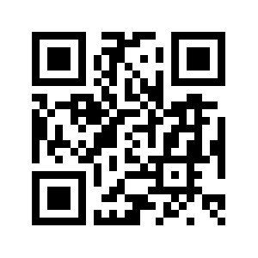
K-Nearest-Neighbor 3D Test Card 2 with k=1
Name: ?
Gender: ?
Weight: 60kg
Height: 1,60m
Hairvolume: 80%
K-Nearest-Neighbor 3D Test Card 2 with k=2
Name: ?
Gender: ?
Weight: 60kg
Height: 1,60m
Hairvolume: 80%
K-Nearest-Neighbor 3D Test Card 2 with k=3
Name: ?
Gender: ?
Weight: 60kg
Height: 1,60m
Hairvolume: 80%
QR Payloads:
„KNN 3D Test Card 2 1“
„KNN 3D Test Card 2 2“
„KNN 3D Test Card 2 3“

Slide 6
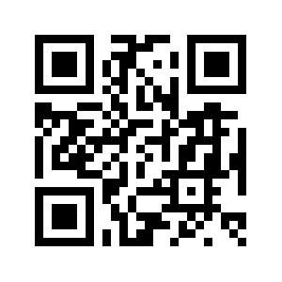
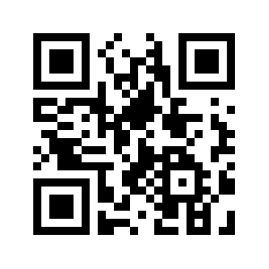
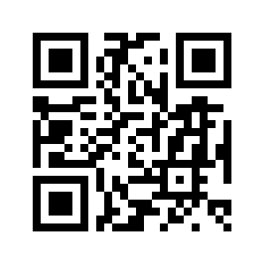
K-Nearest-Neighbor 3D Test Card 3 with k=1
Name: ?
Gender: ?
Weight: 100kg
Height: 2,00m
Hairvolume: 30%
K-Nearest-Neighbor 3D Test Card 3 with k=2
Name: ?
Gender: ?
Weight: 100kg
Height: 2,00m
Hairvolume: 30%
K-Nearest-Neighbor 3D Test Card 3 with k=3
Name: ?
Gender: ?
Weight: 100kg
Height: 2,00m
Hairvolume: 30%
QR Payloads:
„KNN 3D Test Card 3 1“
„KNN 3D Test Card 3 2“
„KNN 3D Test Card 3 3“

